Slide 1
JavaScript Scope
MIS 2402
Department of MIS
Fox School of Business
Temple University

Slide 2
Agenda
What we have already seen (let)
New stuff
const
var
Kinds of scope (global, function level, block level)

Slide 3
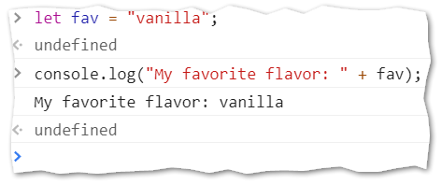
What we have already seen:
Declaring a variable with let
From the web developer console…
Try it!

Slide 4
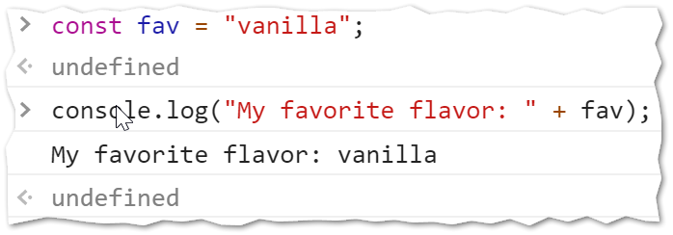
New Stuff
JavaScript gives us two other ways to put a piece of data into the computer’s memory.
JavaScript allows us to define a constant using const
Try this!

Slide 5
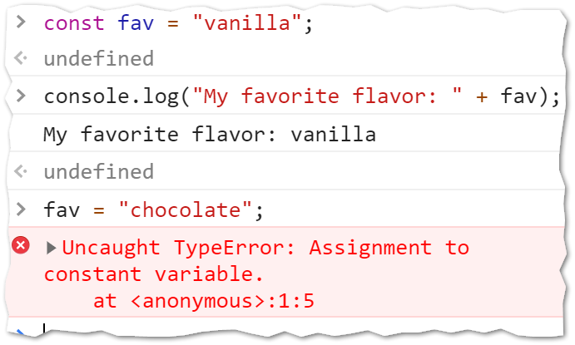
Here’s what makes const different…
Once you declare a variable using const you are prevented from changing its value. You are also prevented from changing it…
Try it!

Slide 6
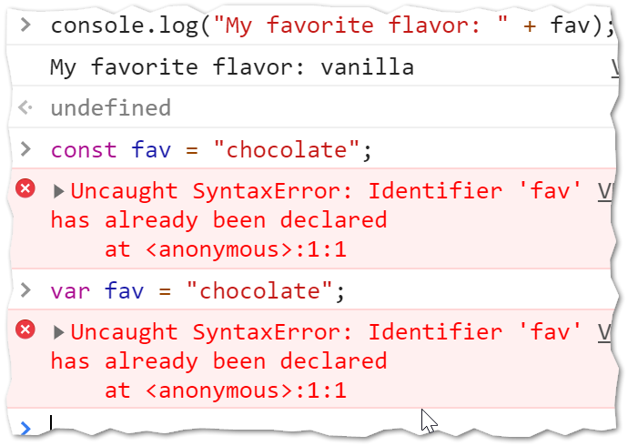
More about const
You are also prevented from declaring it again!
The only way to change the value stored in const is to refresh the whole page.
Try it!

Slide 7
More about const
Typically, we define a constant to control some piece of data in our code that does not change often but is referenced in many places.
Suppose you have an estimated rate of growth for an investment. The estimate only changes once a year, and it is used in several functions. Also, you don’t want to allow a user to edit that value!
See futurevalue.zip

Slide 8
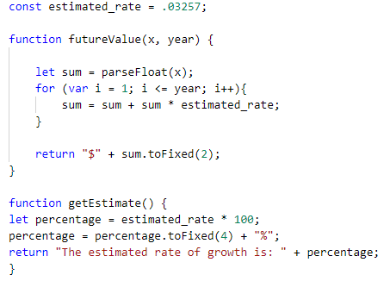
Take note
In our example here, estimated_rate is declared outside of all the functions. It is then used inside all the functions that are below it.
Some important remarks follow…

Slide 9
Global scope
In the prior slide, the constant estimated_rate, was declared outside all the functions. A constant or a variable declared in that position is said to have global scope. That is, it is available everywhere in the code. Be advised that:
There’s no rule that says constants must be defined at the global level.
However… declaring a constant at the global level usually makes sense. Constants represent important facts, that don’t change often. Consequently you probably want to use such an important piece of data globally!
There’s no rule that says that declarations at the global level must be constants. (You can declare global variables with var or let.)
However… declaring a variable at the global level is usually bad. It is much better to pass data into and out of functions using parameters and return. (Just like we’ve been doing all semester long!)

Slide 10
Take note
You may have also noticed that we are using both var and let in the example.
At first glance you might think that var is just another way to declare a variable.
That’s true! But there is an important difference between var and let.

Slide 11
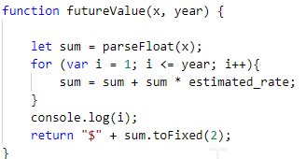
Try this…
Add a console.log(i) to line 53 in the futureValue function.
Run the code and see what happens…

Slide 12
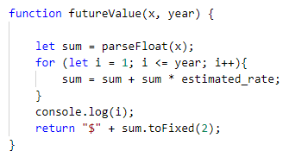
Now try this…
Change line 50 to use let instead of var.
Run the code and see what happens…

Slide 13
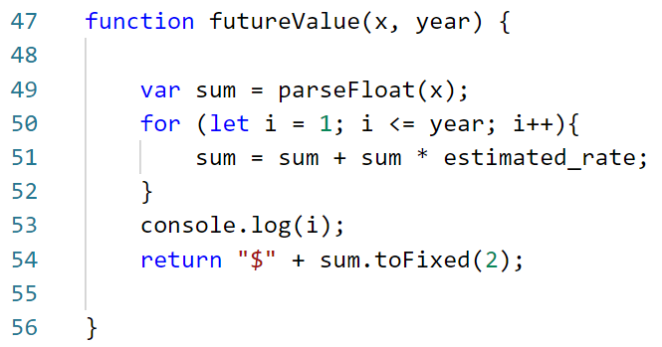
Why did let fail?
The reason let failed was because let defines variables with block level scope. The block is defined by the opening and closing curly braces { }. The variable i exists inside that block (including any more blocks that might be nested inside it.)
Therefore… the variable i does not exist outside the block on line 53!

Slide 14
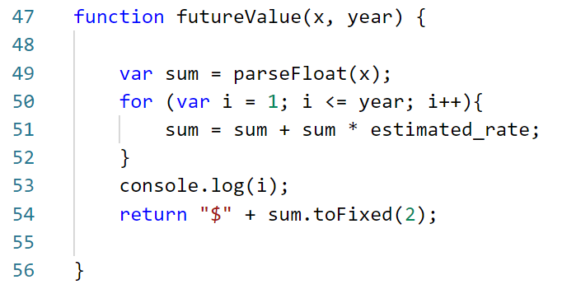
Why did var work?
The reason var worked was because var defines variables with function level scope. Any variable defined with var exists everywhere inside the current function.
From line 49 onward sum is defined
From line 50 onward i is defined

Slide 15
Preferences
Even though using let might seem a little more restrictive, it really is preferred. The let and const options first became a standard part of the JavaScript language 2015 … and it has taken years for them to be fully embraced.
This course uses let for most variable declarations. This is in keeping with the second edition of your textbook, but not the first edition!
In most situations, let can be used in place of var without consequence. This is especially true if you develop the habit of declaring the variables you need at the beginning of a function and avoid declaring variables haphazardly in the middle of your code!

Slide 16
Time for some practice
On your own… outside of class… and not for a grade… solve this problem using JavaScript.
By listing the first six prime numbers: 2, 3, 5, 7, 11, and 13, we can see that the 6th prime is 13.
What is the 10,001st prime number?
THIS IS JUST PRACTICE (YOU DON’T NECESSARILY NEED TO USE THIS SCOPE MATERIAL TO SOLVE THIS PROBLEM)

