Slide 1
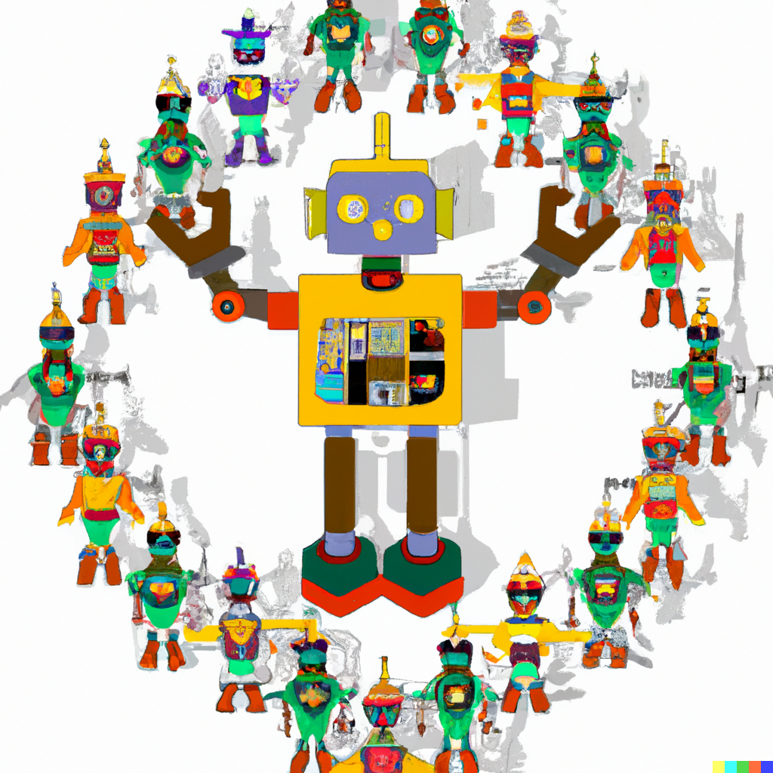
Functions
MIS2402: Web Application Development
Jeremy Shafer
jeremy@temple.edu
https://community.mis.temple.edu/jshafer
The above image was created by the DALL-E 2 service found at https://openai.com/product/dall-e-2
Unless otherwise indicated, all other decorative images are by Unknown Author and licensed under CC BY-NC

Slide 2
Agenda
Talk about what a function is
Equip you with the ability to define your own functions
Discuss the difference between defining a function and calling a function
Discuss why functions are important
Slide 2

Slide 3
By the end of this class…
Understand why programmers often want to define their own functions.
Be able to define simple functions of your own.
Understand the importance of the return statement.
Mentally picture / visualize how a function is processed.

Slide 4

Advisory!
This lecture presents some *big* ideas that will be very important in the days ahead.
It’ll be extra important to think both in terms of generalities (What is it we are trying to do? And why?) and in specifics (How do we express these ideas in JavaScript? What’s the syntax?)
Every lecture is important, but this one in particular will lay the groundwork for the rest of the semester.
Functions are very important!

Slide 5
Before we begin … Let’s talk about… $
What is that crazy $ thing we keep seeing?
It was there in our earliest class examples.
let oldtemp = $("#textInput1").val();
let newtemp = convertFtoC(oldtemp);
$('#textDisplayed1').html(newtemp);
What does it all mean?

Slide 6
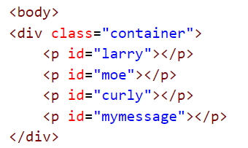
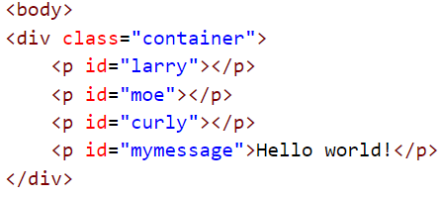
The $ function, explained
OK, it’s time to come clean. The $ function is really at the heart of something called jQuery. Later in the semester we’ll learn more about what jQuery is, and what it can do.
But, for now, think of it this way: the “$” function means “Select”.
So, when we say:
$('#mymessage').html('Hello world!’);
The browser selects the tag with the id “mymessage”
!
Now take action on the tag you found.
We haven’t seen the last of the $ function!

Slide 7
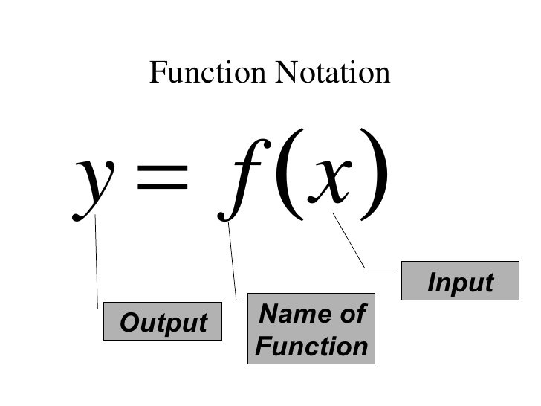
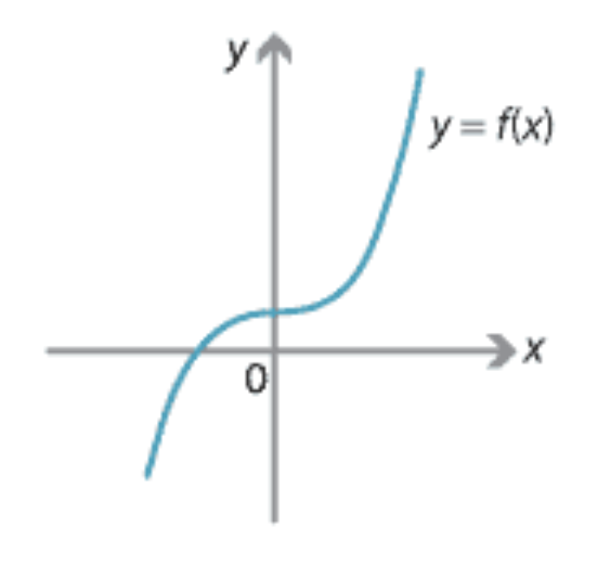
What’s a function in mathematics?
  In mathematics, a function is one or more rules that are applied to an input in order to generate an output.
  The input is the number or value put into the function.
  The output is the number or value that the function generates.
  In this example, we say that f(x) returns the value of y.

Slide 8
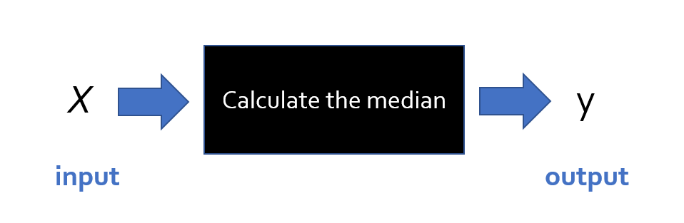
Another example from mathematics
You are probably familiar with the notions of mean, median, and mode.
Think about the steps that you need to take to calculate the median for a set of numbers X.
The set of numbers looks like this: { x₁ , x₂ , x₃ , x₄ … x_{n} }
You can think of a function like a black box. It takes input, something happens inside the box. Then a result comes out the other side of the box!

Slide 9
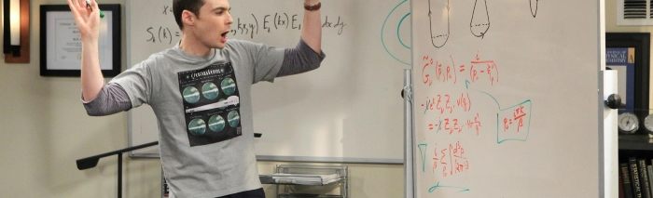
Inside “the box”
Inside the function (that is, “the box”) a mathematician would need to describe the steps (or algorithm) necessary to perform the computation.
Sometimes the operation is so simple, it can be performed with a single formula (mathematicians love it when that happens!) But when the calculation is not that simple, a mathematician must resort to a series of instructions (like pseudo code!)

Slide 10
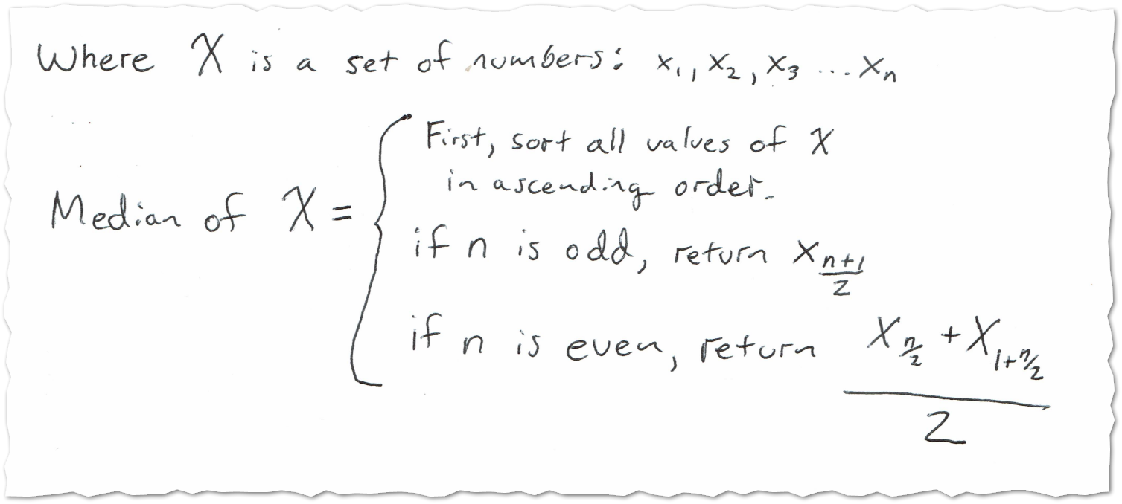
Inside “the box”
To define the median calculation, a mathematician might write something like this …
The point here is that:
The definition of median is a mixture of mathematics, and logical steps.
If you were a statistician, it would be inconvenient to redefine or restate those steps every time you needed them.
It’s a lot easier to refer to a universally agreed on definition of median.

Slide 11
What is a function in programming?
In programming, a function is a collection of statements grouped together in such a way that they can receive zero, one, or more pieces of input. One or more programming statements are then used by the function to generate some output.
Input argument … in this case there’s only one
function convertToCelcius(degrees_fahrenheit){
let the_answer = (degrees_fahrenheit - 32) * ( 5 / 9 );
return the_answer;
}
output
Notice the use of return in the above example. The return command announces that the function is done, and it specifies the value that has been calculated by the function.
Notice also that the curly brackets { } have been used to represent the code block… that is the collection statements that make up the function.

Slide 12
Defining and Calling
Let’s take a look at the feet_to_inches function.
function feet_to_inches(HowManyFeet){
let x = HowManyFeet * 12;
return x;
}
What we see above is the JavaScript code that defines the function.
Take a look:
The name of the function is feet_to_inches.
It takes one input … and that input is given then name HowManyFeet
The two lines of code in between the { } define what the function does
Defining a function is different from using a function. (Just like building a car is different from driving one, and building a chair is different from sitting in it!) We say we are “calling the function” when we use it.

Slide 13




Calling the function
Here we are calling the feet_to_inches function. Notice that, once it is defined and in the computer’s memory (as on the prior slide) it can be used over and over again with different input values.

Slide 14
Calling the function, saving the result
Here we are calling the function, and storing the result in a new variable called y.
Remember this? See the similarities?

Slide 15
What is a function? (3)
So far, our examples illustrated functions which returned a value. In JavaScript, sometimes we don’t worry about what value the function returns. Sometimes we just want to group a bunch of commands together because it is it convenient to do so. In those cases, we leave the return value undefined. For example:
function bottles_of_beer_song(iterations){
for (let i = iterations; i > 0; i--){
console.log(i + ' bottles of beer on the wall, ' );
console.log(i + ' bottles of beer!');
console.log('Take one down, pass it around, ' );
console.log((i - 1) + ' bottles of beer on the wall!');
console.log(' '); //print a blank line
}
}

Slide 16

Let’s look at some examples:
https://misdemo.temple.edu/classexamples/funtimes/fun01.html
https://misdemo.temple.edu/classexamples/funtimes/fun02.html
https://misdemo.temple.edu/classexamples/funtimes/fun03.html
As we review these examples, we can use the Chrome Developer Tools to set breakpoints and step through the code. The two most useful buttons are highlighted below.
This means “step” to the next line of code.
This means finish processing the current function and “step out” of it.
Slide 16

Slide 17
Why would you want to do all this?
Functions in JavaScript (or any other programming language) allow programmers to “divide and conquer”. They provide a mechanism to break large, complicated problems down into a collection of smaller, simpler problems.
Functions allow use assign meaningful names to blocks of code. For example: the name convertFtoC is more understandable than:
y = (x - 32) * (5/9);
Functions help us avoid writing the same sort of code, over and over. Once I write a convertFtoC function, why would I ever write that formula ever again? I shouldn’t have to.
Rewriting the same formula in multiple places is usually a bad idea. For example, if I made a mistake in another portion of the code and use y = x – (32 * 5 / 9) I have created a problem.
Functions allow programmers to solve a tricky problem once, correctly, and then move on to do other things!

Slide 18
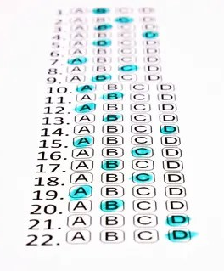
Now let’s review…
Why do programmers use functions?
What 2 characters wrap around a code block?
What 2 characters wrap around a list of parameters?
What is the purpose of the return command?
Must a function always return a value in order to be useful?
OK… time for quiz 2!
Slide 18

