Slide 1
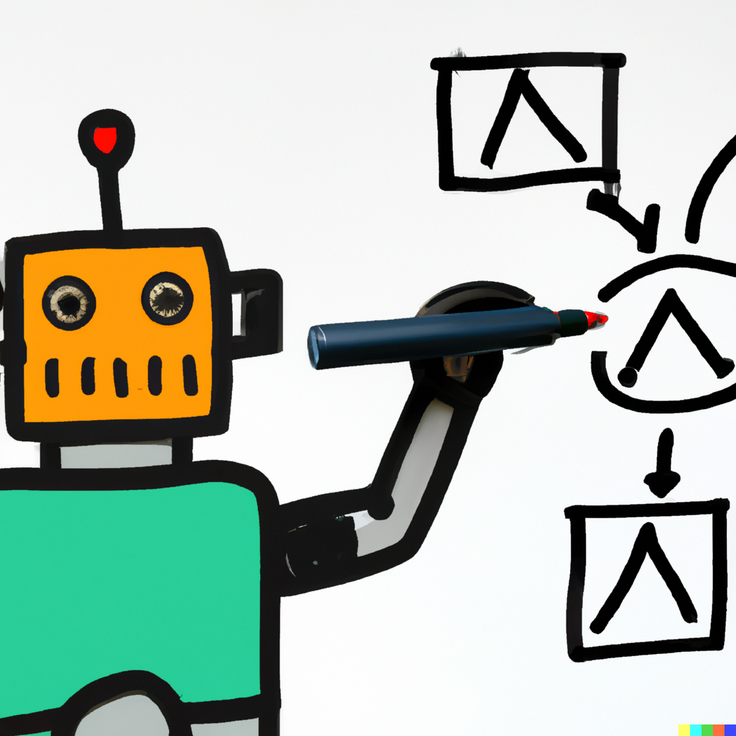
Conditional Statements
MIS2402: Web Application Development
Jeremy Shafer
jeremy@temple.edu
https://community.mis.temple.edu/jshafer
The above image was created by the DALL-E 2 service found at https://openai.com/product/dall-e-2 Unless otherwise indicated, all other decorative images are by Unknown Author and licensed under CC BY-NC

Slide 2
Today’s Agenda
What is a conditional statement? (What is an “if” statement?)
How are “if” statements written in JavaScript
How students should be able to express conditional logic
“if”, “else if”, and “else”
The isNaN function
Zero length strings
Some examples
Some Suggestions
Slide 2

Slide 3
What is a conditional statement? (What is an “if” statement?)
A conditional statement is a rule or idea that can be expressed using the word “if”
Business rules almost always need to be expressed as conditional statements.
Slide 3

Slide 4
Business Rules
In an airport…
If the suitcase weights over 50 pounds then charge an extra $20.00.
If the passenger has valid ID then let them in to the security check line.
In a purchase…
If the customer provided a promotion code then apply a 15% discount.
In a web application…
If the user is authenticated then show the “Edit Profile” link.
If the user provided bad data then show an error message.
If the user is not authenticated then show login form.
Your own example?
Slide 4

Slide 5
A little perspective
Conditional statements are great for something called error trapping … that is, checking data provided by the user to determine if it is correct or not.
A lot of error trapping often happens in the browser of a web application before any sort of request is sent to a remote system. You want to give the user an informative error message before even attempting to send a problematic request. This is called client-side error trapping. This course, MIS2402, introduces client-side concepts, so we’ll use conditional statements for client-side error trapping and client-side calculations.
Error trapping also happens at the server level, along with the implementation/enforcement of business rules. The server-side of an application is the focus of the next MIS programming course, MIS3502.
Slide 5

Slide 6
A little more perspective
Resource
API
API
Resource
Client-side conditional statements to provide “user friendly” experiences.
Clients can make calls to external resources when necessary!
This is the subject domain of MIS2402
Server-side conditional statements to implement business rules, protect sensitive resources, and trap for errors. Server-side error messages tend to be a little less friendly to the end user.
This is the subject domain of MIS3502
Conditional statements are important, they are used everywhere, and you should get comfortable writing them!

Slide 7
How are “if” statements written in JavaScript?
if ( condition ){
//code goes here
}
Here, the word condition represents something that is either true or false. That something could be a variable, a comparison, or a function that returns true or false.
If the condition is true, then the code block will be evaluated.
If the condition is false, then the code block won’t be evaluated.
The condition has a “true or false” value. True and false are Boolean values.
Any statement that evaluates to true or false is a Boolean expression.
Slide 7

Slide 8
A simple conditional statement in JavaScript
//declare a variable and assign it a value
let age = 17;
//check the variable using comparison
if (age >= 18){
console.log('Old enough to vote.');
}
console.log('Done.');
In this example … where is the assignment happening? Where is the comparison? Why are we using “greater than or equal to”?
What will be written to the console when this code runs?

Slide 9
Comparing things
Notice that on the last slide we used one equal sign = to assign a value and we used a right-angle bracket and an equal sign >= to represent “greater than or equal to”.
Those are comparison operators. We use the following operators to compare values.
Operator | Name
== | Equal to
!= | Not equal to
> | Greater than
< | Less than
<= | Less than or equal to
Determine the Boolean value of the following expressions:
( 1 > 5 )
( 1 == 1 )
( 100 <= 100 )
( 100 < 100 )
( 7 != 17 )
( 7 != 7 )
( 7 > 6 )
DISCUSS: In JavaScript, what’s the difference between a single equal sign = and a double equal sign == ?

Slide 10
Another example
//declare a variable and assign it a value
let age = 20;
//check the variable using comparison
if (age >= 18){
console.log('Old enough to vote.');
}
console.log('Done.');

Slide 11
How to express conditional logic
Pseudo Code
JavaScript
Students should be able to express conditional logic using either one of these mechanisms.
Students should be able to translate logic from one representation to another.
The focus of the class is, of course, on JavaScript. But translating like this is a good test of your comprehension!
Slide 11

Slide 12
if, else
Notice that we added in the word “else” here.
The “if” code block will run if the condition is true.
The “else” code block will run if run if the condition is false.
The “else” statement can only be used following an “if” statement.
let age = 24;
if ( age < 18 ){
console.log("Not old enough to vote.");
} else {
console.log("Old enough to vote.");
}
Slide 12

Slide 13
if, else if, else
The “if” and “else” statements can be chained together as shown here.
Often it is useful to end the chain with a single “else” statement that specifies what to do if all else fails.
Notice that only one code block (A,B,C,D or E) will execute using this approach.
let age = 30; if ( age < 18 ){
// code block A
console.log("Not old enough to vote.");
console.log("Can be covered by parent's health insurance");
} else if (age < 21) {
// code block B
console.log("Old enough to vote.");
console.log("Can be covered by parent's health insurance");
} else if (age < 26){
// code block C
console.log("Old enough to vote.");
console.log("Old enough to drink.");
console.log("Can be covered by parent's health insurance");
} else if (age < 29){
//code block D
console.log("Old enough to vote.");
console.log("Old enough to drink.");
console.log("Eligible for COBRA coverage");
} else {
// code block E
console.log("You're on your own, kid.")
}
Slide 13

Slide 14
The isNaN function
Recall that our condition can be a variable, a comparison, or a function that returns true or false.
The isNaN function is built right into the JavaScript language and is a frequently used in error trapping.
The isNaN function returns false if it sent a number, and true if it receives a value that is not a number. The function name, isNaN is short for “is not a number”.

Slide 15
More about the isNaN function
The name of the isNaN function is case sensitive. All the following are incorrect and will cause your JavaScript code to fail: IsNaN, isNan, ISNAN, isnan, etc.
The isNaN function makes an automated attempt to evaluate text (a string) as a number. It will then return true or false accordingly.
let price = "5.0";
if (isNaN(price)){
console.log("Price is not a number");
} else {
console.log("Price is a number.");
}
Determine the Boolean value of the following expressions:
isNaN(5)
isNaN(-3)
isNaN(3.14)
isNaN("3.14")
isNaN(0)
isNaN("lobster")
isNaN("1,000") isNaN("$5.00")

Slide 16
Zero length strings
In most programming languages, a zero-length string is a pair of quotes, with nothing in between them.
Like this: ""
or this: ''
Those strings above have a length of zero.
And that is different from a pair of quotes with one or more spaces in between them.
Like this: " "
or this: ' '
These strings have a length of one, because they hold one space

Slide 17
Zero length strings and isNaN
We previously saw that the isNaN function will return true if provided with a string that has numeric value.
How does isNaN evaluate zero-length strings? What does it do with strings that hold nothing but spaces?
Type the following into Chrome’s web developer console to find out!
isNaN('')
isNaN(' ')

Slide 18
Before we look at some examples
Today’s examples will use the JavaScript prompt and alert commands.
Using prompt or alert is usually a bad idea
Using prompt or alert raises accessibility concerns
Using prompt or alert causes the browser to “hang” while it waits for user action
Using prompt or alert should not be used in any modern web solution
Here they are only being used as a one time, throw away, teaching tool.
In the examples we look at today, some will use conditional statements for error trapping. In other cases, the conditional statement is an essential part of the logic of the calculation we want to perform. See if you can discern the difference.
Slide 18

Slide 19
Some examples
As in previous examples, use the “step” option in Chrome’s web developer tools to watch this code get executed, line by line.
Area of a triangle (different approaches)
https://misdemo.temple.edu/classexamples/triangle2.html
https://misdemo.temple.edu/classexamples/triangle3.html
https://misdemo.temple.edu/classexamples/triangle4.html

Slide 20
Some more examples
Old Enough
https://misdemo.temple.edu/classexamples/oldenough.html
Fuel Economy – Can you find the logic error?
https://misdemo.temple.edu/classexamples/fueleconomy-buggy.html
Fuel Economy – Can you find the logic error?
https://misdemo.temple.edu/classexamples/fueleconomy.html

Slide 21
Some suggestions
In this lecture syntax for if, else if, and else statements were presented.
Students (new programmers) sometimes feel confused about when to use a specific approach.
Suggestions:
focus on using the if statement all by itself until you feel you absolutely must have an “else” code block.
Avoid long “if, else if, else” chains whenever you can. They can be difficult to read and to maintain.
As you saw in the last fuel economy example, the answer did not absolutely require the use of “else if” logic. Putting your statements in the correct order was all that was needed!
Slide 21

Slide 22
General Advice
Start small
Build your solution one logical piece at a time
Test as you go

Slide 23
Let’s review
Can you have an “else” statement without an “if”?
Does isNaN("") evaluate to true or false?
Does isNaN(“$1,000.00") evaluate to true or false?
What are conditional statements commonly used for in code?
Which of these are comparison operators? =, ==, >, <=
What is the “not equal to” operator in JavaScript?
True or False? Modern web pages use prompt and alert all the time and your instructor wants to see those commands in student work.
Slide 23

