Slide 1
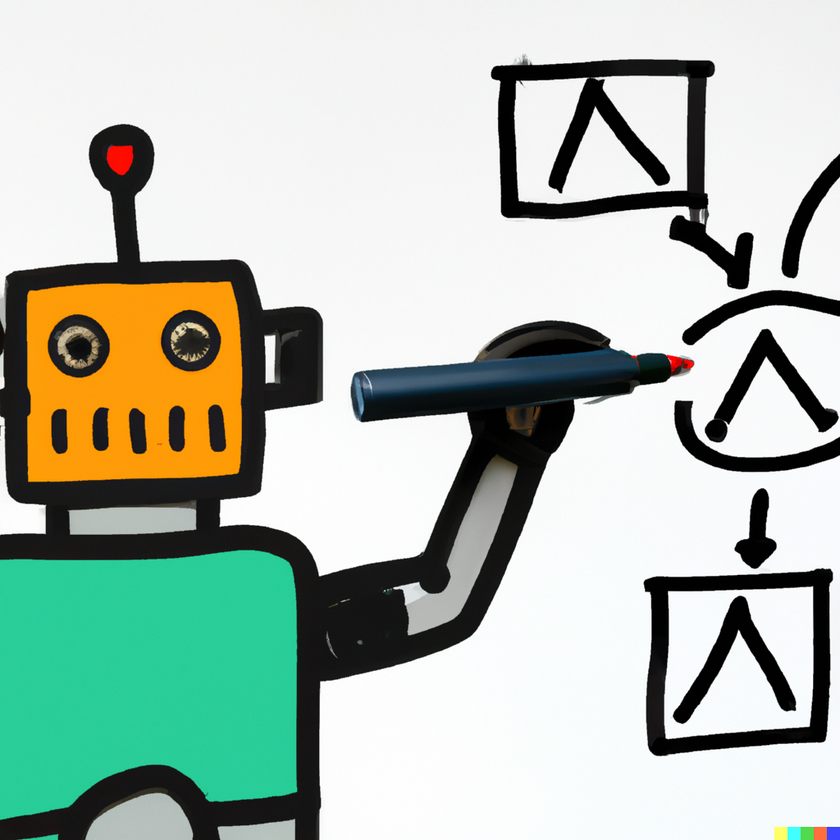
Logical Operators
MIS2402: Web Application Development
Jeremy Shafer
jeremy@temple.edu
https://community.mis.temple.edu/jshafer
The above image was created by the DALL-E 2 service found at https://openai.com/product/dall-e-2 Unless otherwise indicated, all other decorative images are by Unknown Author and licensed under CC BY-NC

Slide 2
Today’s Agenda
Discover what logical operators are.
Explore how logical operators can help us write better conditional statements
More practice with conditional logic
Slide 2

Slide 3
By the end of class …
Become familiar with the logical operators: and, or, and not.
Demonstrate that there is more than one correct way to solve a programming problem
Begin to discuss which approaches might be more (or less) desirable.
Slide 3

Slide 4
Last class we learned about this:
if ( condition ){
//code goes here
}
You’ll recall that the word condition represents something that is either true or false. That something could be a variable, a comparison, or a function that returns true or false.
The condition may also be a compound Boolean expression – that is it could be multiple conditions joined by logical operators. (That’s today’s topic!)
Slide 4

Slide 5
Last class we also learned about comparing things:
Operator | Name
== | Equal to
!= | Not equal to
> | Greater than
< | Less than
<= | Less than or equal to
Determine the Boolean value of the following expressions:
( 1 < 5 )
( 1 == 5 )
( 1 <= 5 )
( 1 != 5)

Slide 6
Now we have logical operators.
Logical operators allow us to combine multiple conditions into a single statement!
For example, the following statement evaluates to true:
( ( 1 < 5) && ( 1 != 5) )
The two ampersands (&&) mean “and”. So this statement is saying: one is less than five, and one is not the same as five.
That sounds true to me!

Slide 7
The logical operators
Operator | Name | Description
&& | And | Returns a true value if both expressions are true. This operator only evaluates the second expression if necessary.
|| | Or | Returns a true value if either expression is true. This operator only evaluates the second expression if necessary. (The two vertical line are made using the “pipe” character, right above the enter key on your keyboard!)
! | Not | Reverses the value of the Boolean expression.

Slide 8
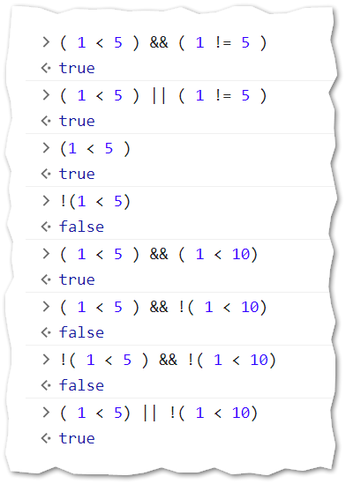
Examples

Slide 9
Truth tables
The "AND" operation
A | B | Result
TRUE | TRUE | TRUE
FALSE | TRUE | FALSE
TRUE | FALSE | FALSE
FALSE | FALSE | FALSE
The "OR" operation
A | B | Result
TRUE | TRUE | TRUE
FALSE | TRUE | TRUE
TRUE | FALSE | TRUE
FALSE | FALSE | FALSE
The "NOT" operation
A | Result
TRUE | FALSE
FALSE | TRUE
Careful! Casual spoken English is different from strict, formal logic!
For example – when a person asks you if you did “A” OR “B” usually the answer is usually not “Yes”. People will casually use the words AND , OR and NOT in ways that are imprecise. Would you not agree? ☺

Slide 10
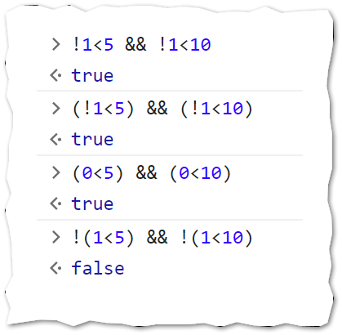
Important note!
Some examples:
What you said…
Using parenthesis around comparisons and conditions will make your code much more readable. Just like in algebra, parentheses are used to force a certain order of operations. Not using parenthesis can make your code difficult (for a human) to read!
This is especially true with the “NOT” operator. The “NOT” will be applied to the first value encountered. The language does not automatically understand that you are (probably) writing some sort of comparison.
What you (probably) meant

Slide 11
Back to the lemonade stand…
Take a moment to “View page source” on these different solutions to the lemonade stand activity from last class. Take note of the different uses of logical operators.
https://misdemo.temple.edu/classexamples/logic/
DISCUSS: Which solution was easier for you to read? Was any solution notably faster / slower? Which answer was “right”?
NOTE: If your function was called thousands of times per second a small difference in speed might matter. But often it does not matter, especially when the code is waiting on human input. (Humans are slow!)
If the difference in speed is negligible, then the best code is the code that is easiest to read and easiest to maintain!

Slide 12
Why are we learning this again?
In the immediate future you’ll need logical operators for performing calculations and client-side error trapping in MIS2402.
Conditional statements are also essential for implementing business rules that you will see in MIS3502 APIs.
Beyond that, in your career, these logical expressions are used in data cleansing, spreadsheets, risk analysis software, robotic process automation, supply chain automation, machine learning, and many other tasks…. even if you are not a “programmer”.
Slide 12

Slide 13
Let’s review
What is the difference between a logical operator and a comparison operator?
What are the three logical operators in JavaScript?
What are some things to think about when comparing two different solutions to a programming problem?
What characters have we used to force our desired order of operations when creating compound Boolean expressions?
Time for a quiz!
Slide 13

