Slide 1
Numbers in JavaScript
MIS2402: Web Application Development
Jeremy Shafer
jeremy@temple.edu
https://community.mis.temple.edu/jshafer
The above image was created by the DALL-E 2 service found at https://openai.com/product/dall-e-2 Unless otherwise indicated, all other decorative images are by Unknown Author and licensed under CC BY-NC

Slide 2
Advisory!
Often, the best way to understand a programming concept is to construct your own, simple, example of it.
As we look at Math and JavaScript today, don’t be afraid to do that. It would be smart to revisit this material and make some examples of your own after today’s lecture!
This approach to learning can be a great time-saver! A few minutes of creative effort can often be a substitute for hours of reading, analyzing someone else’s example and/or trying to memorize seemingly random facts.

Slide 3
Agenda
Review some “old stuff”
Mathematic operations
parseInt
parseFloat
Learn some “new stuff”
NaN
The Math object
A second look at data types
Slide 3

Slide 4
By the end of this class…
Know what these words mean: object, method, attribute
Be able to quickly spot methods and attributes when they are used in JavaScript code
Understand what NaN is in JavaScript and what it represents
Know what the JavaScript data types are

Slide 5
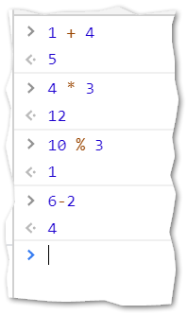
Things we have already seen …
Addition, Subtraction, Multiplication, Division, and Modulus
FUN FACT: You can test / perform all these operations from the Web Developer Tools console.

Slide 6
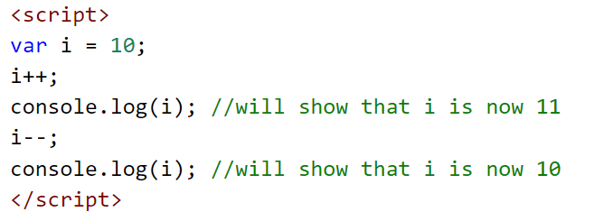
We have also seen …
Some shortcuts: i++ and i--
FUN FACT: These are called unary operators. They are called unary because they only take one operand.

Slide 7
Calculating the perimeter of a square
See this example: https://misdemo.temple.edu/classexamples/perimeter/ex1.html
We should just be able to add up all four sides.
But it doesn’t work! What’s wrong???
X
X
X
X

Slide 8
Converting from one data type to another
When we get data from user input it is string input. That means, before we can do math on any number, we need to somehow convert it to a number.
We can convert the input implicitly. Consider the following example where the variable x is a string that has been provided by a user.
let p = 4 * x; //if x is '5', p will be 20
The conversion was implicit. It happened because the JavaScript language saw the multiplication operator, the number four, and the language parsing process converted the ‘5’ (a string) to a 5 (a number) automatically.

Slide 9
A puzzle
So how could we fix our perimeter calculation?
One possible fix: https://misdemo.temple.edu/classexamples/perimeter/ex2.html
But there are other options https://misdemo.temple.edu/classexamples/perimeter/ex3.html https://misdemo.temple.edu/classexamples/perimeter/ex4.html

Slide 10
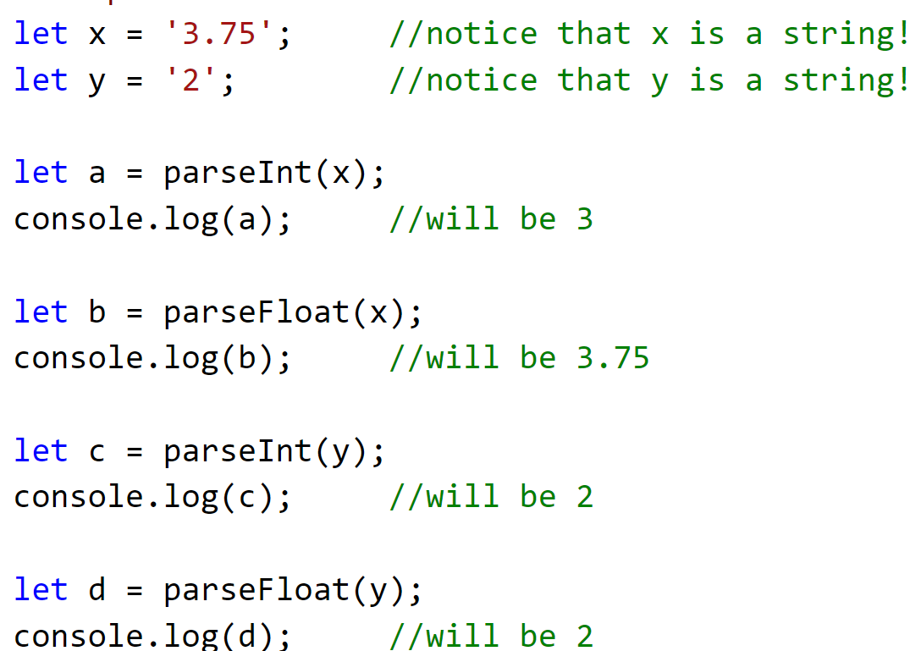
parseInt and parseFloat
We can convert the input explicitly. JavaScript gives us the parseInt and parseFloat functions for that. For example…
Notice that we are not rounding ‘3.75’ we are simply parsing it…. extracting only the integer portion of the number.
Slide 10

Slide 11
An example of data type conversion
The computer’s memory
The code
‘5’
function calculatePerimeter(x) {
x = parseInt(x);
let p = x + x + x + x;
return p }
x = ‘5’
‘5’
5
X 55
p = 20
5 + 5 + 5 + 5
Without the parseInt step, p would have been assigned the result of ‘5’ + ‘5’ + ‘5’ + ‘5’ which is ‘5555’

Slide 12
A special case
The previous examples work because the user input of ‘5’ in x is a string that can be easily converted into a number. If the user provides a string with a non-numeric value, then the output of the conversion operation will be a special constant called NaN which (you guessed it) is short for Not a Number.
let p = 4 * x; //if x is 'dog', p will be NaN
let p = x + x + x + x; //if x is 'dog’, //p will be 'dogdogdogdog'
x = parseInt(x); //if x is 'dog', x will be NaN
x = parseFloat(x); //if x is 'dog', x will be NaN

Slide 13
The special thing about NaN
NaN has a curious property. All mathematic operations performed on NaN will equal NaN.
<script>
let m = 2.2;
let b = 7;
let x = 4;
let y = (m*x) +b;
console.log(y); //15.8
</script>
<script>
let m = 'zebra';
let b = 7;
let x = 4;
let y = (m*x) +b;
console.log(y); //NaN
</script>
<script>
let m = 2.2;
let b = 7;
let x = 'pink';
let y = (m*x) +b;
console.log(y); //NaN
</script>

Slide 14
The plus sign is the exception
The exception is (once again!) the “+” operation.
<script>
let m = 2.2;
let b = 'pluto';
let x = 4;
let y = (m*x) + b;
console.log(y); //8.8pluto
</script>

Slide 15
The Math object
It’s nice that we can do basic arithmetic operations in JavaScript… but what if we needed to do something a little more complicated? Like compute x¹⁰ or find the square root of a number? Or generate a random number? Or round a number to the closest integer?
JavaScript gives us a variety of mathematic constants and functions, all bundled together as part of the Math object.

Slide 16
The Math object (2)
For example, JavaScript gives us the following constants, built right into the language itself. (For the full list, see your textbook!)
Property | What it stands for
Math.PI | 3.14159… the ratio of a circle's circumference to its diameter
Math.SQRT2 | 1.41421… the square root of 2

Slide 17
Methods of the Math object
The Math object also has a number of methods associated with it. A method is a function that is a property of an object. It takes zero or more parameters as input, and returns an output. Here are some of the methods you might be interested in. (Again, for the full list, see your textbook!)
Method | What it does
Math.round(x) | Returns x rounded to the nearest integer.
Math.ceil(x) | Returns x rounded up to the next greatest integer.
Math.pow(base, power) | Returns base returned to some power.
Math.sqrt(x) | Returns the square root of x.
Math.abs(x) | Returns the absolute value of x.
Math.random() | Takes no parameters! Returns a random number between 0 and 1

Slide 18
Objects
With the introduction of the Math object we now have an opportunity to think about the terminology of objects in general.
Objects are simply convenient collections of attributes (like Math.PI) and methods (like Math.random() ).
In the next 2 slides we explore the difference between attributes and methods...

Slide 19
Objects (attributes)
An attribute has a value… and that’s all.
In JavaScript we use a dot (“.”) to separate the object and it’s attribute.
ObjectName.AttributeName

Slide 20
Objects (methods)
A method does something. A method will take 0 or more parameters as input and return some output. As with attributes, a dot (“.”) is used to separate the object and its method.
ObjectName.MethodName()
The number of parameters needed here will depend on the definition of the method!

Slide 21
Objects in MIS2402
JavaScript allows you to create your own objects. But we won’t be doing that this semester! You should, however, understand the basic terminology and syntax we just described.
You should know an object when you see one! JavaScript has lot of built in objects and the Math object is just one of them.

Slide 22
Objects – Built-In versus Defined
JavaScript is a little bit like your brain… there is some functionality that is just built in (like Math.sqrt() to calculate a square root) and there are other things it needs to be told how to do…. like compute the area of a circle!
Ride a bike
Regulate body temp
Sing “Old Town Road”
Breathe
Juggle
Chew and Swallow

Slide 23
Data Types
With all this talk about strings and numbers, now would be a good time to revisit the JavaScript Data types. Here are the eight data types of JavaScript:
Data Type | Description
String | A sequence of characters.
Number | A number represented by 64 bits. This data type is used for both integers and floating-point numbers.
Boolean | A true / false value.
Undefined | A default value automatically assigned to variables that have just been declared.
Null * | A way to intentionally indicate that some value does not exist.
BigInt * | A way to represent really, really big numbers. Good for science stuff.
Symbol * | An arbitrary and unique value.
Object | A data type made up of other data types.
* These data types are not needed in MIS2402
Source: https://developer.mozilla.org/en-US/docs/Web/JavaScript/Data_structures

Slide 24
Now let’s review…
In the following line of code, what object is being used? What attribute? And what method? let x = Math.random() + Math.PI;
What are the syntax conventions used by JavaScript used to represent objects and methods?
Does the following statement work? Why / Why not? console.log(math.random());
True or false? A method must be provided with at least one parameter.
How many data types are there in JavaScript?
NaN plus 1000 will equal what?
When you collect data off an HTML form, what will be its default data type?
What is the % operator used for? What is the value of 10%3
Slide 24

