Slide 1
Single Page Architecture Part 2
MIS2402: Web Application Development
Jeremy Shafer
jeremy@temple.edu
https://community.mis.temple.edu/jshafer
The above image was created by the DALL-E 2 service found at https://openai.com/product/dall-e-2 Unless otherwise indicated, all other decorative images are by Unknown Author and licensed under CC BY-NC

Slide 2
Agenda
A brief review of the new jQuery methods we encountered last class.
A review of the basic premise behind SPA
Revisit the role of error trapping

Slide 3
By the end of this class…
Know some basic facts about bootstrap
More practice showing and hiding content
Exposure to a more sophisticated client
Understand how to identify tags in jQuery using CSS ids.

Slide 4
Last class we…
Defined what a Single Page Architecture is.
Revisited some jQuery commands we can use to make a simple SPA application.

Slide 5
This class…
Revisit error trapping.
Review how all the elements we have studied this semester have brought us to this point.
Look at a more sophisticated Bootstrap layout.

Slide 6
Single Page Architecture
In a Single Page Architecture all of an application’s structure is loaded into a single html page. (Or, at least, as much as possible!) That single page will (probably) include references to other resources in its <head> tag. It will also (probably) interact with Web Services through Ajax calls. But the navigation of the user from one html page to another is avoided. This is done to make the application faster, more efficient, and to give the programmer more control over the user’s experience.
Applications composed of multiple html pages place greater demands on the client and the server. Basically, unnecessary page refreshes are bad!

Slide 7
Our jQuery Methods (Page 1)
jQuery method | Notes / Purpose
$.getJSON() | Initiate an HTTP GET request
$.post() | Initiate an HTTP POST request
.html() | Put data into the inner HTML of a tag. (Can also be used to read the inner html of a tag.)
.val() | Read the value of an input tag. (Can also be used to set the value of an input tag.)
.append() | Append data into the inner HTML of a tag.
.serialize() | Retrieve all the named input tags on a form. Use those names and values to create a string of URL Encoded data.
Slide 7

Slide 8
Our jQuery Methods (Page 2)
jQuery method | Notes / Purpose
.addClass() | Add a CSS style. CSS styles change the way a tag looks.
.removeClass() | Remove the CSS styles applied to the tag.
.show() | Show a tag. Make it visible.
.hide() | Hide a tag. Make it invisible.
Slide 8

Slide 9
Error trapping
Error trapping is programming logic that prevents a user from performing a wrong, misleading, or even dangerous action.
Error trapping protects well-intentioned users from making innocent mistakes.
Error trapping also protects valuable resources from being exploited and/or damaged from malicious users.
Good error trapping is implemented at multiple levels. If one level fails, another level provides the desired level of protection. (This is an example of the IT Security concept called “Security-in-Depth”.)

Slide 10
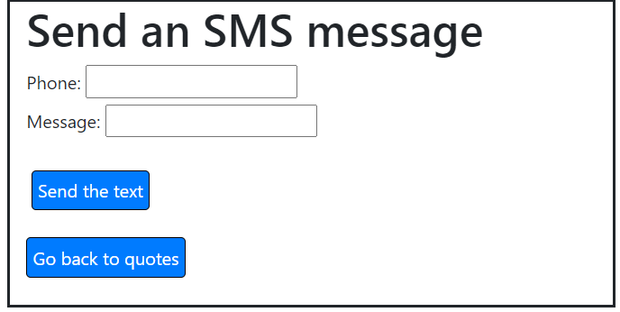
An example: Our last application
What if a user enters a blank message or phone number … that’s bad data… what happens? What *should* happen?
There’s more than one acceptable response! But… generally, the application should:
Give useful / meaningful feedback to the user
Prevent obviously bad data from being sent to the API
Prevent any condition that would cause the application to crash and/or become unavailable!
Nothin’
Click Send

Slide 11
Client side vs. Server Side
We can conceptualize our “inspirational quotes” application like this:
MISDEMO API
Database
Client
TEXTBELT API
Client-Side Error Trapping is implemented here. JavaScript conditional statements and jQuery commands are used to provide immediate (and meaningful) feedback to the user wherever possible!
Server-Side Error Trapping is implemented here by our API provider. It won’t be friendly for our user. Sending bad data to our API might affect costs!

Slide 12
Good error trapping exists at several levels
We can all agree that a blank text message is useless, right? So how do we stop that from happening?
Client
MISDEMO API
TEXTBELT API
Client-Side Error Trapping This would be the first like of defense… and there’s absolutely no need to call any API if the message or phone number blank!
Server-Side Error Trapping – If important data is missing, don’t send the text message!
Slide 12

Slide 13
To build a simple application
You need to be able to present an interface to the user.
HTML is the foundation for your presentation.
Adding Bootstrap CSS to your HTML makes a huge difference!
You need to be able to perform calculations.
JavaScript functions, conditional statements, arithmetic expressions, functions and loops are all important ingredients in any solution!
You need to be able to manipulate that interface.
JavaScript and jQuery are tools that let you get data from user input, respond to click events, and manipulate the appearance of HTML tags.
You need to be able interact with “Cloud” resources
Reading from and writing to APIs is what allows your code to interact with meaningful data and perform interesting tasks!
These are all things you have learned about this semester!

Slide 14
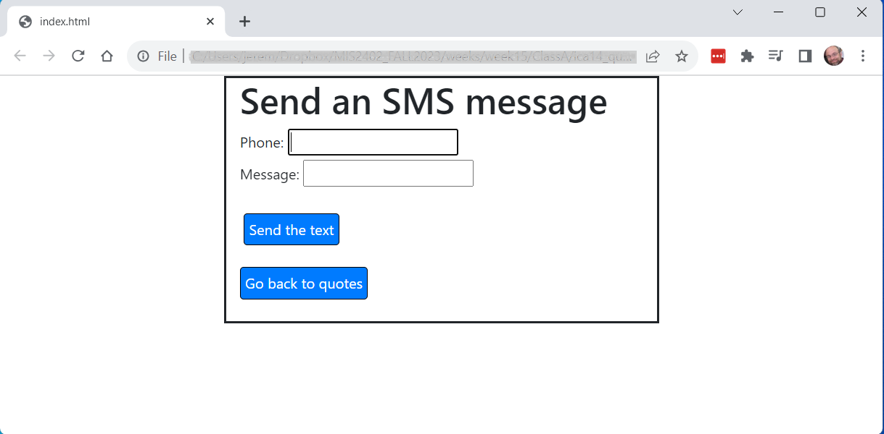
Building an interface with HTML, CSS and Bootstrap
The Bootstrap layout we saw last time…
container
row
2 spans
8 spans
2 spans
Slide 14

Slide 15
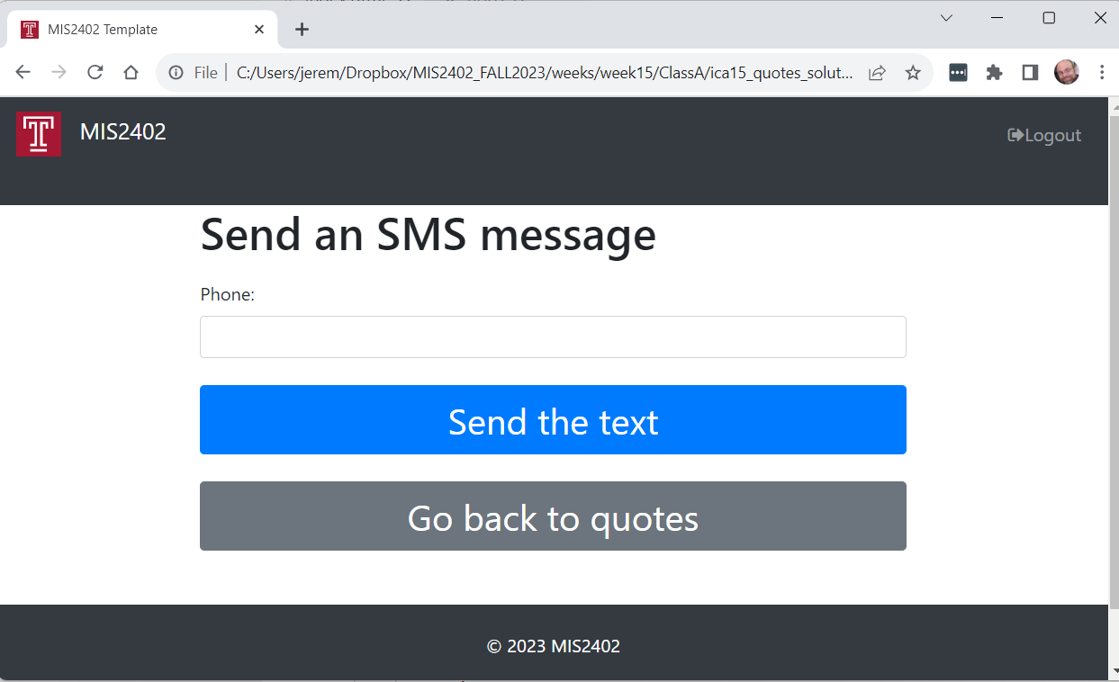
Some improvements…
Changes to a menu icon when the window is narrow
nav
container
row
Another container, row, and 12 span column
2 spans
8 spans
2 spans

Slide 16
Let’s give it a try…

