Slide 1

JavaScript and the World Wide Web
MIS2402: Web Application Development
Jeremy Shafer
jeremy@temple.edu
https://community.mis.temple.edu/jshafer
The above image was created by the DALL-E 2 service found at https://openai.com/product/dall-e-2
Unless otherwise indicated, all other decorative images are by Unknown Author and licensed under CC BY-NC

Slide 2

MIS Instructional Practices
Break large tasks down into smaller tasks.
Don’t be satisfied with “magical” solutions.
Ask good questions in class.
Independently experiment to discover answers.
When your code doesn’t work, step back, think, and try again.
Turn in your work on time.
Code a little each day. Not all at once before a due date.

Slide 3

Before I forget…
This course has a 200 PRO point requirement for MIS Majors
Students are expected to be watching “Practical HTML for No-Coders" video material on their own, outside of class.
Quiz 1 will be a hands-on assessment. It will assess your understanding of the HTML video material.
Slide 3

Slide 4
About the HTML video
Log in to LinkedInLearning.temple.edu
Search for this title: “Practical HTML for No-Coders with Jen Kramer”
The entire video is 1 hour and 39 minutes. You are expected to watch it all.
You should plan on spending roughly 4 hours learning from that video (because it takes time to try the exercises on your own.)
Slide 4

Slide 5
More about the HTML video
Students who watch as little as the first 10 minutes of the video between now and next class will have a big advantage. ( It pays to start early.)
The video uses the codepen.io web application. We only use codepen.io in the first three weeks of the semester.
Slide 5

Slide 6
Agenda
What is JavaScript?
How do web pages work?
What role does JavaScript play in web pages and web applications?
How can you get started using JavaScript today?
Slide 6

Slide 7
By the end of this class…
What’s the difference between the Internet and the WWW?
What’s a programming language?
What’s the most popular programming language on the planet?
What’s the difference between a “domain specific” programming language and “general purpose” programming language?
What’s the difference between a web site and a web application?
What’s a web browser? What functions does it perform?
What software do I need to start learning JavaScript?

Slide 8
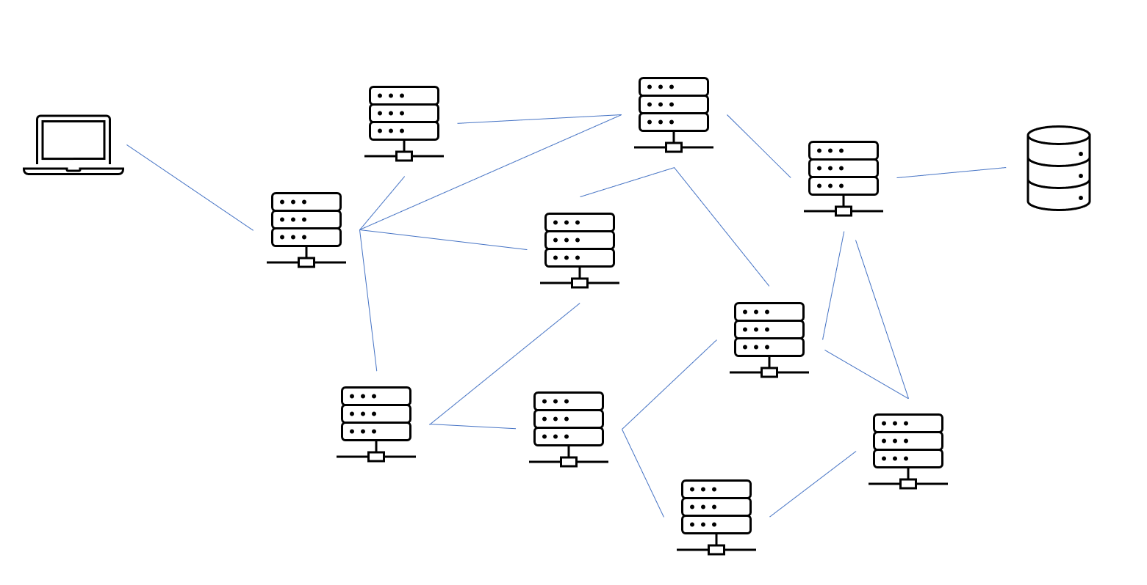
How does the Internet work?
Notes:
Demonstrate with traceroute to www.google.com
Notice the role DNS names and ip addresses
The cloud is an informal term – it is this large collection of interconnect, networked computers … it is the internet.
Your communication with a server is not a direct line… but it “feels” that way.

Slide 9
Internet Conventions
The internet is designed to be:
Fault tolerant
Redundant
Highly Available
Internet communication depends on
Documented standards and conventions
IP addresses ( 255.255.255.255)
DNS Names ( www.google.com )
Protocols and Ports
An example of standards and conventions at work.
Think about an email address that you know. For example:
tux54321@temple.edu
Notes:
What color is the DNS name that indicates where the email should go? What color is the user name? What is the role of the red @ sign?

Slide 10
Another internet convention… the web URL:
https://misdemo.temple.edu/tux54321/index.html
Dear Mr. Internet, I am going to talk the https protocol now.
Look at index.html when you get there. You can expect that to be a HTML file, because it ends in .html.
Look in the tux54321 folder when you get there.
Please go find me the server with this DNS name: misdemo.temple.edu
Fun fact: URL is short for “Uniform Resource Locator”
Notes:
What color is the DNS name that indicates where the email should go? What color is the user name? What is the role of the red @ sign?

Slide 11
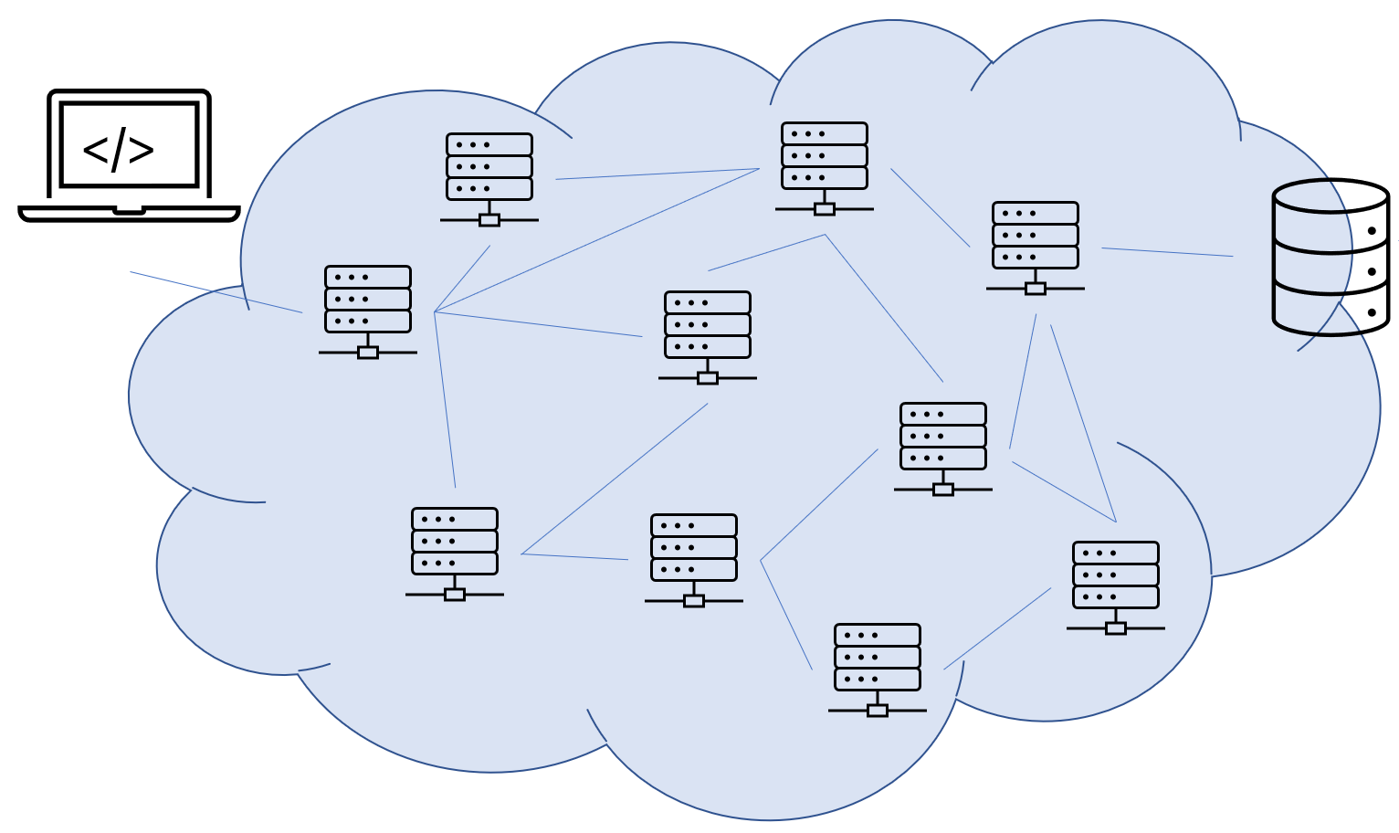
The HTTP protocol
HTTPS (Hypertext Transfer Protocol) on port 443
index.html
page2.html
puppy.html
splash.html
…
etc.
Notes:
The HTTP protocol exists to transfer files from a server to a client.

Slide 12


The web
The HTTPS protocol exists to transfer files from a server to a client.
These Hypertext files are then interpreted by a piece of software on your computer called a browser.
The files are “marked up” using something called HTML.
These files often contain links (also called “anchor tags”) that reference other hypertext files.
And those files link to other hypertext files.
And those other files link to more hypertext files.
And so on.
This collection of linked hypertext files (also called hypertext documents) gives us a web of linked documents…. A worldwide web of documents. This is the WWW.
Notes:
What are some browsers that you know?

Slide 13
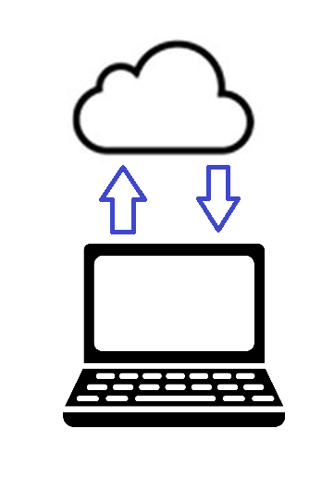
So, how do web pages work?
Client computers run a software product called a browser.
The role of the browser is to request web pages from a URL, receive those files, interpret them, and present them to the user.
The URL you asked for …
The response you got back.
Discuss:
How is “the Internet” different from the “World Wide Web”?
Slide 13

Slide 14
So, what’s in an .html file anyway?
In the .html file your will find three programming languages: HTML, CSS and JavaScript.
They compliment each other, but each language serves a distinct purpose.
Their syntax is different.
The HTML in the file represents the structure of the page’s content.
The CSS controls the presentation of the content (color, font, size, spacing, etc., etc.)
JavaScript specifies logical instructions to be carried out.
HTML
CSS
JavaScript
Slide 14

Slide 15
Why do we need JavaScript?
Without JavaScript, our html would not change. The page would be static (that is, unchanging) like a piece of paper.
At best, we could follow links from one page to another, but that’s it. We’d have nothing but web sites.
JavaScript is what allows us to create web applications. Web applications can collect information from users, perform calculations, and change in appearance as they are used.
HTML
CSS
JavaScript
Slide 15

Slide 16
Some notes about Programming Languages
A programming language is simply a way for people (programmers) to provide instructions for a computer to carry out.
There are many, many, programming languages. But no other language is as pervasive as JavaScript. JavaScript is present in every device that has a browser (desktops, laptops, tablets and phones.)
JavaScript is present on most servers as well, running inside an environment called NodeJS. NodeJS is not the subject of this course, you’ll learn more about Node later.
Slide 16

Slide 17
Wait… HTML and CSS are languages?!
HTML
CSS
JavaScript
Yes, they are. But they’re very limited. They are created to service one specific purpose. They only address a certain domain of tasks.
That’s why HTML and CSS are called “domain specific” languages.
In contrast, JavaScript is a “General Purpose” language. Because it can used to do a wide variety of things.
Slide 17

Slide 18
What do I need to get started?
There are lots and lots of software titles to help you write computer code.
But, as we’ve already said, JavaScript is found in every browser.
So, the absolute minimum software installation you need is a browser.
The browser you will need in this class is: Chrome.
You should also install Firefox, on your own, outside of class.
There will be more software to install later, but for right now, we are just going to use Chrome!
Slide 18

Slide 19
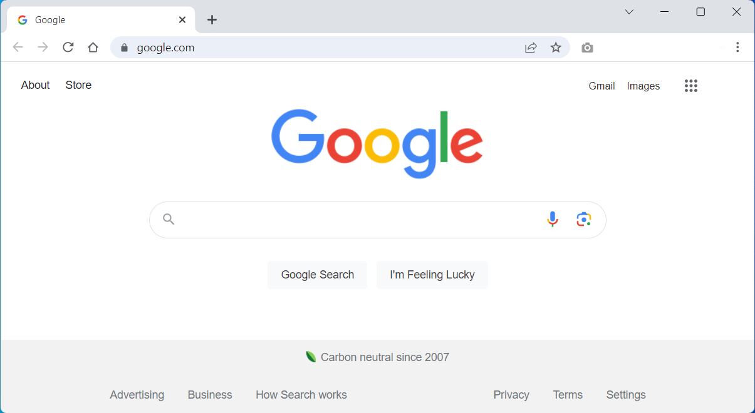
Chrome

Slide 20
Chrome – where to click

Slide 21
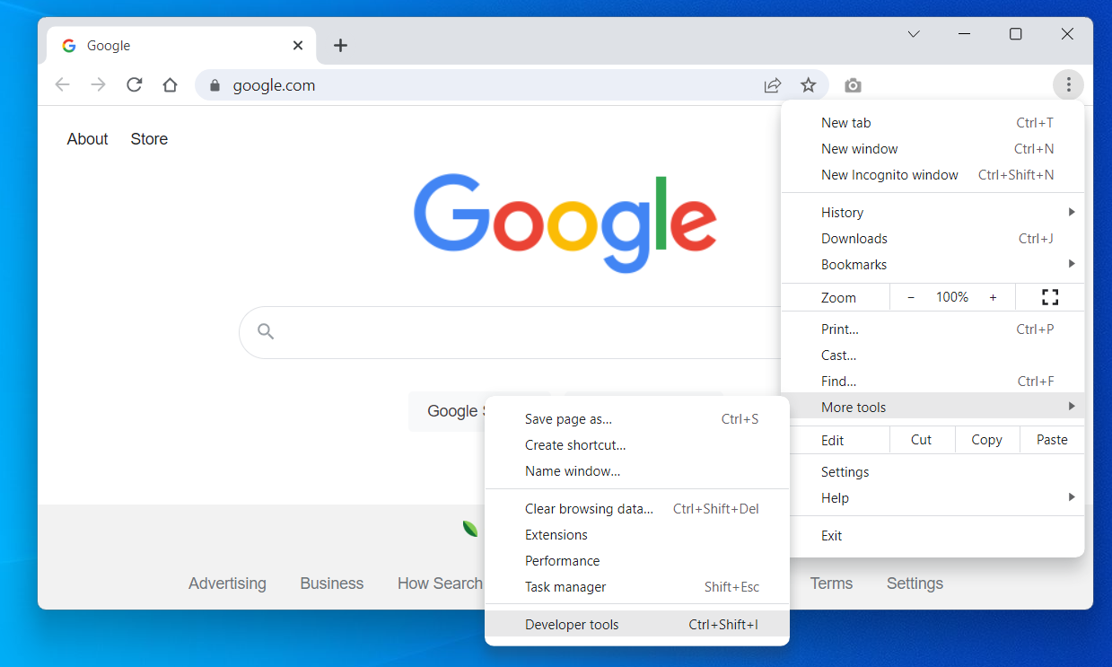
Chrome – Developer tools

Slide 22
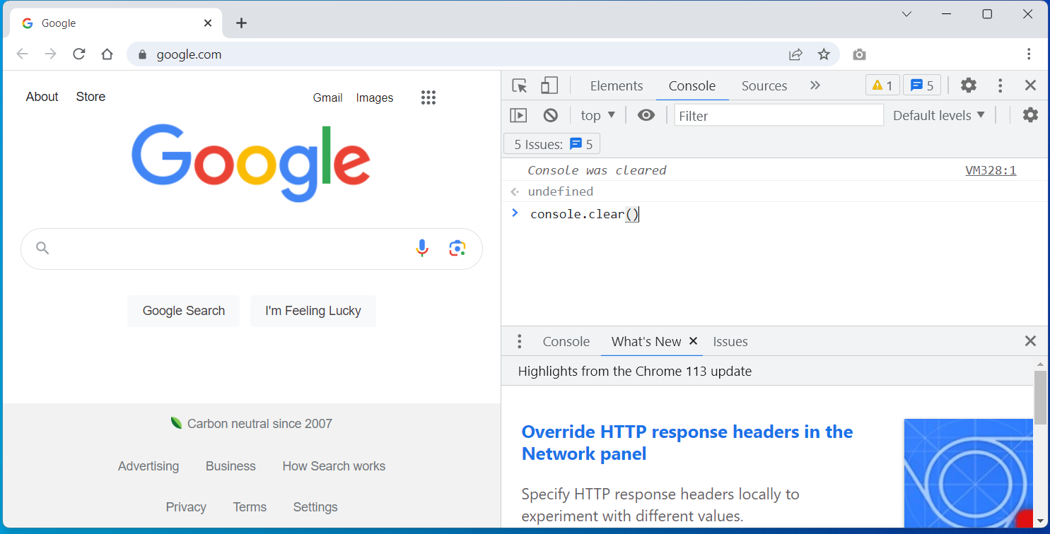
Getting started with the console

Slide 23
Let’s try these commands:
console.clear()
console.log("Hello World");
console.log('Hello World');
alert("Hi there!");
34 / 21
34 + 21
100 * 100
Math.sqrt(100)
Slide 23

Slide 24
But wait, there’s more:
You can do a lot from the web developer console.
We’ll use it a lot in class, and it is a good, quick way to test out a lot of new ideas. Don’t ignore it!
1 + 1 + 2
1 + 1 / 2
(1 + 1 ) / 2
// this is a comment
Math.random()
(70 - 32)*(5/9)
10 * 10 * 10
Math.pow(10,3)
Slide 24

Slide 25
So, how’d we do?
What’s the difference between the Internet and the WWW?
What’s a programming language?
What’s the most popular programming language on the planet?
What’s the difference between a “domain specific” programming language and “general purpose” programming language?
What’s the difference between a web site and a web application?
What’s a web browser? What functions does it perform?
What software do I need to start learning JavaScript?

