Slide 1

Debugging
MIS2402: Web Application Development
Jeremy Shafer
jeremy@temple.edu
https://community.mis.temple.edu/jshafer
The above image was created by the DALL-E 2 service found at https://openai.com/product/dall-e-2
Unless otherwise indicated, all other decorative images are by Unknown Author and licensed under CC BY-NC

Slide 2

Looking ahead
Next class you will have Quiz 1
It is a “hands on” HTML Quiz.
You will do your work on codepen, and turn it in on Canvas (just as you did for ICA01 and ICA02)
DISCUSS: What notes will you be allowed to use for the quiz?
This Photo by Unknown Author is licensed under CC BY-NC-ND

Slide 3
Today’s Agenda
How JavaScript code is interpreted by the browser
Three ways you can find errors in your code
Slide 3

Slide 4
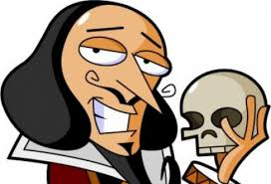

Interpreted Code
There’s a reason your code is inside a <script> tag. That’s because JavaScript is set of instructions (this is, a script) delivered to your browser when the page loads.
Delivering the script, and interpreting (or running) the script are two different things.
Your browser (Chrome) contains a program that interprets (reads and processes) the instructions in your script.
We call that program “the JavaScript engine”.
Slide 4

Slide 5

So…
Before we talk about how your code is interpreted, let’s talk about how it is delivered to your browser, and how web applications work in general!
Slide 5

Slide 6



Some “must have” HTML elements for a web application
The HTML tag | What’s it for?
<a href="">Click Me!</a> | You click on the link, and it retrieves a web page (containing HTML, CSS, and JavaScript) from a host.
<input type="button" value="Go"> | You click on the button, and JavaScript that is associated with the button performs a calculation and/or modifies the HTML on the current page.
<input type="submit" > | A submit button must be used with an HTML form. A submit button will send form data to a host and, just like a link, will direct the user to a new web page. (Looks just like “button” doesn’t it!?)
*
This is all an over-simplification… but these are three fundamental tags and here we are describing the ways in which they are typically used.
Slide 6

Slide 7





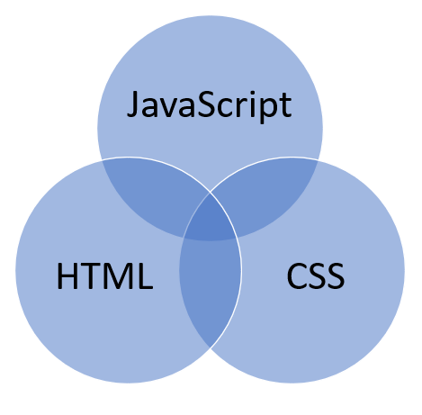
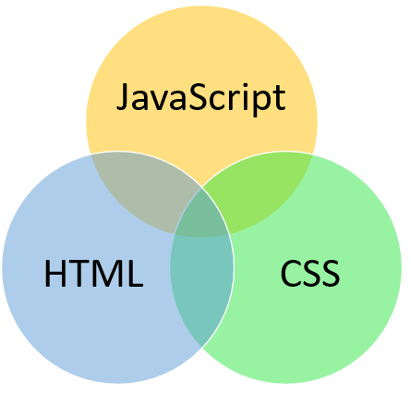
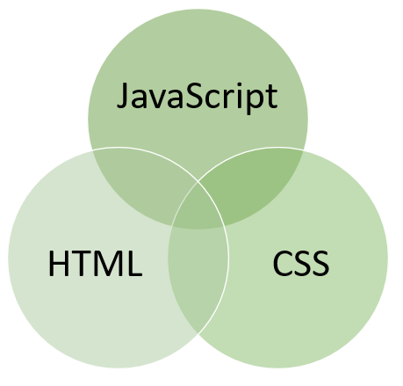
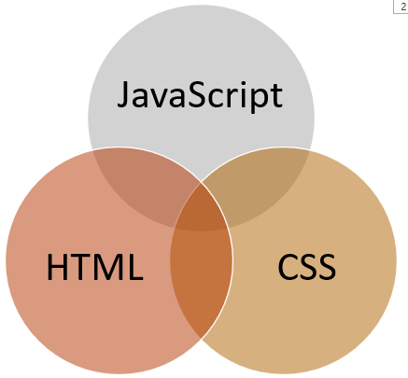
How web applications work…
(delivery)
form data
API / HTTP Request
JSON Response (Just the data!)
This goes on and on forever!!
Slide 7

Slide 8
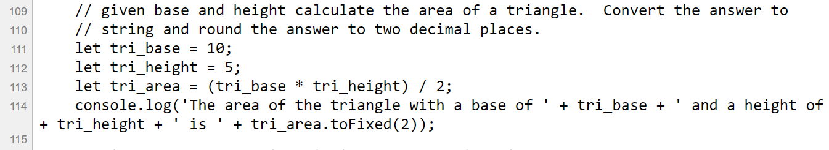
How the JavaScript engine interprets code
First, the code is read into the browser’s memory. Then it starts being interpreted, starting at the top.
Your computer’s memory
This string is written to the console log.
tri_base: 10
‘25.00’
25
tri_height: 5
50
tri_area: 25
‘The area of the triangle with a base of 10 and a height of 5 is 25.00’
Slide 8

Slide 9
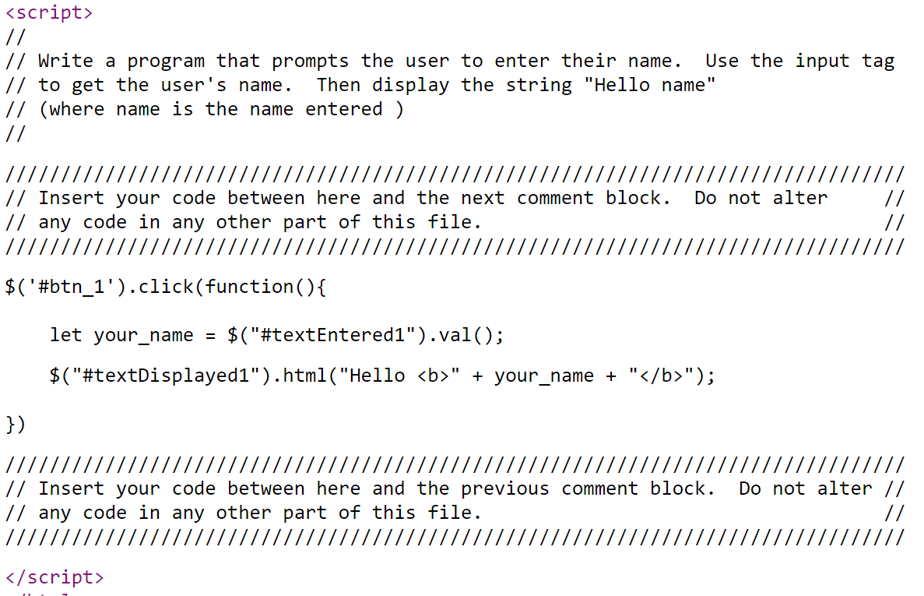
Waiting for something to happen…
Sometimes your code will just sit there and wait for something to happen. Like a button click! This code will sit in your browser’s memory, waiting for a button click.
your_name: ‘Frank’
“Hello <b> Frank </b>”
The result is the “Hello <b>Frank</b>” string being put into the inner HTML of the tag. Now your code is just waiting for the next button click.
Slide 9

Slide 10


What could go wrong? – Two kinds of bugs
Syntax Errors:
Every language has a syntax – a set of rules that define correct usage of the language. When that syntax is broken, you have a “syntax error”.
“Syntax errors: their eazy too spot.
(There a four English syntax errors in the above sentence.)
Logic errors:
Languages express ideas. The syntax of a statement can be correct, but the idea/logic of the statement can be bad. For example:
“This statement is false.”
Slide 10

Slide 11
More examples of logic errors.
“My New Year’s resolution is to not have a New Year’s resolution.”
“Some people enjoy cooking their families and their dogs.”
“To calculate a twenty percent tip at a restaurant, take the total bill and multiply by 20.”
Circular reasoning!
You probably meant: “Some people enjoy cooking, their families, and their dogs.”
You probably meant to multiply by .20. Multiplying by 20 is a huge tip!
Slide 11

Slide 12
Debugging Tips
Check VS Code for live semantic errors
Check the web developer console
  Read all error messages carefully
  Look for line numbers
Add more console.log statements than you need
There’s more… but that’s a good start!
Slide 12

Slide 13

Let’s give it a try…
Slide 13

