Slide 1
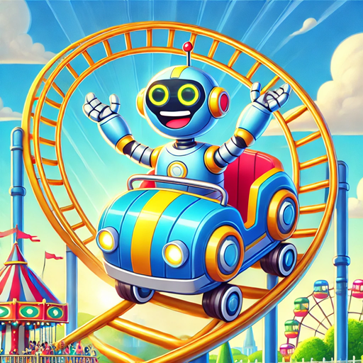
Loops
MIS2402: Web Application Development
Jeremy Shafer
jeremy@temple.edu
https://community.mis.temple.edu/jshafer
The above image was DALL-E, OpenAI, 2024.
Unless otherwise indicated, all other decorative images are by Unknown Author and licensed under CC BY-NC

Slide 2
Today’s Agenda
Discover what loops are, and what they are good for
Learn the syntax of the “for” loop in JavaScript
Observe some animations that illustrate how a “for” loop is processed
Practice writing some simple variations on the “for” loop
Quiz 4
Slide 2

Slide 3
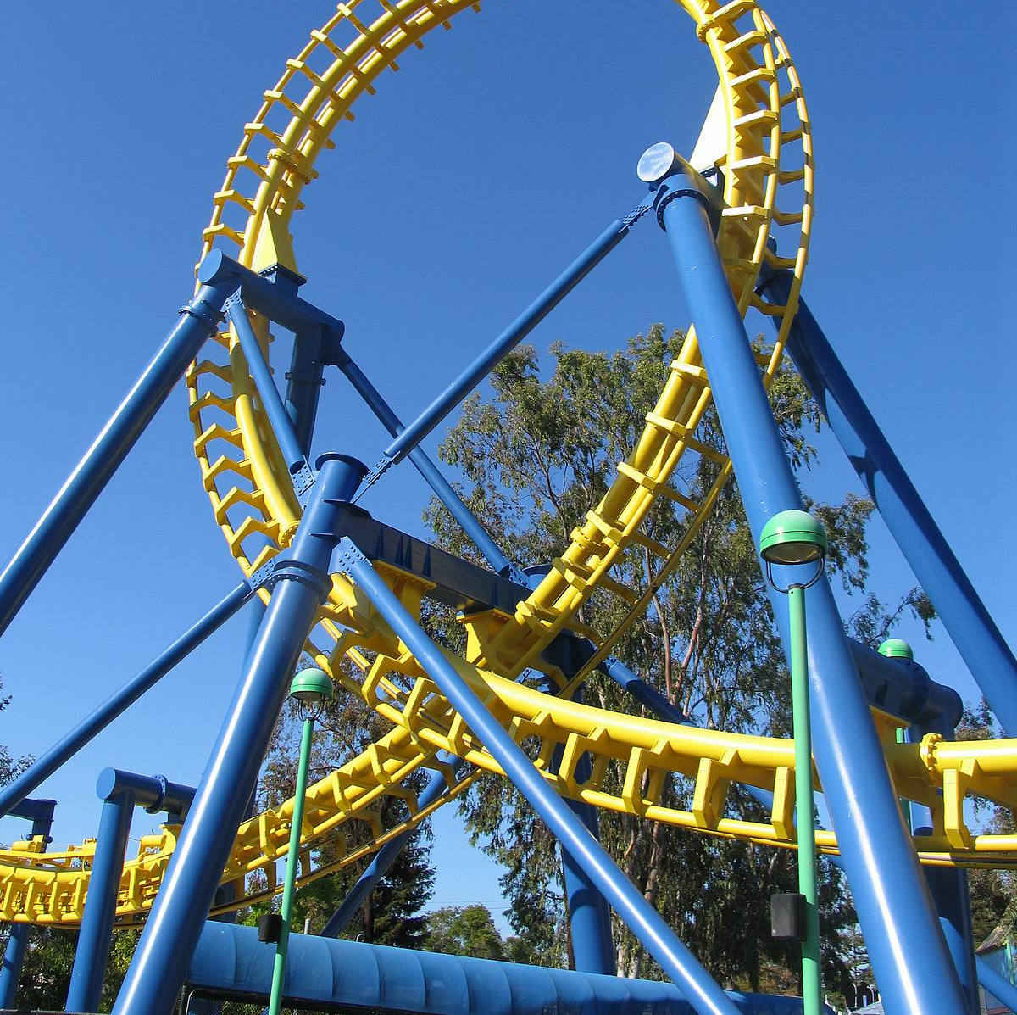
What’s a loop?
In programming, a “loop” is a series of commands (called “a block of code”) that repeats for a specified number of iterations.
It’s a programmatic way of doing the same thing over and over again.
Slide 3

Slide 4

Advisory!
JavaScript supports several different kinds of loop structures.
for
for/in
for/of
while
do/while
All those structures do similar things. In most situations, they are interchangeable!
In this class, we will only use the first one: the “for” loop.
For the new programmer, learning one general purpose loop structure and knowing it well, is better than trying to learn several different structures, each with a slightly different syntax!

Slide 5
The syntax of a JavaScript “for” loop
For example: Write the numbers 1 to 3 to the console.
for (let x = 1; x <= 3; x++) {
console.log(x);
}
x is declared and assigned a value.
The loop continues while this expression is true.
A shorthand way of saying x = x + 1
The code block begins and ends.

Slide 6
Let’s see that with some animation …
The code
The computer’s memory
console.log("Starting");
for (let x = 1; x <= 3; x++) {
console.log(x);
}
x = 1
X 2
X 3
X 4
The console
Starting
1
2
3
This code can be found here https://misdemo.temple.edu/classexamples/loops/loop01.html

Slide 7
Another (simple) example of a “for” loop
This loop adds the numbers from 1 through 3
let sumOfNumbers = 0;
let numberOfLoops = 3;
for ( let counter = 1; counter <= numberOfLoops; counter++ ) {
sumOfNumbers = sumOfNumbers + counter;
}
console.log(sumOfNumbers);
Thinking ahead! We establish
sumOfNumbers here so we can use it later in the loop.
We’re using this variable to control the number of iterations.

Slide 8
Let’s see that with some animation …
The code
The computer’s memory
let sumOfNumbers = 0;
let numberOfLoops = 3;
for (let counter=1;counter <= numberOfLoops; counter++){
sumOfNumbers = sumOfNumbers + counter;
}
console.log(sumOfNumbers);
sumOfNumbers = 0
X 1
X 6
X 3
numberOfLoops=3
counter=1
X 2
X 3
X 4
The console
6
This code can be found here https://misdemo.temple.edu/classexamples/loops/loop02.html

Slide 9
To put it another way…
The loop on the previous page does not add up all the numbers between 1 and 3 in a single step!
Instead, the loop adds up the total, one number at a time. If you ( a human) were given a series of numbers to add up … you would do the same thing!
So.. If you were asked to add 0 + 1 + 2 + 3 you would do something like this:
Step | Notes
1 | 0 + 1 | My total is now 1 because 0 + 1 = 1
2 | 1 + 2 | My total is now 3 because 1 + 2 = 3
3 | 3 + 3 | My total is now 6 because 3 + 3 = 6
6

Slide 10
Another example of a “for” loop
let investment = 10000;
let annualRate = 7.0;
let years = 10;
let futureValue = investment;
for ( let i = 1; i <= years; i++ ) {
futureValue += futureValue * annualRate / 100;
}
console.log(futureValue.toFixed(2)); // displays 19671.51
Other ways that the future value calculation
could be coded inside the code block
//Either of these are good substitutes
futureValue = futureValue + (futureValue * (annualRate / 100));
futureValue = futureValue * (1 + (annualRate / 100))
This code can be found here https://misdemo.temple.edu/classexamples/loops/loop03.html

Slide 11
More examples
Loops can be used to generate repetitive blocks of text.
See https://misdemo.temple.edu/classexamples/loops/loop04.html
Loops can be nested inside other loops
See https://misdemo.temple.edu/classexamples/loops/loop05.html
ALERT! – In that last example we use the jQuery .append() method to add text to a message div tag. Appending text is different from replacing text!

Slide 12
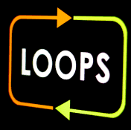
So… what are loops good for?
Performing calculations that require iterations.
-OR-
Generating repetitive text. Sometimes that text is HTML. Tags like these can often be generated with a loop:
    <table> rows
    <select> options
    <ul> items
    <ol> items.
NOTE! Loops are often used in combination with other loops, conditional statements, and functions!
Slide 12

Slide 13
Let’s practice …
In the Chrome console log, write some “for” loops that write the following series to the console log:
1, 2, 3, 4, 5, 6, 7, 8, 9, 10 (the numbers 1 to 10)
10, 9, 8, 7, 6, 5, 4, 3, 2, 1 (the numbers 10 to 1)
5, 10, 15, 20, 25, 30 (the numbers 5 to 30, counting by 5)
12, 10, 8, 6, 4, 2 (the numbers 12 to 2, counting by 2)
This exercise is not very practical! Rarely in coding do you need to count by fives! But it is a good learning exercise because it reinforces your understanding of the basic “for” loop syntax.
for (counter initialization; condition; increment expression ) {
statements
}

Slide 14
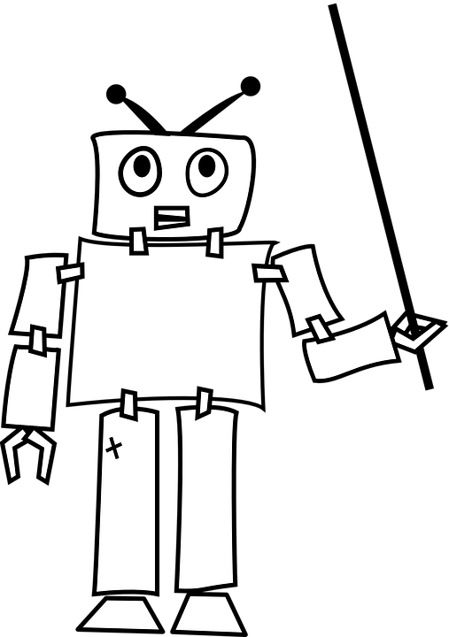
Let’s review
What are 2 things that loops are good for?
What are the three elements that go inside the parenthesis of a JavaScript “for” loop?
What character is used to separate those three elements?
How many lines of code can go in the code block of a JavaScript for loop?
In next week’s quiz, you should be prepared to write simple loops like the ones we just practiced.

