Slide 1

Strings in
JavaScript
MIS2402: Web Application Development
Jeremy Shafer
jeremy@temple.edu
https://community.mis.temple.edu/jshafer
The above image was created by the DALL-E 2 service found at https://openai.com/product/dall-e-2
Unless otherwise indicated, all other decorative images are by Unknown Author and licensed under CC BY-NC

Slide 2
Agenda
Fun fact: This is just a small subset of the string methods available to you in JavaScript. A more complete list can be found here:
https://www.w3schools.com/jsref/jsref_obj_string.asp
Review some “old stuff”
Learn some “new stuff”
  Accessing individual characters
  length
  trim()
  slice()
  substr()
  toUpperCase()
  toLowerCase()
  indexOf()
Slide 2

Slide 3
By the end of this class…
Review the concepts of objects methods and attributes
Understand the length attribute of a string
Become familiar with different techniques for splitting up a string into smaller strings
Be able to write a loop that examines each character in a string

Slide 4
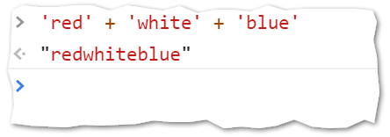
Old stuff
Concatenation… putting strings together.
From the web developer console…
Try it!

Slide 5

New stuff
Strings have one really important attribute (length) and many useful methods. A string is an object.
Ok… that was a little bit of a lie. Technically, a string is not object, it’s a data type. Your textbook explains this fact and related information in considerable detail.
However, the JavaScript language is set up so that you can work with strings “as if” they were objects. And that is how we will think about them.

Slide 6
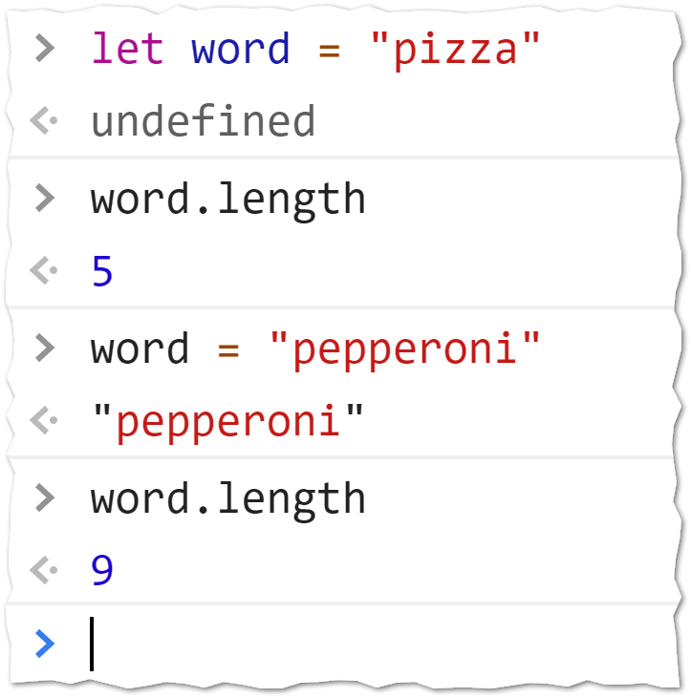
The length attribute
Every variable that is a string has a length attribute.
The length attribute automatically represents the number of characters in the string.
If the contents of the string variable change, the length attribute changes accordingly.
Try it!

Slide 7
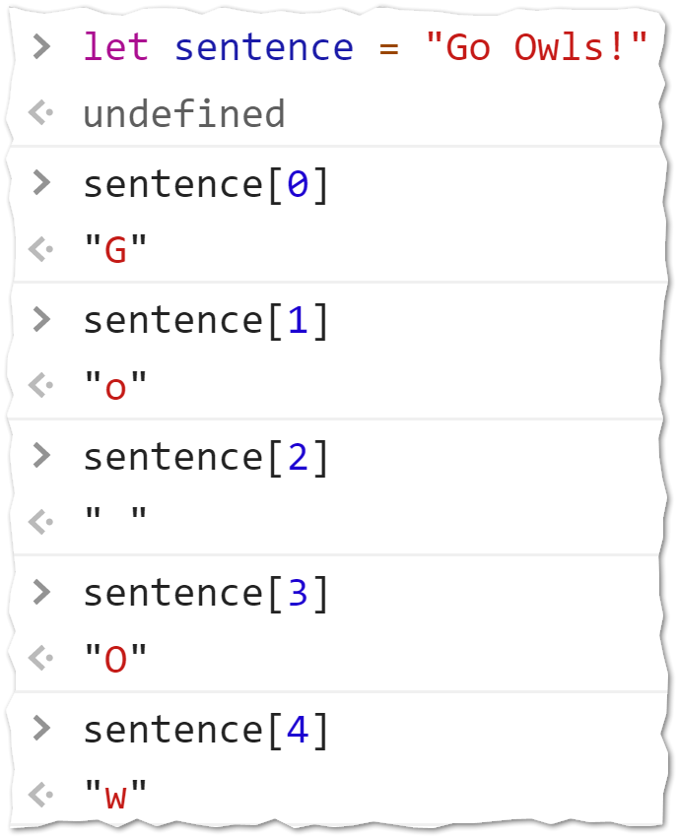
Strings – individual characters
A string can be thought of as a numerically indexed collection of characters.
Each character in the string has a numeric index.
The numbering of the index starts with zero.
To retrieve a character at a location in the string, specify the variable name, and a pair of square brackets. Put the numeric index value inside the square brackets.
Try it!
DISCUSS: Does a blank space " " count as a character?

Slide 8
Write a loop that uses length
Consider the following example. It takes a string of input, and reverses it. For example, if the input is “abcd” then the output would be “dcba”
The computer’s memory
The code
‘Tom’
function reverseString(input){
// The variable output is made to be built
// as the loop iterates.
let output = "";
for(let i = 0; i < input.length; i++){
output = input[i] + output;
}
return output;
}
input = ‘Tom’
0 < 3
1 < 3
3 < 3
2 < 3
X ‘T’
output = ‘’
X X ‘moT’
X ‘oT’
i = 0
X 3
X 1
X 2
‘m’ + ‘oT’
‘T’ + ‘’
‘o’ + ‘T’
‘moT’

Slide 9
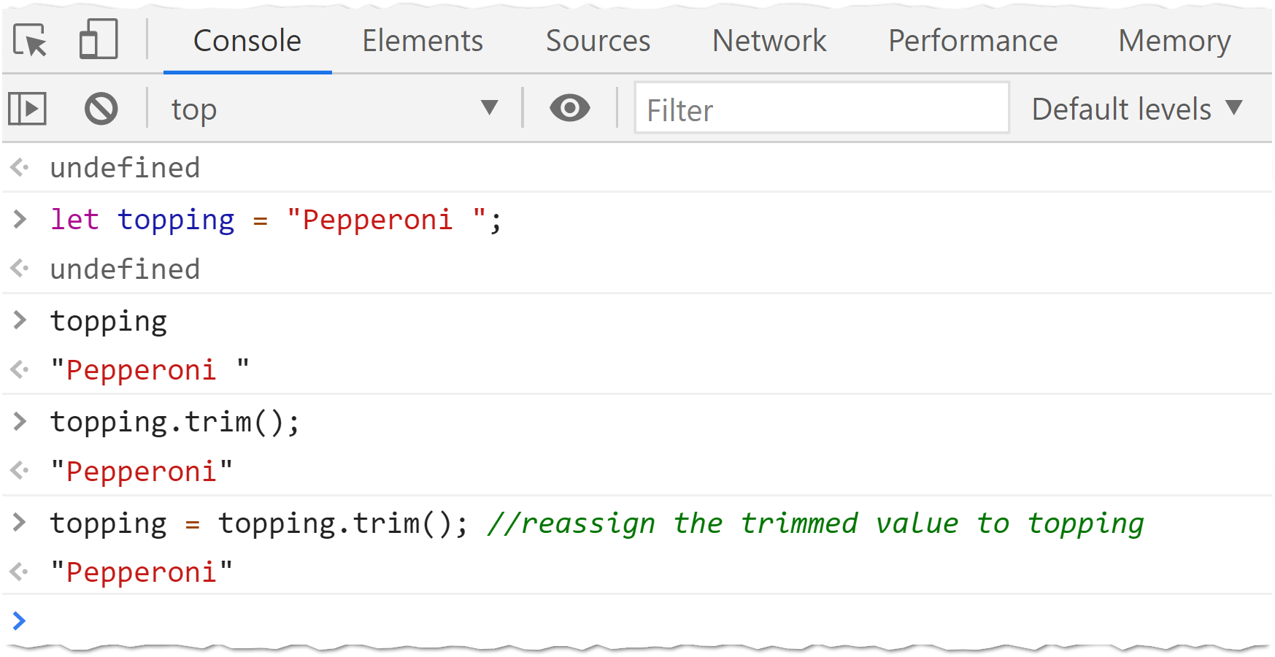
trim()
The trim() method of any string variable can be used to remove any leading or trailing spaces. This method is very handy for cleaning up user input. Try it!

Slide 10
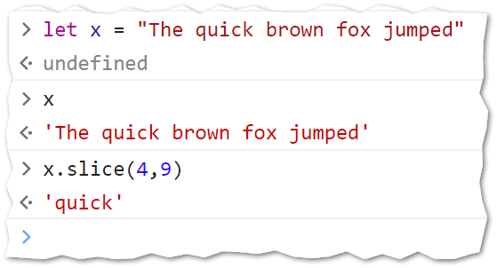
slice()
The slice() method of any string variable can be used to return a portion of a string.
The slice method takes two parameters. The start position and the end position.
The character at the end position is not included in the string.
0 (T)
4 (q)
9 ( )
25 (d)
“The quick brown fox jumped”

Slide 11
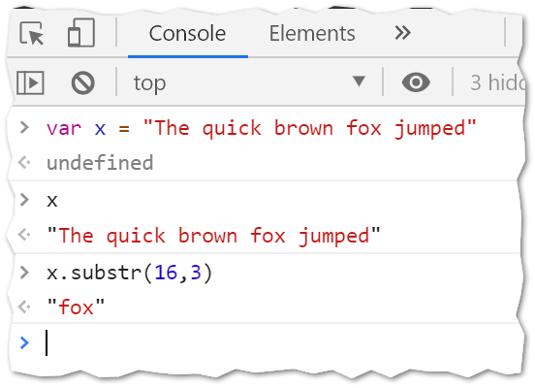

substr()
The substr() method of any string variable can also be used to return a portion of a string. It is a lot like the slice() method!
The substr method takes two parameters. The start position and the length of the desired string segment.
0
25
16
“The quick brown fox jumped”
3

Slide 12
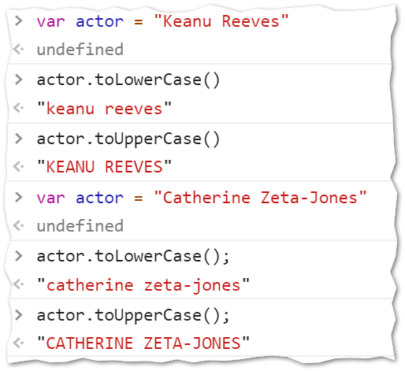

toUpperCase() and toLowerCase()
The toUpperCase() and toLowerCase() methods do exactly what you think they should do. They return all the alphabet characters converted to upper or lower case (and the rest of the non-alphabet characters as they were in the original string!)
These two methods are good for “cleaning up” user input.
Try it!

Slide 13
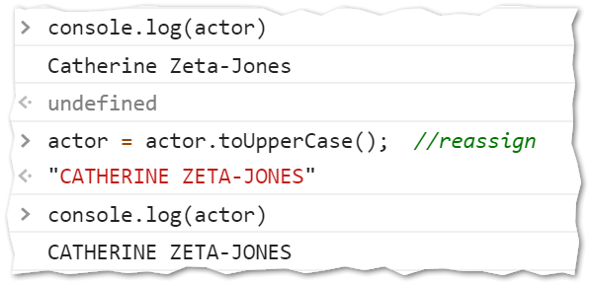
An important clarification
With any of these string methods, keep in mind that they don’t change the original string. As seen in the prior slide, issuing the command actor.toUpperCase() does not change the value held by the actor variable.
If that is what you want to do, you need to reassign the variable with the output of the method. Like this:

Slide 14
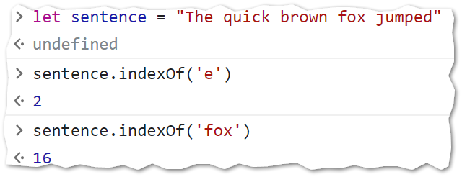
This one is tricky: indexOf
The last string method we will cover is indexOf() and it seems simple enough. But it has something new! It has an optional parameter.
A.indexOf(B) will return the position of the string B inside of A.

Slide 15
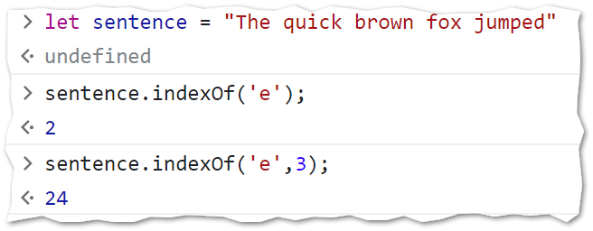
indexOf has an optional parameter
A.indexOf(B,x) will return the position of the string B inside of A with the search starting at position x. This second parameter is optional.

Slide 16
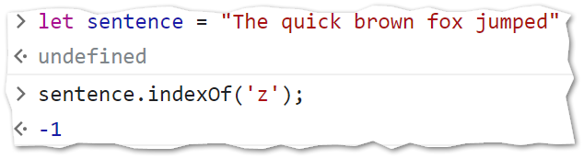
indexOf has a special case
A.indexOf(B) will return the position of the string B inside of A but if B cannot be found in A then the value -1 is returned.

Slide 17
An example
//look carefully!
//The pattern *is* appears
//three times in the following:
// Th*is* *is* a v*is*it
let string = "This is a visit";
let searchFor = "is";
let pos = string.indexOf(searchFor);
let count = 0;
for (count = 0; pos > -1; count++){
pos = pos + 1;
pos = string.indexOf(searchFor,pos);
}
console.log(count); // 3

Slide 18

Now let’s review
The length of a JavaScript string can be best thought of as what? A method? Or an attribute?
What is the length of the string x in the code sample below?
  let x = " A B C "; //notice the spaces
What is the length of the string y in the code sample below?
  let y = " A B C ";
  y = y.trim();
What will be the value of z when the following code completes?
let z = "Hello";
console.log(z.toUpperCase());
What value will be written to the console log when this statement runs?
  let sentence = "Hello World!";
  console.log(sentence.indexOf("e"));
Slide 18

