Slide 1

Arrays in JavaScript
Part 2
MIS2402: Web Application Development
Jeremy Shafer
jeremy@temple.edu
https://community.mis.temple.edu/jshafer
The above image was created by the DALL-E 2 service found at https://openai.com/product/dall-e-2
Unless otherwise indicated, all other decorative images are by Unknown Author and licensed under CC BY-NC

Slide 2
Agenda
Simple Objects / Associative Arrays
2 dimensional arrays
Variations on a theme…

Slide 3
By the end of this class…
Define the term: associatively indexed array
Understand the syntax for expressing simple objects in JavaScript
Be able accurately describe arrays in terms of dimensions (a one-dimensional array, versus a two-dimensional array, etc.)

Slide 4
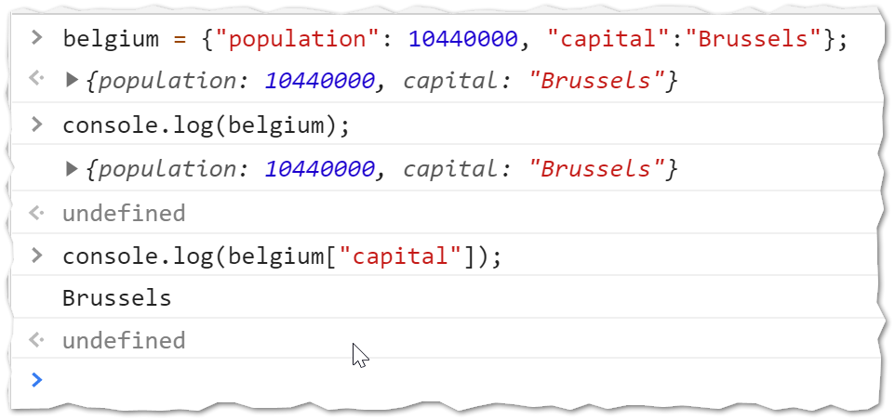
Let’s get started
Open up Chrome
Open up the Developer Tools Console
Type in the following…

Slide 5

What you just did
In the last slide you created a variable called belgium. That variable held multiple values. The variable belgium is an object!
Each attribute of the object is identified by a piece of text. (In this example, “population” and “capital”.)
When we wanted to reference a single piece of data in the variable named belgium, we used the square brackets and the attribute name.
DISCUSS: What does this convention remind you of?

Slide 6

Associative Arrays
When we index an array variable with a number, we call the variable a “numerically indexed” array
When we index a variable with a string, we call the variable an “associatively indexed” array
Technically speaking, the “associatively indexed” arrays in JavaScript are really just simple objects. But, for our purposes, we are going to think of them as if they were arrays with string indices.

Slide 7
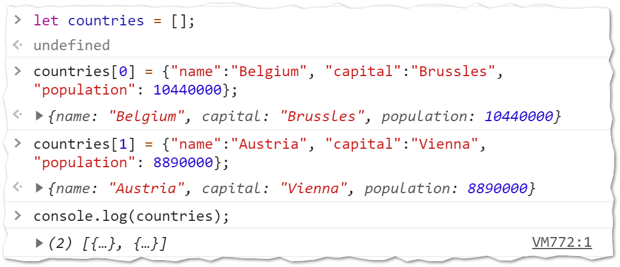
Let’s play some more
When you are done… click on the triangle here!
Notice that we can “drill down” into more detail about the output.

Slide 8

What you just did
In the last slide you saw that a single variable (countries) could hold two country objects.
The first country (element 0) was Belgium.
The second country (element 1) was Austria.
If we want to reference a single piece of data from that variable (for example, “Vienna”) we need two indices. We need the numeric index and the string index.
Try it!

Slide 9
2-dimensional data
This little variable we just created is a 2-dimensional array. It is two dimensional because every piece of data can be located using two keys.

Slide 10
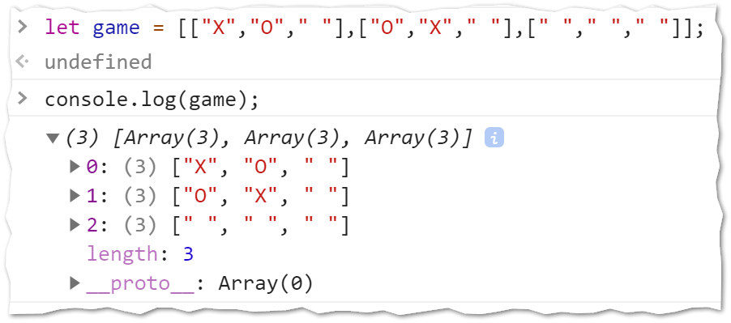
Variations on a theme
There are infinite variations on the nesting of numeric, and associatively indexed arrays. For example, here is a two dimensional, numerically indexed array, that could represent a game of Tic Tac Toe. (Notice that both indices are numeric!)
If you wanted to win the game for X, what indices would you use?

Slide 11
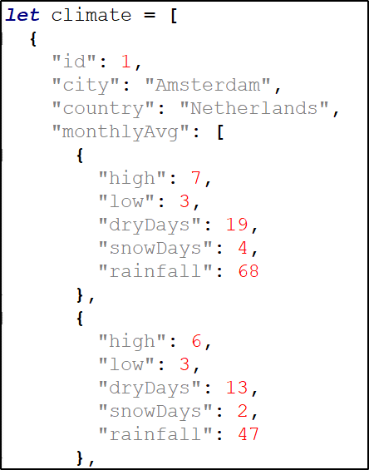
More Variations
We are in no way limited to 2-dimensions. Look here …
If you wanted to use the variable climate and reference the January high temperature in Amsterdam… how many keys would you need?
How many dimensions does this data have?

Slide 12
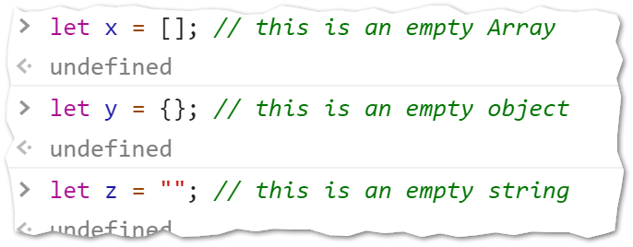
Another note
It’s worth noting that both arrays and objects can be empty.

Slide 13

Think about this…
Look at these options and think about what you have seen so far. One of these options is an invalid definition of JavaScript object.
Which one? Why?
let x = [];
let x = {};
let x = [[]];
let x = [[[]]];
let x = [{}];
let x = {[]};

Slide 14
Let’s review
Here are two variables. let x = []; let y={};
Which one is associatively indexed?
Do associative arrays have a length property? ( And if you are not sure, what’s the fastest way to find out?)
Here is another variable. let z = {"key": 7};
Is z numerically indexed?
Consider this array:
let grid = [ ["A", "B"] , ["C", "D"] ];
Write the statement that will change “C” to “X”.
grid[1][0] = "X";
Notes:
Try the web console! Define an associative array and see if it has a length property

Slide 15

Time for some work…
Notes:
Try the web console! Define an associative array and see if it has a length property

