Slide 1

Arrays in JavaScript
MIS2402: Web Application Development
Jeremy Shafer
jeremy@temple.edu
https://community.mis.temple.edu/jshafer
The above image was created by the DALL-E 2 service found at https://openai.com/product/dall-e-2
Unless otherwise indicated, all other decorative images are by Unknown Author and licensed under CC BY-NC

Slide 2

Agenda
A gentle introduction to arrays
Some practice writing loops that iterate through arrays
  HOT TIP! Arrays are used heavily in MIS3502. So, the time and energy you invest today will pay off in your future.

Slide 3
By the end of this class…
Understand how to declare a simple array.
Define the term: numerically indexed array
Explain the term: zero based
Understand how to reference individual elements of an array one at a time.
Know how to practice creating, manipulating and iterating through arrays using the Chrome Web Developer Console
Understand that JavaScript arrays are a special specific kind of object.

Slide 4
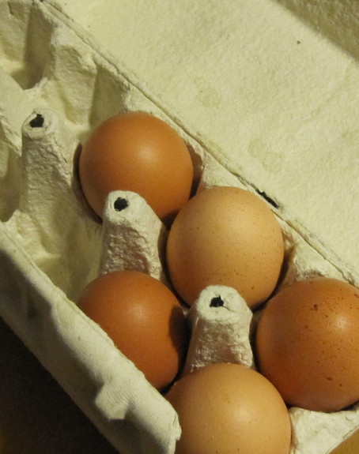
A working definition
Recall that we defined a variable as a named container that holds data.
So far, all our variables have been named containers that hold one single piece of data. That is: a variable X can only hold one piece of data at a time. (One string, one number, one Boolean value, etc.)
An array is a named container that can hold many pieces of data.

Slide 5
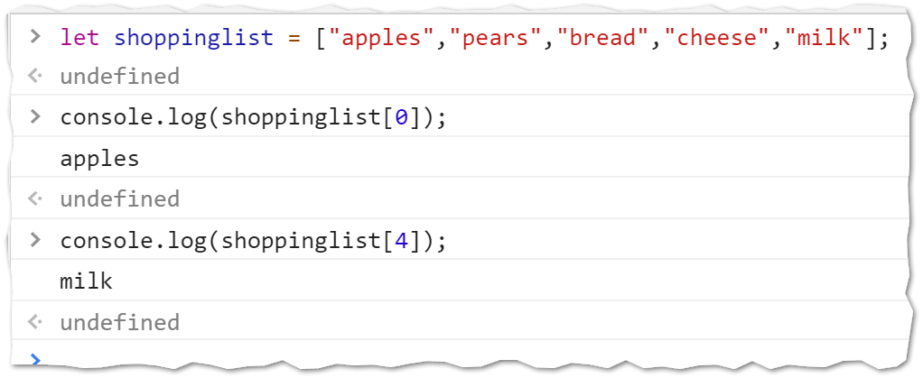
Let’s get started
Open up Chrome
Open up the Developer Tools Console
Type in the following…

Slide 6
What you just did
In the last slide you created a variable called shopping list. That variable held multiple values. The variable shoppinglist is an array!
Each element of the array is identified by a number.
The number 0 is the index to the first element of the array.
So… we just learned that:
  JavaScript allows us to create arrays using the square brackets [ ]
  JavaScript arrays are zero based

Slide 7
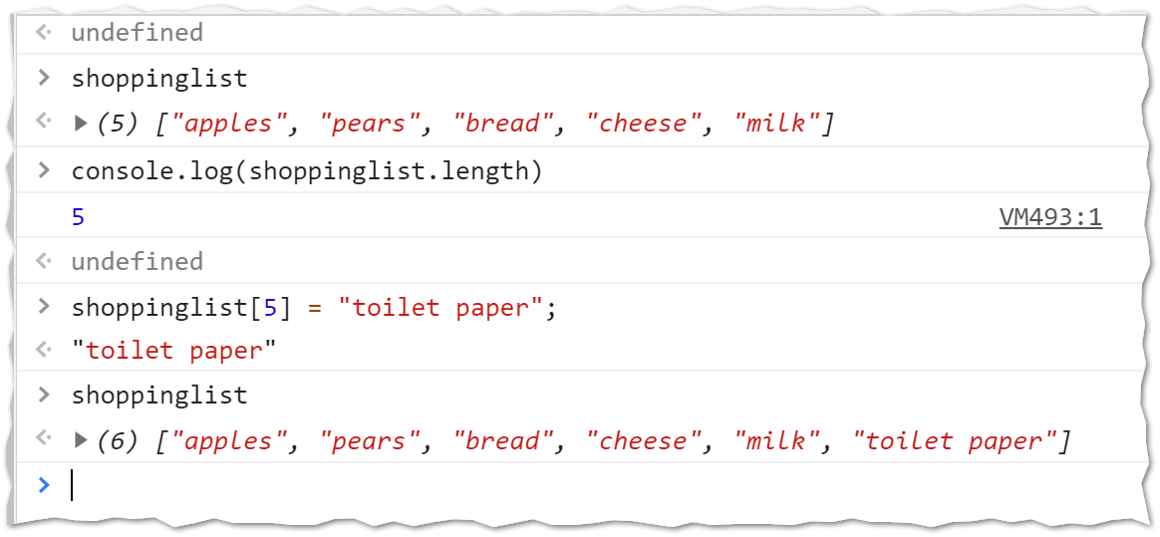
Let’s play some more

Slide 8
What you just did (again)
In the last slide you saw that an array has a length attribute (just like a string does)
You also saw that you could add a new element (in this case, “toilet paper”) on to the end of the array by simply using a new index.
Important
Let’s try something fun… type shoppinglist.sort();
  What did it do?
  Would you describe sort() as a property or a method?
  Sort is a method of instances of the Array object.

Slide 9
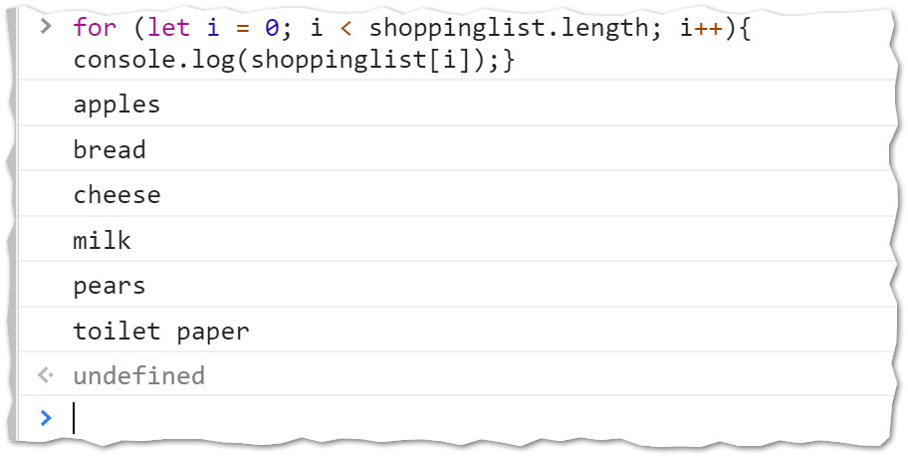
Iterating through an array
Let’s try iterating through an array using a loop.

Slide 10
You can practice this
Open up the Web Developer Console
Define an array of strings: Adam, Barry, Chuck, Dave, Erin, Frank, Glen, Hillary, Irene, Jim
Write loops that print the names in order, in reverse order, and every other name.
Later, in today’s ICA, we will work with an array of numbers.

Slide 11
Now let’s review…
If I have an array named pets, how do I reference the 3rd element of the pets array?
What datatype do we use to index a Simple Array in JavaScript?
What does the term “zero based” mean?
True or False? JavaScript Arrays are Objects.
In this code sample, is 7 an index or an element?
let x = [5,6,7,3,2];
ALERT! On a future quiz you will be asked to write one or more for loops that iterate through an array.
[ ]
Now it’s time for an ICA
Slide 11

