Slide 1

Introduction to JavaScript
(Variables and Simple Math)
MIS2402: Web Application Development
The above image was created by the DALL-E 2 service found at https://openai.com/product/dall-e-2
Unless otherwise indicated, all other decorative images are by Unknown Author and licensed under CC BY-NC
Content created by Jeremy Shafer

Slide 2
Agenda
Examine the role of JavaScript
Discover the developer console in Chrome
Introduce variables, and two simple data types
Putting JavaScript to work doing some simple math
Make output more readable with the parseInt function and the toFixed method
Slide 2

Slide 3
By the end of this class…
Know what a variable is and two basic data types
Know how to “play” with JavaScript using Chrome’s web developer console
Perform simple calculations using JavaScript
Be able to use the parseInt function and the toFixed method
Know what concatenation is, and how it is done in JavaScript

Slide 4
What is JavaScript?
JavaScript is a programming language, created in 1995 by Brendan Eich. He made the original version in just 10 days while working at a company called Netscape.
ECMAScript is the official standard that defines how JavaScript should work.
ECMA stands for: "European Computer Manufacturers Association“
ES6, ES2020, or ES2023 are all versions of the ECMAScript standard.
The name “JavaScript” was originally chosen for marketing purposes because the (completely unrelated) programming language “Java” was popular at the time.
Notes:
It's kind of like: "JavaScript is the dish you eat. ECMAScript is the recipe that tells you how to make it."

Slide 5
What is JavaScript? (continued)
JavaScript is a general-purpose programming language. It is one of the three basic components of a web application.
HTML
CSS
JavaScript
JavaScript is commonly used to manipulate the HTML and CSS in the browser in response to an event.
Today … we are going to just focus on JavaScript itself, separating it from HTML and CSS as much as possible.
Slide 5

Slide 6
Why is JavaScript important?
HTML
(document structure)
JavaScript (logic, calculations, and actions)
CSS (aesthetic appearance)
JavaScript is everywhere! Every device that supports a browser (phones, tablets, laptops, desktops) runs JavaScript.
This makes JavaScript the most widely deployed, and most widely used, programming language on the planet.
To be clear: JavaScript is not the same as Python (another very popular language!)

Slide 7
See the 3 parts in our HTML files…
The <style> tag and related CSS rules are specified inside the <head> tag.
<html>
<head>
<!-- Stuff goes here -->
</head>
<body>
<!-- Stuff goes here -->
</body>
<script>
// Stuff goes here
</script>
</html>
Most html tags go inside the <body> tag.
JavaScript code goes here, inside the <script> tag.
Order matters here! The head tag goes first, followed by body, followed by script. There are acceptable variations on this, but for MIS2402, this is the pattern to follow.
Slide 7

Slide 8
Let’s work with this page:
A simple example
https://misdemo.temple.edu/classexamples/intro.html
Open this link in Chrome (or Edge, or Firefox)
Right click on the page
Choose “View page source”
Slide 8

Slide 9
Before we begin - a quick look at the code
<!DOCTYPE html>
<html>
<head>
<meta charset="utf-8">
<meta name="viewport" content="width=device-width, initial-scale=1">
<!-- Bootstrap 5 CDN -->
<link href="https://cdn.jsdelivr.net/npm/bootstrap@5.2.3/dist/css/bootstrap.min.css" rel="stylesheet">
<script src="https://cdn.jsdelivr.net/npm/bootstrap@5.2.3/dist/js/bootstrap.bundle.min.js"></script>
<!-- jQuery 3.6 CDN -->
<script src="https://ajax.googleapis.com/ajax/libs/jquery/3.6.4/jquery.min.js"></script>
<!-- Font Awesome 5 CDN -->
<link rel="stylesheet" href="https://cdnjs.cloudflare.com/ajax/libs/font-awesome/5.15.4/css/all.min.css">
<title>Simple JavaScript Demo</title>
</head>
<body>
<div class="container">
<p>See the web developer console.</p>
</div>
</body>
<script>
"use strict";
console.log('hello world');
</script>
</html>
The Bootstrap and FontAwesome portions are standard for this class. You don’t need to memorize those!
Slide 9

Slide 10
Let’s zoom in…
<script>
"use strict";
/* some simple examples based on the material covered in class */
console.log("hello world");
</script>
JavaScript is to be written inside the <script> tag.
The “use strict”; line is a best practice. We will talk about that more another day.
Notice the characters used to indicate comments in JavaScript.
/* comment goes here */
DISCUSS: What are comments for?
This is our one line of code
Slide 10
Notes:
Do we all understand what a comment is?
Close the page source tab.

Slide 11
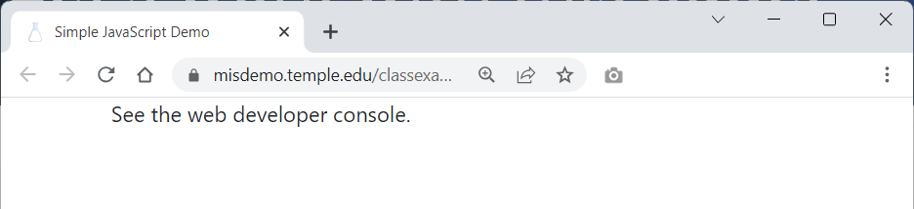
Now look at the developer console
When you view intro.html all you will see is a message that says “See the web developer console.”
Assuming you are using Chrome (and you should be!) click on the three dot icon, “More Tools” and “Developer tools”.
YOU NEED TO KNOW HOW TO DO THIS
Slide 11

Slide 12
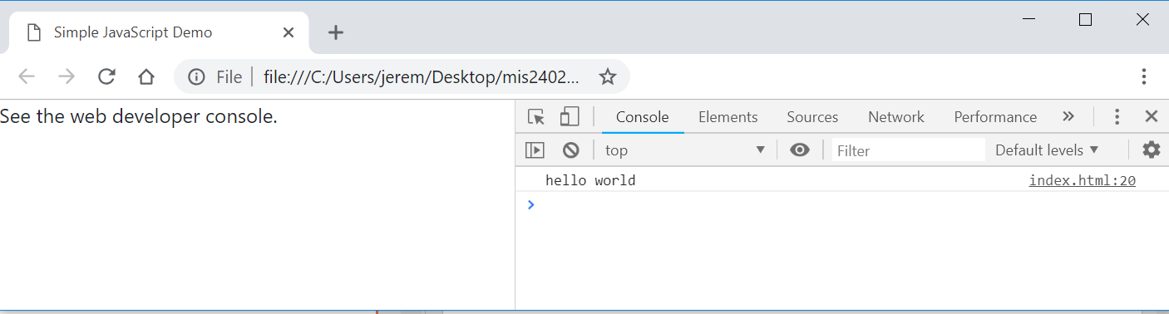
The developer console (2)
The HTML page is all the typical user is going to see.
In the console here we can see a place were JavaScript writes out the text: hello world. This text was generated by the JavaScript command:
console.log(“hello world”);
Writing to the console log is not very useful to anyone but you, the developer. That’s why it is called the developer console. It is, however, an easy place to start!
For the rest of this presentation, we will work in the developer console.

Slide 13
Now try this in the developer console…
DISCUSS
What did console.clear() do?
What character does each JavaScript statement end with?
console.clear();
console.log("hello world");
console.log(10);
The semicolon - Most JavaScript statements end with a semicolon. It is not strictly necessary and often you can get away with omitting the semicolon. But it’s best to keep it in there. Think of it as a “best practice” that makes your code more readable by both machines and your fellow humans.
Data Types - JavaScript supports multiple data types. The two most intuitive data types are string and number. In the statement above what is string data? What is number data? How can you tell the difference?
Slide 13

Slide 14
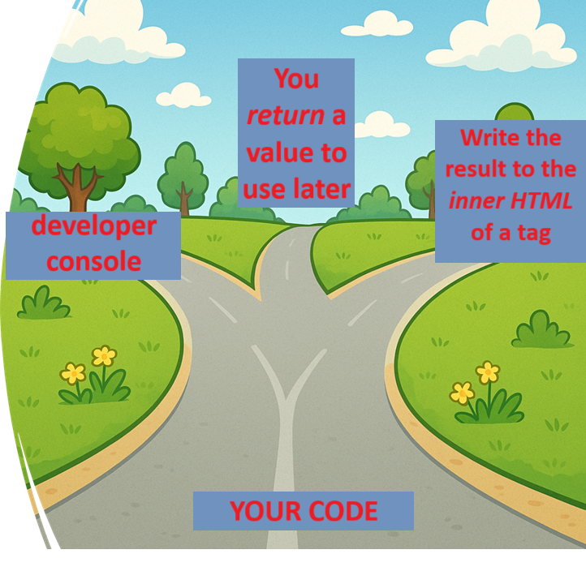
console.log
When we run one or more lines of code, you want some result to be reported somewhere.
This semester your JavaScript code can deliver results to one of three possible destinations.
Pay attention to this, as students sometimes get confused about what their code is supposed to do!
Image generated by OpenAI’s DALL·E, used with ChatGPT.
Notes:
Otherwise, why have any code at all?
Today we are only working in the console log

Slide 15
Humble beginnings…
Let’s type some more code into the console …
A single line comment in JavaScript
Hey look! JavaScript can do math for us!
This is called an expression. That is – we expressed a value (14) as the sum of 10 and 4.
//write an expression to the console
console.log(10 + 4);
//make a variable
let a=42;
console.log(a);
let b=19;
console.log(b);
What we just did here is remarkable! Instead of the literal values 42 and 19, we put those values into something called a variable. The let statement means make a new variable. (Or “let there be a new variable.”)
The variables are a and b. Variables are essential to make a programming language do anything useful!
Slide 15

Slide 16
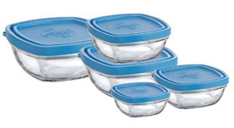
What’s a variable?
In programming, a variable is a named container that holds data. A variable has a name (formally called an identifier) and that identifier can be used to represent a value. So, if my identifier is price then price might have a value of 1.50 ( a dollar and 50 cents) or 30.00 or 1000000 or any other literal value.

Slide 17
What’s declaration? What’s assignment?
Declaration is making a new variable, and assignment is simply the action of putting a value into that variable. Typically, in JavaScript, we do those two actions in a single step.
That’s exactly what we did just two slides ago!
We used the word let to declare a variable.
Then in the same line, we can use the equal sign = to assign a value to the new variable.
//make a variable
let a=42;
console.log(a);
let b=19;
console.log(b);

Slide 18
What’s reassignment?
If a variable already exists, we can simply reassign its value by using the assignment operator again. The assignment operator is = the equal sign.
//reassign the variable a. notice "let" is not needed here
a=10; // the new value 10 overwrites the original value
console.log(a);
//we are doing something sneaky here.
//can you predict the result?
a = a + 1;
console.log(a);
//we will reassign "a" back to its original value
a = 42;

Slide 19
Putting JavaScript to work (simple math)
Here we combine a string with a variable. The result is a new string. This is called concatenation.
//write expressions using variables.
console.log("The value of a is: " + a);
console.log("The value of b is: " + b);
console.log(a + b); //addition (a + b)
console.log(a - b); //subtraction (a - b)
console.log(a * b); //multiplication (a * b)
console.log(a / b); //division (a/b)
Slide 19

Slide 20
Order of operations
a = 10;
b = 2;
//order of precedence
console.log(10 + a / b ); //implicit
console.log(10 + (a / b) ); //explicit
console.log( (10 + a) / b ); //explicit
We already had variables a and b so we are not using let again here. We are just reassigning them.
Discuss - One of these lines results in a different answer. Why?
Slide 20

Slide 21
Working with strings
//how about some strings?
console.log('Fred');
console.log("Velma"); //either single or double quotes is fine
let name_one = 'Shaggy';
let name_two = 'Scooby';
console.log(name_one);
console.log(name_two);
//What happens when you try to add two strings together?
// Think about it - a word like 'Scooby' does not have
// a numeric value so ...
console.log(name_one + name_two);
This is another example of concatenation. The + sign does double duty in JavaScript. It represents both arithmetic addition as well as concatenation.
Slide 21

Slide 22
Now we’re cooking!
// convert feet to inches
let length_in_feet = 6;
let length_in_inches = length_in_feet * 12;
console.log(length_in_feet + " feet is equal to " + length_in_inches + " inches.");
Notice that we used much more meaningful variable names in this example.
We chose length_in_feet and length_in_inches instead of the less obvious names a and b.
That makes our code easier to read!
Slide 22

Slide 23
Best practices for naming variables
Use meaningful names. That way, your identifiers aren’t likely to be reserved words or global properties.
Be consistent: Either use camel casing (taxRate) or underscores (tax_rate) to identify the words within the variables in your scripts or use no word delimiter at all (taxrate).
Use lowercase for all letters unless (of course) you are using camel case.
Don’t start your variable names with a number.
Slide 23

Slide 24
More calculations
// the area of a square
let square_side_length = 123;
let square_area = square_side_length * square_side_length;
console.log('The area of a square with a side length of ' + square_side_length + ' is ' + square_area );
// the perimeter of a square
let square_perimiter = square_side_length * 4;
console.log('The perimeter of a square with a side length of ' + square_side_length + ' is ' + square_perimiter );
Slide 24

Slide 25
Fancier stuff
// fancier stuff - how long is the string?
console.log("How long is the string: " + name_one);
console.log(name_one.length);
// fancier stuff - changing a string to integer
let x = '1812.9';
console.log(parseInt(x));
let y = 'Elephant';
console.log(parseInt(y));
//fancier stuff - converting a number to string
let pi = 3.14159265359;
console.log(pi.toFixed(2)); //what is the 2 for?
Slide 25

Slide 26
Making numbers easier to read
parseInt()
This function converts a value (a string or a number) into an integer (a whole number) removing any decimal precision. The parseInt function does not round. The parseInt function is a function that takes an argument.
Example:
parseInt(42.9); //here 42.9 is the argument and 42 is the returned value
toFixed()
The toFixed method formats a number and returns a string rounded to some number of decimal places. The toFixed method is a method. Notice the subtle difference in syntax here between a method and a function.
Example:
let mynumber = 3.1415; // toFixed will now be a method of the mynumber variable
mynumber.toFixed(2); // here the returned value is the string: "3.14"

Slide 27
Review Questions
What is the primary purpose of JavaScript?
What is the most widely used programming language on the planet? Why?
What is console.log used for?
What is a variable?
In a web page, where does the JavaScript code go?
What will be the value of x? let x = parseInt(9.9999);
What will be the value of y?
let a = 8.88888;
let y = a.toFixed(3);

