Slide 1

Functions
MIS2402: Web Application Development
The above image was created by the DALL-E 2 service found at https://openai.com/product/dall-e-2
Unless otherwise indicated, all other decorative images are by Unknown Author and licensed under CC BY-NC
Content created by Jeremy Shafer

Slide 2
Agenda
Talk about what a function is
Equip you with the ability to define your own functions
Discuss the difference between defining a function and calling a function
Discuss why functions are important
Slide 2

Slide 3
By the end of this class…
Understand why programmers often want to define their own functions.
Be able to define simple functions of your own.
Understand the importance of the return statement.
Mentally picture / visualize how a function is processed.

Slide 4
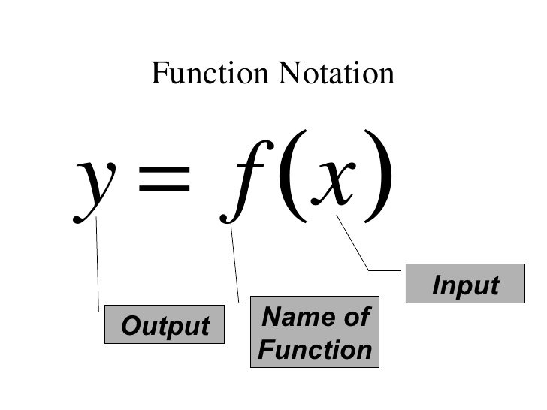
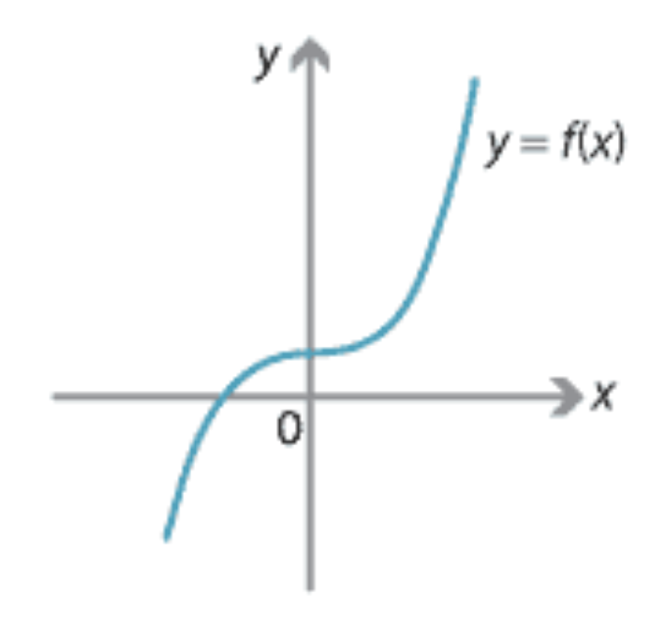
What’s a function in mathematics?
  In mathematics, a function is one or more rules that are applied to an input so that an output can be generated.
  The input is the number or value put into the function.
  The output is the number or value that the function generates.
  In this example, we say that f(x) returns the value of y.

Slide 5
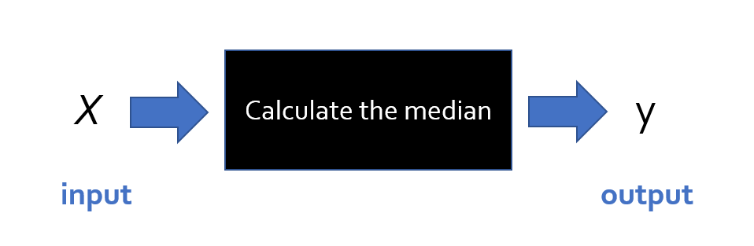
Another example from mathematics
You are probably familiar with the notions of mean, median, and mode.
Think about the steps that you need to take to calculate the median for a set of numbers X.
The set of numbers looks like this: { x₁ , x₂ , x₃ , x₄ … x_{n} }
You can think of a function like a black box. It takes input, something happens inside the box. Then a result comes out the other side of the box!
Mean, median, and mode are all good examples of functions. But median is an extra good example because calculating the median requires more than just a formula!

Slide 6
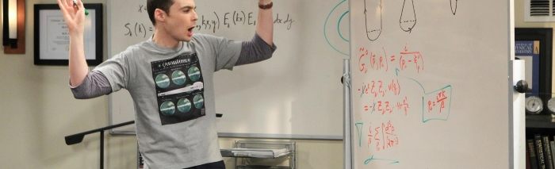
Inside “the box”
Inside the function (that is, “the box”) a mathematician would need to describe the steps (or algorithm) necessary to perform the computation.
Sometimes the operation is so simple, it can be performed with a single formula (mathematicians love it when that happens!)
But when the calculation is not that simple, a mathematician must resort to a series of instructions.

Slide 7
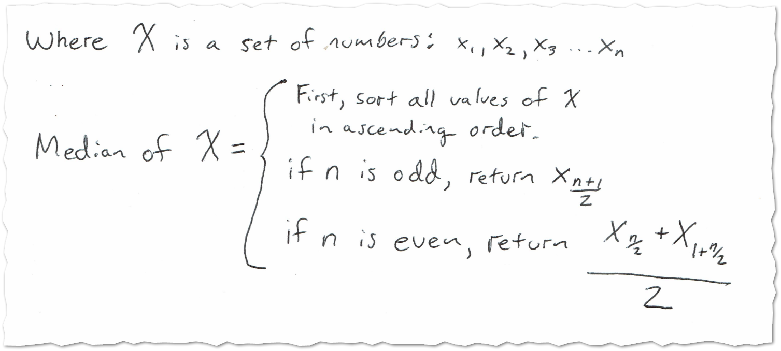
Inside “the box”
To define the median calculation, a mathematician might write something like this …
A programmer might call that pseudo code. It’s not actual code that can be directly run by a computer.
But it is a set of detailed instructions.
The instructions are detailed enough that they could be translated to runnable code in some language (JavaScript, Python, etc.)
Notes:
The point here is that:
The definition of median is a mixture of mathematics, and logical steps.
If you were a statistician, it would be inconvenient to redefine or restate those steps every time you needed them.
It’s a lot easier to refer to a universally agreed on definition of median.

Slide 8
What is a function in programming?
In programming, a function is a collection of statements grouped together in such a way that they can receive zero, one, or more pieces of input. One or more programming statements are then used by the function to generate some output.
Input argument … in this case there’s only one
function convertToCelcius(degrees_fahrenheit){
let the_answer = (degrees_fahrenheit - 32) * ( 5 / 9 );
return the_answer;
}
output
Notice the use of return in the above example. The return command announces that the function is done, and it specifies the value that has been calculated by the function.
Notice also that the curly brackets { } have been used to represent the code block… that is the collection statements that make up the function.

Slide 9
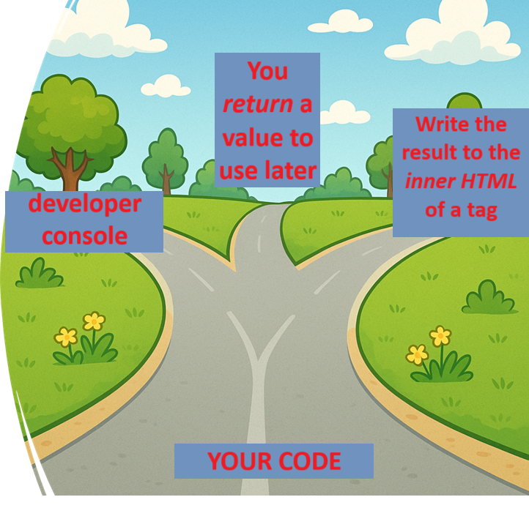
return
Remember this picture?
The function on the last slide did not use console.log
Instead, it used return to send the result of the calculation back.
Back where? Back to where the function was called from.
Image generated by OpenAI’s DALL·E, used with ChatGPT.
Notes:
Otherwise, why have any code at all?
Today we are only working in the console log

Slide 10
Defining and Calling
Let’s take a look at the feet_to_inches function.
function feet_to_inches(HowManyFeet){
let x = HowManyFeet * 12;
return x;
}
What we see above is the JavaScript code that defines the function.
Take a look:
The name of the function is feet_to_inches.
It takes one input … and that input is given then name HowManyFeet
The two lines of code in between the { } define what the function does
Defining a function is different from calling a function. (Just like building a car is different from driving one, and building a chair is different from sitting in it!) We say we are “calling the function” when we use the function.

Slide 11




Calling the function
Here we are calling the feet_to_inches function. Notice that, once it is defined and in the computer’s memory (as on the prior slide) it can be used over and over again with different input values.

Slide 12
Calling the function, assigning the result to a variable
Here we are calling the function, and storing the result in a new variable called y.
Remember this? See the similarities?

Slide 13
Do I have to use return?
In JavaScript, sometimes we don’t worry about what value the function returns. Sometimes we just want to group a bunch of commands together because it is it convenient to do so. In those cases, we leave the return value undefined. For example:
function bottles_of_beer_song(iterations){
for (let i = iterations; i > 0; i--){
console.log(i + ' bottles of beer on the wall, ' );
console.log(i + ' bottles of beer!');
console.log('Take one down, pass it around, ' );
console.log((i - 1) + ' bottles of beer on the wall!');
console.log(' '); //print a blank line
}
}

Slide 14

Let’s look at some examples:
https://misdemo.temple.edu/classexamples/funtimes/fun01.html
https://misdemo.temple.edu/classexamples/funtimes/fun02.html
https://misdemo.temple.edu/classexamples/funtimes/fun03.html
As you review fun01, you can use the Chrome Developer Tools to set breakpoints and step through the code. The two most useful buttons are highlighted below.
This means “step” to the next line of code.
This means finish processing the current function and “step out” of it.
Slide 14

Slide 15
Why would you want to do all this?
Functions in JavaScript (or any other programming language) allow programmers to “divide and conquer”. They provide a mechanism to break large, complicated problems down into a collection of smaller, simpler problems.
Functions allow use assign meaningful names to blocks of code. For example: the name convertFtoC is more memorable than:
y = (x - 32) * (5/9);
Functions help us avoid writing the same sort of code, over and over. Once I write a convertFtoC function, why would I ever write that formula ever again? I shouldn’t have to.
Rewriting the same formula in multiple places is usually a bad idea. For example, if I made a mistake in another portion of the code and use y = x – (32 * 5 / 9) I have created a problem.
Functions allow programmers to solve a tricky problem once, correctly, and then move on to do other things!

Slide 16
Before we begin … Let’s talk about… $
What is that crazy $ thing we saw in fun03?
It was there in our earliest class examples.
let oldtemp = $("#textInput1").val();
let newtemp = convertFtoC(oldtemp);
$('#textDisplayed1').html(newtemp);
What does it all mean?

Slide 17
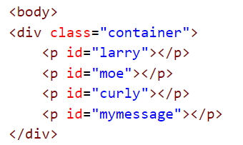
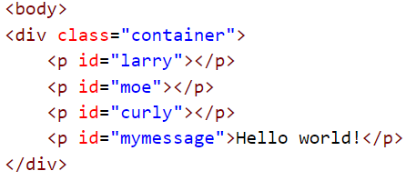
The $ function, explained
OK, it’s time to come clean. The $ function is really at the heart of something called jQuery. Later in the semester we’ll learn more about what jQuery is, and what it can do.
But, for now, think of it this way: the “$” function means “Select”.
So, when we say:
$('#mymessage').html('Hello world!’);
The browser selects the tag with the id “mymessage”
!
Now take action on the tag you found.
We haven’t seen the last of the $ function!

Slide 18
Now let’s review…
Why do programmers use functions?
What 2 characters wrap around a code block?
What 2 characters wrap around a list of parameters?
What is the purpose of the return command?
Must a function always return a value to be useful?
Slide 18

