Slide 1

An Introduction to JavaScript
MIS2402: Web Application Development
Jeremy Shafer
jeremy@temple.edu
https://community.mis.temple.edu/jshafer
The above image was created by the DALL-E 2 service found at https://openai.com/product/dall-e-2
Unless otherwise indicated, all other decorative images are by Unknown Author and licensed under CC BY-NC

Slide 2
Agenda
Review of the role of JavaScript
Revisit the developer console in Chrome
An introduction to variables, and two simple data types
Putting JavaScript to work doing some simple math
Making our output more readable with the parseInt function and the toFixed method
Slide 2

Slide 3
By the end of this class…
Know what a variable is and two basic data types
Know how to “play” with JavaScript using Chrome’s web developer console
Perform simple calculations using JavaScript
Be able to use parseInt and toFixed
Know what concatenation is, and how it is done in JavaScript

Slide 4
Remember this?
HTML
CSS
JavaScript
JavaScript is a general purpose programming language.
It is commonly used to manipulate the HTML and CSS in the browser in response to an event.
But today … we are going to just focus on JavaScript itself, separating it from HTML and CSS as much as possible.
Slide 4

Slide 5
See the 3 parts in our HTML files…
The <style> tag and related CSS rules are specified inside the <head> tag.
<html>
<head>
<!-- Stuff goes here -->
</head>
<body>
<!-- Stuff goes here -->
</body>
<script>
// Stuff goes here
</script>
</html>
Most html tags go inside the <body> tag.
JavaScript code goes here, inside the <script> tag.
Order matters here! The head tag goes first, followed by body, followed by script. There are acceptable variations on this, but for MIS2402, this is the pattern to follow.
Slide 5

Slide 6
Let’s see some examples
Here are some examples that should be familiar to you:
https://misdemo.temple.edu/classexamples/f2c.html
https://misdemo.temple.edu/classexamples/triangle.html
https://misdemo.temple.edu/classexamples/bmicalc.html
Use the “View page source” feature of Chrome to look at each page.
Find the three sections: head, body, and script.
Slide 6

Slide 7
What is JavaScript for?
What is the purpose of code that we find in the <script> tag?
Perform calculations by using variables, expressions, conditional statements, loops and functions.
Wait for events to occur and take actions when they do. (For example: what happens when a button gets clicked?)
Manipulate the HTML tags found in the <body>
This is what JavaScript has been traditionally used for. These are all actions that take place when JavaScript runs inside in a web browser like Chrome.
JavaScript can also run outside the browser, in its own environment called a node. That implementation of JavaScript is called node.js. Node.js is not used in this class but is a major topic in MIS3502.
Slide 7

Slide 8
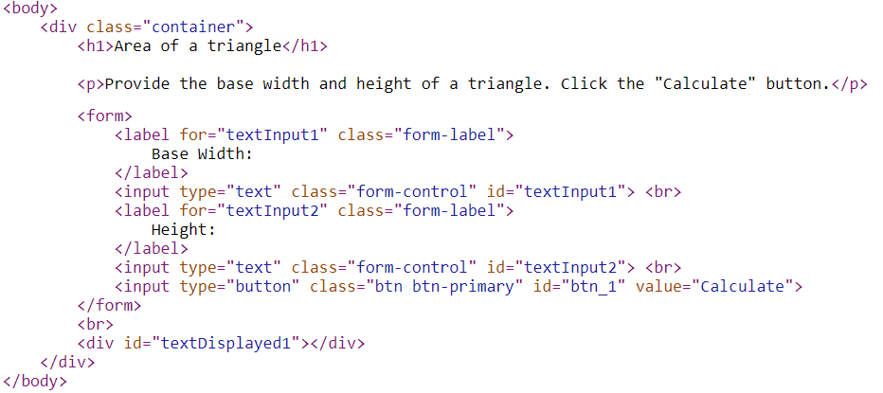
A second look at the <body> tag contents
The <h1> tag here is said to have inner HTML. The text “Area of a triangle” is the inner HTML of the <h1> tag. What other tags have inner HTML?
Is there an HTML tag here that simply cannot have inner HTML? Why?
Some, but not all, of the HTML tags have been assigned attributes. The attributes are highlighted in red. Which attribute do you suppose would be used to uniquely identify a tag?
Using an id (like textDisplayed1) to identify a tag becomes very important when we write JavaScript code. We need to identify a tag before we can manipulate it.
Slide 8

Slide 9
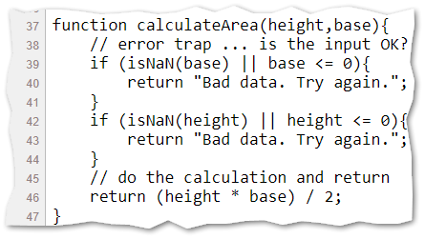
Some more basics
The JavaScript code block: In JavaScript it is often useful to group multiple lines of code together into a sort of bundle called a “code block”. The curly brackets { } are used to indicate where a code block begins and ends.
JavaScript comments: In any programming language, it is often advantageous to add comments – notes to yourself or another programmer. In JavaScript, a pair of forward slashes // are used to indicate the beginning of a single line comment.
As you work on the assignments in this class, always pay attention to the comments provided to you by the instructor.
Slide 9

Slide 10

Let’s work with this page:
https://misdemo.temple.edu/classexamples/intro.html
Slide 10

Slide 11
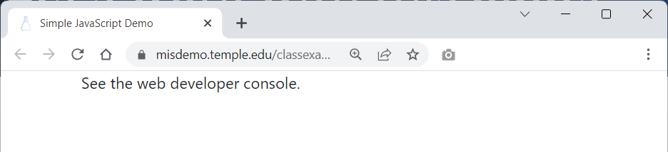
The developer console
When you preview intro.html all you will see is a message that says “See the web developer console.”
Assuming you are using Chrome (and you should be!) click on the three dot icon, “More Tools” and “Developer tools”.
Slide 11

Slide 12
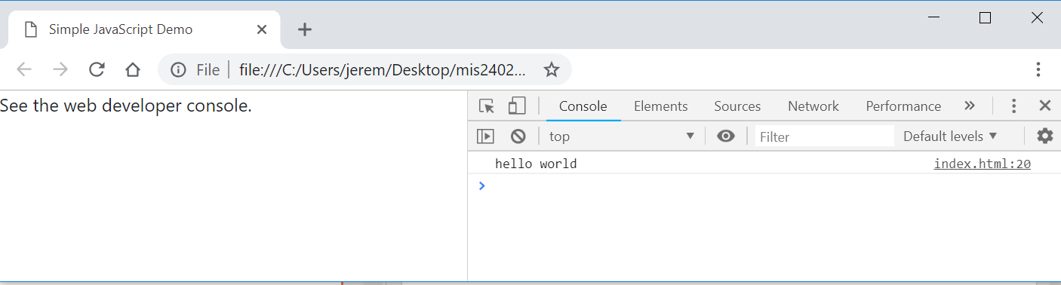
The developer console (2)
We have already started thinking about the HTML that our JavaScript can manipulate…. But not today!
Now we can see a place were JavaScript writes out content: hello world. This text was generated by the JavaScript command:
console.log(“hello world”);

Slide 13
Before we begin - a quick look at the code
<!DOCTYPE html>
<html>
<head>
<meta charset="utf-8">
<meta name="viewport" content="width=device-width, initial-scale=1">
<!-- Bootstrap 5 CDN -->
<link href="https://cdn.jsdelivr.net/npm/bootstrap@5.2.3/dist/css/bootstrap.min.css" rel="stylesheet">
<script src="https://cdn.jsdelivr.net/npm/bootstrap@5.2.3/dist/js/bootstrap.bundle.min.js"></script>
<!-- jQuery 3.6 CDN -->
<script src="https://ajax.googleapis.com/ajax/libs/jquery/3.6.4/jquery.min.js"></script>
<!-- Font Awesome 5 CDN -->
<link rel="stylesheet" href="https://cdnjs.cloudflare.com/ajax/libs/font-awesome/5.15.4/css/all.min.css">
<title>Simple JavaScript Demo</title>
</head>
<body>
<div class="container">
<p>See the web developer console.</p>
</div>
</body>
<script>
"use strict";
console.log('hello world');
</script>
</html>
The Bootstrap and FontAwesome portions are standard for this class. You don’t need to memorize those!
Slide 13

Slide 14
Let’s zoom in…
<script>
"use strict";
/* some simple examples based on the material covered in class */
console.log("hello world");
</script>
JavaScript is to be written inside the <script> tag.
The “use strict”; line is a best practice. We will talk about that more another day.
This is our one line of code
Notice the characters used to indicate comments in JavaScript.
/* comment goes here */
Slide 14

Slide 15
Now try this in the developer console…
DISCUSS
What did console.clear() do?
What character does each JavaScript statement end with?
console.clear();
console.log("hello world");
console.log(10);
The semicolon: Most JavaScript statements end with a semicolon. It is not strictly necessary and often you can get away with omitting the semicolon. But it’s best to keep it in there. Think of it as a “best practice” that makes your code more readable by both machines and your fellow humans.
Data Types: JavaScript supports multiple data types. The two most intuitive data types are string and number. In the statement above what is string data? What is number data? How can you tell the difference?
Slide 15

Slide 16
Humble beginnings…
Let’s type some more code into the console …
A single line comment in JavaScript
Hey look! JavaScript can do math for us!
This is called an expression. That is – we expressed a value (14) as the sum of 10 and 4.
//write an expression to the console
console.log(10 + 4);
//make a variable
let a=42;
console.log(a);
let b=19;
console.log(b);
What we just did here is remarkable! Instead of the literal values 42 and 19, we put those values into something called a variable. The let statement means make a new variable. (Or “let there be a new variable.”)
The variables are a and b. Variables are essential to make a programming language do anything useful!
Slide 16

Slide 17
Putting JavaScript to work (simple math)
Here we combine a string with a variable. The result is a new string.
//write expressions using variables.
console.log("The value of a is: " + a);
console.log("The value of b is: " + b);
console.log(a + b); //addition (a + b)
console.log(a - b); //subtraction (a - b)
console.log(a * b); //multiplication (a * b)
console.log(a / b); //division (a/b)
Slide 17

Slide 18
Order of operations
a = 10;
b = 2;
//order of precedence
console.log(10 + a / b ); //implicit
console.log(10 + (a / b) ); //explicit
console.log( (10 + a) / b ); //explicit
We already had variables a and b so we are not using let again here. We are just reassigning them.
Discuss - One of these lines results in a different answer. Why?
Slide 18

Slide 19
Working with strings
//how about some strings?
console.log('Fred');
console.log("Velma"); //either single or double quotes is fine
let name_one = 'Shaggy';
let name_two = 'Scooby';
console.log(name_one);
console.log(name_two);
//What happens when you try to add two strings together?
// Think about it - a word like 'Scooby' does not have
// a numeric value so ...
console.log(name_one + name_two);
We call this operation concatenation. The + sign does double duty in JavaScript. It represents both arithmetic addition as well as concatenation.
Slide 19

Slide 20
Now we’re cooking!
// convert feet to inches
let length_in_feet = 6;
let length_in_inches = length_in_feet * 12;
console.log(length_in_feet + " feet is equal to " + length_in_inches + " inches.");
Notice that we used much more meaningful variable names in this example.
We chose length_in_feet and length_in_inches instead of the less obvious names a and b.
That makes our code easier to read!
Slide 20

Slide 21
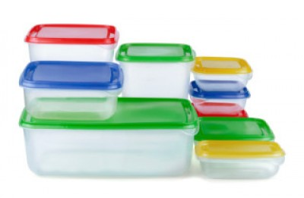
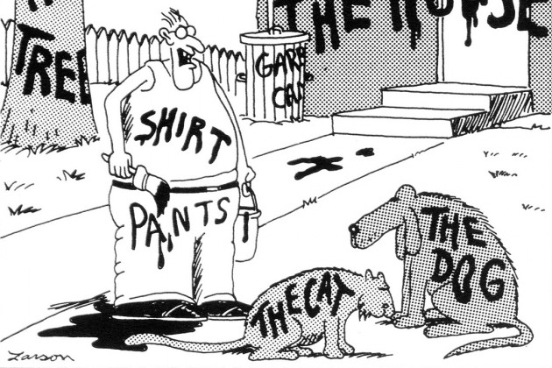
Variables
Slide 21

Slide 22
Rules for naming variables
Variable names are called identifiers.
Identifiers can only contain letters, numbers, the underscore, and the dollar sign.
Identifiers can’t start with a number.
Identifiers are case-sensitive.
Identifiers can be any length.
Identifiers can’t be the same as reserved words.
Avoid using global properties and methods as identifiers.
This means that let and console would be poor variable names!
Some good examples:
subtotal
index_1
$
taxRate
calculate_click
$log

Slide 23
Camel casing versus underscore notation
Camel case notation
theCat
theDog
theHouse
Underscore notation
the_cat
the_dog
the_house
Both are fine…
Slide 23

Slide 24
Naming recommendations for identifiers
Use meaningful names. That way, your identifiers aren’t likely to be reserved words or global properties.
Be consistent: Either use camel casing (taxRate) or underscores (tax_rate) to identify the words within the variables in your scripts.
If you’re using underscore notation, use lowercase for all letters.
Slide 24

Slide 25
More calculations
// the area of a square
let square_side_length = 123;
let square_area = square_side_length * square_side_length;
console.log('The area of a square with a side length of ' + square_side_length + ' is ' + square_area );
// the perimeter of a square
let square_perimiter = square_side_length * 4;
console.log('The perimeter of a square with a side length of ' + square_side_length + ' is ' + square_perimiter );
Slide 25

Slide 26
Fancier stuff
// fancier stuff - how long is the string?
console.log("How long is the string: " + name_one);
console.log(name_one.length);
// fancier stuff - changing a string to integer
let x = '1812.9';
console.log(parseInt(x));
let y = 'Elephant';
console.log(parseInt(y));
//fancier stuff - converting a number to string
let pi = 3.14159265359;
console.log(pi.toFixed(2));
Slide 26

Slide 27

Now let’s review…
Which of the following are domain specific languages: HTML, CSS, JavaScript
Describe some things you can do with JavaScript.
What symbol is used to assign a value to a variable?
What operator is used for concatenation? Is that same operator used for something else too?
What two data types have we seen so far?
How do you open the web developer console in Chrome?
What are some differences between parseInt and toFixed?
Are students expected to memorize the contents of the <head> tag?
What’s an example of an invalid JavaScript variable name?
OK… time for quiz 1!
Slide 27

