Slide 1
Scope in JavaScript
MIS2402: Web Application Development
Jeremy Shafer
jeremy@temple.edu
https://community.mis.temple.edu/jshafer
The above image was created by the DALL-E 2 service found at https://openai.com/product/dall-e-2 Unless otherwise indicated, all other decorative images are by Unknown Author and licensed under CC BY-NC

Slide 2
Agenda
The JavaScript keywords var, let, and const
The concept of scope defined and illustrated
Wrap up & Quiz
Bonus/optional content: At the end of this presentation there is an optional challenge. Students who wish that they could *somehow* get better at solving problems independently are encouraged to give this optional challenge a try.

Slide 3
By the end of this class…
Understand what is meant by the term “Scope”
Understand the differences between var, let, and const in JavaScript
Understand the term “block scope”

Slide 4
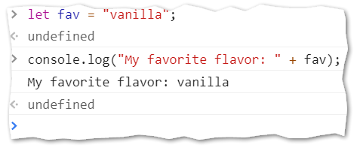
What we have already seen…
Declaring a variable with let
From the web developer console…
Try it!

Slide 5
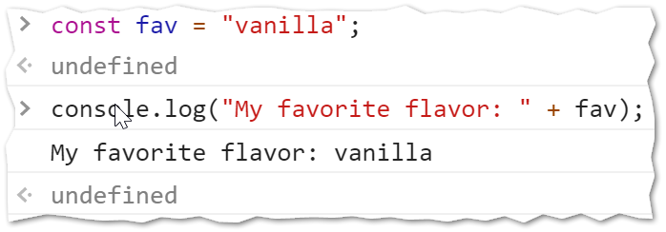
New stuff!
JavaScript gives us two other ways to put a piece of data into the computer’s memory.
JavaScript allows us to define a constant using const
Try this!
Slide 5

Slide 6
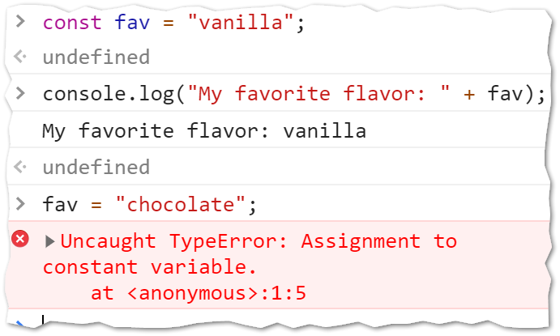
What makes const different?
Once you declare a variable using const you are prevented from changing its value. You are also prevented from changing it…
Try it!
Slide 6

Slide 7
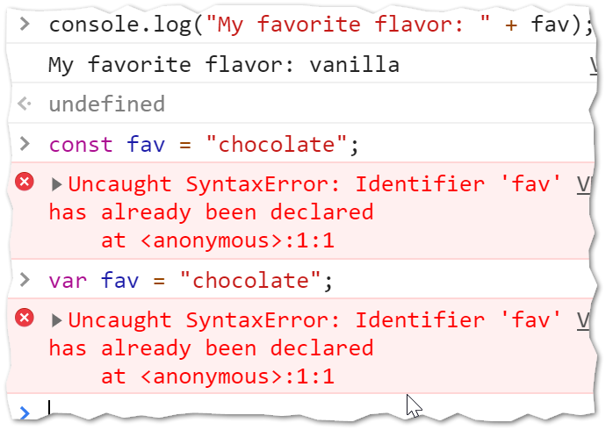
More about const
You are also prevented from declaring it again!
The only way to change the value stored in const is to refresh the whole page.
Try it!
Slide 7

Slide 8
Using const in code (a practical example)
Typically, we define a constant to control some piece of data in our code that does not change often but is referenced in many places.
Suppose you have an estimated rate of growth for an investment. The estimate only changes once a year, and it is used in several functions. Also, you don’t want to allow a user to edit that value!
See futurevalue.zip
Slide 8

Slide 9
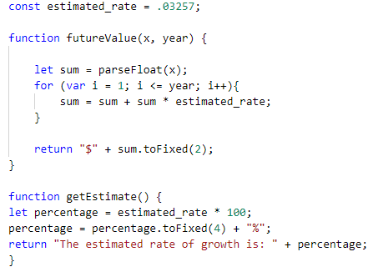
Take note…
In our example here, estimated_rate is declared outside of all the functions. It is then used inside all the functions that are below it.
Some important remarks follow…
Slide 9

Slide 10
Global Scope
In the prior slide, the constant estimated_rate, was declared outside all the functions. A constant or a variable declared in that position is said to have global scope. That is, it is available everywhere in the code.
Slide 10

Slide 11
Global Scope and Constants
There’s no rule that says constants must be defined at the global level.
However… declaring a constant at the global level usually makes sense. Constants represent important facts, that don’t change often. Consequently, you probably want to use such an important piece of data globally!
There’s no rule that says that declarations at the global level must be constants. (You can declare global variables with var or let.)
However… declaring a variable at the global level is usually bad. It is much better to pass data into and out of functions using parameters and return. (Just like we’ve been doing all semester long!)
Slide 11

Slide 12
Notes about var and let
You may have also noticed that we are using both var and let in the example.
At first glance you might think that var is just another way to declare a variable.
That’s true! But there is an important difference between var and let.
Slide 12

Slide 13
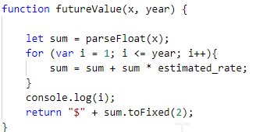
Try this:
Add a console.log(i) to line 53 in the futureValue function.
Run the code and see what happens…
Slide 13

Slide 14
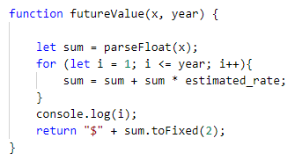
Now try this:
Change line 50 to use let instead of var.
Run the code and see what happens…
Slide 14

Slide 15
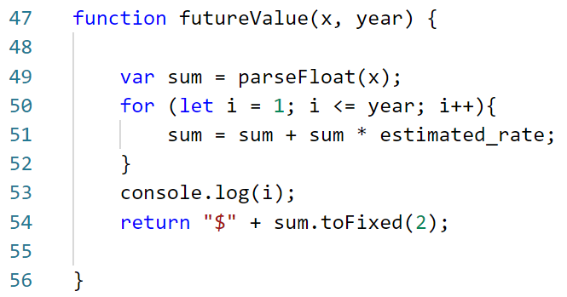
Why did let fail?
The reason let failed was because let defines variables with block level scope. The block is defined by the opening and closing curly braces { }. The variable i exists inside that block (including any more blocks that might be nested inside it.)
Therefore… the variable i does not exist outside the block on line 53!
Slide 15

Slide 16
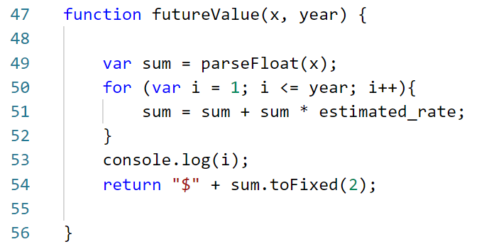
Why did var work?
The reason var worked was because var defines variables with function level scope. Any variable defined with var exists everywhere inside the current function.
From line 49 onward sum is defined
From line 50 onward i is defined
Slide 16

Slide 17
Preferences (1)
Even though using let might seem a little more restrictive, it really is preferred. The let and const options first became a standard part of the JavaScript language 2015 … and it has taken years for them to be fully embraced.
This course uses let for most variable declarations. This is in keeping with the second edition of your textbook, but not the first edition!
Slide 17

Slide 18
Preferences (2)
In most situations, let can be used in place of var without consequence. This is especially true if you develop the habit of declaring the variables you need at the beginning of a function and avoid declaring variables haphazardly in the middle of your code!
Slide 18

Slide 19
Now let’s review…
What is block level scope?
Which of the following keywords will define a variable with block level scope? var, l et, const
Which of the following keywords can often ( but not always ) be used interchangeably? var, let, const
Under what circumstances would you want to use the const keyword?
Now it’s time for a quiz
Slide 19

Slide 20
On your own (optional)
Outside of class… and not for a grade… solve this problem using JavaScript.
The first six prime numbers are: 2, 3, 5, 7, 11, and 13
Note that the 6th prime is 13.
So, what is the 10,001st prime number?
THIS IS JUST PRACTICE (YOU DON’T NECESSARILY NEED TODAY’S SCOPE MATERIAL TO SOLVE THIS PROBLEM)
Slide 20

