Slide 1

jQuery, Ajax, and JSON
(oh, my!)
MIS2402: Web Application Development
Jeremy Shafer
jeremy@temple.edu
https://community.mis.temple.edu/jshafer
The above image was created by the DALL-E 2 service found at https://openai.com/product/dall-e-2
Unless otherwise indicated, all other decorative images are by Unknown Author and licensed under CC BY-NC

Slide 2
Agenda
What is jQuery again?
What is JSON?
What is Ajax?
$.getJSON - One technique for making an Ajax call

Slide 3
By the end of this class…
Recognize the syntax of 2-dimensional JSON data.
Understand and describe what an Ajax call is.
Know which of several possible jQuery methods we will use in this class.

Slide 4
Let’s remember… jQuery
jQuery is a library.
“The jQuery library is a collection of JavaScript functions that are professionally developed and free for use. They are meant to help you do common tasks more simply.”
We introduced a few jQuery methods early in the semester and we have been quietly using them all semester long.
.html()
.val()
.append()
Discuss: What do each of the above do?

Slide 5

JSON
JSON is a data format.
Most of you have already encountered JSON in another course, MIS2502 Data Analytics.
JSON is short for JavaScript Object Notation.
JSON is the convention for representing arrays and simple objects in JavaScript.
[ ] for numerically indexed arrays
{ } for simple objects (a.k.a. associative arrays, a.k.a key / value pairs )
JSON is an extremely popular data
format used to exchange data between systems.
It is pronounced “Jay - Sawn” not “Jason”

Slide 6
What does JSON look like?
A JSON object often looks like a collection of key/value pairs as illustrated here:
[{
"KEY" : "VALUE",
"KEY" : "VALUE",
"KEY" : "VALUE"
}]
There are many acceptable variations on this theme, but this is common!

Slide 7
For example:
let people = [{
"NameOfInsured" : "Jeremy Shafer",
"Spouse" : "Kimberly Shafer",
"Dependents" : ["Amanda","Tyler","Jordan"]
},
{…},
{…}
]
DISCUSS: How would you get to the piece of data “Tyler”?
people[0][“Dependents”][1]

Slide 8
Ok, so what’s Ajax?
AJAX is short for Asynchronous JavaScript and XML
It is the combination of these technologies, not a separate technology in itself

Slide 9
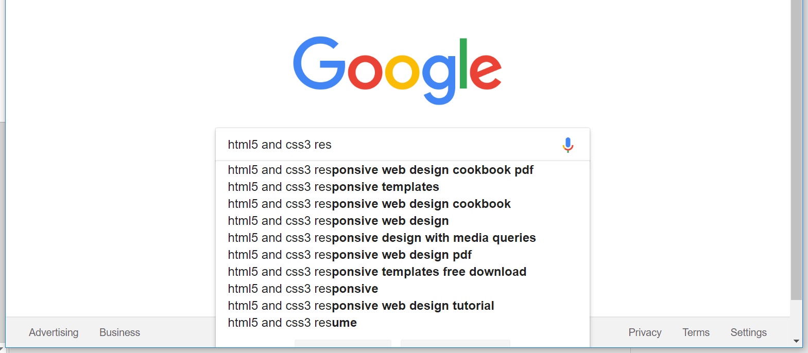
Google’s Auto Suggest is an Ajax application

Slide 10
AJAX uses JavaScript to call resources
Web server
HTTP Request
Browser
JavaScript Engine
The data we asked for.
Database
The format of the data might be JSON, or XML, or CSV, or something else.
No matter what the format is, this is still and Ajax request.

Slide 11
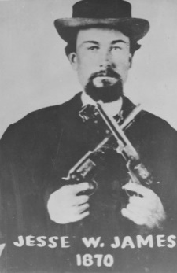
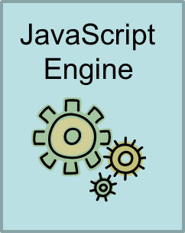
A little Ajax history
Not this Jesse James! ☺
The term "Ajax" was publicly stated on 18 February 2005 by Jesse James Garrett in an article titled "Ajax: A New Approach to Web Applications", based on techniques used on Google pages.
This object acts like a browser, inside the browser. The object is used to retrieve a web resource.
XMLHttpRequest()

Slide 12
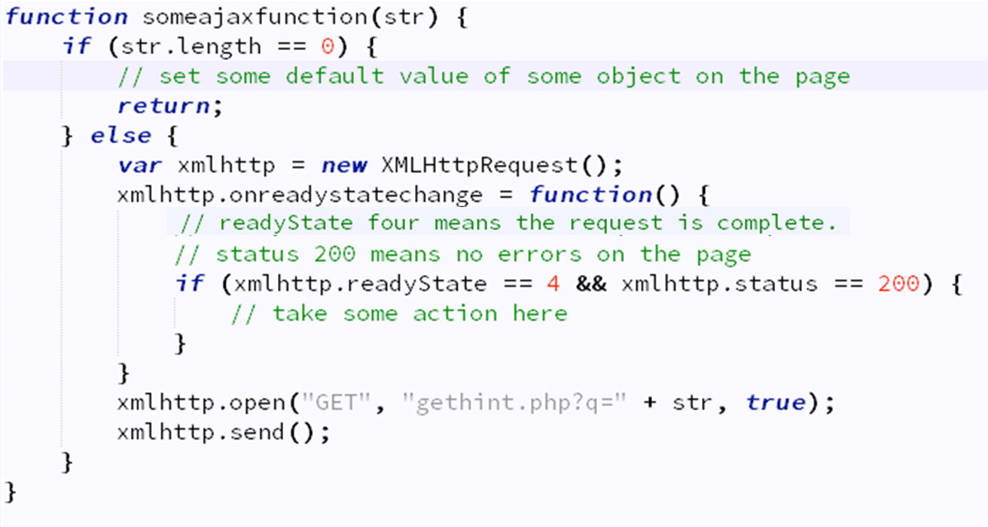
You can make Ajax calls with nothing but JavaScript
Yuck! ☹

Slide 13
Or… using jQuery
There’s actually a piece here that we’re intentionally leaving out for now. We would use an optional parameter here to send data to someurl
Yes, there really is a dot here.
$.getJSON(someurl, function(result) { some things to do })
There are other jQuery methods used to do make Ajax calls:
.ajax() .load()
.get() .post()
A list of jQuery Ajax methods can be found here:
https://www.w3schools.com/jquery/jquery_ref_ajax.asp
This piece is called “the callback function”.
It is the function, that runs, when the call to someurl comes back.

Slide 14
One more time…
This is the callback function that will execute when the Ajax call is a success.
$.getJSON(someurl, function(result) { some things to do});
The URL to visit
Result is the simple object returned by the getJSON method.
One or more commands.
I can use the data in result here!

Slide 15


Concluding Thoughts
CDN
(jQuery)
Web API
Web Server
CDN
(Bootstrap)
CDN
(other ?)
Web API

Slide 16
Let’s review
What is JSON short for?
What is Ajax?
What is the purpose of jQuery?
Do I need jQuery to make an Ajax call?
What is a callback function?
Which jQuery method will we use in this class to make Ajax calls?
Notes:
Try the web console! Define an associative array and see if it has a length property

Slide 17

Time for some work…
Notes:
Try the web console! Define an associative array and see if it has a length property

