Slide 1

Ajax:
GET versus POST
MIS2402: Web Application Development
Jeremy Shafer
jeremy@temple.edu
https://community.mis.temple.edu/jshafer
The above image was created by the DALL-E 2 service found at https://openai.com/product/dall-e-2
Unless otherwise indicated, all other decorative images are by Unknown Author and licensed under CC BY-NC

Slide 2
Agenda
Explore how we can send data to an API
Look at the most popular convention(s) for interacting with an API
A “best practice” for students in this class
Learn by doing

Slide 3
By the end of this class…
Know what URL encoded data is
Know what the word serialization means
Be able to use the jQuery $.post method
Be able to explain the difference between GET and POST

Slide 4
Let’s remember… jQuery’s getJSON method
jQuery is a library.
“The jQuery library is a collection of JavaScript functions that are professionally developed and free for use. They are meant to help you do common tasks more simply.”
$.getJSON is a method of the jQuery object.
Discuss: What does the $.getJSON method allow us to do?
What is Ajax short for?

Slide 5
AJAX uses JavaScript to call resources
Web server
HTTP Request
Browser
JavaScript Engine
The data we asked for.
Database
The format of the data might be JSON, or XML, or CSV, or something else.
No matter what the format is, this is still an Ajax request.

Slide 6
HTTP requests have different methods
HTTP methods you need to know in MIS2402:
GET – Use this to read / retrieve data
POST – Use this to send / store data
Other common methods:
PUT – Use this completely replace an existing data item
PATCH – Use this to update one specific piece of an existing item
DELETE – Use this to destroy / remove an item
And there are more…

Slide 7
Watch out! One word, two meanings!
We are using the word “method” here in a new / different way.
An HTTP method is a kind of communication.
The method of an object is used to call some kind of functionality (that is, do take some action.)
The same word (method) has different meaning, depending on the context.

Slide 8

Today we’re going to write code that sends a text message to your phone
I don’t know how to do that!
Wait, what?
Yes, yes you do. What you already know…
HTML / CSS
JavaScript/jQuery
How to get JSON data with $.getJSON
What don’t know yet…
How to send data with $.post()
But we can fix that!

Slide 9
The jQuery post method…
This is the callback function that will execute when the Ajax call is a success.
The URL to visit
$.post(someurl, datatosend, function(result) { things to do});
The data to send
The object returned by the post method.
One or more commands.
The data in result can be used here!

Slide 10
Conventional use of GET and POST
As we’ve already seen, HTTP GET is usually used to retrieve data.
We need the jQuery $.post method because HTTP POST operations are used to send or create data to a system.
We will create our text messages using HTTP POST.
Web server
Browser
HTTP POST method
is used to send (or create) data
JavaScript Engine
HTTP GET method
is used to retrieve data
Database

Slide 11
What’s the plan?
For this class, we have an external that can be used to send a text message. It is called Textbelt. See: https://misdemo.temple.edu/textbelt
We will make an HTML form that holds these things:
  The phone number we want to send a message to
  The text message we want to send
  Hidden fields that hold your misdemo username and password
  A button to initiate the action
Initially we will use the free / demo API key that textbelt gives us.
We will collect all the data on the form, get it ready, and send it to the API. This is “getting ready” process involves something called serialization.
Once we are satisfied that this works, we will use a real API key.

Slide 12
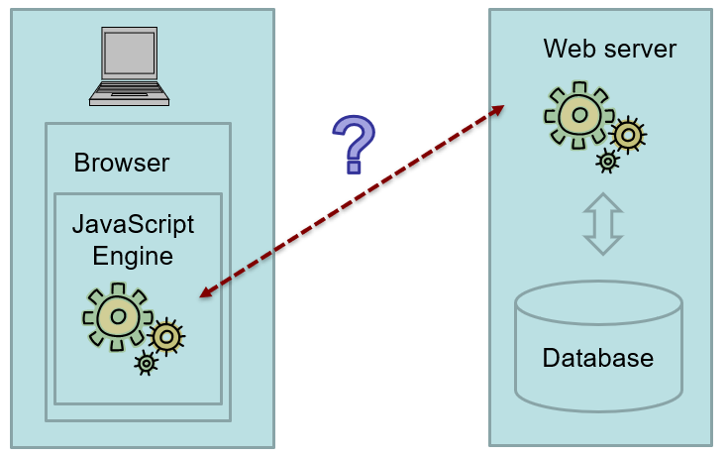

Data Serialization
Data serialization is the process of translating structured data into a format that can be stored or transmitted in one computer environment, and then later reconstructed in another computer environment.
URL Encoded data is often used to send a data request.
JSON is often used to provide a server’s response.
Both JSON and URL encoded data are forms of serialized data.
Let’s see some serialized data.
(demo_sms.zip)

Slide 13
What does URL encoded data look like?
phone=2155551212&message=test
These are key/value pairs, separated by ampersands.
This is an example of URL encoded data.
Data requests are often sent in this manner.
In this class we will follow this pattern … send a data request as URL Encoded data and get a JSON response back.

Slide 14

Another difference between GET and POST
GET
The GET method transmits data in the query string portion of a URL:
https://www.google.com/search?q=piano+cat
POST
The POST method transmits data in the body of the HTTP request. This means that data, sent by POST, is not cached in the browser or easily observed by the user.
key=textbelt&phone=2155551212&message=test

Slide 15
BEST PRACTICES
Send data using URL encoded data (if the API permits it)
Receive data as JSON (if the API permits it)
Use console.log to examine the data you are sending
Use console.log to examine the results you get back

Slide 16


What’s the point?
API for SMS
(textbelt)
CDN
(jQuery)
API for …
the next thing!
CDN
(Bootstrap)
API for …
the next thing!
CDN
(other ?)
API for …
the next thing!

Slide 17

Try it, you’ll like it.
Use the $.post method to send the_serialized_data to the textbelt API endpoint: https://misdemo.temple.edu/textbelt
Type in your cell phone number into the form and a message. Click “Send the text”
Be sure to define a call back function that receives a variable called “data”
Use console.log(data) to inspect the contents of data as it is returned from the API.

Slide 18
Let’s review
What special characters are used to separate key value pairs in URL encoded data?
Is URL encoded data used primarily for sending data, receiving data, or both?
What HTTP method is used for reading data?
What HTTP method is used for creating a new resource?
What are the two serialization methods have we seen today?
Which is the least secure? Data sent in the query string, or data sent in the body of the HTTP request?
Notes:
Try the web console! Define an associative array and see if it has a length property

