Slide 1
JavaScript Debugging
MIS 2402
Department of MIS
Fox School of Business
Temple University

Slide 2
Agenda
How JavaScript code is interpreted by the browser
Three ways you can find errors in your code

Slide 3
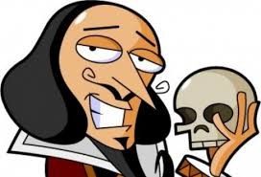
Interpreted Code
There’s a reason your code is inside a <script> tag. That’s because JavaScript is set of instructions (a script) delivered to your browser when the page loads.
Delivering the script, and interpreting (or running) the script are two different things. Your browser (Chrome) contains a program that interprets (reads and processes) the instructions in your script. We call that program the JavaScript engine.

Slide 4
So…
Before we talk about how your code is interpreted, let’s talk about how it is delivered to your browser, and how web applications work in general!

Slide 5
Some “must have” HTML elements for a web application
The HTML tag | What’s it for?
<a href="">Click Me!</a> | You click on the link, and it retrieves a web page (containing HTML, CSS, and JavaScript) from a host.
<input type="button" value="Go"> | You click on the button, and JavaScript that is associated with the button performs a calculation and/or modifies the HTML on the current page.
<input type="submit" > | A submit button must be used with an HTML form. A submit button will send form data to a host and, just like a link, will direct the user to a new web page. (Looks just like “button” doesn’t it!?)
*
This is all an over-simplification… but these are three fundamental tags and here we are describing the ways in which they are typically used.

Slide 6
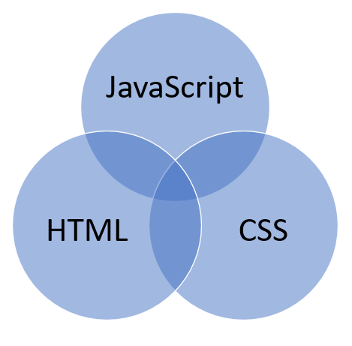
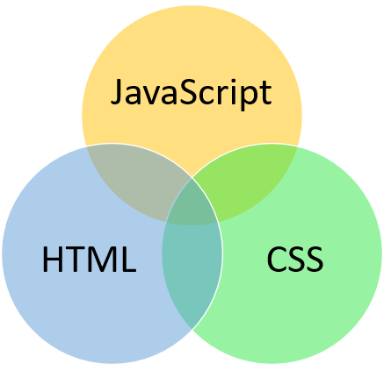
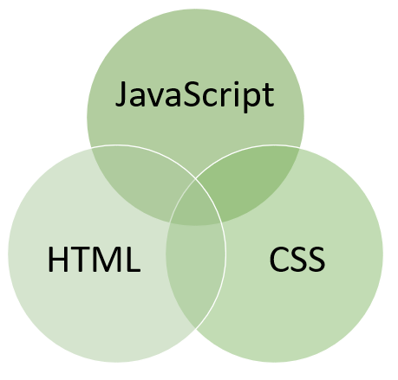
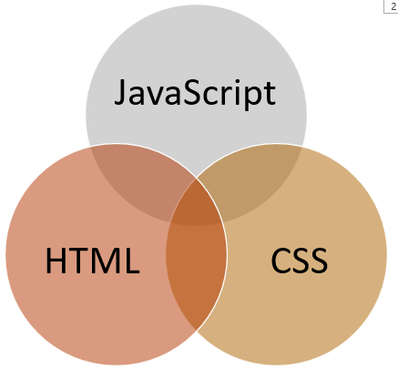
How web applications work…
(delivery)
form data
API / HTTP Request
JSON Response (Just the data!)

Slide 7
How the JavaScript engine interprets code
First, the code is read into the browser’s memory. Then it starts being interpreted, starting at the top.
This string is written to the console log.
Your computer’s memory
tri_base: 10
‘25.00’
25
tri_height: 5
50
tri_area: 25
‘The area of the triangle with a base of 10 and a height of 5 is 25.00’

Slide 8
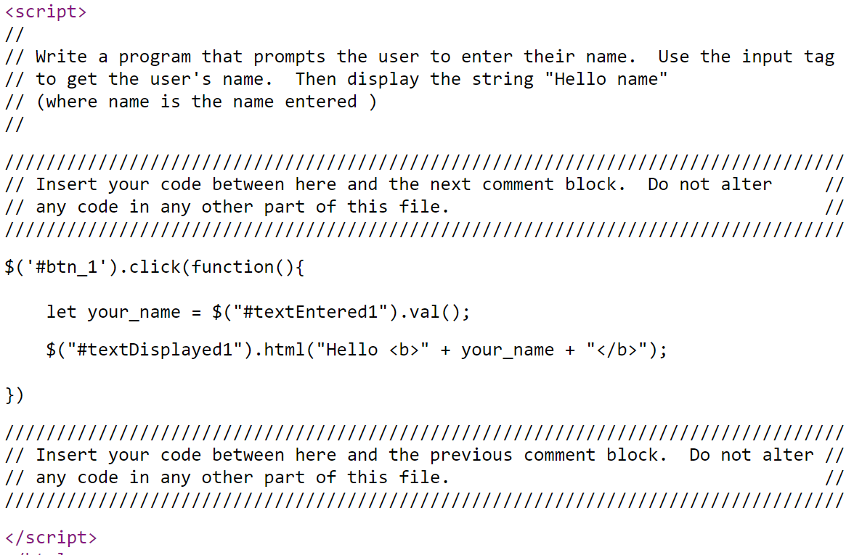
Waiting for something to happen…
Sometimes your code will just sit there and wait for something to happen. Like a button click! This code will sit in your browser’s memory, waiting for a button click.
your_name: ‘Frank’
“Hello <b> Frank </b>”
The result is the “Hello <b>Frank</b>” string being put into the inner HTML of the tag. Now your code is just waiting for the next button click.

Slide 9
What could go wrong? – Two kinds of bugs
Syntax Errors: Every language has a syntax – a set of rules that define correct usage of the language. When that syntax is broken, you have a “syntax error”. “Syntax errors: their eazy too spot. (There a four English syntax errors in the above sentence.)
Logic errors:
Languages express ideas. The syntax of a statement can be correct, but the idea/logic of the statement can be bad. For example: “This statement is false.”

Slide 10
More examples of logic errors.
“My New Year’s resolution is to not have a New Year’s resolution.”
“Let’s eat Grandma.”
“To calculate a twenty percent tip at a restaurant, take the total bill and multiply by 20.”
Circular reasoning!
You probably meant: “Let’s eat, Grandma.”
You probably meant to multiply by .20. Multiplying by 20 is a huge tip!

Slide 11
Debugging Tips
Check VS Code for live semantic errors
Check the web developer console
Read all error messages carefully
Look for line numbers
Add more console.log statements than you need
There’s more… but that’s a good start!

Slide 12
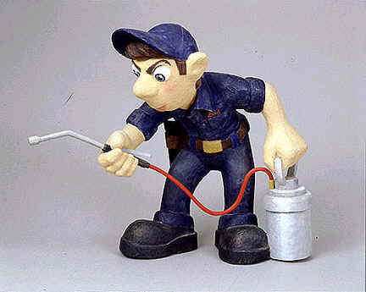
Let’s give it a try…

