Slide 1
MIS2502: Data and Analytics
FOX
MIS

Slide 2
The Information Architecture of an Organization
Fall 2022
FOX
MIS
Leila Hosseini
Leila.hosseini@temple.edu
http://community.mis.temple.edu/leila

Slide 3
Two types of data
Transactional
Captures data to support operation
Analytical
Captures data to support analysis and reporting
An aggregated view of the business
Real-time
Historical
Data describing an event

Slide 4
Components of an information infrastructure
Transactional Database
Captures data describing an event
Analytical Data Store
Used in analysis and reporting
For everyday transactions
Extracted from transactional data
Supports management of an organization’s data
Supports managerial decision-making
This is what is commonly thought of as “database management”
This is the foundation for “advanced data analytics”

Slide 5

The Information Architecture of an Organization
Data entry
Transactional Database
Data extraction
Analytical Data Store
Data analysis
Stores real-time transactional data in a relational or NoSQL database
Stores historical transactional and summary data

Slide 6
Transactional Database

Slide 7
Transactional Database
Definition of Transaction
In business, a transaction is the exchange of information, goods, or services.
Examples of transactions
  Purchase a product
  Enroll in a course
  Hire an employee
For databases, a transaction is an action performed in a database management system.
Data is in real-time
  Reflects current state
  How things are “now”
Transactional databases deal with both: they store information about business transactions using database transactions

Slide 8
Transactional Database
Relational Database
NoSQL Database

Slide 9
Transactional Database
Relational Database

Slide 10
Relational Database (RDBMS)
The Relational Paradigm:
  How transactional data is collected and stored
Primary Goal: Minimize redundancy (normalization)
  Reduce errors
  Less space required
Most database management systems are based on the relational paradigm
  MySQL, Oracle, Microsoft Access, SQL Server
?
Which of these do you think
is more important today

Slide 11
Relational Database (RDBMS)
Student-Class enrollment Example
This is good because:
Data is entered and stored once
Minimizes redundancy

Slide 12
Relational Database (RDBMS)
Student-Class enrollment Example
A series of tables with logical associations between them
The associations (relationships) allow the data to be combined
Student
StudentID
Name
Major
GPA
Student-Class
StudentClassID
StudentID
ClassID
Class
ClassID
Name

Slide 13
Transactional Database
NoSQL Database

Slide 14
NoSQL Database
Stands for “Not only SQL”
  Supports semi-structured (unstructured) data
Primary Goal: flexibility and scalability
  schema-less and nested data
  requires less management
Better fit for companies dealing big data & real time web applciations
  Facebook, Airbnb, Netflix, LinkedIn, …
?

Slide 15
NoSQL Database
Schema-less and embedded documents
LastName: “WELLS”
GPA: 3.0
Major: “MIS”
Class: {ClassID: 1234,
ClassName:“MIS2101”}
LastName: “NORBERT”
Major: “FIN”
Class: [{ClassID: 1235,
ClassName:“MIS2502”,…}
… ]
LastName: “KENDALL”
GPA: 3.5
Class: [{ClassID: 1234,
ClassName:“MIS2101”}
… ]
This is good because:
More flexible – easily insert/delete data
More faster – requires less merging (join)

Slide 16
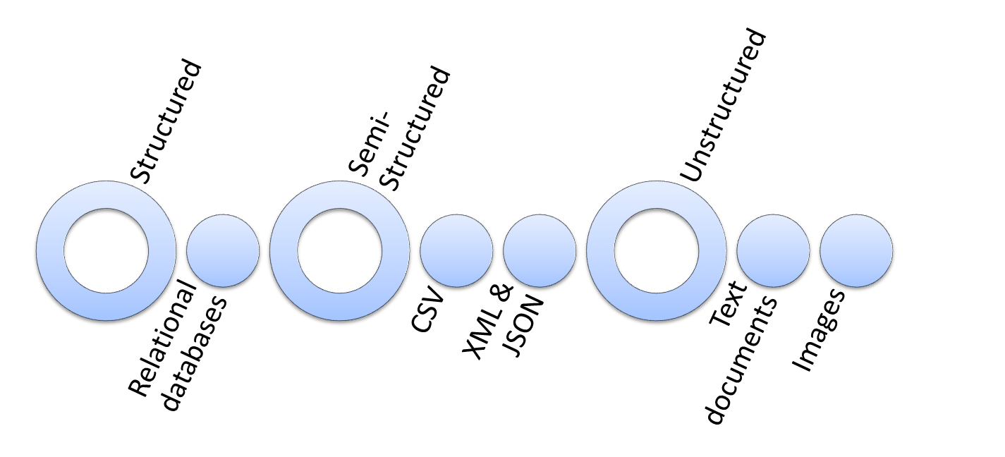
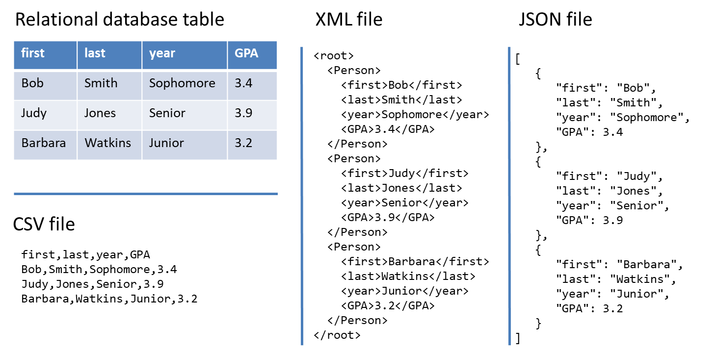
From structured to unstructured data

Slide 17
Analytical Data Store
Stores historical and summarized data
  “Historical” means we keep everything
Data is extracted from the transactional database and reformatted for the analytical data store
Extract
Transform
Load
Transactional Database
Data conversion
Analytical Data Store
Query
Query
We’ll discuss this in much more detail later in the course!!

Slide 18
Three Advanced Data Analytic Techniques
Used to classify data according to a pre-defined outcome
Decision Trees
Used to determine distinct groups of data
Clustering
Find out which events predict the occurrence of other events
Association Rule

Slide 19
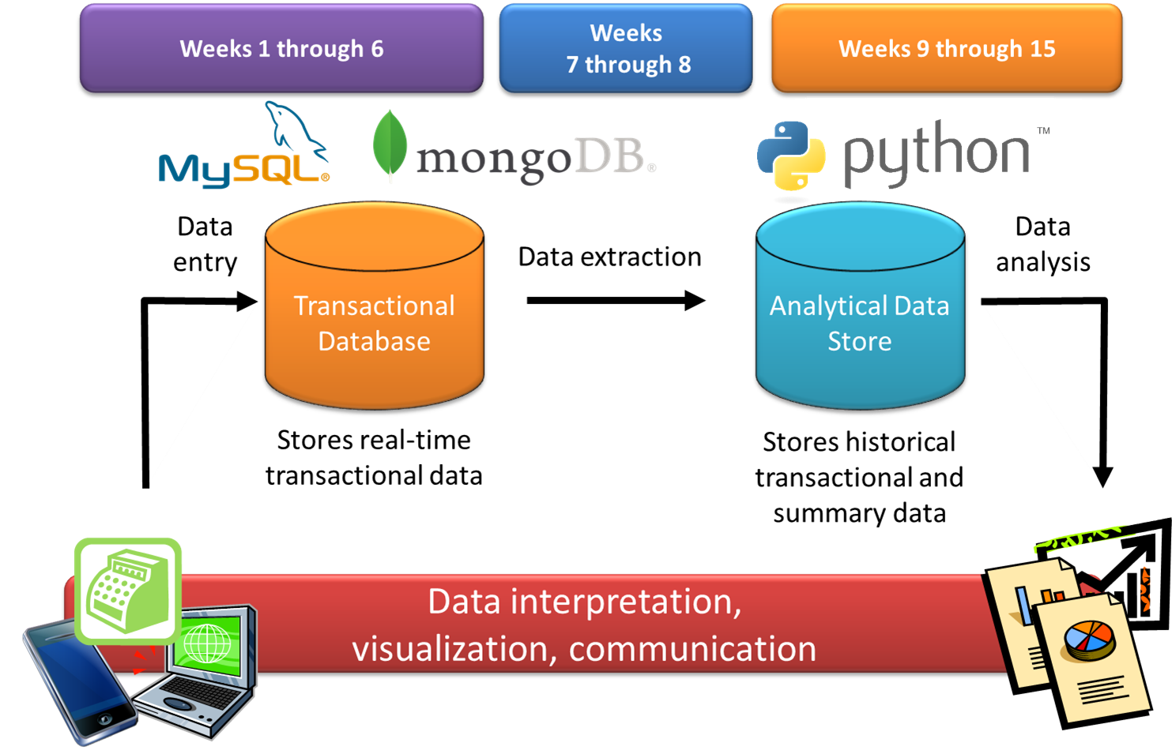
The agenda for the course

