Slide 1
MIS2502: Data and Analytics
FOX
MIS

Slide 2
Principles of Data Visualization
Fall 2022
FOX
MIS
Leila Hosseini
Leila.hosseini@temple.edu
http://community.mis.temple.edu/leila

Slide 3

The agenda for the course
Weeks 1 through 6
Weeks
7 through 8
Weeks 9 through 15
Data entry
Transactional Database
Analytical Data Store
Data analysis
Data extraction
Stores real-time transactional data in a relational or NoSQL database
Stores historical transactional and summary data
Data interpretation,
visualization, communication

Slide 4
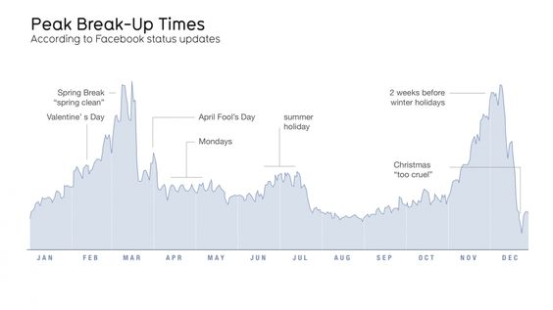
Why data visualization?
“Quite simply, humans are amazing pattern-recognition machines. They
have the ability to recognize many different types of patterns - and then
transform
these
‘recursive
probabalistic
fractals’
into
concrete,
actionable steps.” –Dominic Basulto
Ref. https://www.ted.com/talks/david_mccandless_the_beauty_of_data_visualization

Slide 5
Data visualization can:
Provide clear understanding of patterns in data
Detect hidden structures in data
Condense information

Slide 6
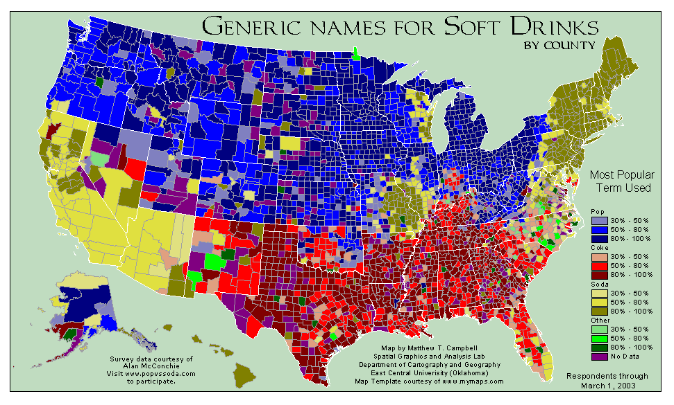
What can you learn from this map?
http://www.popvssoda.com/countystats/total-county.html

Slide 7
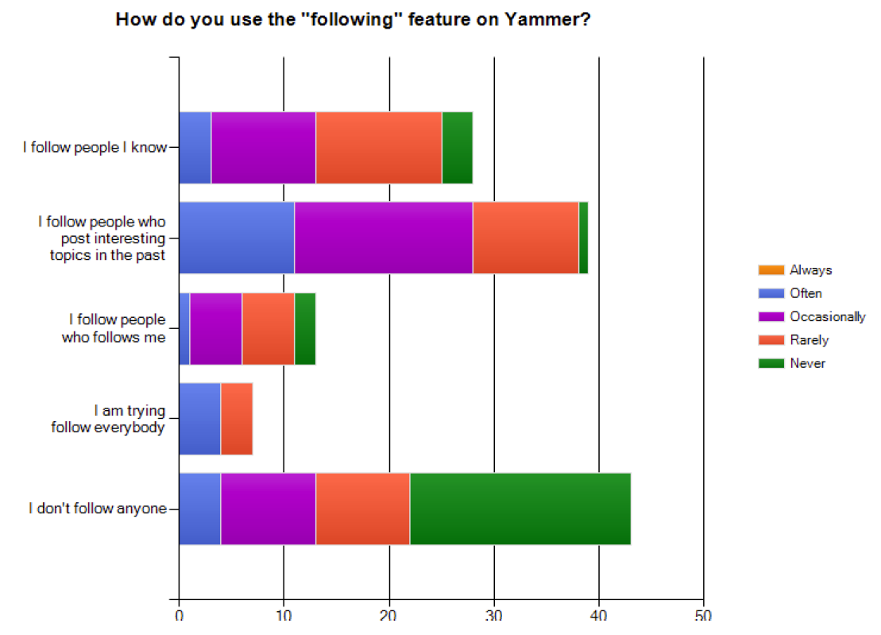
What makes a good chart?
This is from an academic conference paper.
What are the problems with this chart?
Zhang et al. (2010), “A case study of micro-blogging in the enterprise: use, value, and related issues,” Proceedings of the 28th International Conference on Human Factors in Computing Systems.

Slide 8
Some basic principles (adapted from Tufte 2009)
1
2
3
The chart should tell a story
The chart should have graphical integrity
The chart should minimize graphical complexity
Tufte’s fundamental principle:
Above all else show the data

Slide 9
Principle 1: The chart should tell a story
Graphics should be clear on their own
The chart should yield insight beyond the text
“If the statistics are boring, then you’ve got the wrong numbers.” (Tufte 2009)
The depictions should enable meaningful comparison

Slide 10
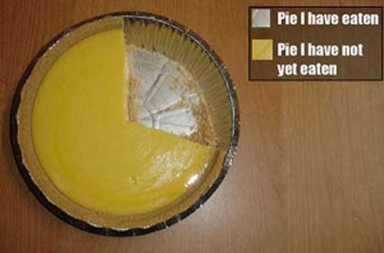
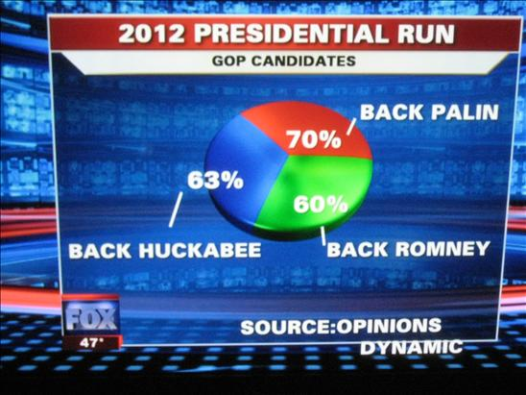
Do these tell a story?
http://www.evl.uic.edu/aej/491/week03.html
http://flowingdata.com/2009/11/26/fox-news-makes-the-best-pie-chart-ever/

Slide 11
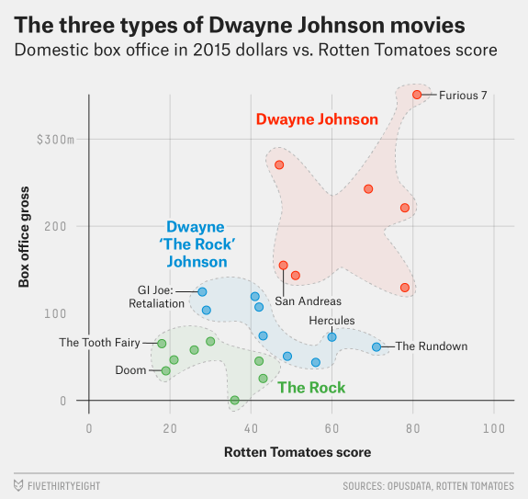
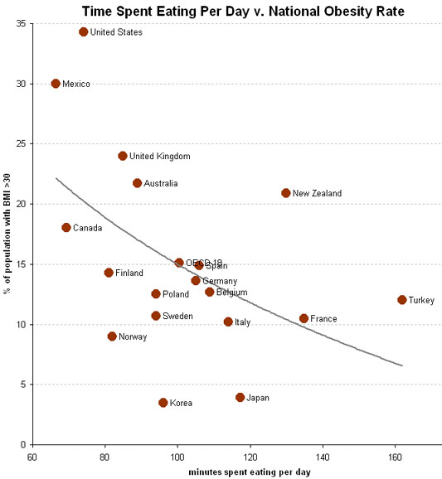

Telling a Story
http://fivethirtyeight.com/features/the-three-types-of-dwayne-the-rock-johnson-movies/
http://economix.blogs.nytimes.com/2009/05/05/obesity-and-the-fastness-of-food/

Slide 12
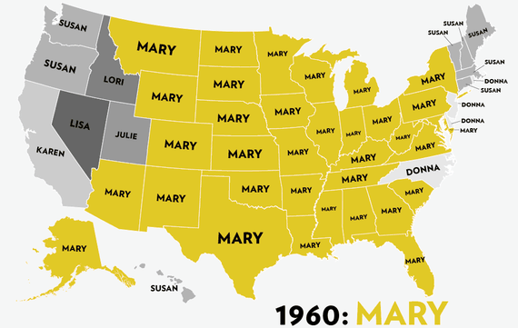
Most Popular Girl Names in Map
by Reuben Fischer-Baum (http://jezebel.com/map-sixty-years-of-the-most-popular-names-for-girls-s-1443501909)

Slide 13
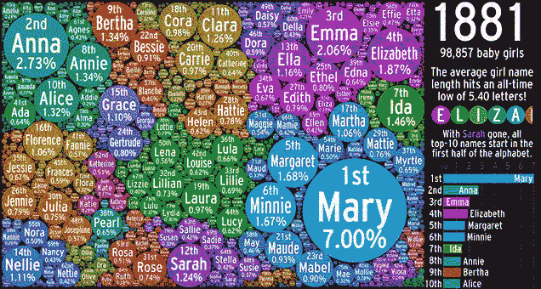
Popular Girls Names in Bubbling Visualization
http://gizmodo.com/over-100-years-of-popular-girls-names-in-one-bubbling-v-1691686567

Slide 14

Does it tell a good story?
http://gizmodo.com/8-horrible-data-visualizations-that-make-no-sense-1228022038

Slide 15
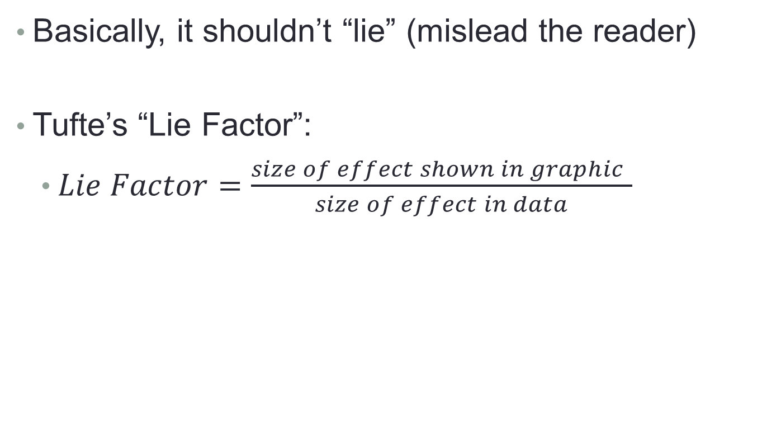
Principle 2: The chart should have graphical integrity
Basically, it shouldn’t “lie” (mislead the reader)
Tufte’s “Lie Factor”:
  $Lie Factor=\frac{size of effect shown in graphic }{size of effect in data}$
Should be ~ 1
> 1 = exaggerated effect
< 1 = understated effect

Slide 16
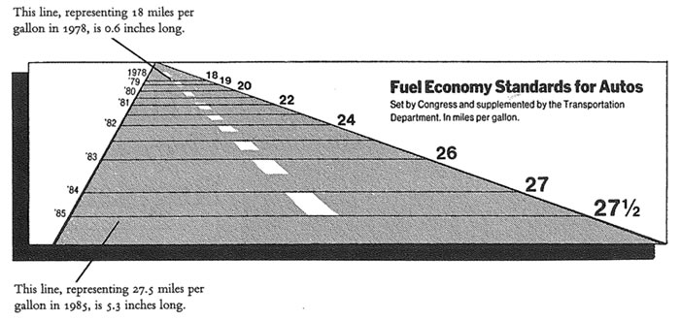
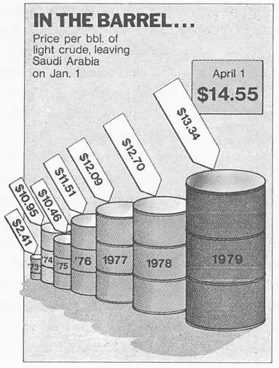
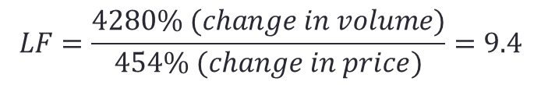
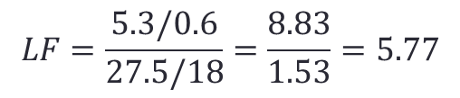
Examples of the “lie factor”
$$LF=\frac{5.3/0.6}{27.5/18}=\frac{8.83}{1.53}=5.77$$
Reprinted from Tufte (2009), p. 57 & p. 62
$$LF=\frac{4280\% (change in volume)}{454\% (change in price)}=9.4$$

Slide 17
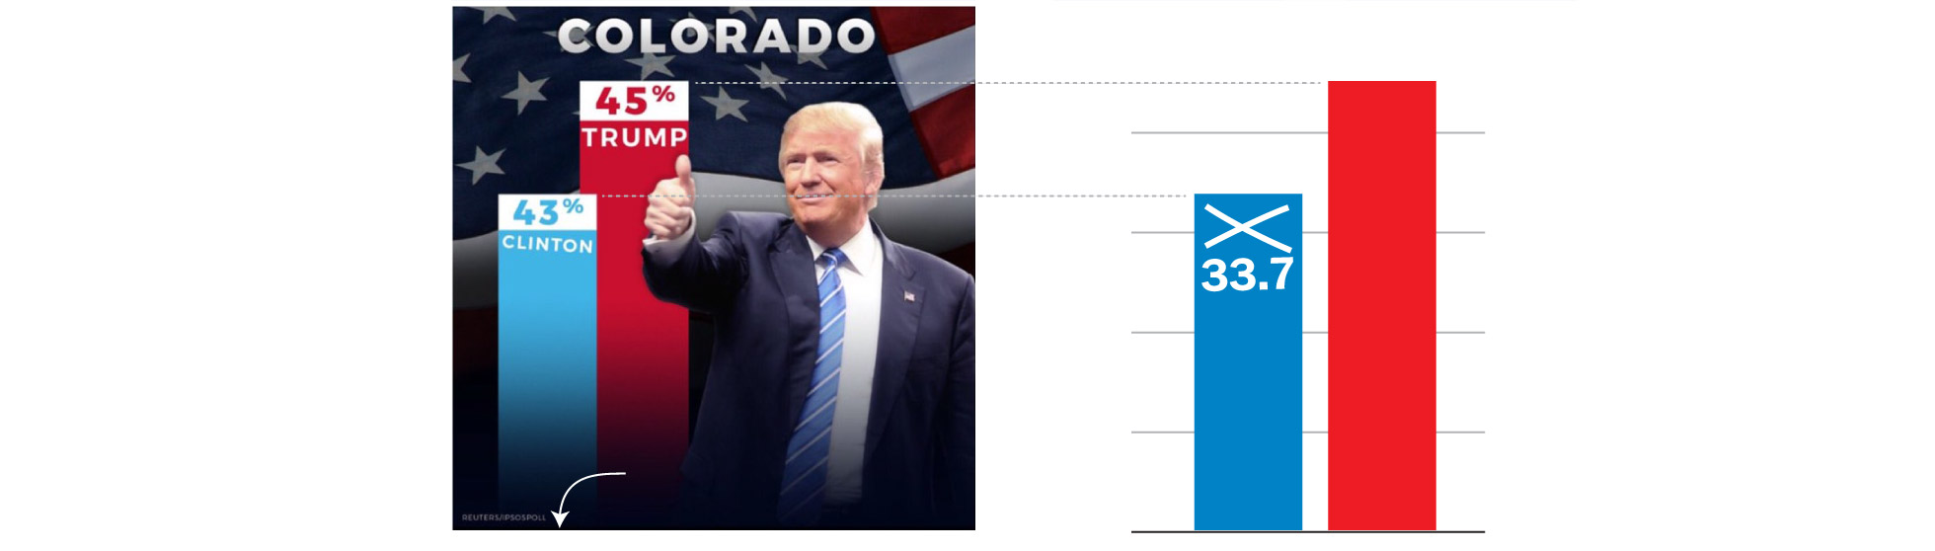
How is this deceptive?
The original graphic from President Trump’s tweet.
(Look at the y-axis)
https://www.washingtonpost.com/graphics/politics/2016-election/trump-charts/

Slide 18
How is this deceptive?
The original graphic from President Trump’s tweet.
(Look at the y-axis)
Does the scale match the numbers?
https://www.washingtonpost.com/graphics/politics/2016-election/trump-charts/

Slide 19
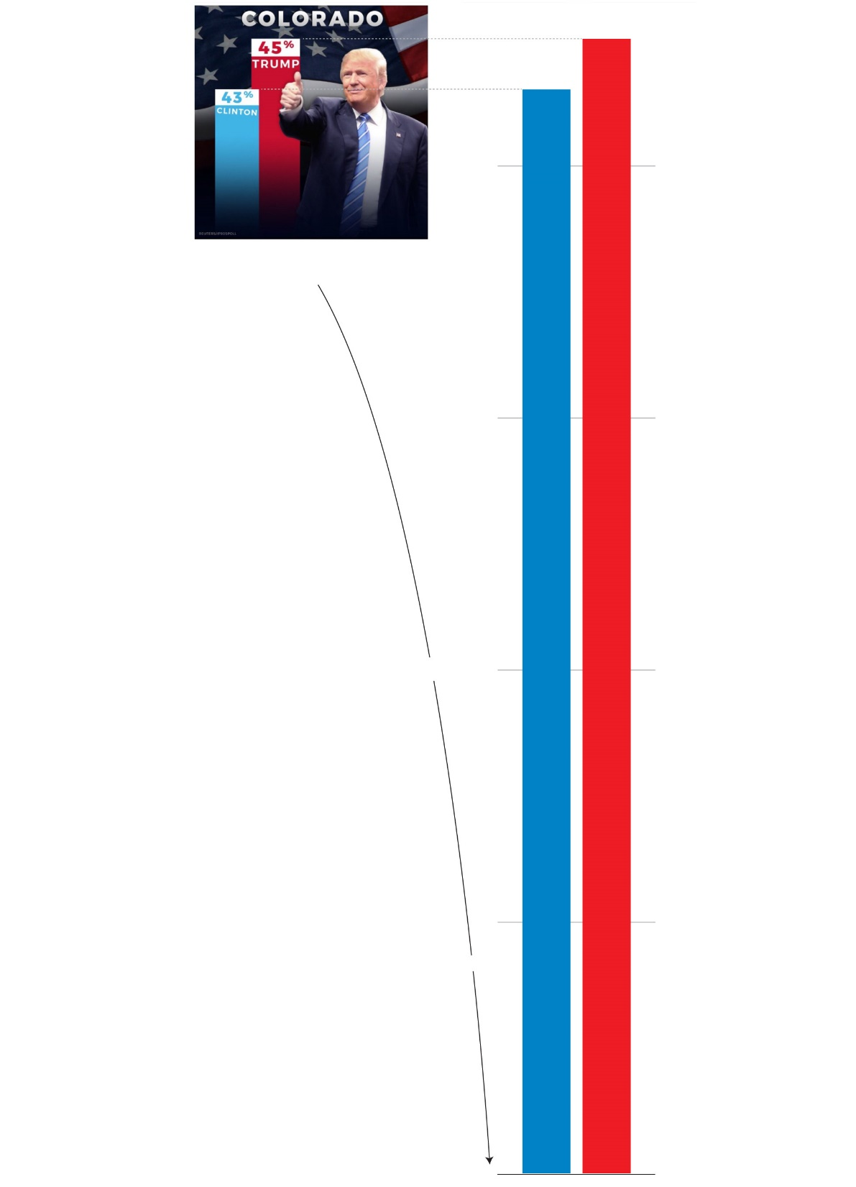
Where would the real baseline end up?
45
43
https://www.washingtonpost.com/graphics/politics/2016-election/trump-charts/

Slide 20
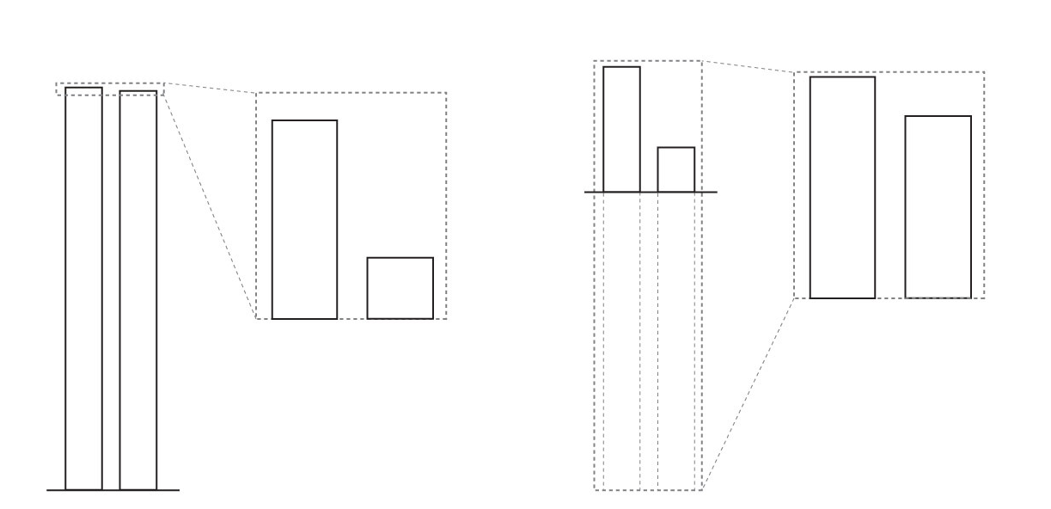
Exaggerated Effect
(LF>1)
Understated Effect
(LF<1)
A
A
A
B
A
B
B
B
https://www.washingtonpost.com/graphics/politics/2016-election/trump-charts/

Slide 21
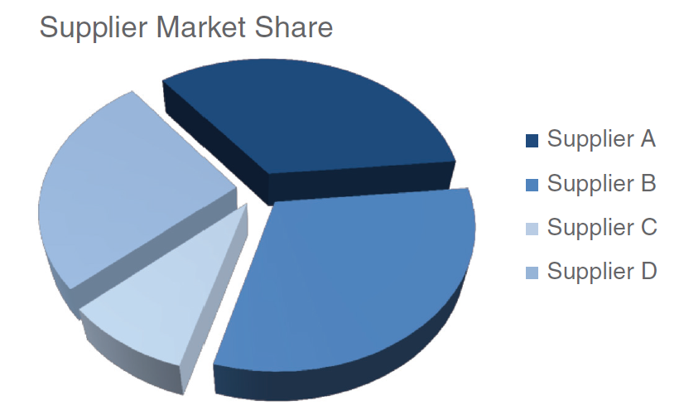
3D Pie Chart: which supplier is the largest?
Source: Knaflic (2015). Storytelling with Data: A Data Visualization Guide for Business Professionals. Chapter 2.

Slide 22
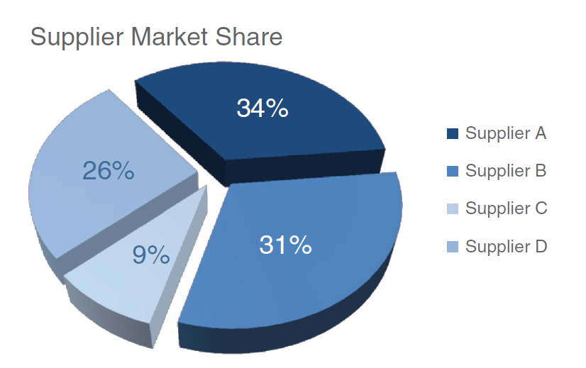
3D Pie Chart: which supplier is the largest?
Supplier B—which looks largest, at 31%—is actually smaller than Supplier A, at 34%!
Source: Knaflic (2015). Storytelling with Data: A Data Visualization Guide for Business Professionals. Chapter 2.

Slide 23
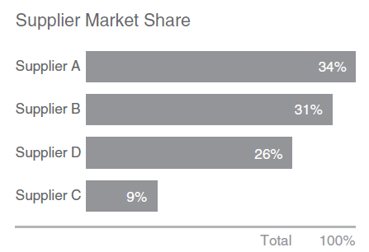
What can be used instead?

Slide 24
Principle 3: The chart should minimize graphical complexity
Generally, the simpler the better…
Key concepts
Data-ink
Sometimes a table is better
Chartjunk

Slide 25
Which one is better…?
For a few data points, a table can do just as well…
Salesperson | Total Sales
Peacock | $225,763.68
Leverling | $201,196.27
Davolio | $182,500.09
Fuller | $162,503.78
Callahan | $123,032.67
King | $116,962.99
Dodsworth | $75,048.04
Suyama | $72,527.63
Buchanan | $68,792.25
The table carries more information in less space
and is more precise.

Slide 26

Data Ink
The amount of “ink” devoted to data in a chart
Tufte’s Data-Ink ratio:
  $Data−ink ratio=\frac{data−ink}{total ink used in graphic}$
Should be ~ 1
< 1 = more non-data related ink in graphic
= 1 implies all ink devoted to data
Tufte’s principle:
Erase ink whenever possible

Slide 27
Being conscious of data ink
Lower data-ink ratio
(worse)
Higher data-ink ratio
(better)

Slide 28
3-D Charts
Evaluate this from a data-ink perspective.
How does it affect the clarity of the chart?

Slide 29
One of the golden rules of data visualization is…..
Never use 3D!
Data Integrity/ Lie Factor
3D skews numbers, making them difficult to interpret or compare
Graphical Complexity
Adding 3D to graphs introduces unnecessary chart elements like side and floor panels
Source: Knaflic (2015). Storytelling with Data: A Data Visualization Guide for Business Professionals. Chapter 2.

Slide 30
Chartjunk: Data Ink “gone wild”
Unnecessary visual clutter that doesn’t provide additional insight
Distraction from the story the chart is supposed to convey
When the data-ink ratio is low, chartjunk is likely to be high

Slide 31
Example: Moiré effects (Tufte 2009)
Creates illusion of movement
Stands out, in a bad way

Slide 32
Example: The Grid
Why are these examples of chartjunk?
What could you do to remedy it?

Slide 33
Data Ink Working For Us
Evaluate this chart in terms of Data Ink.
Imagine this as a bar chart. As a table!!

Slide 34
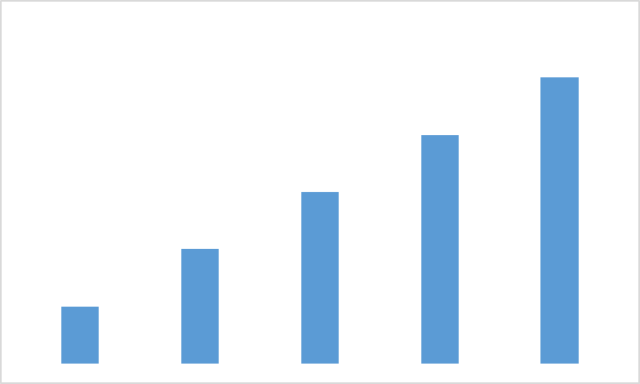
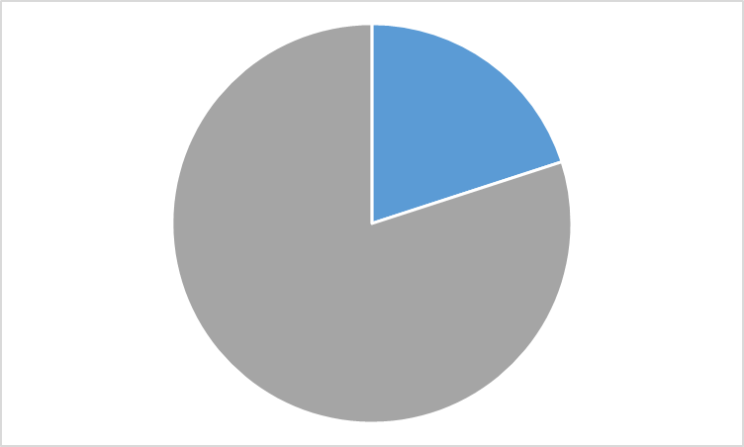
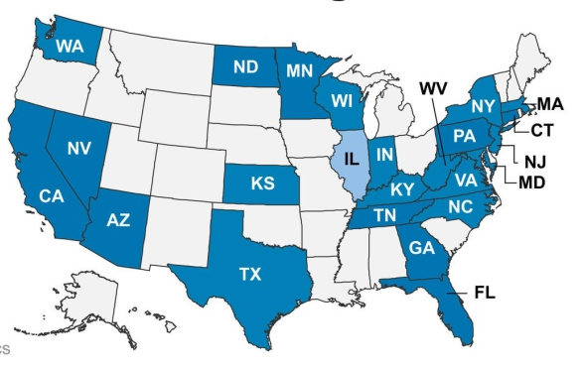
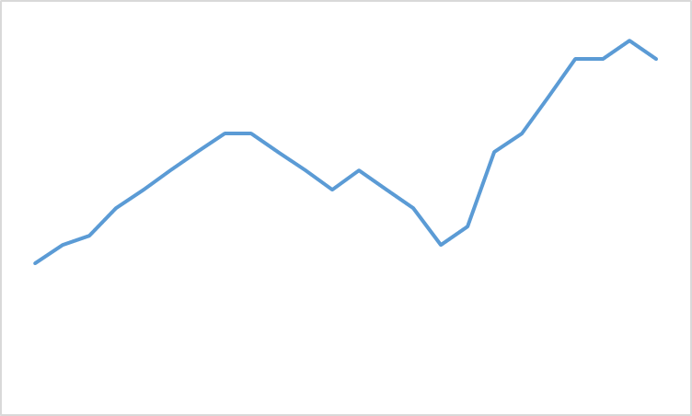
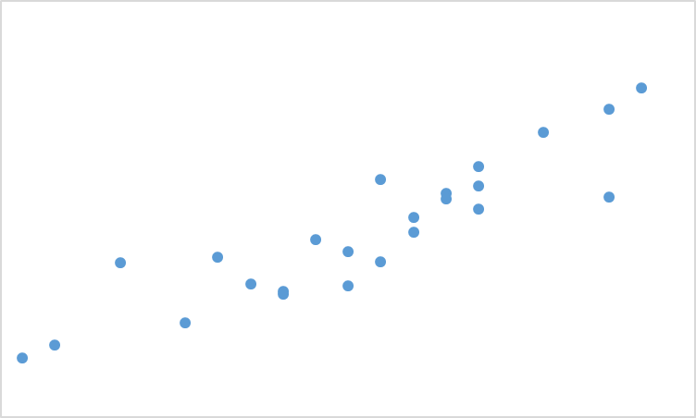
Common Chart Types
Bars
(For Comparison)
Pie
(For Composition)
Map
(For Spatial Comparison)
Line
(For Evolution)
Scatterplot
(Relationship)

Slide 35
Review: Data principles (adapted from Tufte 2009)
1
2
3
The chart should tell a story
The chart should have graphical integrity
The chart should minimize graphical complexity
Tufte’s fundamental principle:
Above all else show the data

Slide 36
Summary
Use data visualization principles to assess a visualization
  Tell a story
  Graphical integrity (lie factor)
  Minimize graphical complexity (data ink, chartjunk)
Explain how a visualization can be improved based on those principles
Types of visualization

Slide 37
In Class Activity #8

