Slide 1
Review for Exam 2
MIS2502: Data and Analytics
Leila Hosseini

Slide 2
Overview
Date/Time: Friday, Oct 28,
9:00 am – 9:50 am (50 minutes)
Multiple-choice and short-answer questions
Closed-book, closed-note

Slide 3
Coverage
Check the Exam 2 Study Guide
Not every item on this list may be on the exam, and there may be items on the exam not on this list.

Slide 4
SQL Joins
Used to combine two or more tables, based on the common fields between them.
Suppose we have….
MyDB.Customer
MyDB.Order
CustomerID | LastName | FirstName | Country
1 | Futterkiste | Alfreds | Germany
2 | Trujillo | Ana | US
3 | Moreno | Antonio | Mexico
OrderID | CustomerID | OrderDate | Amount
10308 | 2 | 1996-09-18 | 100
10309 | 1 | 1996-09-19 | 10
10310 | 1 | 1996-09-20 | 63

Slide 5
(Inner) Join
SELECT *
FROM MyDB.Customer
JOIN MyDB.Order ON Order.CustomerID=Customer.CustomerID;
MyDB.Customer
MyDB.Order
CustomerID | LastName | FirstName | Country
1 | Futterkiste | Alfreds | Germany
2 | Trujillo | Ana | US
3 | Moreno | Antonio | Mexico
OrderID | CustomerID | OrderDate | Amount
10308 | 2 | 1996-09-18 | 100
10309 | 1 | 1996-09-19 | 10
10310 | 1 | 1996-09-20 | 63
CustomerID | LastName | FirstName | Country
1 | Futterkiste | Alfreds | Germany
1 | Futterkiste | Alfreds | Germany
2 | Trujillo | Ana | US
OrderID | CustomerID | OrderDate | Amount
10309 | 1 | 1996-09-19 | 10
10310 | 1 | 1996-09-20 | 63
10308 | 2 | 1996-09-18 | 100

Slide 6
More Variations to Join
Step 1: We start with a simple join
SELECT *
FROM MyDB.Customer JOIN MyDB.Order
ON Order.CustomerID=Customer.CustomerID;
Q: What is the total order amount by country?
CustomerID | LastName | FirstName | Country
1 | Futterkiste | Alfreds | Germany
1 | Futterkiste | Alfreds | Germany
2 | Trujillo | Ana | US
OrderID | CustomerID | OrderDate | Amount
10309 | 1 | 1996-09-19 | 10
10310 | 1 | 1996-09-20 | 63
10308 | 2 | 1996-09-18 | 100
Step 2: We then end up with -
SELECT Customer.Country, SUM(Order.Amount)
FROM MyDB.Customer JOIN MyDB.Order
ON Order.CustomerID=Customer.CustomerID
GROUP BY Customer.Country;
Country | SUM(Amount)
US | 100
Germany | 73

Slide 7
SQL (Subselects)
Subselect query can return
  One single value (one column, one row)
  A temporary table (one or multiple columns, one or multiple rows)

Slide 8
One single value: Used With Comparison Operators
SELECT column_name1
FROM schema_name.table_name1
WHERE column_name2 comparison_operator
(SELECT column_name3
FROM schema_name.table_name2
WHERE condition);
Treated as a single value
comparison_operator could be equality operators such as =, >, <, >=, <=, <>.

Slide 9
Subselect as One Single Value: Example 1
MyDB.Order
Q: What are the order IDs with order amount below average?
OrderID | CustomerID | OrderDate | Amount
10308 | 2 | 1996-09-18 | 100
10309 | 1 | 1996-09-19 | 10
10310 | 1 | 1996-09-20 | 63
Step 1. We start by writing a subselect query that returns the average order amount:
SELECT AVG(Amount) FROM MyDB.Order
Amount
57.6667
Step 2. We treat the subselect query as a single value:
SELECT OrderID, Amount
FROM MyDB.Order
WHERE Amount <(SELECT AVG(Amount) FROM MyDB.Order);
OrderID | Amount
10309 | 10

Slide 10
Subselect as One Single Value: Example 2
Q: Which German customer placed the order(s) with the highest order amount?
MyDB.Order
MyDB.Customer
OrderID | CustomerID | OrderDate | Amount
10308 | 2 | 1996-09-18 | 100
10309 | 1 | 1996-09-19 | 10
10310 | 1 | 1996-09-20 | 63
CustomerID | LastName | FirstName | Country
1 | Futterkiste | Alfreds | Germany
2 | Trujillo | Ana | US
3 | Moreno | Antonio | Mexico
SELECT * FROM MyDB.Order
JOIN MyDB.Customer
ON Order.CustomerID=Customer.CustomerID;
Recall the simple join query…
OrderID | CustomerID | OrderDate | Amount | CustomerID | LastName | FirstName | Country
10308 | 2 | 1996-09-18 | 100 | 2 | Trujillo | Ana | US
10309 | 1 | 1996-09-19 | 10 | 1 | Futterkiste | Alfreds | Germany
10310 | 1 | 1996-09-20 | 63 | 1 | Futterkiste | Alfreds | Germany

Slide 11
Subselect as One Single Value: Example 2
Q: Which German customer placed the order(s) with the highest order amount?
Step 1. We start by writing a subselect query that returns the highest order amount for German customers:
SELECT MAX(Order.Amount)
FROM MyDB.Order JOIN MyDB.Customer
ON Order.CustomerID=Customer.CustomerID
WHERE Customer.Country=‘Germany’;
Amount
63
Step 2. We treat the subselect query as a single value:
SELECT Customer.LastName, Customer.FirstName, Order.Amount
FROM MyDB.Order JOIN MyDB.Customer
ON Order.CustomerID=Customer.CustomerID
WHERE Customer.Country=‘Germany’
AND Amount= (SELECT MAX(Order.Amount)
FROM MyDB.Order JOIN MyDB.Customer
ON Order.CustomerID=Customer.CustomerID
WHERE Customer.Country=‘Germany’);
LastName | FirstName | Amount
Futterkiste | Alfreds | 63

Slide 12
As a temporary table
SELECT column_name(s)
FROM
(SELECT column_name(s)
FROM schema_name.table_name2
WHERE condition)
WHERE condition;
Treated as a table

Slide 13
Subselect as Temporary table
Q: How many states are there in the customer table?
Recall the Customer table:
CustomerID | FirstName | LastName | City | State | Zip
1001 | Greg | House | Princeton | NJ | 09120
1002 | Lisa | Cuddy | Plainsboro | NJ | 09123
1003 | James | Wilson | Pittsgrove | NJ | 09121
1004 | Eric | Foreman | Warminster | PA | 19111

Slide 14
Subselect as Temporary table
Q: How many states are there in the customer table?
Step 1. We start by writing a subselect query that returns the unique states in the table :
State
NJ
PA
SELECT DISTINCT State FROM orderdb.Customer;
Step 2. We treat the subselect query as a temporary table:
SELECT COUNT(*)
FROM (SELECT DISTINCT State FROM orderdb.Customer) AS tmp1;
2

Slide 15
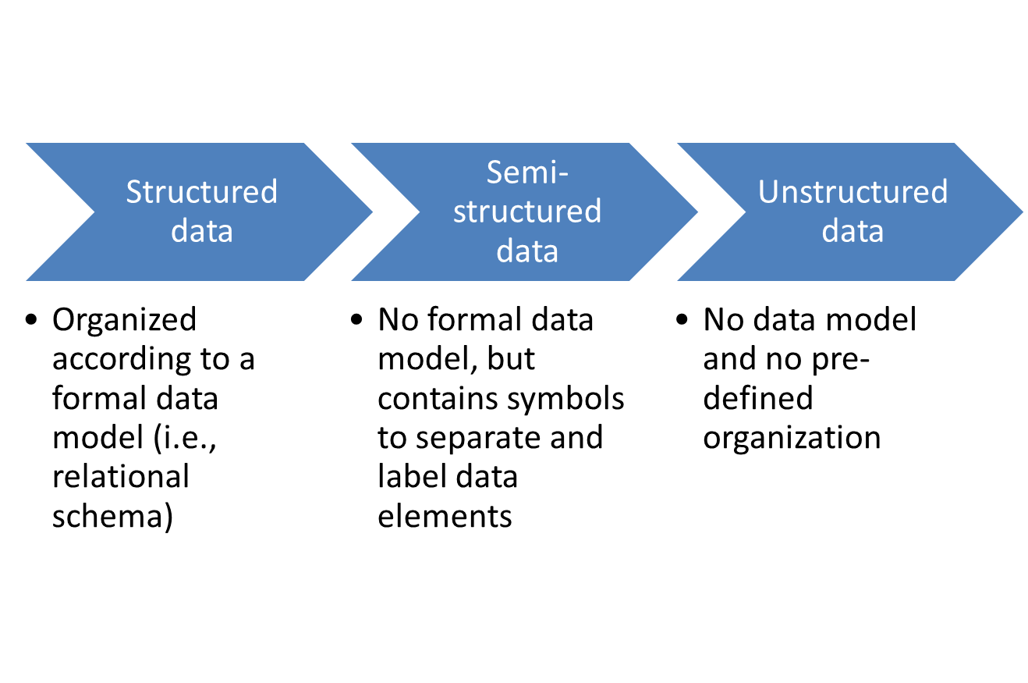
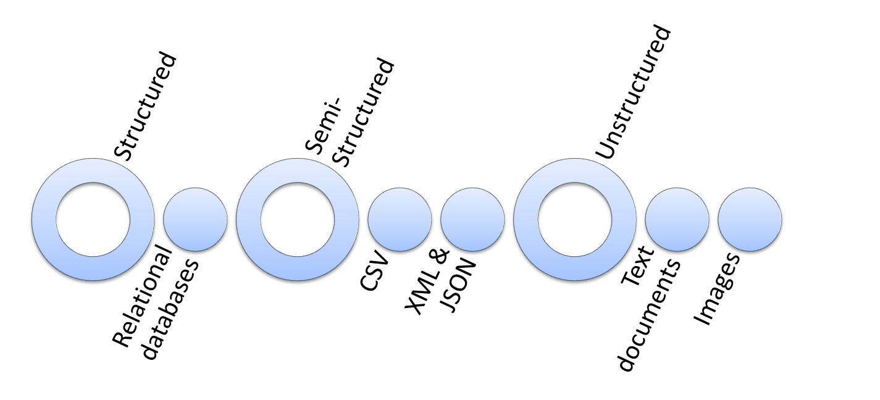
Semi-Structured Data

Slide 16
Semi-Structured Data
CSV
Comma-separated Values
Each value is separated by a comma
The first row is often the field names.
Uses text for values between tags for labels
<opening tag>data</closing tag>
<height>172</height>
XML
Extensible Markup Language
Uses key-value pairs
key: value
“name”: “C-3PO”
JSON
JavaScript Object Notation

Slide 17
Semi-Structured Data
Relational database table
XML file
JSON file
first | last | year | GPA
Bob | Smith | Sophomore | 3.4
Judy | Jones | Senior | 3.9
Barbara | Watkins | Junior | 3.2
<root>
<Person>
<first>Bob</first>
<last>Smith</last>
<year>Sophomore</year>
<GPA>3.4</GPA>
</Person>
<Person>
<first>Judy</first>
<last>Jones</last>
<year>Senior</year>
<GPA>3.9</GPA>
</Person>
<Person>
<first>Barbara</first>
<last>Watkins</last>
<year>Junior</year>
<GPA>3.2</GPA>
</Person>
</root>
[
{
"first": "Bob",
"last": "Smith",
"year": "Sophomore",
"GPA": 3.4
},
{
"first": "Judy",
"last": "Jones",
"year": "Senior",
"GPA": 3.9
},
{
"first": "Barbara",
"last": "Watkins",
"year": "Junior",
"GPA": 3.2
}
]
CSV file
first,last,year,GPA
Bob,Smith,Sophomore,3.4
Judy,Jones,Senior,3.9
Barbara,Watkins,Junior,3.2

Slide 18
RDBMS vs. NoSQL
RDBMS | NoSQL
Pre-defined schema | Flexible schema
Data is distributed across multiple tables | Data is typically nested in a few collection
Based on relations | (Very few) relations
Not good for hierarchical work | Best fit for hierarchical work

Slide 19
MySQL vs MongoDB Query
MySQL | MongoDB
WHERE | $match
GROUP BY | $group
ORDER BY | $sort
LIMIT | $limit
SELECT expressions FROM.. | $project
JOIN | $lookup
n/a | $size, $all, dot notation
SELECT purchaseMethod, sum(price) as totalprice
FROM salesDB.sales
WHERE couponUsed = FALSE
GROUP BY purchaseMethod
ORDER BY sum(price) ASC
LIMIT 2;
db.sales.aggregate(
[ { $match: { couponUsed: FALSE }},
{ $group: { _id: "$purchaseMethod",
totalprice: { $sum: "$price" }}},
{ $sort: { totalprice: 1 }},
{ $limit: 2 }
])

Slide 20
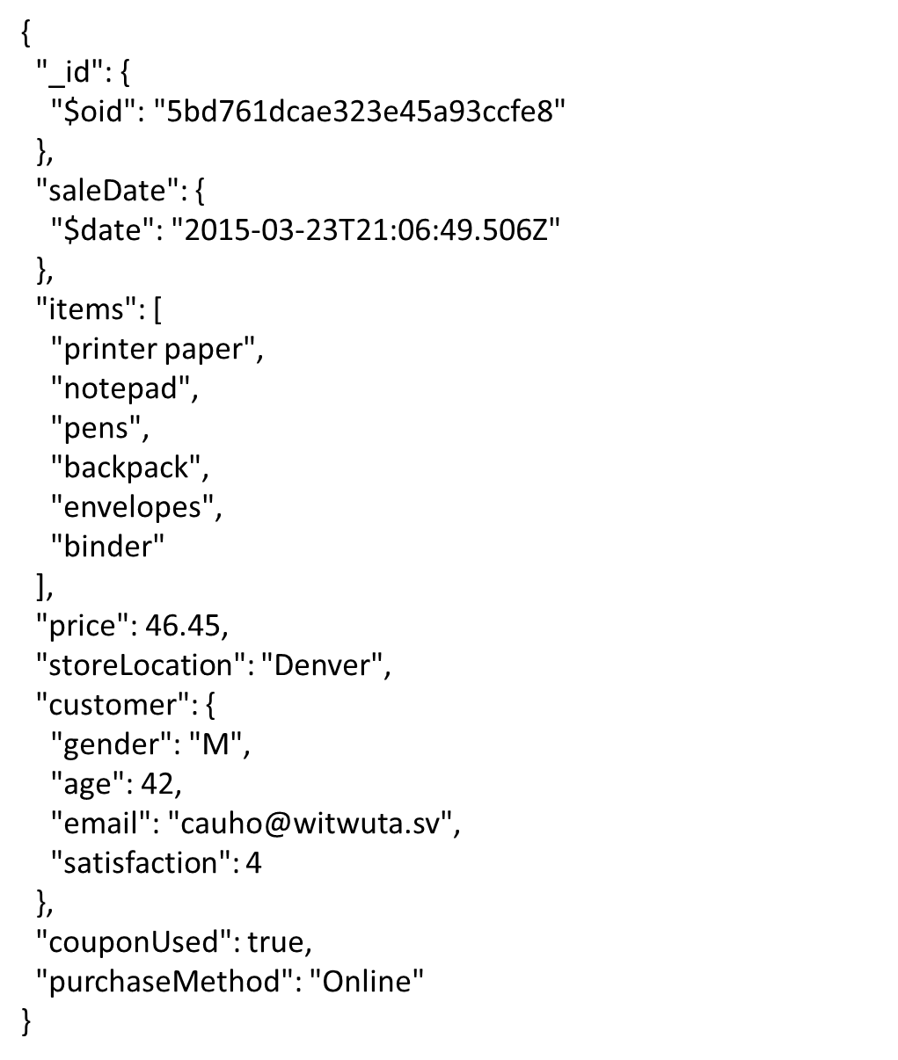
MongoDB
salesdb.sales
NoSQL code
$match: { price: { $gt: 180} }
$project: {_id: 1, price: 1, storeLocation: 1}
Describe what the code will return.
Present id, price and store location of sales where price is greater than 180.

Slide 21
MongoDB
salesdb.sales
NoSQL code
$match: { and: [{ price: { $gt: 180} } ,
{ storeLocation: "Seattle"}]}
$ project: {_id: 1, price: 1, storeLocation: 1}
What is the problem with the code? Write a correct code.
$match: { $and: [{ price: { $gt: 180} } ,
{ storeLocation: "Seattle"}]}
$ project: {_id: 1, price: 1, storeLocation: 1}

Slide 22
ETL
Transform data into an analysis-ready format
Load it into the analytical data store
Extract data from the transactional database
What is it? Why is it important?
  Data consistency
  Data quality
Explain the purpose of each component (Extract, Transform, Load)

Slide 23
Data Visualization
Data visualization principles.
  Tell a story
  Graphical integrity (lie factor)
  Minimize graphical complexity (data ink, chartjunk, Moiré effects )

Slide 24
Issues with this chart?
Issues:
Tell a Story
  Vertical axis isn’t labeled. We don’t know the units
  Because there are many states to compare, horizontal lines may be helpful
Graphical Integrity
  The 3D chart makes it difficult to compare sizes
  The cone-shaped bars make it even harder to compare sizes
Graphical Complexity
  The 3D chart requires more ink (Chartjunk)
  The number labels are unnecessary

Slide 25
Good Luck!

