Slide 1
MIS2502: Data and Analytics
FOX
MIS

Slide 2
Association Rule Mining
Fall 2022
FOX
MIS
Leila Hosseini Leila.hosseini@temple.edu http://community.mis.temple.edu/leila

Slide 3
Association Rule Mining
Find out which items predict the occurrence of other items
Also known as “affinity analysis” or “market basket” analysis

Slide 4
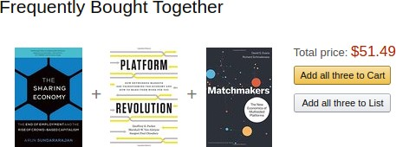
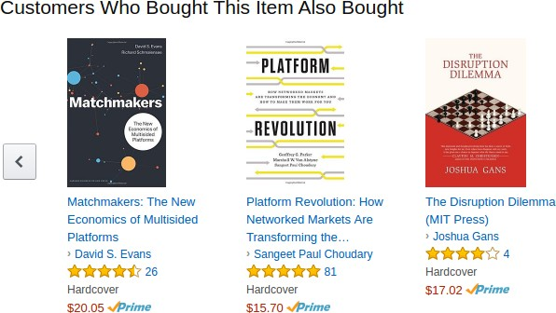
Case 1: Amazon Recommender System
Figure: Amazon recommendations while viewing a book

Slide 5
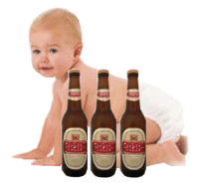
Case 2: The parable of the beer and diapers
It goes (with minor variations) like this:
Some time ago, one retail store decided to combine the data from its loyalty card system with that from its point of sale systems. The former provided the store with demographic data about its customers, the latter told it where, when and what those customers bought.
Once combined, the data was mined extensively and many correlations appeared. Some of these were obvious; people who buy gin are also likely to buy tonic. However, one correlation stood out like a sore thumb because it was so unexpected.
On Friday afternoons, young American males who buy diapers also have a predisposition to buy beer. No one had predicted that result, so no one would ever have even asked the question in the first place.

Slide 6
Market-Basket Transactions
Basket | Items
1 | Bread, Milk
2 | Bread, Diapers, Beer, Eggs
3 | Milk, Diapers, Beer, Coke
4 | Bread, Milk, Diapers, Beer
5 | Bread, Milk, Diapers, Coke
We usually start from a data set like this – with baskets of transactions
And the idea is to find associations between products

Slide 7
Market-Basket Transactions
Basket | Items
1 | Bread, Milk
2 | Bread, Diapers, Beer, Eggs
3 | Milk, Diapers, Beer, Coke
4 | Bread, Milk, Diapers, Beer
5 | Bread, Milk, Diapers, Coke
X → Y (antecedent → consequent)
(aka LHS →RHS)
{Diapers} → {Beer}, {Milk, Bread} → {Diapers} {Beer, Bread} → {Milk}, {Bread} → {Milk, Diapers}
Association Rules from these transactions

Slide 8
Core idea: The itemset
Itemset A group of items of interest {Milk, Diapers, Beer}
Association rules express relationships between itemsets
X → Y {Milk, Diapers} → {Beer} “when you have milk and diapers, you are also likely to have beer”
Basket | Items
1 | Bread, Milk
2 | Bread, Diapers, Beer, Eggs
3 | Milk, Diapers, Beer, Coke
4 | Bread, Milk, Diapers, Beer
5 | Bread, Milk, Diapers, Coke

Slide 9
Support Count (σ)
Basket | Items
1 | Bread, Milk
2 | Bread, Diapers, Beer, Eggs
3 | Milk, Diapers, Beer, Coke
4 | Bread, Milk, Diapers, Beer
5 | Bread, Milk, Diapers, Coke
Support count (σ)
In how many baskets does the itemset appear?
σ{Milk, Diapers, Beer} = 2
(i.e., in baskets 3 and 4)
You can calculate support count for both X and Y separately
σ{Milk, Diapers} = ?
σ{Beer} = ?
X
Y
2 baskets have milk, beer, and diapers
5 baskets total

Slide 10
Support (s)
Basket | Items
1 | Bread, Milk
2 | Bread, Diapers, Beer, Eggs
3 | Milk, Diapers, Beer, Coke
4 | Bread, Milk, Diapers, Beer
5 | Bread, Milk, Diapers, Coke
Support (s)
Fraction of transactions that
contain all items in the itemset
s({Milk, Diapers, Beer})
= σ{Milk, Diapers, Beer} /(# of transactions)
=2/5 = 0.4
You can calculate support for both X and Y separately
Support for X: s{Milk, Diapers}= ?
Support for Y: s{Beer}= ?
X
Y
This means 40% of the baskets contain Milk, Diapers and Beers

Slide 11
Confidence (c)
Confidence (c) is the strength of the association
Measures how often items in Y appear in transactions that contain X
Basket | Items
1 | Bread, Milk
2 | Bread, Diapers, Beer, Eggs
3 | Milk, Diapers, Beer, Coke
4 | Bread, Milk, Diapers, Beer
5 | Bread, Milk, Diapers, Coke
Support for total itemset X and Y
Support for X
This says 67% of the times when you have milk and diapers in the itemset you also have beer!
c must be between 0 and 1 1 is a complete association
0 is no association

Slide 12
Calculating and Interpreting Confidence
Basket | Items
1 | Bread, Milk
2 | Bread, Diapers, Beer, Eggs
3 | Milk, Diapers, Beer, Coke
4 | Bread, Milk, Diapers, Beer
5 | Bread, Milk, Diapers, Coke
Association Rule (a→b) | Confidence (a→b) | What it means
{Milk,Diapers} → {Beer} | 0.4/0.6 = 2/3= 0.67 | 2 baskets have milk, diapers, beer 3 baskets have milk and diapers So, 67% of the baskets with milk and diapers also have beer
{Milk,Beer} → {Diapers} | 0.4/0.4 = 2/2= 1.0 | 2 baskets have milk, diapers, beer 2 baskets have milk and beer So, 100% of the baskets with milk and beer also have diapers
{Milk} → {Diapers,Beer} | 0.4/0.8 = 2/4 = 0.5 | 2 baskets have milk, diapers, beer 4 baskets have milk So, 50% of the baskets with milk also have diapers and beer

Slide 13
But don’t blindly follow the numbers
i.e., high confidence suggests a strong association…
But this can be deceptive
Consider {Bread} →{Diapers}
Support for the total itemset is 0.6 (3/5)
And confidence is 0.75 (3/4) – pretty high
But is this just because both are frequently occurring items (s=0.8)?
You’d almost expect them to show up in the same baskets by chance

Slide 14
Lift
Takes into account how co-occurrence differs from what is expected by chance
i.e., if items were selected independently from one another
Support for total itemset X and Y
Support for X times support for Y

Slide 15
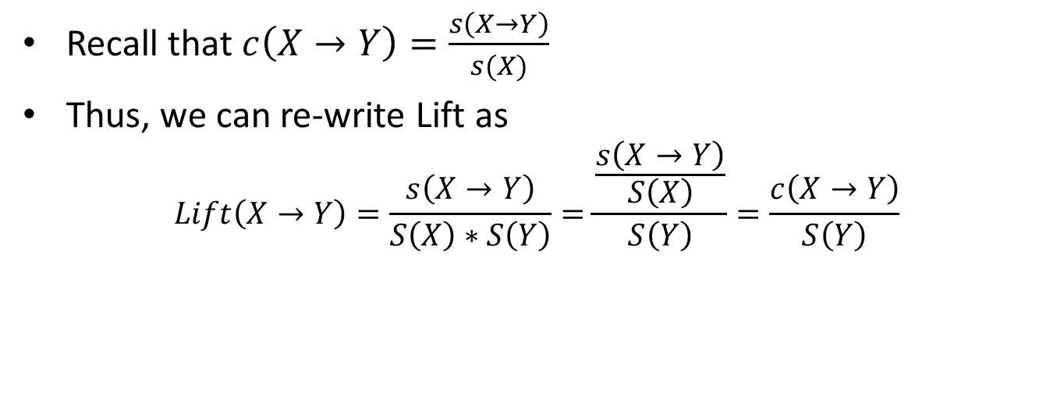
What does the Lift mean?
Recall that$c\left(X→Y\right)=\frac{s\left(X→Y\right)}{s(X)}$
Thus, we can re-write Lift as
$$Lift\left(X→Y\right)=\frac{s\left(X→Y\right)}{S\left(X\right)∗S\left(Y\right)}=\frac{\frac{s\left(X→Y\right)}{S\left(X\right)}}{S\left(Y\right)}=\frac{c\left(X→Y\right)}{S\left(Y\right)}$$
$c\left(X→Y\right)$: how often items in Y appear in transactions that contain X
$S(Y)$: how often items in Y appear in all transactions
Lift > 1 | The occurrence of X → Y together is more likely than what you would expect by chance ($\frac{c\left(X→Y\right)}{s\left(Y\right)}>1$)
Lift<1 | The occurrence of X → Y together is less likely than what you would expect by chance
Lift=1 | The occurrence of X → Y together is the same as what you would expect by chance (i.e. X and Y are independent of each other)

Slide 16
Lift Example
Basket | Items
1 | Bread, Milk
2 | Bread, Diapers, Beer, Eggs
3 | Milk, Diapers, Beer, Coke
4 | Bread, Milk, Diapers, Beer
5 | Bread, Milk, Diapers, Coke
What’s the lift for the rule: {Milk, Diapers} → {Beer}
So X = {Milk, Diapers} Y = {Beer} s({Milk, Diapers} → {Beer}) = 2/5 = 0.4 s({Milk, Diapers}) = 3/5 = 0.6 s({Beer}) = 3/5 = 0.6 So
When Lift > 1, the occurrence of X → Y together is more likely than what you would expect by chance

Slide 17
Another example
 | Netflix
Cable TV |  | No | Yes
 | No | 200 | 3800
 | Yes | 8000 | 1000
What is the effect of Netflix on Cable TV? (Netflix → CableTV)
Total = 200 + 3800 + 8000 + 1000 = 13000
People with both services = 1000/13000 → 7.7%
People with Cable TV = (8000+1000)/13000 → 69.2%
People with Netflix = (3800+1000)/13000 → 36.9%
$$Lift\left(\text{Netflix}→\text{CableTV}\right)=\frac{0.077}{0.692∗0.369}=\frac{0.07}{0.24}=30\%$$
Having one negatively affects the purchase of the other (lift < 1)

Slide 18
Selecting the rules
The steps
List all possible association rules
Compute the support and confidence for each rule
Drop rules that don’t make the thresholds
Use lift to further check the association
We know how to calculate the measures for each rule
Support
Confidence
Lift
Then we set up thresholds for the minimum rule strength we want to accept

Slide 19
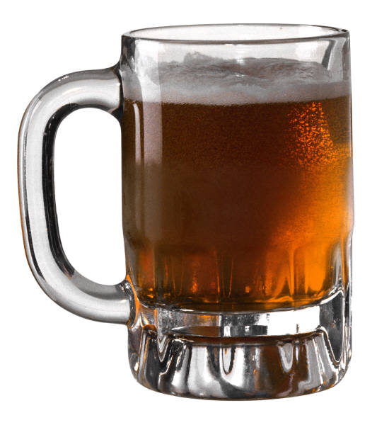
Once you are confident in a rule, take action
{Diapers} → {Beer}
Possible Marketing Actions
Put diaper next to beer in the store
What are some others?
Put diaper away from beer in the store (why?)
Bundle beer and diaper into “New Parent Coping Kit”

Slide 20
Summary
Support, confidence, and lift
Explain what each means
Can you have high confidence and low lift?
How to compute
In-Class Activity:
Part 1: Computing Confidence, Support, and Lift
Part 2: Association Rule Mining Using R

Slide 21
Support
Fraction of transactions that contain all items
Confidence
Measures how often items in Y appear in transactions that contain X
Lift
How co-occurrence differs from what is expected by chance
$$Lift\left(X→Y\right)=\frac{s\left(X→Y\right)}{S\left(X\right)∗S\left(Y\right)}=\frac{\frac{s\left(X→Y\right)}{S\left(X\right)}}{S\left(Y\right)}=\frac{c\left(X→Y\right)}{S\left(Y\right)}$$

