Slide 1
MIS2502: Data and Analytics
FOX
MIS

Slide 2
NoSQL
Part 1: Basic Queries
Spring 2023
FOX
MIS
Leila Hosseini
Leila.hosseini@temple.edu
http://community.mis.temple.edu/leila

Slide 3

Where we are…
Now we’re here…
Data entry
Transactional Database
Data extraction
Analytical Data Store
Data analysis
Stores real-time transactional data in a relational or NoSQL database
Stores historical transactional and summary data

Slide 4
What is NoSQL?
Stands for “Not Only SQL”
Non-relational data storage systems
Supports unstructured format (no fixed schema)

Slide 5
Why RDBMS?
Relational Databases – popular and commonly used
Minimize redundancy
  - Reduce errors
  - Less space required
Supports Joins
  across multiple tables allowing for normalized
  forms of data to be stored once

Slide 6
Why NoSQL?
Supports semi-structured (unstructured) data
  Unique data type extensions can be easily
  integrated into existing collections
Handling “Big” data with better performance
  RDBMS normalization and joins are powerful, but add up in cost
Operational issues (scale, performance and availability)

Slide 7
RDBMS vs. NoSQL
RDBMS | NoSQL
Pre-defined schema | Flexible schema
Data is distributed across multiple tables | Data is typically nested in a few collection
Based on relations | (Very few) relations
Not good for hierarchical work | Best fit for hierarchical work

Slide 8
NoSQL vs RDBMS – How to pick?
Nature of data
  Row/column (structured)
  Unstructured, complex which needs nesting
Schema
  Static: RDBMS,
  Dynamic: NoSQL
Self-contained: NoSQL, Joins: RDBMS
Flexibility of query
  RDBMS: Joins allow for flexibility
  NoSQL: Duplication of data, implement joins if necessary

Slide 9

What is MongoDB?
MongoDB is
  Created by 10gen
  (term coined from humongous)
  an open source, document-oriented database design
  stores BSON (JSON-like) documents
  Schema-less

Slide 10
MongoDB Database
Database
Collection
Collection
Document
Document
Document
Document
Document
RDBMS | MongoDB
Database | Database
Table | Collection
Column | Field
Row | Document
Join | Embedded Document Linking across Document
Foreign Key | Reference

Slide 11
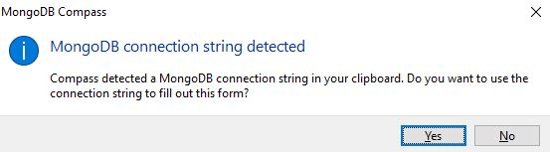
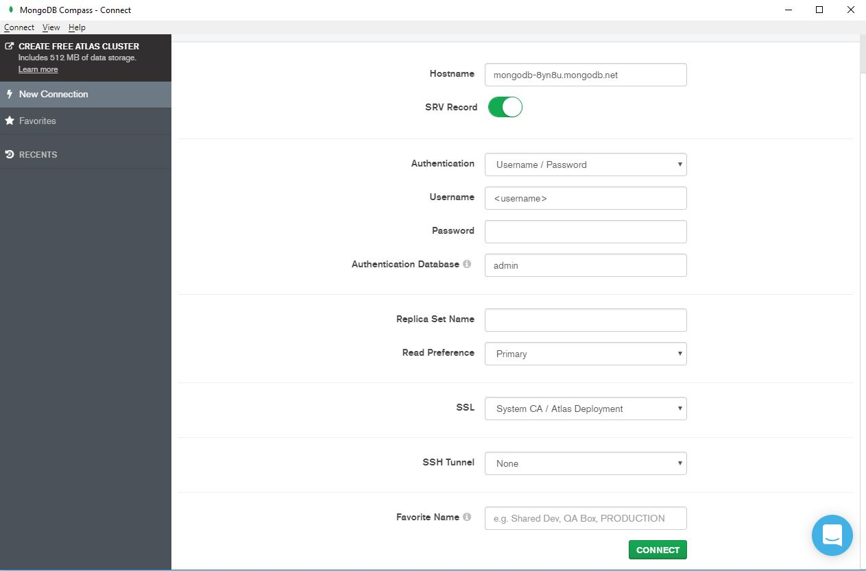
Connecting to a MongoDB Server
Before you open the compass, copy the connection string below:
mongodb+srv://username:password@cluster0.sm5q4j0.mongodb.net/test
Click yes and type in your username and password.
You can use the same username and password you used to connect MySQL.

Slide 12
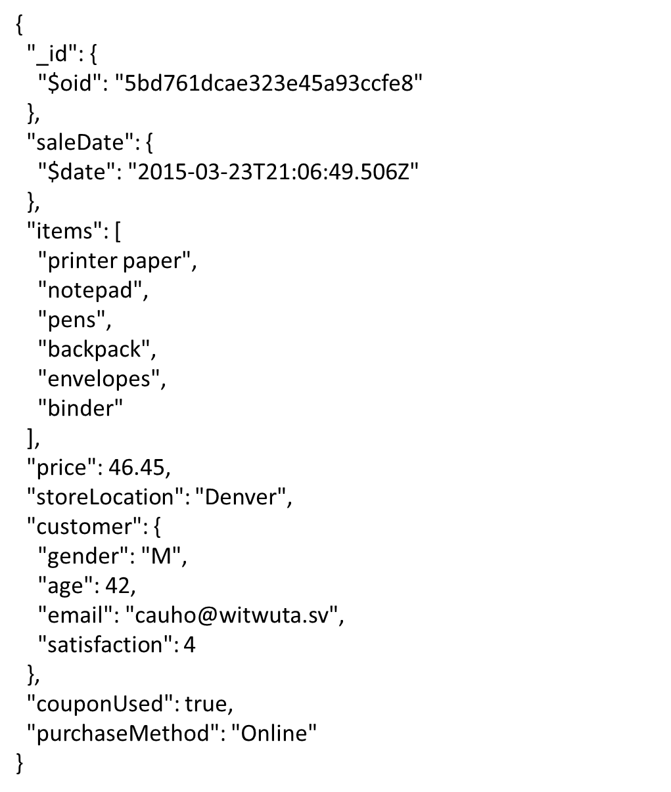
Dataset
salesdb.sales
JSON array
JSON object

Slide 13
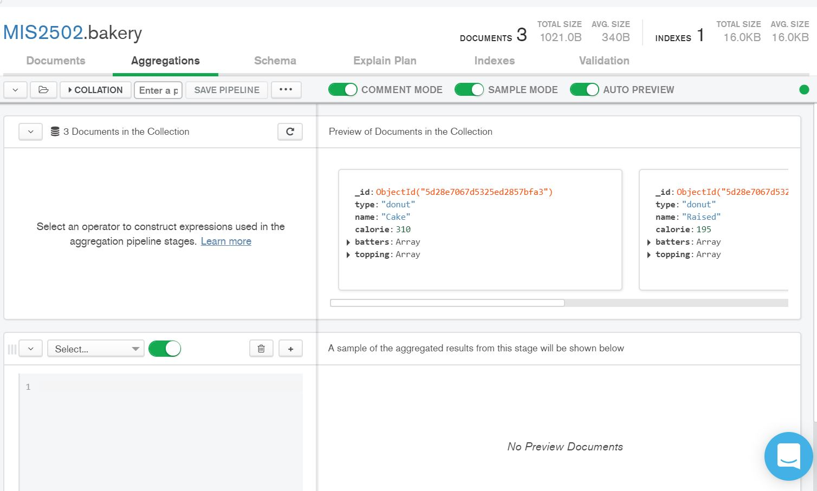
Aggregation Tab
Aggregation tap allows us to create pipeline stages, which specifies multiple stages of queries, to return a subset of documents from collection.
Select a type of stage
Add a new stage

Slide 14
MySQL vs MongoDB Query
MySQL | MongoDB
WHERE | $match
GROUP BY | $group
ORDER BY | $sort
LIMIT | $limit
SELECT expressions FROM.. | $project
Example..
SELECT purchaseMethod, sum(price) as totalprice
FROM salesDB.sales
WHERE couponUsed = FALSE
GROUP BY purchaseMethod
ORDER BY sum(price) ASC
LIMIT 2;
db.sales.aggregate(
[ { $match: { couponUsed: FALSE }},
{ $group: { _id: "$purchaseMethod",
totalprice: { $sum: "$price" }}},
{ $sort: { totalprice: 1 }},
{ $limit: 2 }
])

Slide 15
Return the Specified Fields
Select $project stage and copy the following expression into the panel:
$project: { items: 1, storeLocation: 1, customer: 1 }
The operation corresponds to the following SQL statement:
SELECT items, storeLocation, customer
FROM salesdb.sales;
The _id field is, by default, included in the output documents. You can remove by setting the field to 0.
Ref: https://docs.atlas.mongodb.com/data-explorer/cloud-agg-pipeline

Slide 16
Specify Equality Condition
$match stage filters the documents to pass only the
documents that match the specified condition(s)
Syntax :
$match: { field1: value1, ... }
The below code corresponds to the following SQL statement:
$match: { storeLocation: "Seattle"}
SELECT items, storeLocation, customer
FROM salesdb.sales WHERE storeLocation = “Seattle”;
$match work as WHERE statement in a SQL query.

Slide 17
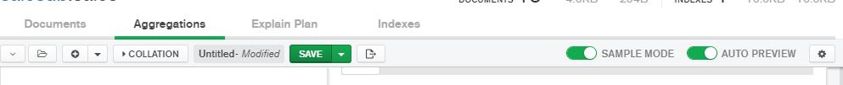
Compass vs MongoDB
Compass
$project: { items: 1, storeLocation: 1, customer: 1 }
$match: { storeLocation: "Seattle"}
MongoDB
Click Export To Language to see the code.
db.sales.aggregate{
[{ $project: {items: 1,storeLocation:1,customer:1}},
{ $match: {storeLocation: "Seattle"}}]
}

Slide 18
Does order matter?
What happens when we type in the following code? What happens when we switch the order of $project and $match?
$ project: { items: 1, customer: 1 }
$ match: { storeLocation: “Seattle” }
Unlike SQL, in the aggregation pipeline, each stage transforms the documents as they pass through the pipeline. Therefore, order matters!!!

Slide 19
Specify Conditions Using Operators
Syntax :
$match: { field1: { operator1: value1 }, ... }
For example,
$match: { price: { $gt: 200 } }
corresponds to the following SQL statement:
SELECT * FROM MIS2502.sales
WHERE price > 200;
Name | Description | Name | Description
$eq | equal to | $lt | less than
$gt | greater than | $lte | less than or equal to
$gte | greater than or equal to | $ne | not equal to

Slide 20
AND and OR Conditions
Syntax :
$match: { $and(or) : [ { condition1 }, { condition2 } , …} ] }
$and and $or operator performs a logical operation on an array of two or more <conditions>.
$match: { $and: [{ price: { $gt: 180} } ,
{ storeLocation: "Seattle"}]}
The operation corresponds to the following SQL statement:
SELECT * FROM salesDB.sales
WHERE price > 180 AND storeLocation = “Seattle”;

Slide 21
Sort Results
Using $sort stage, we can specify the sort order of the returned documents.
$sort: { price: 1 }
The operation corresponds to the following SQL statement:
SELECT * FROM salesDB.sales ORDER By price ASC;
We can set the field to 1 (-1), to specify ascending (descending) order for a field,.

Slide 22
Limit Results
Using $limit stage, we can specify the number of the returned documents.
$limit: 3
The operation corresponds to the following SQL statement:
SELECT * FROM salesDB.sales LIMIT 3;
So, what may happen if we put $limit on the first stage?

Slide 23
Aggregation
$group documents by some specified expression and outputs to the next stage a document for each distinct grouping
Syntax :
$group: { _id: expression,
field1: {accumulator1:expression1}, ... }
$group: { _id: "$purchaseMethod",
totalprice: { $sum: "$price"} }
corresponds to the following SQL statement:
SELECT purchaseMethod, sum(price) as totalprice
FROM salesDB.sales
Group by purchaseMethod;

Slide 24
Aggregation
Similar to GROUP BY in SQL, the output documents can contain computed filed
$group: { _id: "$purchaseMethod",
totalprice: { $sum: "$price"},
avgprice: { $avg: "$price"},
maxprice: { $max: "$price"},
number: { $sum:1} }
corresponds to the following SQL statement:
SELECT purchaseMethod, sum(price) as totalprice,
avg(price) as avgprice, max(price) as maxprice, count(price) as number
FROM salesDB.sales
Group by purchaseMethod;
In $group, we use $sum: 1 to count the number of documents.

Slide 25
Group by null
Grouping _id with null will calculate the total price and the average quantity as well as counts for all documents in the collection.
$group: { _id: null,
totalprice: { $sum: "$price"},
avgprice: { $avg: "$price"},
maxprice: { $max: "$price"},
number: { $sum:1} }
corresponds to the following SQL statement:
SELECT sum(price) as totalprice, avg(price) as avgprice, max(price) as maxprice, count(price) as number
FROM salesDB.sales;

Slide 26
MySQL vs MongoDB Query
MySQL | MongoDB
WHERE | $match
GROUP BY | $group
ORDER BY | $sort
LIMIT | $limit
SELECT expressions FROM.. | $project
Example..
SELECT purchaseMethod, sum(price) as totalprice
FROM salesDB.sales
WHERE couponUsed = FALSE
GROUP BY purchaseMethod
ORDER BY sum(price) ASC
LIMIT 2;
db.sales.aggregate(
[ { $match: { couponUsed: FALSE }},
{ $group: { _id: "$purchaseMethod",
totalprice: { $sum: "$price" }}},
{ $sort: { totalprice: 1 }},
{ $limit: 2 }
])

Slide 27
Summary
Given a semi structured database, we now should be able to create a NoSQL statement to answer a question
Understand how each stage in aggregation tap works and the relationship with SQL keywords
  $project
  $match
  $sort
  $limit
  $group

Slide 28
Syntax for MongoDB
KEY : Value
Field name (e.g., customer) | Numeric value
“Field name with dot notation” (e.g., “customer.name”) | “String value” (e.g., “Seattle”)
$accumulator/operator (e.g., $sum, $gt) | “$Field name” (e.g., “$customer”)
$project: { items: 1, storeLocation: 1, customer: 1 }
$match: { $and: [{ price: { $gt: 180} } ,
{ storeLocation: "Seattle"}]}
$group: { _id: "$purchaseMethod",
totalprice: { $sum: "$price"} }

Slide 29
In Class Activity #6

