Slide 1
MIS2502: Data and Analytics
FOX
MIS

Slide 2
Introduction to Advanced Analytics and R
Spring 2023
FOX
MIS
Leila Hosseini
Leila.hosseini@temple.edu
http://community.mis.temple.edu/leila

Slide 3

The Information Architecture of an Organization
Now we’re here…
Data entry
Transactional Database
Data extraction
Analytical Data Store
Data analysis
Stores real-time transactional data in a relational or NoSQL database
Stores historical transactional and summary data

Slide 4
What is Advanced Data Analytics?
The examination of data or content using sophisticated techniques and tools, to discover deeper insights, make predictions, or generate recommendations.
Goals:
Extraction of implicit, previously unknown, and potentially useful information from data
Exploration and analysis of large data sets to discover meaningful patterns
Prediction of future events based on historical data

Slide 5
Three Analytics Tasks We Will Be Doing in this Class
Decision Trees
Clustering
Association Rule Mining

Slide 6
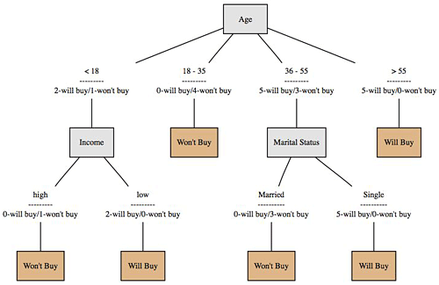
Decision Trees
Used to classify data
according to a
pre-defined outcome
Based on characteristics
of that data
Can be used to predict future outcomes
http://www.mindtoss.com/2010/01/25/five-second-rule-decision-chart/
Uses
Predict whether a customer should receive a loan
Flag a credit card charge as legitimate
Determine whether an investment will pay off

Slide 7
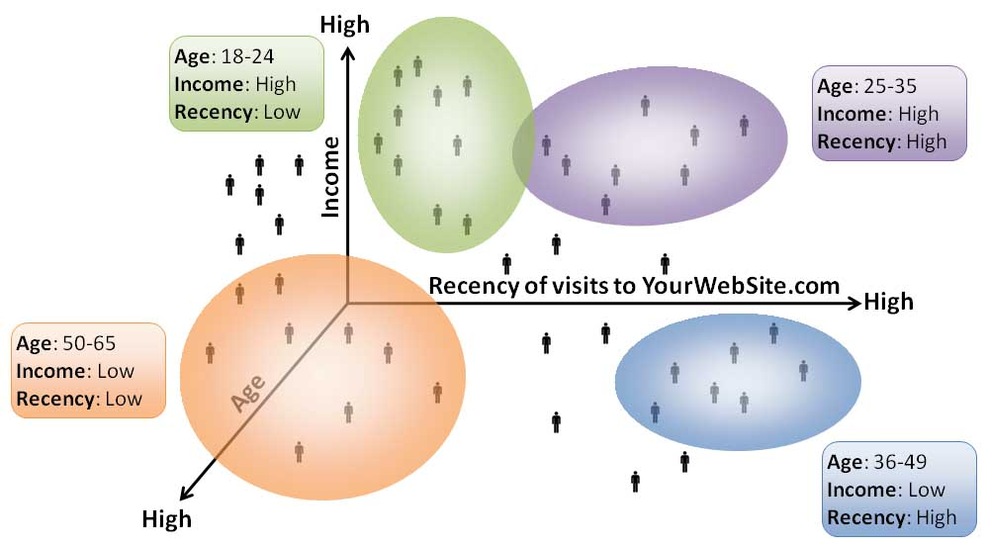
Clustering
Used to determine distinct groups of data
Based on data across multiple dimensions
Uses
Customer segmentation
Identifying patient care groups
Performance of business sectors
http://www.datadrivesmedia.com/two-ways-performance-increases-targeting-precision-and-response-rates/

Slide 8

Association Rule Mining
Find out which events predict the occurrence of other events
Often used to see which products are bought together
Uses
What products are bought together?
Amazon’s recommendation engine
Telephone calling patterns

Slide 9


Now we will start using Python and Jupyter Notebook heavily in class activities and assignments
Python has become one of the dominant software environments for data analysis
And has a large user community that contribute functionality
Make sure you download both on your computer!

Slide 10
High-level general-purpose programming language programming language
Open source, free
Many, many, many statistical add-on “packages” that perform data analysis
Web-based interactive computing platform
Nicer interface that makes Python easier to use
Requires Python to run (but also supports other 40 programming languages).
(The base/engine)
(Easy interface)

Slide 11
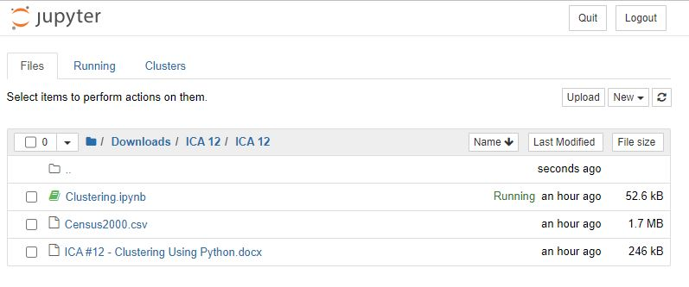
Jupyter Interface
Notebook Dashboard
When you launch jupyter notebook the first page that you encounter is the Notebook Dashboard

Slide 12
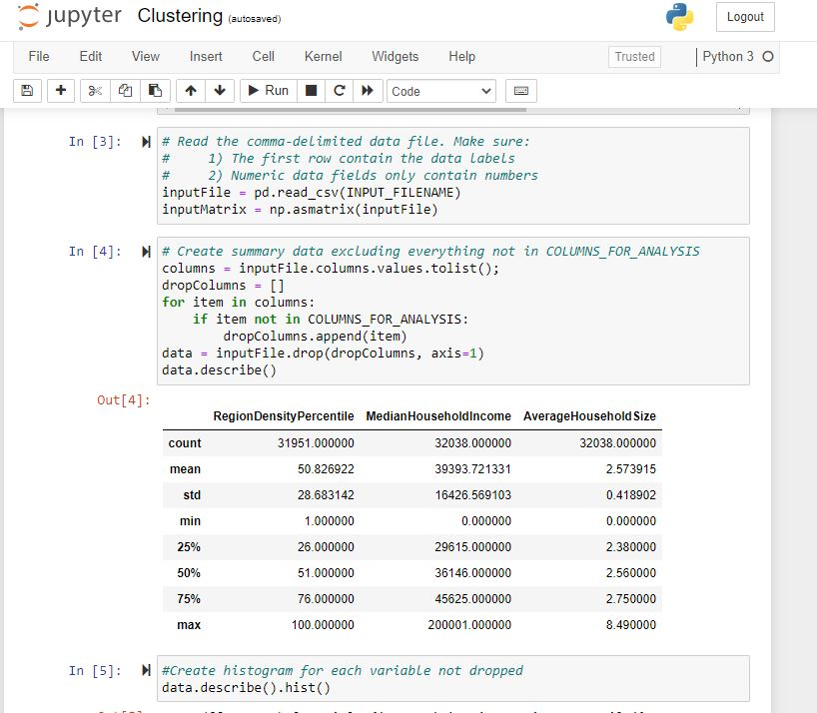
Jupyter Interface
Notebook Editor
The notebook has two modes − Command mode and Edit mode. Notebook enters edit mode when a cell is clicked.

Slide 13
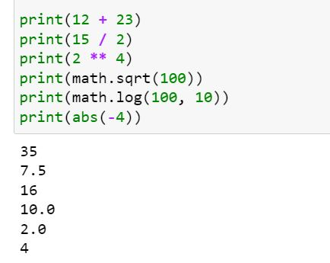
The Basics: Calculations
In its simplest form, Python can be used for simple calculations:
math.sqrt, math.log are functions.
Functions accept parameters
(in parentheses) and return a value
Once you run the code in each cell, the results of the code will show below

Slide 14
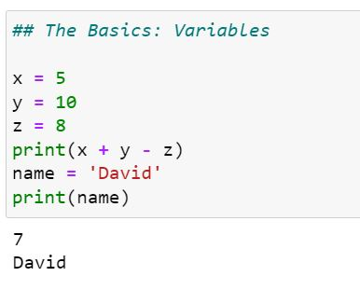
The Basics: Variables
  Variables are named containers for data
  The assignment operator in Python is: =
  Variable names can start with a letter or digits.
    Just not a number by itself.
    Examples: result, x1, 2b (not 2)
  Python is case-sensitive (i.e. Result is a different variable than result)
x, y, and z are variables that can be manipulated

Slide 15
Basic Data Types
Type | Range | Assign a Value
Numeric | Numbers | X = 1 Y = -2.5
Character | Text strings | Name = ‘Mark’ Color = ‘red’
Logical (Boolean) | TRUE or FALSE | Correct = True

Slide 16
Advanced Data Types
Lists
Data frames

Slide 17
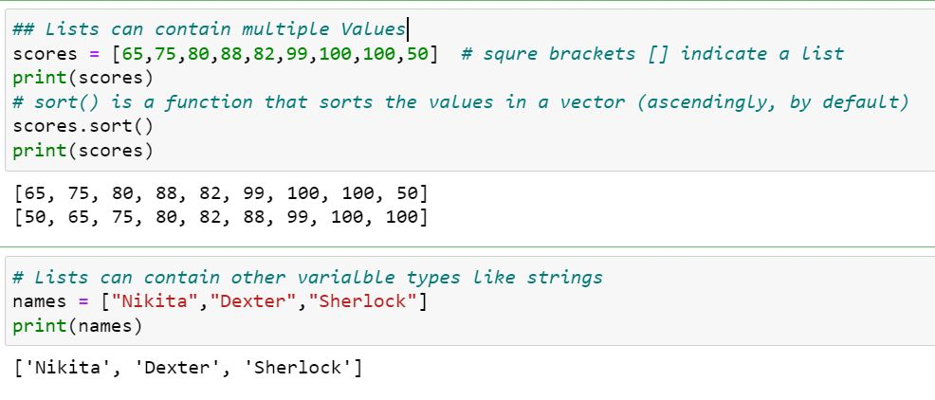
Lists
Lists are defined by a pair of square brackets on either end with individual elements separated by commas

Slide 18
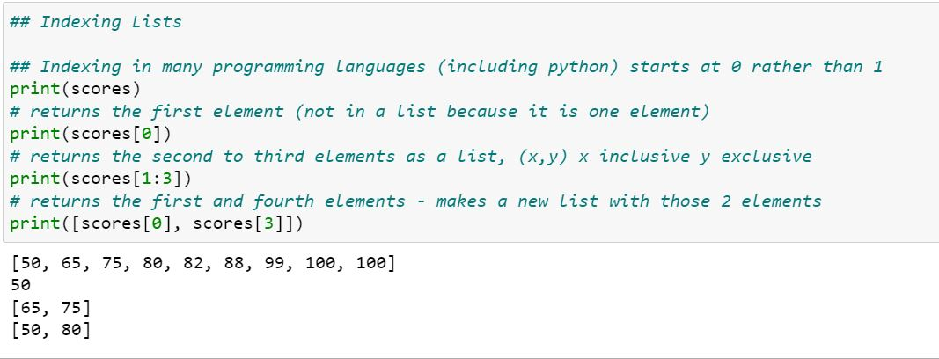
Indexing Lists
We use brackets [ ] to pick specific elements in the list.
In Python, the index of the first element is 0

Slide 19
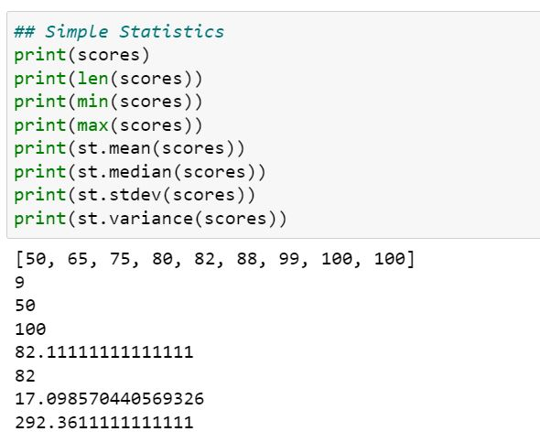
Simple statistics with Python
You can get descriptive statistics from a list
Again, len(), min(), max(), st.mean(), st.median(), st.stdev(), and st.variance() are all functions.
These functions accept lists as parameter.

Slide 20
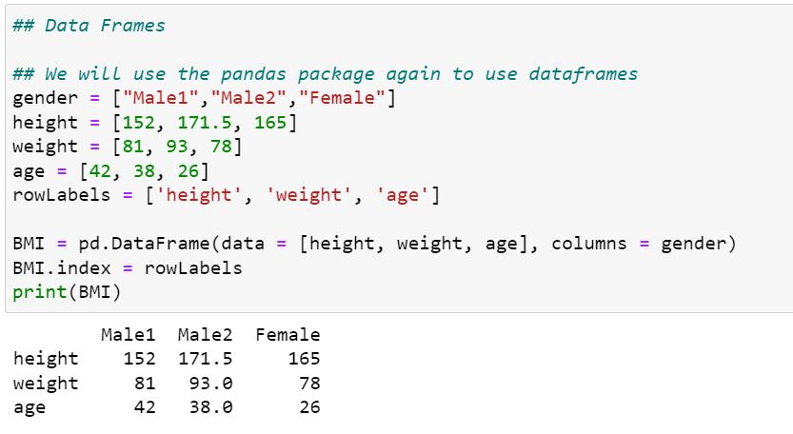
Data Frames
A data frame is a type of variable used for storing data tables
  is a special type of list where every element of the list has same length (i.e. data frame is a “rectangular” list)

Slide 21
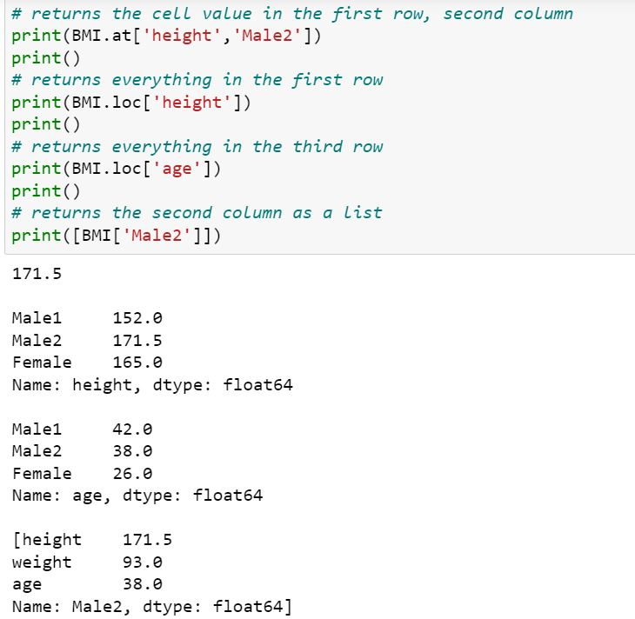
Identify elements of a data frame

Slide 22
Packages
Packages (add-ons) are collections of Python functions and code in a well-defined format.
To install a package:
  import math
  import statistics as st
Each package only needs to be installed once
We can also use ‘as’ statement and give a compact name
We can use the code when we want to shorten the name of ‘statistics’ to ‘st’

Slide 23
Import Data into Python
Python can handle all kinds of data files. We will mostly deal with csv files
Use pd.read_csv() function to import csv data
  You need to specify path to the data file
  If not, the csv file should be located in the same folder
  By default, comma is used as field delimiter
  First row is used as variable names

Slide 24
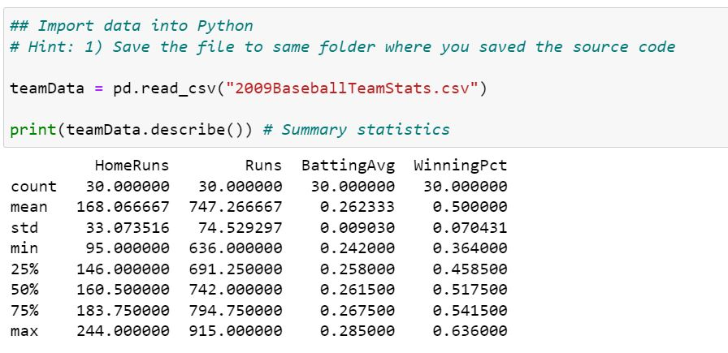
Reading data from a file
reads data from a CSV file and creates a data frame called teamData that store the data table.

Slide 25
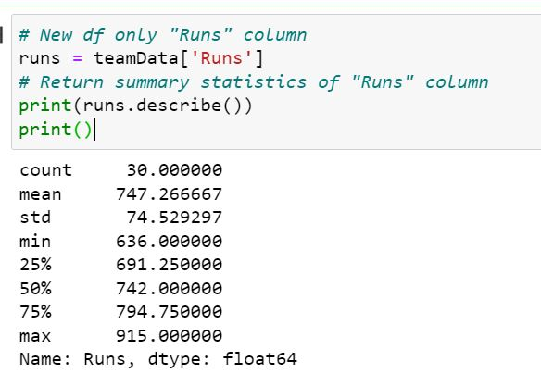
Reading data from a file
reference the Runs column in the data frame using square brackets []

Slide 26
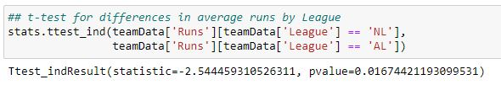
Looking for differences across groups:
(t-test)
We want to know if National League (NL) teams scored more runs than American League (AL) Teams
  And if that difference is statistically significant
To do this, we can run a t-test
Results of t-test for differences in Runs by League)

Slide 27


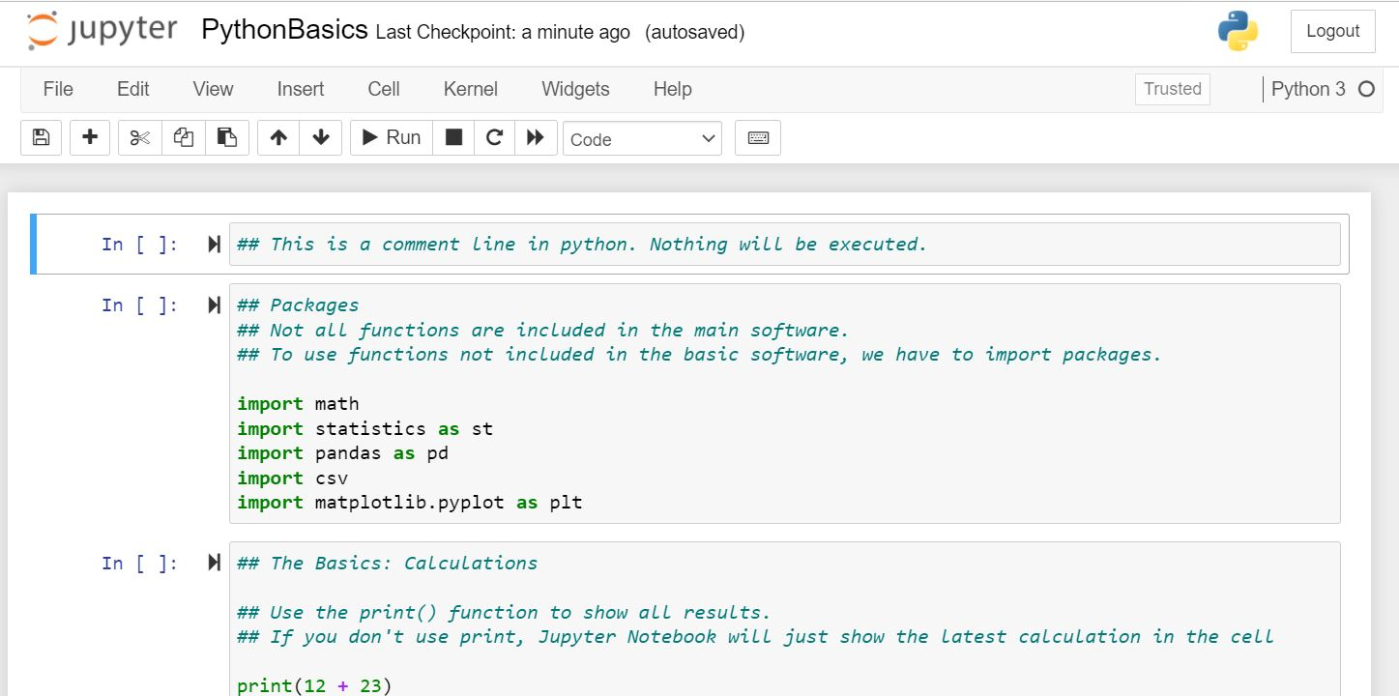
Running this analysis as a script
button will run the code in the selected cell
button will run the whole code

Slide 28
In Class Activity #9

