Slide 1
MIS2502: Data and Analytics
FOX
MIS

Slide 2
Classification using Decision Trees
Spring 2023
FOX
MIS
Leila Hosseini
Leila.hosseini@temple.edu
http://community.mis.temple.edu/leila

Slide 3
What is Classification?
A statistical method used to determine to what category (or “class”) a new observation belongs
  On the basis of a training data set containing observations whose categories were known
Examples
Task | Observations | Categories (Classes)
Flagging a credit card transaction as a fraudulent charge | Credit card transactions | Fraudulent vs. legitimate
Filtering spam emails | Emails | Spam vs. non-spam
Determining whether a customer should be given a loan | Customers | Default vs. no default

Slide 4
How Classification Works
1
  Choose a categorical outcome variable
2
  Split the data set into training and validation subsets
3
  Use the training set to find a model that predicts the outcome as a function of the other attributes
4
  Apply the model to the validation set to check accuracy
5
  Apply the final model to future cases (i.e. prediction)

Slide 5
How Classification Works
Training Set
TID | Income | Debt | Owns/ Rents | Outcome
1 | 25k | 35% | Owns | Default
2 | 35k | 40% | Rent | Default
3 | 33k | 15% | Owns | No default
4 | 28k | 19% | Rents | Default
5 | 55k | 30% | Owns | No default
6 | 48k | 35% | Rent | Default
7 | 65k | 17% | Owns | No default
8 | 85k | 10% | Rents | No default
…
Derive model
Classification software (such as R)
Validation Set
TID | Income | Debt | Owns/ Rents | Outcome
1 | 80k | 35% | Rent | ?
2 | 20k | 40% | Owns | ?
3 | 15k | 15% | Owns | ?
4 | 50k | 19% | Rents | ?
5 | 35k | 30% | Owns | ?
Apply model

Slide 6
Goals
Accuracy
It won’t be 100% accurate, but should be as close as possible
Prediction
An automated, reliable way to predict the outcome
The trained model should assign new observations to the right category
The model’s rules can be applied to new records as they come along

Slide 7

Classification Method: Decision Tree
A model to determine membership of cases or values of a outcome variable based on one or more predictor variables (Tan, Steinback, and Kumar 2004)

Slide 8


Classification Method: Decision Tree
Classification tree
Split over income
Income
Age
<50K
>=50K
Age
45
Default
Split over age
<45
>=45
X
Default
No Default
X
50K
Default
Did not default
Income
X New customer

Slide 9
How Decision Tree algorithm works
Start with single node with all training data
Yes
Are samples all of same classification?
No
No
Are there predictor(s) that will split the data?
Yes
Partition node into child nodes according to predictor(s)
No
Are there more nodes (i.e., new child nodes)?
DONE!
Yes
Go to next node.

Slide 10
Example: Credit Card Default
Predictors
Classification
TID | Income | Debt | Owns/ Rents | Outcome
1 | 25k | 35% | Owns | Default
2 | 35k | 40% | Rent | Default
3 | 33k | 15% | Owns | No default
4 | 28k | 19% | Rents | Default
5 | 55k | 30% | Owns | No default
6 | 48k | 35% | Rent | Default
7 | 65k | 17% | Owns | No default
8 | 85k | 10% | Rents | No default
…
We create the tree from a set of training data
Each unique combination of predictors is associated with an outcome
This set was “rigged” so that every combination is accounted for and has an outcome
Training Set

Slide 11
Example: Credit Card Default
Predictors
Classification
Child node
Leaf node
TID | Income | Debt | Owns/ Rents | Outcome
1 | 25k | 35% | Owns | Default
2 | 35k | 40% | Rent | Default
3 | 33k | 15% | Owns | No default
4 | 28k | 19% | Rents | Default
5 | 55k | 30% | Owns | No default
6 | 48k | 35% | Rent | Default
7 | 65k | 17% | Owns | No default
8 | 85k | 10% | Rents | No default
…
Root node
Debt > 20%
Default
Income
<40k
Owns house
No Default
Debt < 20%
Rents
Default
Credit
Approval
Owns house
No Default
Debt > 20%
Income
>40k
Rents
Default
Debt < 20%
No Default
Training Set

Slide 12
Same Data, Different Tree
Predictors
Classification
Credit
Approval
Owns
Rents
Income < 40k
Income > 40k
Debt > 20%
Default
Debt < 20%
No Default
No Default
Income < 40k
Income > 40k
Default
Debt > 20%
Default
Debt < 20%
No Default
TID | Income | Debt | Owns/ Rents | Outcome
1 | 25k | 35% | Owns | Default
2 | 35k | 40% | Rent | Default
3 | 33k | 15% | Owns | No default
4 | 28k | 19% | Rents | Default
5 | 55k | 30% | Owns | No default
6 | 48k | 35% | Rent | Default
7 | 65k | 17% | Owns | No default
8 | 85k | 10% | Rents | No default
…
Training Set
We just changed the order of the predictors.

Slide 13
Start with root node
Credit
Approval
Income
<40k
Income
>40k
Debt > 20%
Rents
Debt > 20%
Debt < 20%
Owns house
Rents
Owns house
Debt < 20%
Default
No Default
Default
No Default
Default
No Default
There are both “defaults” and “no defaults” in the set
So we need to look for predictors to split the data
Credit
Approval

Slide 14
First split: on income
Credit
Approval
Income
<40k
Income
>40k
Debt > 20%
Rents
Debt > 20%
Debt < 20%
Owns house
Rents
Owns house
Debt < 20%
Default
No Default
Default
No Default
Default
No Default
Income (with 40k as the cutoff point) is a factor that produces the greatest “separation”
  More income, less default
But there are also a combination of defaults and no defaults within each income group
So look for another split
Credit
Approval
Income <40k
Income >40k

Slide 15
Second split: on debt
Credit
Approval
Income
<40k
Income
>40k
Debt > 20%
Rents
Debt > 20%
Debt < 20%
Owns house
Rents
Owns house
Debt < 20%
Default
No Default
Default
No Default
Default
No Default
Debt is a factor
  (Income < 40, Debt < 20, Owns = No default)
  but
  (Income < 40, Debt < 20, Rents = Default)
But there are also a combination of defaults and no defaults within some debt groups
So look for another split
Credit
Approval
Income <40k
Income >40k
Debt >20%
Debt <20%
Debt >20%
Debt <20%

Slide 16
Third split: on owns/rents
Credit
Approval
Income
<40k
Income
>40k
Debt > 20%
Rents
Debt > 20%
Debt < 20%
Owns house
Rents
Owns house
Debt < 20%
Default
No Default
Default
No Default
Default
No Default
Credit
Approval
Income <40k
Income >40k
Debt >20%
Debt <20%
Debt >20%
Debt <20%
Default
Owns house
Rents
No Default
Default
Owns house
Rents
No Default
Default
No Default
Owns/Rents is a factor
For some cases it doesn’t matter, but for some it does
So you group similar branches
…And we stop because we’re out of predictors!

Slide 17

How does it know when and how to split?
There are statistics that show
When a predictor variable maximizes distinct outcomes
(if age is a predictor, we should see that older people buy; younger people don’t)
When a predictor variable separates outcomes
(if age is a predictor, we should not see older people who buy mixed up with older people who don’t)

Slide 18
Reading the Decision Tree Result
Outcome cases are not 100% certain
  There are probabilities attached to each outcome in a node
  So let’s code “Default” as 1 and “No Default” as 0
Credit
Approval
Income <40k
Income >40k
Debt >20%
Debt <20%
Debt >20%
Debt <20%
Owns house
Rents
Owns house
Rents
0.85
0.20
How many leaf nodes are there?
0.30
0.22
0.60
0.26

Slide 19
Reading the Decision Tree Result
Outcome cases are not 100% certain
  There are probabilities attached to each outcome in a node
  So let’s code “Default” as 1 and “No Default” as 0
Credit
Approval
Income <40k
Income >40k
Debt >20%
Debt <20%
Debt >20%
Debt <20%
Owns house
Rents
Owns house
Rents
Numbers next to the leaf nodes:
Represent the probabilities of the predicted outcome being 1 (1=“Default”)
0.85
0.20
0.30
0.22
0.60
0.26

Slide 20
Reading the Decision Tree Result
Outcome cases are not 100% certain
  There are probabilities attached to each outcome in a node
  So let’s code “Default” as 1 and “No Default” as 0
Credit
Approval
Income <40k
Income >40k
Debt >20%
Debt <20%
Debt >20%
Debt <20%
1
Owns house
Rents
0
0
Owns house
Rents
0
1
0
Numbers next to the leaf nodes:
Represent the probabilities of the predicted outcome being 1 (1=“Default”)
0.85
0.20
0.30
0.22
0.60
0.26

Slide 21
Reading the Decision Tree Result
Outcome cases are not 100% certain
  There are probabilities attached to each outcome in a node
  So let’s code “Default” as 1 and “No Default” as 0
Credit
Approval
Income <40k
Income >40k
Debt >20%
Debt <20%
Debt >20%
Debt <20%
1
Owns house
Rents
0
0
Owns house
Rents
0
1
0
0.85
0.20
For example, for people with income<40K, Debt>20%,
the probability of “default” is 0.85
(or 85%)
0.30
0.22
0.60
0.26

Slide 22
Reading the Decision Tree Result
Outcome cases are not 100% certain
  There are probabilities attached to each outcome in a node
  So let’s code “Default” as 1 and “No Default” as 0
Value of 1:
we predict that these people are likely to
“Default”
Credit
Approval
Income <40k
Income >40k
Debt >20%
Debt <20%
Debt >20%
Debt <20%
1
Owns house
Rents
0
0
Owns house
Rents
0
1
0
0.85
0.20
0.30
0.22
Value of 0:
we predict that these people are likely to “No Default”
0.60
0.26

Slide 23
Reading the Decision Tree Result
Outcome cases are not 100% certain
  There are probabilities attached to each outcome in a node
  So let’s code “Default” as 1 and “No Default” as 0
Credit
Approval
Income <40k
Income >40k
Debt >20%
Debt <20%
Debt >20%
Debt <20%
1
Owns house
Rents
0
0
Owns house
0
1
0
Rents
So what is the chance that:
1. A renter making more than $40,000 and debt more than 20% of income will default?
2. A home owner making less than $40,000 and debt less than 20% of income will default?
0.85
0.20
0.30
0.22
0.60
0.26

Slide 24
Reading the Decision Tree Result
Outcome cases are not 100% certain
  There are probabilities attached to each outcome in a node
  So let’s code “Default” as 1 and “No Default” as 0
Credit
Approval
Income <40k
Income >40k
Debt >20%
Debt <20%
Debt >20%
Debt <20%
1
Owns house
Rents
0
0
Owns house
0
1
0
Rents
So what is the chance that:
1. A renter making more than $40,000 and debt more than 20% of income will default?
2. A home owner making less than $40,000 and debt less than 20% of income will default?
0.85
0.20
0.30
0.22
0.60
0.26

Slide 25
Reading the Decision Tree Result
Outcome cases are not 100% certain
  There are probabilities attached to each outcome in a node
  So let’s code “Default” as 1 and “No Default” as 0
Credit
Approval
Income <40k
Income >40k
Debt >20%
Debt <20%
Debt >20%
Debt <20%
1
Owns house
Rents
0
0
Owns house
0
1
0
Rents
So what is the chance that:
1. A renter making more than $40,000 and debt more than 20% of income will default?
2. A home owner making less than $40,000 and debt less than 20% of income will default?
0.85
0.20
0.30
0.22
0.60
0.26

Slide 26
Reading the Decision Tree Result
Outcome cases are not 100% certain
  There are probabilities attached to each outcome in a node
  So let’s code “Default” as 1 and “No Default” as 0
Credit
Approval
Income <40k
Income >40k
Debt >20%
Debt <20%
Debt >20%
Debt <20%
1
Owns house
Rents
0
0
Owns house
Rents
0
1
0
0.85
0.20
Describe the characteristics of the most likely and least likely groups to default.
0.30
0.22
0.60
0.26

Slide 27
Reading the Decision Tree Result
Outcome cases are not 100% certain
  There are probabilities attached to each outcome in a node
  So let’s code “Default” as 1 and “No Default” as 0
Credit
Approval
Income <40k
Income >40k
Debt >20%
Debt <20%
Debt >20%
Debt <20%
1
Owns house
Rents
0
0
Owns house
Rents
0
1
0
0.85
0.20
Describe the characteristics of the most likely and least likely groups to default.
0.30
0.22
0.60
0.26

Slide 28
Apply to new (validation) data
Validation Set
Credit
Approval
Income
<40k
Income
>40k
Debt > 20%
Rents
Debt > 20%
Debt < 20%
Owns house
Rents
Owns house
Debt < 20%
Default
No Default
Default
No Default
Default
No Default
TID | Income | Debt | Owns/ Rents | Decision (Predicted) | Decision (Actual)
1 | 80k | 35% | Rent | Default | No Default
2 | 20k | 40% | Owns | Default | Default
3 | 15k | 15% | Owns | No Default | No Default
4 | 50k | 19% | Rents | No Default | Default
5 | 35k | 30% | Owns | Default | Default
How well did the decision tree do in predicting the outcome?
When it’s “good enough,” we’ve got our model for future decisions.

Slide 29
Classification Accuracy:
How often does the tree make a correct prediction?
Error rate: Percent of misclassified records out of the total records
Correct classification rate: Percent of correctly classified records out of the total records
Error rate + Correct classification rate = 100%
A good decision tree model should have high classification accuracy, meaning
  Low error rate
  High correct classification rate

Slide 30
Classification Accuracy: A Numeric Example
A Confusion Matrix compares the predicted outcomes to the observed (actual) outcomes
The Confusion Matrix
 |  | Predicted outcome:
 |  | Default | No default
Observed outcome: | Default | 600 | 100
 | No default | 150 | 650 | Total: 1500
Error rate = (150+100) /1500= 16.7%
Correct classification rate = (100%-16.7%) = 83.3%
  (Another way to compute:
  Correct classification rate = (600+650)/1500 = 83.3%)

Slide 31
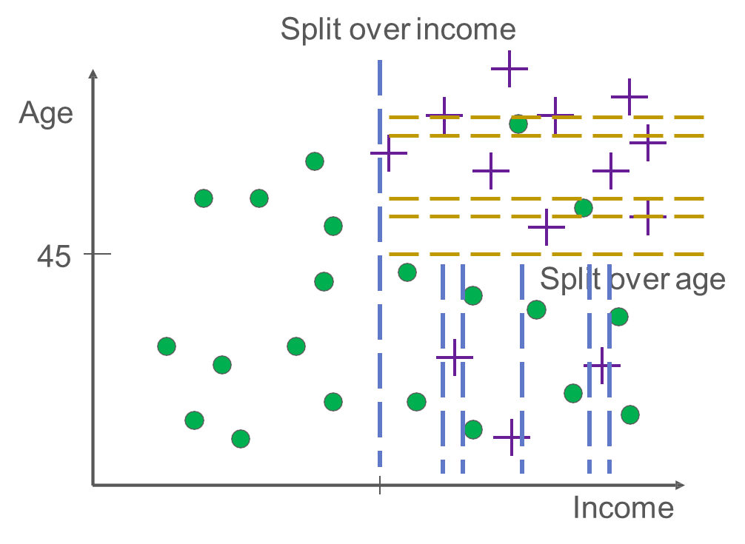
Can we keep splitting as long as it can?
You may get better classification accuracy for the training set
But the tree will become too complex
  Difficult to interpret
Another Problem: “Overfitting”

Slide 32
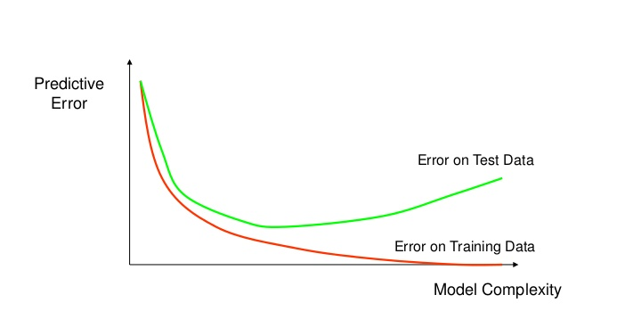
How overfitting affects prediction
  If the tree is too complex, it may have poor predictive performance for new data, as it can exaggerate minor fluctuations (noises) in the training data.
Error rate
Validation set
Training set
Tree size
“A good model must not only fit the training data well but also accurately classify records it has never seen.”

Slide 33
Avoid Overfitting: Control Tree Size
In R, you can control tree size using:
Minimum split
  Minimum number of observations in each node needed to add an additional split.
  Smaller minimum split →
  more complex tree
Complexity factor
  Minimum reduction in error needed to add an additional split.
  Smaller complexity factor →
  more complex tree

Slide 34
Minimum Split
100
Income < 40K
Income > 40K
35
65
Male
Female
29
36
If Minimum Split is 40, tree ends here
What if Minimum split is 30?

Slide 35
Avoid Overfitting: Prune the Tree
“Prune” the tree
Idea behind pruning:
A very large tree is likely to overfit the training set
Therefore the weakest branches, which hardly reduce error rate, should be removed

Slide 36
Summary
What is classification
Structure of a decision tree
  Outcome variables: categorical values
  Predictor variables
Classification accuracy:
  Error rate and correct classification rate
Interpret a decision tree
  Determine the probability of an event happening based on predictor variable values
Pros and cons of a complex tree
  Overfitting

Slide 37
In Class Activity #10

