Slide 1
Review for Exam 3
MIS2502: Data and Analytics
Leila Hosseini

Slide 2
Overview
Date/Time: Thursday, April 27,
9:30 am – 10:50 am (80 minutes)
Multiple-choice and short-answer questions
Closed-book, closed-note
Please bring your calculator

Slide 3
Coverage
Check the Exam 3 Study Guide
Data Mining and Data Analytics Techniques
Using Python and Jupyter
Decision Tree Analysis
Cluster Analysis
Association Rules
Not every item on this list may be on the exam, and there may be items on the exam not on this list.

Slide 4
Study Materials
Lecture slides
In-class activities
Assignments

Slide 5
How data mining differs from other analysis
Simple analysis tells you what is happening, or what has happened
Whatever can be done using SQL, Pivot table and Tableau Prep is not data mining
Sum, average, min, max, time trend…
Data mining can tell you why it is happening, and help predict what will happen
Decision Trees
Clustering
Association Rules
Notes:
In terms of data mining, we more focus on the future / what will happen in the future/why it is happening

Slide 6
When to use which analysis? (Decision Trees, Clustering, and Association Rules)
When someone gets an A in this class, what other classes do they get an A in?
What predicts whether a company will go bankrupt?
If someone upgrades to an iPhone, do they also buy a new case?
Which presidential candidate will win the election?
Can we group our website visitors into types based on their online behaviors?
Can we identify different product markets based on customer demographics?
Association Rules
Decision Trees
Association Rules
Decision Trees
Clustering
Clustering
Notes:
Based on each situation which technique should we use
A – association between classes
D – observation(companies)
A – iphone (ante)

Slide 7
Using Python
The role of packages in Python
Basic syntax for Python, for example:
Variable assignment
Identify functions versus variables
Identify how to access a variable (column) from a dataset (table)
Notes:
Packages provides functionality thatis not covered by r and rstudio
Assignment operator
Assign the results from the function
This is a way we can access specific column

Slide 8
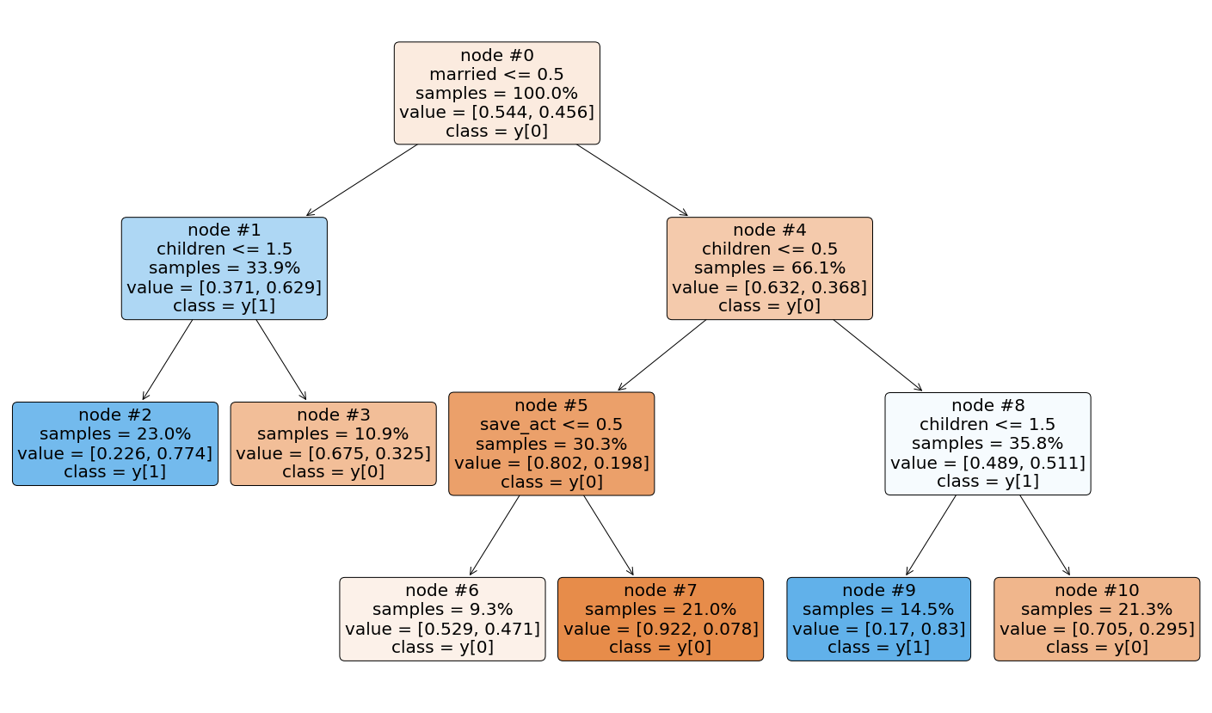
Decision Tree Analysis
Outcome variable: Discrete/Categorical
Interpreting decision tree output
Probability of purchase?
Who are most/least likely to buy?

Slide 9
Decision Tree Analysis
What are the pros and cons with a complex tree?
How would minimum split affect the tree?
MINIMUMSPLIT: the minimum number of observations that must exist in a node in order for a split to be attempted
Pros: Better accuracy
Cons: hard to interpret, overfitting
more complex tree
Smaller MINIMUMSPLIT →

Slide 10
Classification Accuracy
 |  | Predicted outcome:
 |  | 0 | 1
Observed outcome: | 0 | 1001 | 45
 | 1 | 190 | 3764 | Total: 5000
Error rate?
Correct classification rate?
(190+45) /5000= 0.047 (4.7%)
(1-0.047) = 0.953 (95.3%)

Slide 11
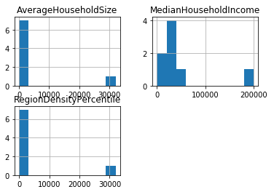
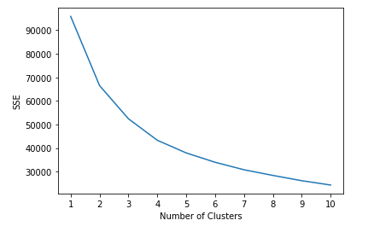
Cluster Analysis
Interpret output from a cluster analysis

Slide 12
Cohesion and Separation
Cohesion
Higher withinss = Lower cohesion (BAD)
High withinss means that elements within cluster are far away from each other
Separation
Higher betweenss = Higher separation(GOOD)
High betweenss means that different clusters are far away from each other
What happens to those statistics as the number of clusters increases?
Higher cohesion (Good)
Lower separation (Bad)

Slide 13
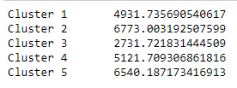
Cohesion and Separation
Interpret withinss (cohesion) and betweensss (separation)
withinss error (cohesion)
total betweensss error
average betweensss error (separation)

Slide 14
Standardized (Normalized) Data
Interpret standardized cluster means for each input variable
For standardized values, “0” is the average value for that variable.
For Cluster 5:
average RegionDensityPercentile >0 ➔ higher than the population average
average MedianHouseholdIncome, and AverageHouseholdSize <0 ➔ lower than the population average

Slide 15
Association Rules
Interpret the output from an association rule analysis
Compute support count ($σ$), support (s), confidence, and lift
$$\text{c}\left(\text{X}\text{→}\text{Y}\right)\text{=}\frac{\text{s}\left(\text{X}\text{→}\text{Y}\right)}{\text{s}\text{(}\text{X}\text{)}}$$
These two formulas will be provided
But you need to know how to compute support

Slide 16
Compute Support, confidence, and lift
Basket Items
1 Coke, Pop-Tarts, Donuts
2 Cheerios, Coke, Donuts, Napkins
3 Waffles, Cheerios, Coke, Napkins
4 Bread, Milk, Coke, Napkins
5 Coffee, Bread, Waffles
6 Coke, Bread, Pop-Tarts
7 Milk, Waffles, Pop-Tarts
8 Coke, Pop-Tarts, Donuts, Napkins
Rule | Support | Confidence | Lift
{Coke} → {Donuts}
{Coke, Pop-Tarts} →{Donuts}

Slide 17
Compute Support, confidence, and lift
Basket Items
1 Coke, Pop-Tarts, Donuts
2 Cheerios, Coke, Donuts, Napkins
3 Waffles, Cheerios, Coke, Napkins
4 Bread, Milk, Coke, Napkins
5 Coffee, Bread, Waffles
6 Coke, Bread, Pop-Tarts
7 Milk, Waffles, Pop-Tarts
8 Coke, Pop-Tarts, Donuts, Napkins
Rule | Support | Confidence | Lift
{Coke} → {Donuts} | 3/8 = 0.375 | 3/6 = 0.50 | $$\frac{0.375}{0.75∗0.375}=1.33$$
{Coke, Pop-Tarts} →{Donuts}

Slide 18
Compute Support, confidence, and lift
Basket Items
1 Coke, Pop-Tarts, Donuts
2 Cheerios, Coke, Donuts, Napkins
3 Waffles, Cheerios, Coke, Napkins
4 Bread, Milk, Coke, Napkins
5 Coffee, Bread, Waffles
6 Coke, Bread, Pop-Tarts
7 Milk, Waffles, Pop-Tarts
8 Coke, Pop-Tarts, Donuts, Napkins
Rule | Support | Confidence | Lift
{Coke} → {Donuts} | 3/8 = 0.375 | 3/6 = 0.50 | $$\frac{0.375}{0.75∗0.375}=1.33$$
{Coke, Pop-Tarts} →{Donuts} | 2/8 = 0.25 | 2/3 = 0.67 | $$\frac{0.25}{0.375∗0.375}=1.78$$

Slide 19
Compute Support, confidence, and lift
Basket Items
1 Coke, Pop-Tarts, Donuts
2 Cheerios, Coke, Donuts, Napkins
3 Waffles, Cheerios, Coke, Napkins
4 Bread, Milk, Coke, Napkins
5 Coffee, Bread, Waffles
6 Coke, Bread, Pop-Tarts
7 Milk, Waffles, Pop-Tarts
8 Coke, Pop-Tarts, Donuts, Napkins
Rule | Support | Confidence | Lift
{Coke} → {Donuts} | 3/8 = 0.375 | 3/6 = 0.50 | $$\frac{0.375}{0.75∗0.375}=1.33$$
{Coke, Pop-Tarts} →{Donuts} | 2/8 = 0.25 | 2/3 = 0.67 | $$\frac{0.25}{0.375∗0.375}=1.78$$
{Coke, Pop-Tarts} →{Donuts} has both higher lift and confidence
Which rule has the stronger association?
Consider:
a customer with coke in the shopping cart.
a customer with coke and pop-tarts in the shopping cart.
Who do you think is more likely to buy donuts?
The second one, with a higher lift

Slide 20
Compute Support, confidence, and lift
 | Krusty-O’s
Potato Chips |  | No | Yes
 | No | 5000 | 1000
 | Yes | 4000 | 500
 |  |  |  | Total: 10500
What is the lift for the rule {Potato Chips} → {Krusty-O’s}?
Are people who bought Potato Chips more likely than chance to buy Krusty-O’s too?

Slide 21
Compute Support, confidence, and lift
 | Krusty-O’s
Potato Chips |  | No | Yes
 | No | 5000 | 1000
 | Yes | 4000 | 500
 |  |  |  | Total: 10500
What is the lift for the rule {Potato Chips} → {Krusty-O’s}?
Are people who bought Potato Chips more likely than chance to buy Krusty-O’s too?
$$Lift= \frac{\left.s(Potato Chips, KrustyOs\right)}{\left.s\left(Potato Chips\right)∗s(KrustyOs\right)}=\frac{0.048}{0.429∗0.143}=0.782$$
They appear in the same basket less often than what you’d expect by chance (i.e., Lift < 1).

Slide 22
Association Rules
What does Lift > 1 mean? Would you take action on such a rule?
What about Lift < 1?
What about Lift = 1?
The occurrence of X → Y together is more likely than what you would expect by random chance (positive association)
The occurrence of X → Y together is less likely than what you would expect by random chance (negative association)
The occurrence of X → Y together is the same as random chance (no apparent association. X and Y are independent of each other)

Slide 23
Association Rules
Can you have high confidence and low lift?
A numeric demonstration: Suppose we have 10 baskets. X appears in 8 baskets. Y appears in 8 baskets. X and Y co-appear in 6 baskets…
$$σ\left(X\right)=8⟹s\left(X\right)=0.8$$
$$σ\left(Y\right)=8⟹s\left(Y\right)=0.8$$
$$σ\left(X→Y\right)=6⟹s\left(X→Y\right)=0.6$$
$Confidence=$ $\frac{σ\left(X→Y\right)}{σ\left(X\right)}=\frac{6}{8}=0.75$
$$Lift= \frac{s\left(X→Y\right)}{s\left(X\right)∗s(Y)}=\frac{0.6}{0.8∗0.8}=0.9375<1$$
When both X and Y are popular….
You get high confidence
But low lift
When both X and Y are popular, you’d almost expect them to show up in the same baskets by chance !

Slide 24
Good luck!

