Slide 1
Clustering and Segmentation
MIS2502: Data and Analytics
JaeHwuen Jung
jaejung@temple.edu
http://community.mis.temple.edu/jaejung

Slide 2
Case: Walmart’s Customer Segmentation
Wal-Mart has partitioned its 200 million customers into three core consumer groups. The three are:
Value-Price Shoppers - Those with like low prices who can’t afford much more.
Brand Aspirationals - People with low incomes who are fixated on brand names like KitchenAid; and,
Price-Sensitive Affluents - Wealthier shoppers who love deals;
Armed with its new insights, Wal-Mart said, from now on, all product decisions would be organized around the three groups.
Link: http://www.scdigest.com/assets/newsViews/07-03-27-2.php?cid=977

Slide 3
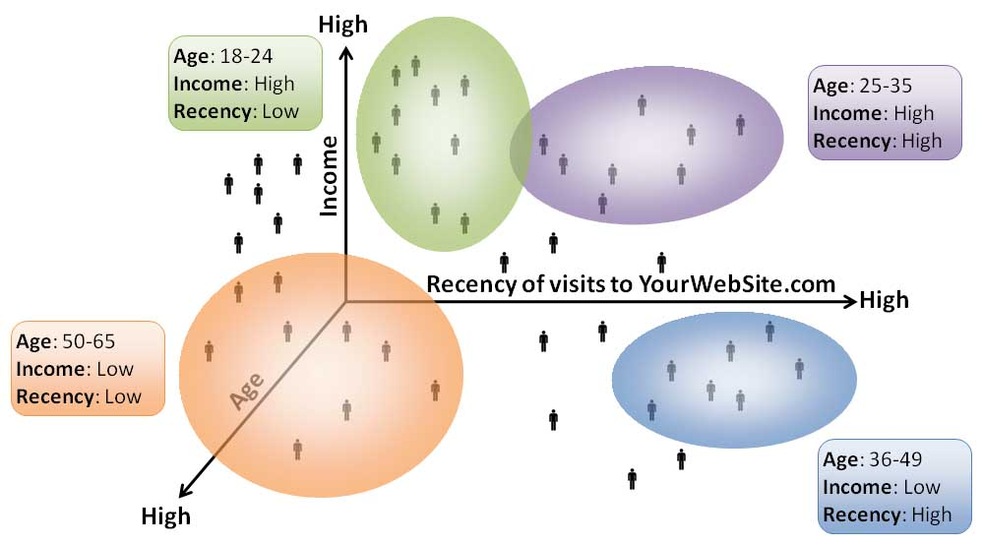
What is Cluster Analysis?
The process of grouping data so that
Observations within a group will be similar to one another
Observations from different groups will be dissimilar
Distance within clusters is minimized
http://www.datadrivesmedia.com/two-ways-performance-increases-targeting-precision-and-response-rates/
Distance between clusters is maximized

Slide 4
Applications
Marketing (Market Segmentation)
Discover distinct customer groups for targeted promotions
Industry analysis
Finding groups of similar firms based on profitability, growth rate, market size, products, etc.
Political forecasting
Group neighborhoods by demographics, lifestyles and political view
Biology
Finance
Group similar plants into species
Define groups of similar stocks based on financial characteristics, and select stocks from different groups to create balanced portfolios

Slide 5
What cluster analysis is NOT
Classification
(like Decision Trees)
People simply place items into categories
Simple categorization by attributes
Dividing students into groups by last name
The clusters must be learned from the data, not from external specifications.
Creating the “buckets” beforehand is categorization, but not clustering.

Slide 6
How would you design an algorithm to group these data points?
Here is the initial data set

Slide 7
K-Means: Overview
“K” stands for number of clusters
  We have to choose a “K” first
The idea is assign each observation to one and only one cluster based on the similarity among observations
We call the center of each cluster as “centroid”

Slide 8
K-Means Demonstration
Choose K points as initial centroids

Slide 9
K-Means Demonstration
Assign data points according to distance

Slide 10
K-Means Demonstration
Recalculate the centroids

Slide 11
K-Means Demonstration
And re-assign the points

Slide 12
K-Means Demonstration
And keep doing that until you settle on a final set of clusters

Slide 13
K-Means Algorithm
Choose K clusters
Select K points as initial centroids
Assign each point to the cluster with the closest centroid
Yes
Recompute the centroid of each cluster
No
Did the center change?
DONE!

Slide 14
Another Interaction Demonstration
http://stanford.edu/class/ee103/visualizations/kmeans/kmeans.html
https://www.naftaliharris.com/blog/visualizing-k-means-clustering/

Slide 15

Choosing the initial centroids
It matters
Choosing the right number “K”
Choosing the right initial location
Bad choices create bad groupings
They won’t make sense within the context of the problem
Unrelated data points will be included in the same group
There’s no single, best way to choose initial centroids

Slide 16
Example of Poor Initialization
This may “work” mathematically but the clusters don’t make much sense.

Slide 17
Before Clustering:
Normalize (Standardize) the data
Sometimes we have variables in very different scales
  For example, income between $0-1 billion versus age between 0-100
Normalization: Adjusts for differences in scale
How to normalize data?
  Subtracting with the average and dividing by the standard deviation
  This transform data into a “standard” scale
    New average = 0
    New standard deviation = 1

Slide 18
Normalization: A Numeric Example
If we have 10 students’ age values:
The normalized age values would be:
Age
19
22
23
20
20
21
21
22
18
20
Age
-1.06
0.93
1.59
-0.40
-0.40
0.27
0.27
0.93
-1.73
-0.40
Average: 20.6
Standard deviation: 1.51
New average: 0
New standard deviation: 1
Normalizing 1st student’s age: (19-20.6)/1.51= -1.06
Normalizing 2nd student’s age: (22-20.6)/1.51= 0.93

Slide 19
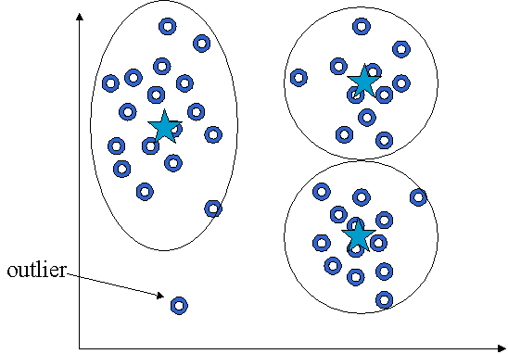
Before Clustering: Remove outliers
Find observations that are very different from others
  To reduce dispersion that can skew the cluster centroids
  And they don’t represent the population anyway
http://web.fhnw.ch/personenseiten/taoufik.nouri/kbs/clustering/DM-Part5.htm

Slide 20
Clusters can be ambiguous
How many clusters?
6
2
4
The difference is the threshold you set.
How distinct must a cluster be to be it’s own cluster?
adapted from Tan, Steinbach, and Kumar. Introduction to Data Mining (2004)

Slide 21
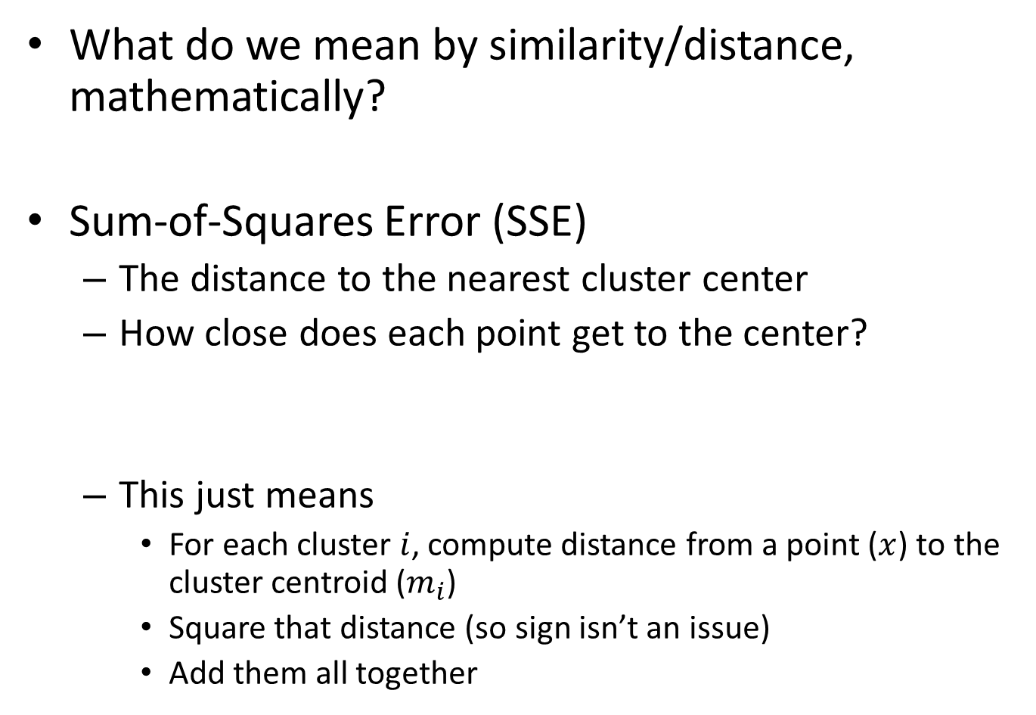
Evaluating K-means Clusters
What do we mean by similarity/distance, mathematically?
Sum-of-Squares Error (SSE)
  The distance to the nearest cluster center
  How close does each point get to the center?
  This just means
    For each cluster $i$, compute distance from a point ($x$) to the cluster centroid ($m_{i}$)
    Square that distance (so sign isn’t an issue)
    Add them all together
SSE is always non-negative (>=0)

Slide 22
Example: Within-Cluster SSE
Cluster 1
Cluster 2
3
3.3
1
1.3
1.5
2
SSE₁ = 1² + 1.3² + 2² = 1 + 1.69 + 4 = 6.69
SSE₂ = 3² + 3.3² + 1.5² = 9 + 10.89 + 2.25 = 22.14
Within-cluster SSE measures cohesion – how tightly grouped each cluster is

Slide 23
Within-Cluster SSE
Considerations
Lower individual within cluster SSE = a better cluster
Lower total SSE = a better set of clusters
More clusters will reduce within-cluster SSE
Reducing within-cluster SSE increases cohesion
(we want that)

Slide 24
SSE between clusters
(Between-cluster SSE)
What we are missing is: distance between centroids
Also can use SSE
  You’d want to maximize SSE between clusters
Increasing between-cluster SSE increases separation
(we want that)
Cluster 1
Cluster 5

Slide 25
Trade-off: Cohesion versus Separation
2 clusters
6 clusters
versus
More clusters → higher cohesion (good)
(lower within cluster SSE)
More clusters → lower separation (bad)
(lower between cluster SSE)

Slide 26
Choosing the number of clusters (K)
Can be determined by external reasons
In many cases, there’s no single answer…
But here’s what we can do:
  Make sure the clusters are describing distinct groups (separation).
  Make sure that the range of values on each variable within a cluster is not too large to be useful (cohesion).

Slide 27

Figuring out if our clusters are good
“Good” means
  Meaningful
  Useful
  Provides insight
How to interpret the clusters?
  Obtain summary statistics
  Visualize the clusters
This is somewhat subjective and depends upon the expectations of the analyst

Slide 28
Limitations of K-Means Clustering
K-Means gives unreliable results when
Clusters vary widely in size
Clusters vary widely in density
The data set has a lot of outliers
Clusters are not in rounded shapes
The clusters may never make sense.
In that case, the data may just not be well-suited for clustering!

Slide 29
The Keys to Successful Clustering
High cohesion
Low within-cluster SSE
High separation
High between-cluster SSE
We want:
Choose the right number of clusters
Choose the right initial centroids
No easy way to do this
Trial-and-error, knowledge of the problem, and looking at the output

Slide 30
Summary
What is cluster analysis?
When to use this technique (applications)?
What is the basic idea behind K-means clustering algorithm?
  K: the number of clusters
  Centroid
How to process data before clustering?
  Normalization
  Removing outliers
Sum of squares errors (SSE) – to measure distance
  Within-cluster SSE: Cohesion
  Between-cluster SSE: Seperation

Slide 31
In Class Activity #12

