Slide 1
Review for Exam 1
MIS2502: Data and Analytics
JaeHwuen Jung
jaejung@temple.edu
http://community.mis.temple.edu/jaejung

Slide 2
Overview
Place: On Canvas
Please take the exam at a place where you can have
a stable and fast internet connection!
Tell everyone in your household to not watch movies, stream audio or do on-line gaming for the duration of your exam.
Multiple-choice and short-answer questions
Closed-book, closed-notes
You are NOT allowed to use scrap paper. If you need a place to take notes while writing SQL, please use the space where you type in the code.

Slide 3
Coverage
Check the Exam 1 Study Guide
Not every item on this list may be on the exam, and there may be items on the exam not on this list.

Slide 4
The Things You Can Do With Data/ The Information Architecture of an Organization
Data vs. information
Transaction
  Business transaction
  Database transaction
Transactional database vs. Analytical data store
  Characteristics, goals, relationship

Slide 5

The Information Architecture of an Organization
Data entry
Transactional Database
Data extraction
Analytical Data Store
Data analysis
Stores real-time transactional data in a relational or NoSQL database
Stores historical transactional and summary data

Slide 6
Components of an information infrastructure
Transactional Database
Captures data describing an event
Analytical Data Store
Used in analysis and reporting
For everyday transactions
Extracted from transactional data
Supports management of an organization’s data
Supports managerial decision-making
This is what is commonly thought of as “database management”
This is the foundation for “advanced data analytics”

Slide 7
Relational Data Modeling
Be able to interpret Database Schema
  Entities
  Attributes
    Entity attributes vs. relationship attributes
    Primary key and non-key attributes
  Relationships & Cardinality
    Maximum cardinality: One-to-one, one-to-many, many-to-many
    Minimum cardinality: optional or mandatory (i.e., 0 or 1)
Best practices for normalization

Slide 8
Understanding Database Schema
Table Name
(Entity)
Table
Customer
CustomerID
FirstName
LastName
City
State
Zip
Order
OrderNumber
CustomerID
OrderDate
Primary Key
Foreign
Key
Field
(Attributes
of the
Entity)
Cardinality

Slide 9
Cardinality
Maximum
Cardinality
Customer
CustomerID
FirstName
LastName
City
State
Zip
Order
OrderNumber
CustomerID
OrderDate
Minimum
Cardinality
Maximum cardinality
  Describes the maximum number of entities that participate in a relationship (either or )
Minimum cardinality
  Describes the minimum number of entities that participate in a relationship (either or )

Slide 10
Maximum Cardinality
How to understand the notations:
at most - one
at most - many
Customer
CustomerID
FirstName
LastName
City
State
Zip
Order
OrderNumber
CustomerID
OrderDate
  One customer can have many orders.
  One order can only belong to one customer.

Slide 11
Minimum Cardinality
How to understand the notations:
at least - one
at least - zero
Customer
CustomerID
FirstName
LastName
City
State
Zip
Order
OrderNumber
CustomerID
OrderDate
  One customer can have no (zero) orders.
  One order has to belong to at least one customer.

Slide 12
Cardinality: Example 1
Each department has many faculty members
But each faculty is affiliated with one and only one department
Department
Faculty
Minimum: One
(not explicitly stated)

Slide 13
Cardinality: Example 2
Each student needs to declare at least one and at most two majors (that is, first major and second major) at the beginning of the first year.
Student
Major
Maximum: Many
(not explicitly stated)
Minimum: One
(not explicitly stated)

Slide 14
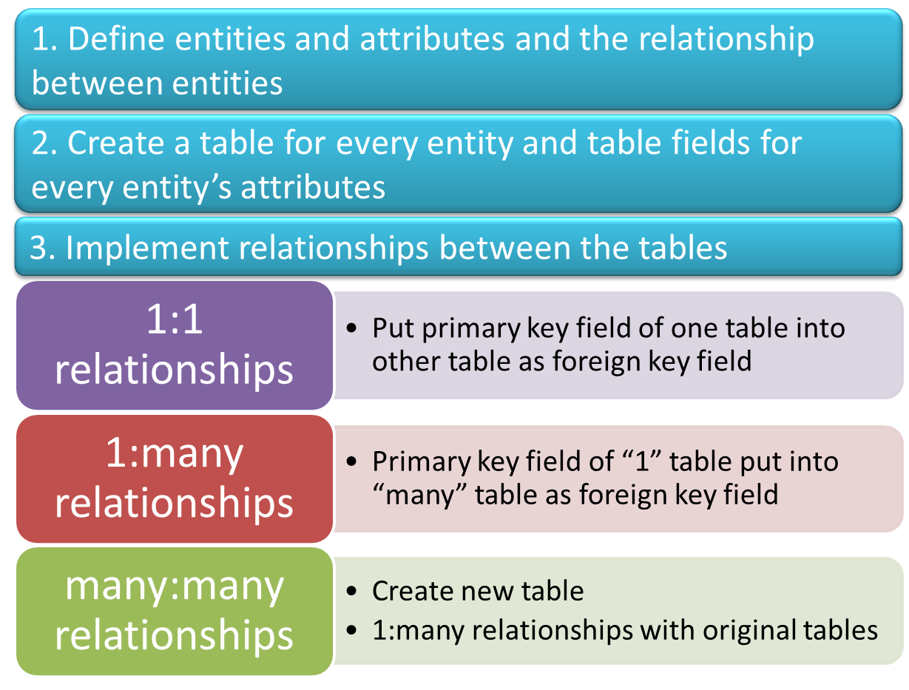
Relational Data Modeling

Slide 15
SQL Query
SELECTing from a single table or JOINing multiple tables will be on this exam
Subselect will be on the second exam

Slide 16
Basic SQL
Given a schema of a database, be able to create a SQL statement to answer a question
Understand how to use
  SELECT
  FROM
  DISTINCT
  WHERE (and how to specify conditions)
  AND/OR
  COUNT, AVG, MIN, MAX, SUM
  GROUP BY
  ORDER BY (ASC/DESC)
  LIMIT
SELECT [DISTINCT] expression(s)
FROM schema_name.table_name(s)
[WHERE condition(s)]
[GROUP BY expression(s)]
[ORDER BY expression(s) [ ASC | DESC ]]
[LIMIT number_rows];

Slide 17
SELECT from 1 Table
Recall the Customer table…
SELECT *
FROM orderdb.Customer;
CustomerID | FirstName | LastName | City | State | Zip
1001 | Greg | House | Princeton | NJ | 09120
1002 | Lisa | Cuddy | Plainsboro | NJ | 09123
1003 | James | Wilson | Pittsgrove | NJ | 09121
1004 | Eric | Foreman | Warminster | PA | 19111
SELECT FirstName, LastName
FROM orderdb.Customer
WHERE State=‘NJ’;
FirstName | LastName
Greg | House
Lisa | Cuddy
James | Wilson

Slide 18
Order By, Group By
GROUP BY:
  Return the results for each group in the specified field
  Often used together with the functions
    COUNT, MIN, MAX, AVG, SUM
  One result is returned for each group
ORDER BY:
  Sort records based on the specified field or function
  Default: ASC
  Specify DESC to make it descending.

Slide 19
Group By (Example)
OrderProductID | OrderNumber | ProductID | Quantity
1 | 101 | 2251 | 2
2 | 101 | 2282 | 3
3 | 101 | 2505 | 1
4 | 102 | 2251 | 5
5 | 102 | 2282 | 2
6 | 103 | 2505 | 3
7 | 104 | 2505 | 8
Ask: What is the total quantity sold per order (by order number)?
Order-Product
SELECT OrderNumber, SUM(Quantity)
FROM orderdb.OrderProduct
GROUP BY OrderNumber;
OrderNumber | SUM(Quantity)
101 | 6
102 | 7
103 | 3
104 | 8

Slide 20
Group By and Order By (Example)
OrderProductID | OrderNumber | ProductID | Quantity
1 | 101 | 2251 | 2
2 | 101 | 2282 | 3
3 | 101 | 2505 | 1
4 | 102 | 2251 | 5
5 | 102 | 2282 | 2
6 | 103 | 2505 | 3
7 | 104 | 2505 | 8
Ask: What is the total quantity sold per order (by order number)?
Sort the results descendingly based on total quantity sold
Order-Product
SELECT OrderNumber, SUM(Quantity)
FROM orderdb.OrderProduct
GROUP BY OrderNumber
OrderNumber | SUM(Quantity)
104 | 8
102 | 7
101 | 6
103 | 3
ORDER BY SUM(Quantity) DESC;

Slide 21
DISTINCT and GROUP BY
SELECT DISTINCT State
FROM orderdb.Customer;
State
NJ
PA
SELECT State
FROM orderdb.Customer
GROUP BY State;
State
NJ
PA
TIP: GROUP BY can be used without aggregation functions.
In this case, the result returned will be similar to DISTINCT

Slide 22
Combining WHERE, GROUP BY, and ORDER BY
Recall the Customer table:
CustomerID | FirstName | LastName | City | State | Zip
1001 | Greg | House | Princeton | NJ | 09120
1002 | Lisa | Cuddy | Plainsboro | NJ | 09123
1003 | James | Wilson | Pittsgrove | NJ | 09121
1004 | Eric | Foreman | Warminster | PA | 19111
Ask:
How many customers are there in each city in New Jersey? Order the results alphabetically in descending order by city

Slide 23
One more note: Combining WHERE, GROUP BY, and ORDER BY
X
SELECT City, COUNT(*)
FROM orderdb.Customer
WHERE State='NJ'
GROUP BY City
ORDER BY City DESC;
SELECT City, COUNT(*)
FROM orderdb.Customer
GROUP BY City
ORDER BY City DESC
WHERE State='NJ';
This is the correct SQL statement
This won’t work
City | COUNT(*)
Princeton | 1
Plainsboro | 1
Pittsgrove | 1
When combining WHERE, GROUP BY, and ORDER BY, write the WHERE condition first, then GROUP BY, then ORDER BY.

Slide 24
SQL Joins
Used to combine two or more tables, based on the common fields between them.
Suppose we have….
MyDB.Customer
MyDB.Order
CustomerID | LastName | FirstName | Country
1 | Futterkiste | Alfreds | Germany
2 | Trujillo | Ana | US
3 | Moreno | Antonio | Mexico
OrderID | CustomerID | OrderDate | Amount
10308 | 2 | 1996-09-18 | 100
10309 | 1 | 1996-09-19 | 10
10310 | 1 | 1996-09-20 | 63

Slide 25
(Inner) Join
SELECT * FROM MyDB.Customer
JOIN MyDB.Order ON Order.CustomerID=Customer.CustomerID;
MyDB.Customer
MyDB.Order
CustomerID | LastName | FirstName | Country
1 | Futterkiste | Alfreds | Germany
2 | Trujillo | Ana | US
3 | Moreno | Antonio | Mexico
OrderID | CustomerID | OrderDate | Amount
10308 | 2 | 1996-09-18 | 100
10309 | 1 | 1996-09-19 | 10
10310 | 1 | 1996-09-20 | 63
CustomerID | LastName | FirstName | Country
1 | Futterkiste | Alfreds | Germany
1 | Futterkiste | Alfreds | Germany
2 | Trujillo | Ana | US
OrderID | CustomerID | OrderDate | Amount
10309 | 1 | 1996-09-19 | 10
10310 | 1 | 1996-09-20 | 63
10308 | 2 | 1996-09-18 | 100

Slide 26
More Variations to Join
Step 1: We start with a simple join
SELECT *
FROM MyDB.Customer JOIN MyDB.Order
ON Order.CustomerID=Customer.CustomerID;
Q: What is the total order amount by country?
CustomerID | LastName | FirstName | Country
1 | Futterkiste | Alfreds | Germany
1 | Futterkiste | Alfreds | Germany
2 | Trujillo | Ana | US
OrderID | CustomerID | OrderDate | Amount
10309 | 1 | 1996-09-19 | 10
10310 | 1 | 1996-09-20 | 63
10308 | 2 | 1996-09-18 | 100
Step 2: We then end up with -
SELECT Customer.Country, SUM(Order.Amount)
FROM MyDB.Customer JOIN MyDB.Order
ON Order.CustomerID=Customer.CustomerID
GROUP BY Customer.Country;
Country | SUM(Amount)
US | 100
Germany | 73

Slide 27
Outer Join
SELECT * FROM MyDB.Customer
LEFT JOIN MyDB.Order ON Order.CustomerID=Customer.CustomerID;
MyDB.Customer
MyDB.Order
CustomerID | LastName | FirstName | Country
1 | Futterkiste | Alfreds | Germany
2 | Trujillo | Ana | US
3 | Moreno | Antonio | Mexico
OrderID | CustomerID | OrderDate | Amount
10308 | 2 | 1996-09-18 | 100
10309 | 1 | 1996-09-19 | 10
10310 | 1 | 1996-09-20 | 63
CustomerID | LastName | FirstName | Country
1 | Futterkiste | Alfreds | Germany
1 | Futterkiste | Alfreds | Germany
2 | Trujillo | Ana | US
3 | Moreno | Antonio | Mexico
OrderID | CustomerID | OrderDate | Amount
10309 | 1 | 1996-09-19 | 10
10310 | 1 | 1996-09-20 | 63
10308 | 2 | 1996-09-18 | 100

Slide 28
More Variations to Join
Q: What is total number of orders by country?
Return all countries including those have no order.
Step 1: We start with left join
SELECT *
FROM MyDB.Customer LEFT JOIN MyDB.Order
ON Order.CustomerID=Customer.CustomerID;
CustomerID | LastName | FirstName | Country
1 | Futterkiste | Alfreds | Germany
1 | Futterkiste | Alfreds | Germany
2 | Trujillo | Ana | US
3 | Moreno | Antonio | Mexico
OrderID | CustomerID | OrderDate | Amount
10309 | 1 | 1996-09-19 | 10
10310 | 1 | 1996-09-20 | 63
10308 | 2 | 1996-09-18 | 100
Step 2: We then end up with -
SELECT Customer.Country, COUNT(OrderID)
FROM MyDB.Customer LEFT JOIN MyDB.Order
ON Order.CustomerID=Customer.CustomerID
GROUP BY Customer.Country;
Country | COUNT(OrderID)
Germany | 2
US | 1
Mexico | 0

Slide 29
Good Luck!

