Slide 1
Review for Final Exam
MIS2502: Data and Analytics
JaeHwuen Jung jaejung@temple.edu http://community.mis.temple.edu/jaejung

Slide 2
Overview
Date/Time: Monday, May 3,
1:00 to 2:15 PM (65 minutes in a 75 minute window so you can set up Proctorio)
Place: On Canvas
Please take the exam at a place where you can have stable, high speed internet connection! Tell your relatives, roommates, pets, to stay off the wifi.
Multiple-choice and short-answer questions
Closed-book, closed-note
You will use a calculator for a few questions (provided in Proctorio)!

Slide 3
Coverage
Check the Final Exam Study Guide
Advanced Data Analytics Techniques
Using R and RStudio
Decision Tree Analysis
Cluster Analysis
Association Rules
SQL (Join, WHERE, Group By, Order By, Limit, etc.)
Not every item on this list may be on the exam, and there may be items on the exam not on this list.

Slide 4
Study Materials
Lecture slides
In-class exercises
Assignments

Slide 5
How data mining differs from other analysis
Simple analysis tells you what is happening, or what has happened
Whatever can be done using SQL, Pivot table and Tableau Prep is not data mining
Sum, average, min, max, time trend…
Advanced Data Analysis can tell you why it is happening, and help predict what will happen
Decision Trees
Clustering
Association Rules
Notes:
In terms of data mining, we more focus on the future / what will happen in the future/why it is happening

Slide 6
When to use which analysis? (Decision Trees, Clustering, and Association Rules)
When someone gets an A in this class, what other classes do they get an A in?
What predicts whether a company will go bankrupt?
If someone upgrades to an iPhone, do they also buy a new case?
Which presidential candidate will win the election?
Can we group our website visitors into types based on their online behaviors?
Can we identify different product markets based on customer demographics?
Association Rules
Decision Trees
Association Rules
Decision Trees
Clustering
Clustering
Notes:
Based on each situation which technique should we use
A – association between classes
D – observation(companies)
A – iphone (ante)

Slide 7
Using R and RStudio
Difference between R and RStudio
The role of packages in R
Basic syntax for R, for example:
Variable assignment (e.g. NUM_CLUSTERS <- 5)
Identify functions versus variables
(e.g. kmeans() is a function, kmeans is a variable)
Identify how to access a variable (column) from a dataset (table) (e.g. dataSet$Salary)
Notes:
Packages provides functionality thatis not covered by r and rstudio
Assignment operator
Assign the results from the function
This is a way we can access specific column

Slide 8
Hypothesis Testing
uses p-values to weigh the strength of the evidence
T-test: A small p-value (typically ≤ 0.05) suggests that there is a statistically significant difference in means.
> t.test(subset$TaxiOut~subset$Origin);
Welch Two Sample t-test
data: subset$TaxiOut by subset$Origin
t = 51.5379, df = 24976.07, p-value < 2.2e-16
alternative hypothesis: true difference in means is not equal to 0
95 percent confidence interval:
6.119102 6.602939
sample estimates:
mean in group ORD mean in group PHX
20.58603 14.22501
$$2.2e−16=2.2×{10}^{−16}≤0.05$$
So we conclude that the difference is statistically significant
More about p-values:
http://www.dummies.com/how-to/content/the-meaning-of-the-p-value-from-a-test.html
http://www.dummies.com/how-to/content/statistical-significance-and-pvalues.html
Notes:
Scientific notiation – reduce space

Slide 9
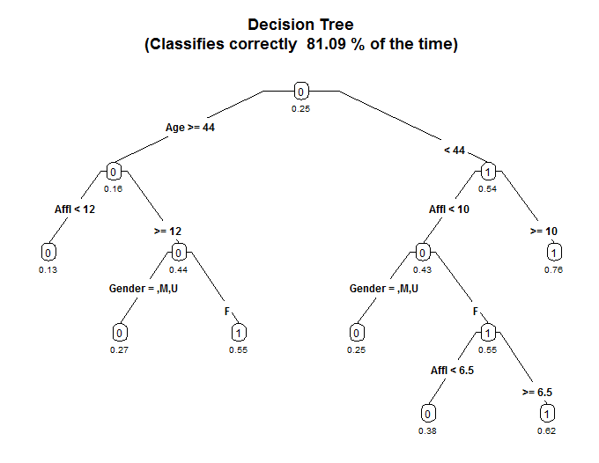
Decision Tree Analysis
Outcome variable: Discrete/Categorical
Interpreting decision tree output
Probability of purchase?
Who are most/least likely to buy?

Slide 10
Decision Tree Analysis
What are the pros and cons with a complex tree?
How would complexity factor affect the tree?
How would minimum split affect the tree?
MINIMUMSPLIT: the minimum number of observations that must exist in a node in order for a split to be attempted
Pros: Better accuracy
Cons: hard to interpret, overfitting
COMPLEXITY FACTOR: the reduction in error needed for an additional split to be allowed
Smaller COMPLEXITYFACTOR →
more complex tree
Smaller MINIMUMSPLIT →
more complex tree

Slide 11
Classification Accuracy
 |  | Predicted outcome:
 |  | 0 | 1
Observed outcome: | 0 | 1001 | 45
 | 1 | 190 | 3764 | Total: 5000
Error rate?
Correct classification rate?
(190+45) /5000= 0.047 (4.7%)
(1-0.047) = 0.953 (95.3%)

Slide 12
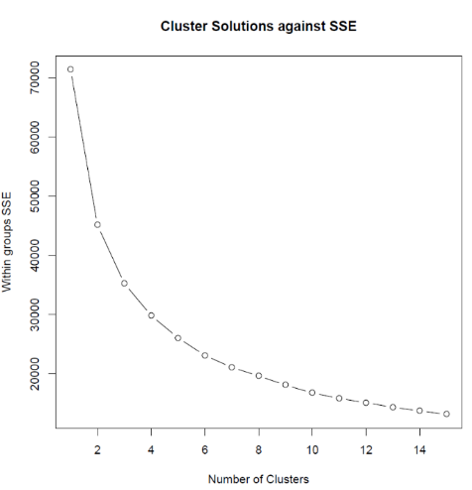
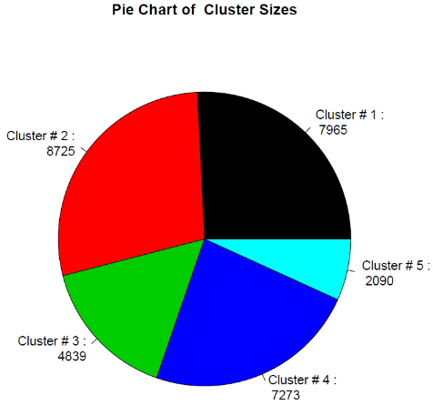
Cluster Analysis
Interpret output from a cluster analysis

Slide 13
Cohesion and Separation
Cohesion
Higher withinss = Lower cohesion (BAD)
High withinss means that elements within cluster are far away from each other
Separation
Higher betweenss = Higher separation(GOOD)
High betweenss means that different clusters are far away from each other
What happens to those statistics as the number of clusters increases?
Higher cohesion (Good)
Lower separation (Bad)

Slide 14
Cohesion and Separation
Interpret withinss (cohesion) and betweensss (separation)
> # Display withinss (i.e. the within-cluster SSE for each cluster)
> cat("\nWithin cluster SSE for each cluster (Cohesion):")
Within cluster SSE for each cluster (Cohesion):
> MyKMeans$withinss;
[1] 6523.491 990.183 6772.426 2707.390 5102.896
withinss error (cohesion)
> # Display betweenss (i.e. the SSE between clusters)
> cat("\nTotal between-cluster SSE (Seperation):")
Total between-cluster SSE (Seperation):
> MyKMeans$betweenss
[1] 45301.67
> # Compute average separation: more clusters = less separation
> cat("\Average between-cluster SSE:")
Average between-cluster SSE:
> MyKMeans$betweenss/NUM_CLUSTER
[1] 9060.334
total betweensss error
average betweensss error (separation)

Slide 15
Standardized (Normalized) Data
Interpret standardized cluster means for each input variable
For standardized values, “0” is the average value for that variable.
For Cluster 5:
average RegionDensityPercentile >0 ➔ higher than the population average
average MedianHouseholdIncome, and AverageHouseholdSize <0 ➔ lower than the population average

Slide 16
Association Rules
Interpret the output from an association rule analysis
Compute support count ($σ$), support (s), confidence, and lift
lhs rhs support confidence lift
611 {CCRD,CKING,MMDA,SVG} => {CKCRD} 0.01026154 0.6029412 5.335662
485 {CCRD,MMDA,SVG} => {CKCRD} 0.01026154 0.5985401 5.296716
489 {CCRD,CKING,MMDA} => {CKCRD} 0.01776999 0.5220588 4.619903
265 {CCRD,MMDA} => {CKCRD} 0.01776999 0.5107914 4.520192
530 {CCRD,MMDA,SVG} => {CKING} 0.01701915 0.9927007 1.157210
308 {CCRD,MMDA} => {CKING} 0.03403829 0.9784173 1.140559
$$\text{c}\left(\text{X}\text{→}\text{Y}\right)\text{=}\frac{\text{s}\left(\text{X}\text{→}\text{Y}\right)}{\text{s}\text{(}\text{X}\text{)}}$$
These two formulas will be provided
But you need to know how to compute support

Slide 17
Compute Support, confidence, and lift
Basket Items
1 Coke, Pop-Tarts, Donuts
2 Cheerios, Coke, Donuts, Napkins
3 Waffles, Cheerios, Coke, Napkins
4 Bread, Milk, Coke, Napkins
5 Coffee, Bread, Waffles
6 Coke, Bread, Pop-Tarts
7 Milk, Waffles, Pop-Tarts
8 Coke, Pop-Tarts, Donuts, Napkins
Rule | Support | Confidence | Lift
{Coke} → {Donuts} | 3/8 = 0.375 | 3/6 = 0.50 | $$\frac{0.375}{0.75∗0.375}=1.33$$
{Coke, Pop-Tarts} →{Donuts} | 2/8 = 0.25 | 2/3 = 0.67 | $$\frac{0.25}{0.375∗0.375}=1.78$$
{Coke, Pop-Tarts} →{Donuts} has both higher lift and confidence
Which rule has the stronger association?
Consider:
a customer with coke in the shopping cart.
a customer with coke and pop-tarts in the shopping cart.
Who do you think is more likely to buy donuts?
The second one, with a higher lift

Slide 18
Compute Support, confidence, and lift
 | Krusty-O’s
Potato Chips |  | No | Yes
 | No | 5000 | 1000
 | Yes | 4000 | 500
 |  |  |  | Total: 10500
What is the lift for the rule {Potato Chips} → {Krusty-O’s}?
Are people who bought Potato Chips more likely than chance to buy Krusty-O’s too?
$$Lift= \frac{\left.s(Potato Chips, KrustyOs\right)}{\left.s\left(Potato Chips\right)∗s(KrustyOs\right)}=\frac{0.048}{0.429∗0.143}=0.782$$
They appear in the same basket less often than what you’d expect by chance (i.e., Lift < 1).

Slide 19
Association Rules
What does Lift > 1 mean? Would you take action on such a rule?
What about Lift < 1?
What about Lift = 1?
The occurrence of X → Y together is more likely than what you would expect by random chance (positive association)
The occurrence of X → Y together is less likely than what you would expect by random chance (negative association)
The occurrence of X → Y together is the same as random chance (no apparent association. X and Y are independent of each other)

Slide 20
Association Rules
Can you have high confidence and low lift?
A numeric demonstration: Suppose we have 10 baskets. X appears in 8 baskets. Y appears in 8 baskets. X and Y co-appear in 6 baskets…
$$σ\left(X\right)=8⟹s\left(X\right)=0.8$$
$$σ\left(Y\right)=8⟹s\left(Y\right)=0.8$$
$$σ\left(X→Y\right)=6⟹s\left(X→Y\right)=0.6$$
$Confidence=$ $\frac{σ\left(X→Y\right)}{σ\left(X\right)}=\frac{6}{8}=0.75$
$$Lift= \frac{s\left(X→Y\right)}{s\left(X\right)∗s(Y)}=\frac{0.6}{0.8∗0.8}=0.9375<1$$
When both X and Y are popular….
You get high confidence
But low lift
When both X and Y are popular, you’d almost expect them to show up in the same baskets by chance !

Slide 21
SQL Query
Given a schema of a database, be able to create a SQL statement to answer a question
Understand how to use
SELECT
FROM
DISTINCT
WHERE (and how to specify conditions)
AND/OR
COUNT, AVG, MIN, MAX, SUM
GROUP BY
ORDER BY (ASC/DESC)
LIMIT
Join Tables

Slide 22
Good luck!

