Slide 1
The Things You Can Do With Data
MIS2502: Data and Analytics
Youngjin Kwon
youngjin.kwon@temple.edu http://community.mis.temple.edu/ykwon

Slide 2
Data versus information
Data
Information
Discrete, unorganized, raw facts
The transformation of those facts into meaning

Slide 3
Examples of Data
Data
Quantity sold
Information
Course enrollment
Star rating
Customer name
Discount
?

Slide 4
So then how do companies turn data into information?

Slide 5
Example: Netflix
Predict viewing habits
Find the next smash-hit series.
e.g. House of Cards, Orange is the New Black
Personalize promotions
Account for 1/3 of peak-time internet traffic in the US.
“The foundation of the streaming business was analytics.”
–Dave Hastings
http://knowledge.wharton.upenn.edu/article/how-data-analytics-is-shaping-what-you-watch/
https://www.linkedin.com/pulse/amazing-ways-netflix-uses-big-data-drive-success-bernard-marr
https://blog.kissmetrics.com/how-netflix-uses-analytics/

Slide 6
Example: Spotify
Predict listening habits
Personalize playlists
Recommend newly released songs
https://everynoise.com/engenremap.html

Slide 7
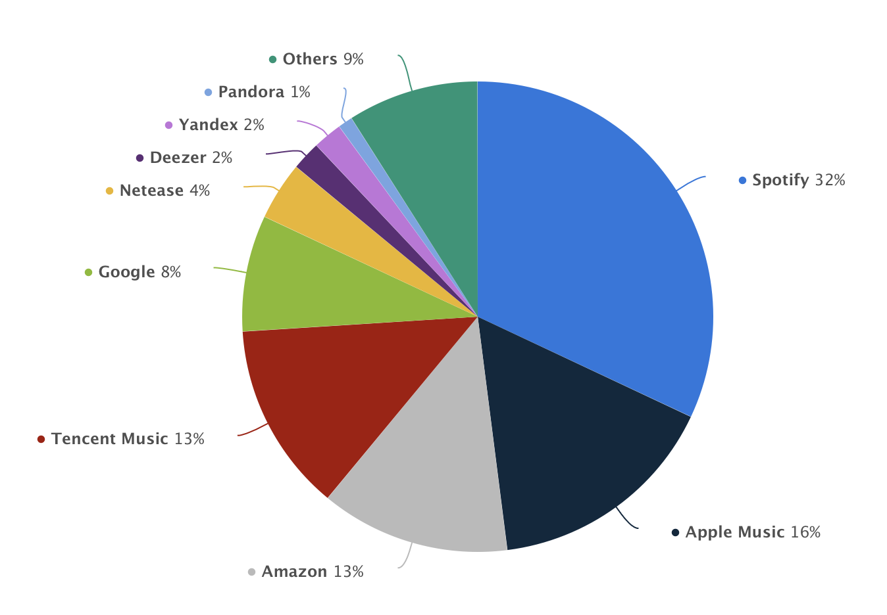

Slide 8
Q: Your Own Example?

Slide 9
The Process of Data Analytics
Determine data you need
Collect data
Store data (week 1 – 2)
Extract/Process data (week 2 – 10): MySQL/MongoDB
Analyze data (week 10 – 15): Python
Presentation of data/information (week 10)

