Slide 1
SQL – Getting Information Out of a Database Part 2: Advanced Queries
MIS2502: Data and Analytics
Youngjin Kwon youngjin.kwon@temple.edu http://community.mis.temple.edu/ykwon

Slide 2
Querying multiple tables
Right now, you can answer with data from a single table
What if you need to combine two (or more) tables?
For example, what if we want to find out the orders a customer placed?

Slide 3
The (Inner) Join
We’ve seen this before
We matched the Order and Customer tables based on the common field (CustomerID)
We can construct a SQL query to do this
Order Table
Customer Table
`Order` Number | OrderDate | Customer ID | Customer ID | FirstName | LastName | City | State | Zip
101 | 2011-3-2 | 1001 | 1001 | Greg | House | Princeton | NJ | 09120
102 | 2011-3-3 | 1002 | 1002 | Lisa | Cuddy | Plainsboro | NJ | 09123
103 | 2011-3-4 | 1001 | 1001 | Greg | House | Princeton | NJ | 09120
104 | 2011-3-6 | 1004 | 1004 | Eric | Foreman | Warminster | PA | 19111

Slide 4
Why is Foreign Key in a Many Side?
What is a foreign key is in the customer table using OrderNumber?
This is how it is. MySQL is built to use only a single value in a cell.
i.e., Order 101 and 103 made by Customer 1001 are not processed separately.
Customer ID | OrderNumber | FirstName | City | FirstName | LastName
1001 | 101, 103 | Greg | Princeton | Greg | House
1002 | 102 | Lisa | Plainsboro | Lisa | Cuddy
1001 |  | Greg | Princeton | Greg | House
1004 | 104 | Eric | Warminster | Eric | Foreman

Slide 5
Joining tables
Syntax :
SELECT column_name(s) FROM schema_name.table_name1
JOIN schema_name.table_name2
ON table_name1.column = table_name2.column;
SELECT * FROM orderdb.Customer
JOIN orderdb.Order
ON Customer.CustomerID=Order.CustomerID;
Returns this:
Customer. CustomerID | FirstName | LastName | City | State | Zip | Order Number | OrderDate | Order. CustomerID
1001 | Greg | House | Princeton | NJ | 09120 | 101 | 2011-3-2 | 1001
1002 | Lisa | Cuddy | Plainsboro | NJ | 09123 | 102 | 2011-3-3 | 1002
1001 | Greg | House | Princeton | NJ | 09120 | 103 | 2011-3-4 | 1001
1004 | Eric | Foreman | Warminster | PA | 19111 | 104 | 2011-3-6 | 1004

Slide 6
A closer look at the JOIN syntax
SELECT * FROM orderdb.Customer
JOIN orderdb.Order
ON Customer.CustomerID=Order.CustomerID;
SELECT * | Return all the columns from both tables
FROM orderdb.Customer JOIN orderdb.Order | The two tables to be joined
ON Customer.CustomerID = Order.CustomerID | Only choose records where the CustomerID exists in both tables
Another way to say it:
Choose customers that have placed an order
The “.” notation is table_name.column_name
We need this when two tables have the same column name.

Slide 7
A more complex join
Question: What products did each customer order?
We want to wind up with this view of the database
OrderNumber | FirstName | LastName | ProductName | Quantity | Price
101 | Greg | House | Cheerios | 2 | 3.99
101 | Greg | House | Bananas | 3 | 1.29
101 | Greg | House | Eggo Waffles | 1 | 2.99
102 | Lisa | Cuddy | Cheerios | 5 | 3.99
102 | Lisa | Cuddy | Bananas | 2 | 1.29
103 | Greg | House | Eggo Waffles | 3 | 2.99
104 | Eric | Foreman | Eggo Waffles | 8 | 2.99

Slide 8
How to do it?
We need information from Customer and Product (and OrderProduct)
To associate Customer table with Product table, we need to follow the path from Customer to Product

Slide 9
Here’s the query
SELECT Order.OrderNumber, Customer.FirstName, Customer.LastName, Product.ProductName, OrderProduct.Quantity, Product.Price FROM orderdb.Customer JOIN orderdb.Order ON Customer.CustomerID=Order.CustomerID JOIN orderdb.OrderProduct ON Order.OrderNumber=OrderProduct.OrderNumber JOIN orderdb.Product ON Product.ProductID=OrderProduct.ProductID;
It looks more complicated than it actually is!
Note that we have three join statements.

Slide 10
What is the total price of all products bought by the customer “Greg House”? Hint: select sum(price*quantity)

Slide 11
Now there are endless variations
Question: What is the total price of products bought by the customer “Greg House”?
SELECT SUM(Price*Quantity)
FROM orderdb.Customer
JOIN orderdb.Order ON Customer.CustomerID=Order.CustomerID JOIN orderdb.OrderProduct
ON Order.OrderNumber=OrderProduct.OrderNumber
JOIN orderdb.Product ON Product.ProductID=OrderProduct.ProductID WHERE FirstName=‘Greg’ AND LastName = ‘House’;
Answer:
23.81

Slide 12
Consider another example
Question: Get a full list of ALL customers and their orders information
Customer. CustomerID | FirstName | LastName | City | State | Zip
1001 | Greg | House | Princeton | NJ | 09120
1002 | Lisa | Cuddy | Plainsboro | NJ | 09123
1001 | Greg | House | Princeton | NJ | 09120
1004 | Eric | Foreman | Warminster | PA | 19111
1003 | James | Wilson | Pittsgrove | NJ | 09121
Customer
Order Number | OrderDate | Order. CustomerID | Customer. CustomerID
101 | 2011-3-2 | 1001 | 1001
102 | 2011-3-3 | 1002 | 1002
103 | 2011-3-4 | 1001 | 1001
104 | 2011-3-6 | 1004 | 1004
Order

Slide 13
Consider another example
(Outer join) This is the view of the database we want
Customer. CustomerID | FirstName | LastName | City | State | Zip | Order Number | OrderDate | Order. CustomerID
1001 | Greg | House | Princeton | NJ | 09120 | 101 | 2011-3-2 | 1001
1002 | Lisa | Cuddy | Plainsboro | NJ | 09123 | 102 | 2011-3-3 | 1002
1001 | Greg | House | Princeton | NJ | 09120 | 103 | 2011-3-4 | 1001
1004 | Eric | Foreman | Warminster | PA | 19111 | 104 | 2011-3-6 | 1004
1003 | James | Wilson | Pittsgrove | NJ | 09121 | NULL | NULL | NULL
(Inner join) This is also possible
Customer. CustomerID | FirstName | LastName | City | State | Zip | Order Number | OrderDate | Order. CustomerID
1001 | Greg | House | Princeton | NJ | 09120 | 101 | 2011-3-2 | 1001
1002 | Lisa | Cuddy | Plainsboro | NJ | 09123 | 102 | 2011-3-3 | 1002
1001 | Greg | House | Princeton | NJ | 09120 | 103 | 2011-3-4 | 1001
1004 | Eric | Foreman | Warminster | PA | 19111 | 104 | 2011-3-6 | 1004

Slide 14
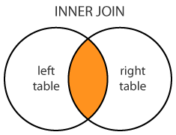
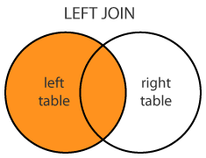
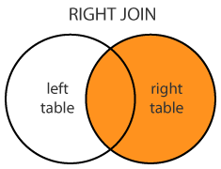
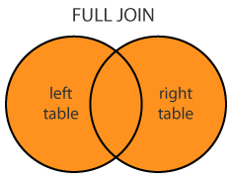
Outer Join
We need another operator
for the item that has a match, it behaves like a Join,
but for the items that have NO MATCH, it appends the record with NULLs
The operators with these properties are called outer joins. (There are several of them)
The operators that we studied already are also called inner joins (To distinguish them from outer joins)
reference: www.dofactory.com/sql/join

Slide 15
Left Join
Syntax :
SELECT column_name(s) FROM schema_name.left_table_name
LEFT JOIN schema_name.right_table_name
ON left_table_name.column = right_table_name.column;
(INNER) JOIN: Select records that have matching values in both tables.
LEFT (OUTER) JOIN: Select records from the first (left-most) table with matching right table records.

Slide 16
Joining tables using Join
Comparing the following two queries!
SELECT * FROM orderdb.Customer
LEFT JOIN orderdb.Order
ON Customer.CustomerID=Order.CustomerID;
SELECT * FROM orderdb.Customer
JOIN orderdb.Order
ON Customer.CustomerID=Order.CustomerID;
(Right join is not an exam)
SELECT * FROM orderdb.Customer
RIGHTJOIN orderdb.Order
ON Customer.CustomerID=Order.CustomerID;

Slide 17
Another example
What is the number of orders of each customer?

Slide 18
Another example
Question: What is the number of orders of each customer?
SELECT Customer.customerID, Count(ordernumber)
FROM Orderdb.Customer
JOIN Orderdb.Order ON Customer.CustomerID=Order.CustomerID
GROUP BY CustomerID;
SELECT Customer.customerID, Count(ordernumber)
FROM Orderdb.Customer
LEFT JOIN Orderdb.Order ON Customer.CustomerID=Order.CustomerID
GROUP BY CustomerID;
What query will you use?
Here, we use Count(ordernumber) not Count(*). See what happens!

Slide 19
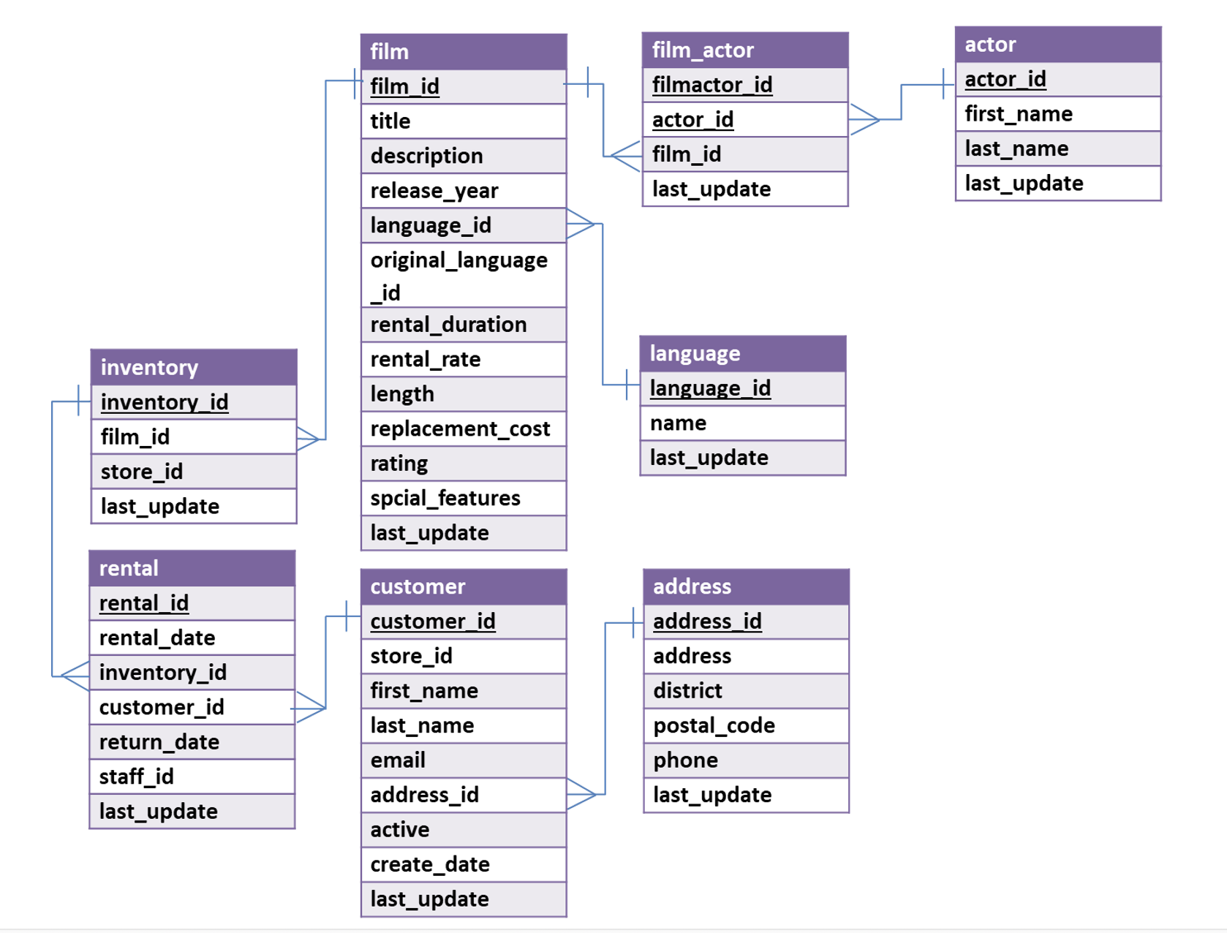
Scary Example
Question: Can you return the list of actor(s) that each customer have watched in movies?
Hint: Group By multiple columns using comma(,)

Slide 20
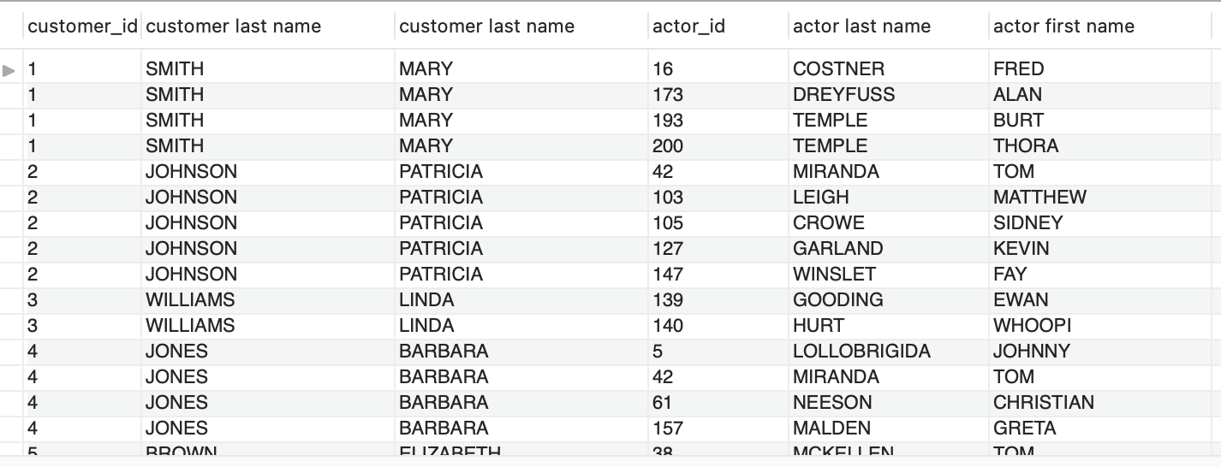
Scary Example
This is what we want:
Customer ID and their first/last names
Actor ID and their first/last name

Slide 21
ScarIER Example! (not on exam)
Question: Can you return the list of actor(s) that each customer has watched in movies? + how many of each actor has each customer watched?
This is what we want:
Customer ID and their first/last names
Actor ID and their first/last names
How many each customer has watched each actor
Hint: Group By multiple columns using comma(,)

Slide 22
The LIMIT Clause
We could try to use LIMIT to find the least expensive product:
SELECT * FROM orderdb.Product ORDER BY Price ASC LIMIT 1;
But what if there is more than one product with the lowest value for price AND we don’t know how many there are?

Slide 23
Where MIN() alone fails us…
SELECT MIN(price) FROM orderdb.Product;
BUT
SELECT MIN(price),ProductName FROM orderdb.Product;
Price
1.29
Price | ProductName
1.29 | Cheerios
Wait…. Cheerios’ price should be 3.99.
So what’s going on??

Slide 24
What’s wrong…
SELECT MIN(price),ProductName FROM orderdb.Product;
It returns the MIN(price): $1.29
MIN() will always return only one row
So for ProductName, it chooses the first row in the Product column, i.e., Cheerios
Price | ProductName
1.29 | Cheerios
And it will do this for any function (AVG, SUM, etc.)

Slide 25
So we need a SQL subselect statement
It’s where you have a SELECT statement nested inside another SELECT statement!
SELECT Price,ProductName FROM orderdb.Product WHERE Price= (SELECT MIN(Price) FROM orderdb.Product);
Now you get all records back with that (lowest) price and avoid the quirk of the MIN() function.
This is a temporary table from the database with one column and one row.

Slide 26
How would SQL execute this query?
SELECT Price,ProductName FROM orderdb.Product WHERE Price= (SELECT MIN(Price) FROM orderdb.Product);
SELECT MIN(Price)
FROM orderdb.Product
Step 1: Execute what is in the parentheses to find the lowest price
Step 2: Plug the lowest price into the main query, and execute the main query
MIN(Price)
1.29
SELECT Price,ProductName FROM orderdb.Product WHERE Price=1.29;
Price | ProductName
1.29 | Bananas

Slide 27
And it also handles ties!
SELECT Price,ProductName FROM orderdb.Product WHERE Price= (SELECT MAX(Price) FROM orderdb.Product);
Now you get all records back with that highest price and avoid the quirk of the MAX() and MIN() functions.
Price | ProductName
3.99 | Cheerios
3.99 | French Toast
But these are the highest-priced products overall, not the highest-priced products bought by a particular customer…

Slide 28
Subselects come in handy in other situations too…
We want to get a COUNT of how many DISTINCT states there are in the table.
SELECT COUNT(*) FROM (SELECT DISTINCT State FROM orderdb.Customer) AS tmp1;
To see how this works:
Start with what is in the parentheses
SELECT DISTINCT State FROM orderdb.Customer
…then COUNT those values
State
NJ
PA
2

Slide 29
Why do we need AS?
SELECT COUNT(*) FROM (SELECT DISTINCT State FROM orderdb.Customer) AS tmp1;
You’re basically SELECTing from the temporary table generated by the nested query.
But since you’re SELECTing FROM that temporary table you have to give it a name (i.e., tmp1)

Slide 30
Subselects with Joins
Question: What is the least expensive product bought by customers from New Jersey?
To do this, we will need all the tables.

Slide 31
Subselects with Joins
First, we need to figure out the lowest price of products by customers from New Jersey?
But this is not enough… We also need to find the product name.
SELECT MIN(Product.Price)
FROM orderdb.Customer, JOIN orderdb.Order ON Customer.CustomerID=Order.CustomerID JOIN orderdb.OrderProduct ON Order.OrderNumber=OrderProduct.OrderNumber JOIN orderdb.Product ON Product.ProductID=OrderProduct.ProductID
WHERE Customer.State='NJ';
Price
1.29

Slide 32
Subselects with Joins
So we nest the previous query in a big query:
SELECT DISTINCT Product.ProductName, Product.Price FROM orderdb.Customer, JOIN orderdb. Order ON Customer.CustomerID=Order.CustomerID JOIN orderdb.OrderProduct ON Order.OrderNumber=OrderProduct.OrderNumber JOIN orderdb.Product ON Product.ProductID=OrderProduct.ProductID WHERE Customer.State='NJ' AND Product.Price=(
SELECT MIN(Product.Price) FROM orderdb.Customer, JOIN orderdb.Order ON Customer.CustomerID=Order.CustomerID JOIN orderdb.OrderProduct ON Order.OrderNumber=OrderProduct.OrderNumber JOIN orderdb.Product ON Product.ProductID=OrderProduct.ProductID
WHERE Customer.State='NJ');
ProductName | Price
Bananas | 1.29

Slide 33
Summary
Given a schema of a database, we now should be able to create a SQL statement (query) to answer a question
Understand how to use
SELECT … FROM …
DISTINCT
WHERE (and how to specify conditions)
AND/OR
ORDER BY (ASC/DESC)
Functions: COUNT, AVG, MIN, MAX, SUM
GROUP BY
LIMIT
Joins (and differences between inner/outer join)
Subselects

