Slide 1
NoSQL Part 2: Advanced Queries
MIS2502: Data and Analytics
Youngjin Kwon youngjin.kwon@temple.edu http://community.mis.temple.edu/ykwon

Slide 2
So far, we looked at how NoSQL query can be similar to SQL query.
However, due to the different properties of NoSQL dataset, there are more types of queries that can be useful when using NoSQL database.
Nested document
LastName: “WELLS”
GPA: 3.0
Major: “MIS”
Class: {ClassID: 1234,
ClassName:“MIS2101”}
…
Array
LastName: “NORBERT”
Major: [“FIN”, “MIS”,…]
Class: [{ClassID: 1235,
ClassName:“MIS2502”,…},
… ]
LastName: “KENDALL”
GPA: 3.5
Class: {ClassID: 1234,
ClassName:“MIS2101”}
…

Slide 3
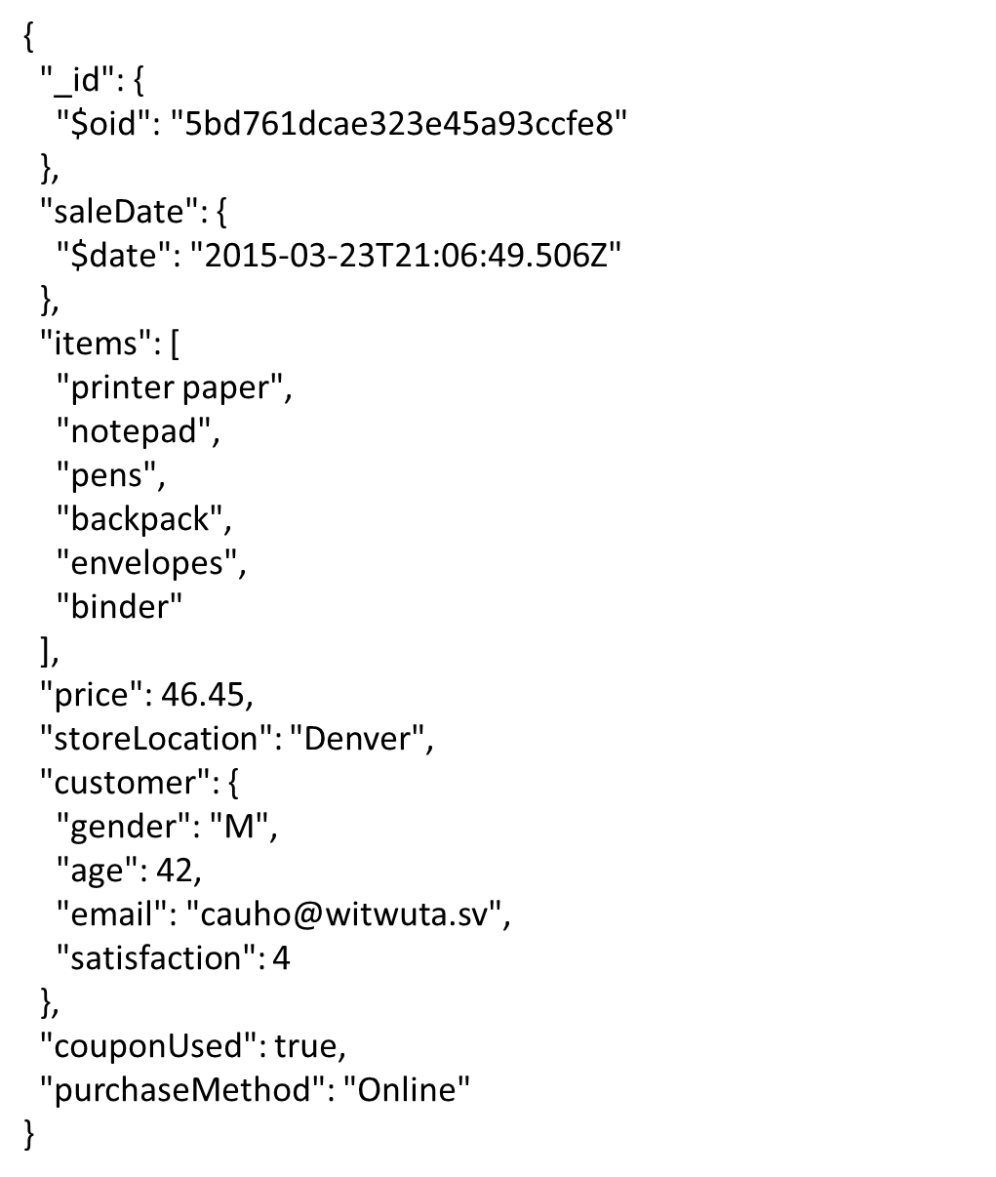
Query on Nested Document
Can we only show sales occurred from customers less than 40 years old?
JSON array
JSON object

Slide 4
Query on Nested Document
We can use dot notation to specify a query condition on fields in an embedded/nested document
To return sales occurred from customers he less than 40 years old
$match: { "customer.age": { $lt : 40 } }
Make sure the fields are surrounded by “”.

Slide 5
Query on Nested Document
We can apply dot notation to combine conditions using AND and OR operator
To return sales happened from customers less than 40 years old AND male
$match: { $and:
[ {"customer.age": { $lt: 40} },
{"customer.gender":"M"} ]
}

Slide 6
Query an Array
{
"_id": {
"$oid": "5bd761dcae323e45a93ccfe8"
},
"saleDate": {
"$date": "2015-03-23T21:06:49.506Z"
},
"items": [
"printer paper",
"notepad",
"pens",
"backpack",
"envelopes",
"binder"
],
"price": 46.45,
"storeLocation": "Denver",
"customer": {
"gender": "M",
"age": 42,
"email": "cauho@witwuta.sv",
"satisfaction": 4
},
"couponUsed": true,
"purchaseMethod": "Online"
}
Can we only show sales that contain binder?
JSON array
JSON object

Slide 7
Query an Array
We can use the same {<field>: <value>} syntax to the array. So, let’s try
$match: { items: "binder" }
To specify equality condition on an array, <value> should be the exact array to match.
$match: { items: ["binder"] }
This will return documents that satisfy exact array to match, including the order of the elements.
Then, how would the code below work?
$match: { items: ["binder", "pens"] }

Slide 8
Query an Array
$all operator selects the documents where the value of a field is an array that contains all the specified elements.
Syntax :
$match: { field: { $all: [ value1 , value2 ... ] } }
$all vs $and operator
The $all is equivalent to an $and operation of the
specified values; i.e. the following two statements
are identical:
$match: { items: { $all: [ "binder" ,"pens" ] } }
$match: { $and: [ {items: "binder"}, {items: "pens"}] }

Slide 9
Query an Array based on Size
$size operator matches any array with the number of elements specified by the argument
Syntax :
$match: { field: { $size: value } }
For example,
$match: { items: { $size: 2 } }
returns all documents in collection where items field is
an array with 2 elements.

Slide 10
Do we have to JOIN tables?
salesDB.sales
salesDB.list
{
"_id": {
"$oid": "5bd761dcae323e45a93ccfe8"
},
"saleDate": {
"$date": "2015-03-23T21:06:49.506Z"
},
"items": [
"printer paper",
"notepad",
"pens",
"backpack",
"envelopes",
"binder"
],
"price": 46.45,
"storeLocation": "Denver",
"customer_id": "5bd761dcae323e45a93cd000",
"couponUsed": true,
"purchaseMethod": "Online"
}
{
"_id": {
"$oid": "5bd761dcae323e45a93ccfe8"
},
"saleDate": {
"$date": "2015-03-23T21:06:49.506Z"
},
"items": [
"printer paper",
"notepad",
"pens",
"backpack",
"envelopes",
"binder"
],
"price": 46.45,
"storeLocation": "Denver",
"customer": {
"gender": "M",
"age": 42,
"email": "cauho@witwuta.sv",
"satisfaction": 4
},
"couponUsed": true,
"purchaseMethod": "Online"
}
Embedded document
Reference
salesDB.customer
{ "_id": {
"$oid": "5bd761dcae323e45a93cd000"
},
"gender": "M",
"age": 42,
"email": "cauho@witwuta.sv",
"satisfaction": 4
}

Slide 11
Join with $lookup
$lookup performs a left (outer) join to another collection in the same database to filter in documents from the “joined” collection for processing.
Syntax :
$lookup: {
from: collection to join,
localField: field from the input document,
foreignField: field from another document,
as: name of output array field
}

Slide 12
Join with $lookup
To perform a left (outer) join from list collection to customer collection
$lookup: { from: "customer",
localField: "customer_id",
foreignField: "_id",
as: "customer_info" }
The operation corresponds to the following SQL statement:
SELECT * FROM salesDB.list
LEFT JOIN salesDB.customer
ON list.customer_id = customer. _id;

Slide 13
Syntax for MongoDB
KEY : Value
Field name | Numeric value
“Field name with dot notation” | “String value”
$accumulator/operator (e.g., $sum, $gt) | “$Field name”
$project: { items: 1, “customer.name”: 1 }
$match: { $and: [{ price: { $gt: 180} } ,
{ storeLocation: "Seattle"}]}
$group: { _id: "$purchaseMethod",
totalprice: { $sum: "$price"} }

Slide 14
In Class Activity #7

