Slide 1
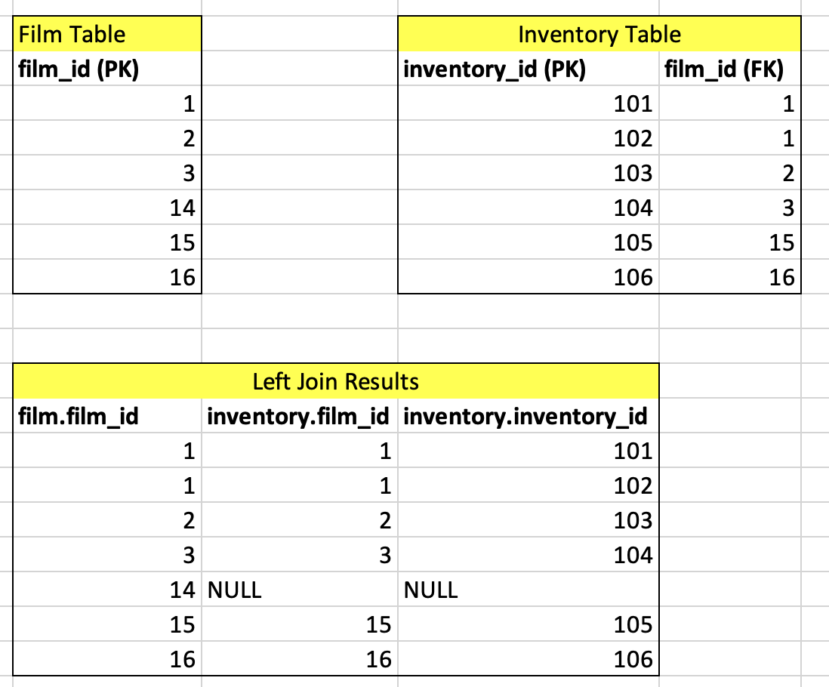
Advanced Topic in Left Join
Assume that you put Film table in the left and left-join Inventory table to it. Film-Inventory is a one-to-many relationship
The result is the table below.
Here's our goal:
(ICA#3 Q8) How many inventories are there for each film?
Here’s a tricky part when you write a query for this question.
Based on what column would you count rows? (Specify table and column names)
Based on what column would you group by rows? (Specify table and column names)

Slide 2
Advanced Topic in Left Join
Below is an answer template to the question.
You should be careful with table and column names (which are bolded below).
SELECT TABLE.COLUMN, count(TABLE.COLUMN)
FROM moviedb.film
LEFT JOIN moviedb.inventory ON film.film_id = inventory.film_id
GROUP By TABLE.COLUMN;
Before you check the answer in the next slide, carefully think about what table and column you would write in each of above.
Hint: All the queries, functions, and statements will be run based on the result of LEFT JOIN in the page 1. Think about what will be selected, counted, and grouped based on your query.

Slide 3
Advanced Topic in Left Join
The answer can be either of the following:
(1)
SELECT film.film_id, count(inventory.film_id)
FROM moviedb.film
LEFT JOIN moviedb.inventory ON film.film_id = inventory.film_id
GROUP By film.film_id;
(2)
SELECT film.film_id, count(inventory.inventory_id)
FROM moviedb.film
LEFT JOIN moviedb.inventory ON film.film_id = inventory.film_id
GROUP By film.film_id;
SEELCT inventory.film_id -> WRONG
Why? You want to find inventories of ALL films in Film table. Inventory table might not contain some films in Film table
COUNT(film.film_id) -> WRONG
Why? In the left-join result in page 1, film.film_id column does not have null values. If you count the column, films which are not in Inventory table will be counted.
GROUP BY inventory.film_id -> WRONG.
Why? It can sometimes work, but you have a much better way for GROUP By

Slide 4
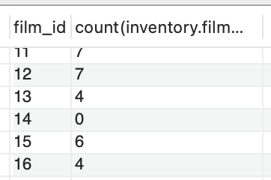
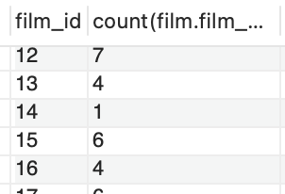
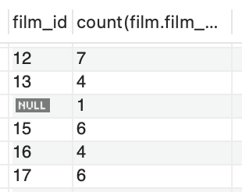
Advanced Topic in Left Join
SELECT film.film_id, count(inventory.film_id)
FROM moviedb.film
LEFT JOIN moviedb.inventory ON film.film_id = inventory.film_id
GROUP By film.film_id;
SELECT film.film_id, count(film.film_id)
FROM moviedb.film
LEFT JOIN moviedb.inventory ON film.film_id = inventory.film_id
GROUP By film.film_id;
SELECT inventory.film_id, count(film.film_id)
FROM moviedb.film
LEFT JOIN moviedb.inventory ON film.film_id = inventory.film_id
GROUP By film.film_id;

