Slide 1
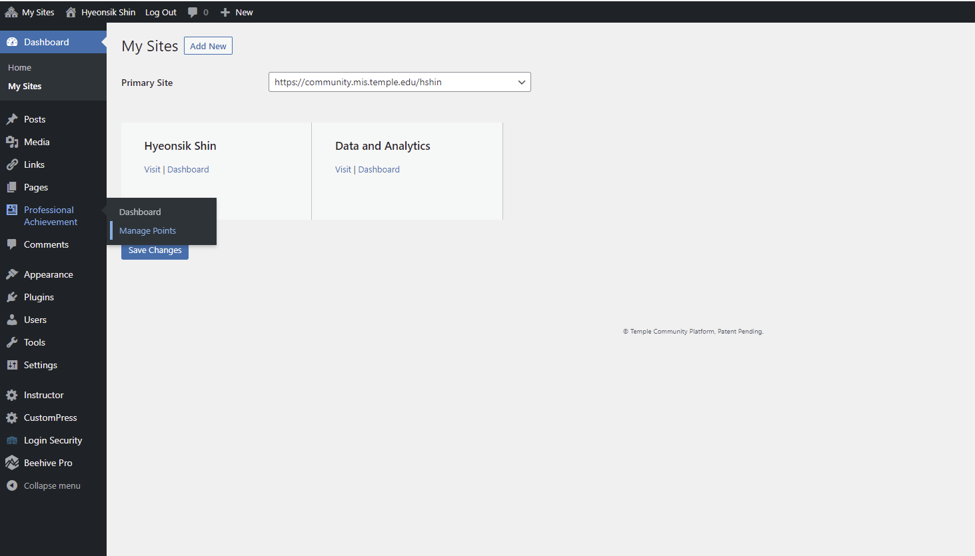
1. Click “Manage Points” under Professional Achievement

Slide 2
2. Click “Add New”

Slide 3
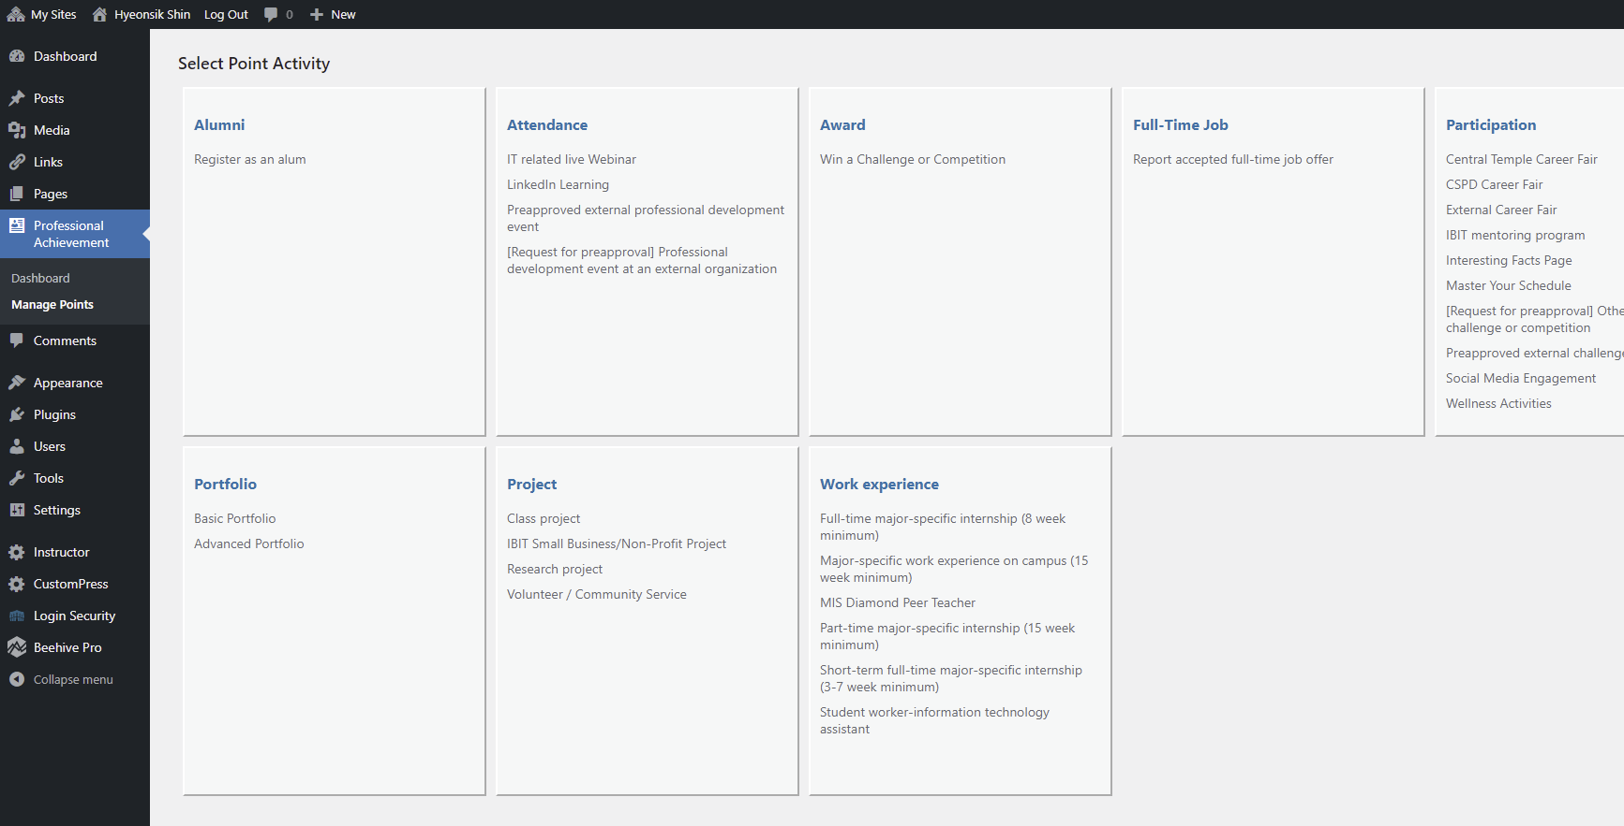
3. Click “Class project”

Slide 4
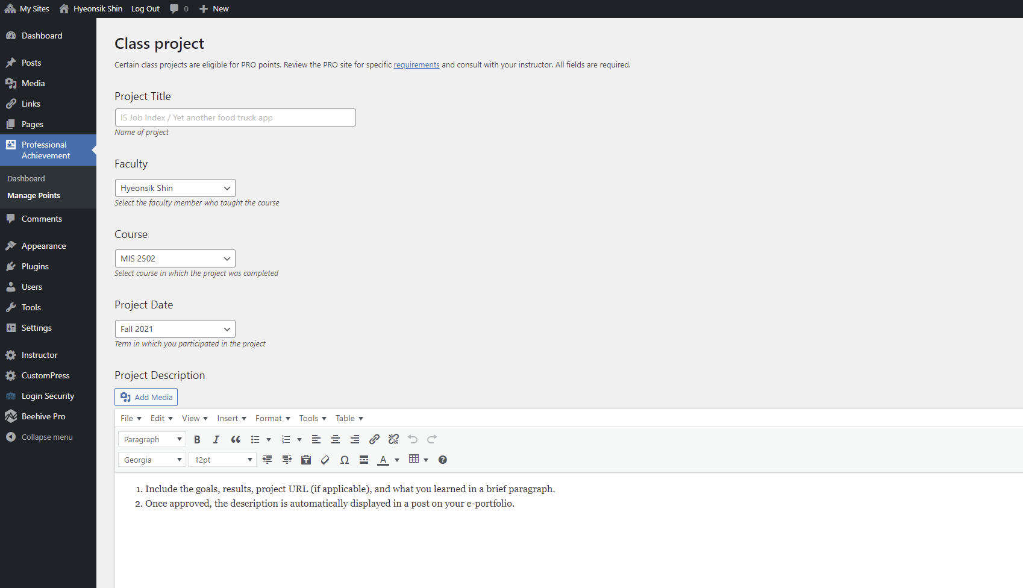
4. After you write a project title as you want,
select my name under Faculty.
Select MIS 2502 under Course.
Select Fall 2021 under Project Date.

Slide 5
5. Click Add Media to insert your file (Word file or pdf) into the writing area.

Slide 6
6. Briefly describe what your assignment is about.

Slide 7
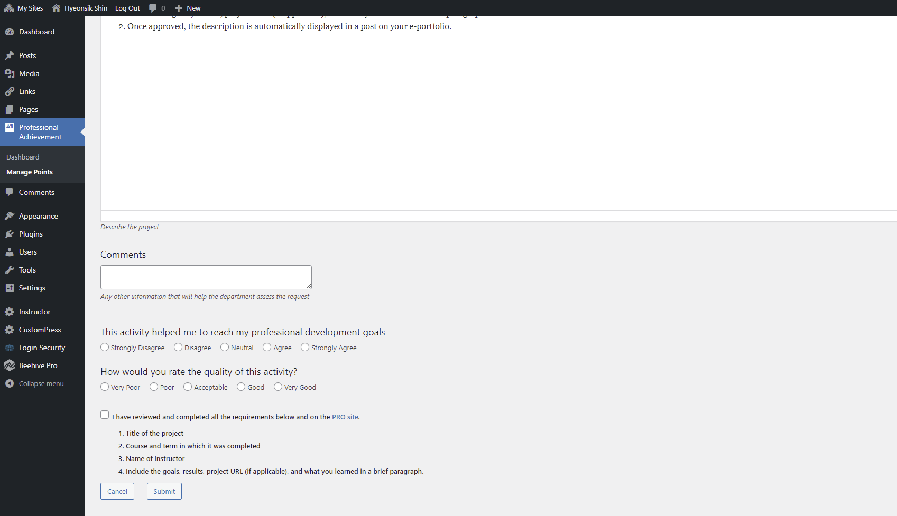
7. Click Submit. Your instructor will receive an email about your submission soon.

