Slide 1
Review for Exam 2
MIS2502: Data and Analytics
Youngjin Kwon
youngjin.kwon@temple.edu http://community.mis.temple.edu/ykwon

Slide 2
Overview
Date/Time: Wednesday, Mar 23,
3:0x pm – 3:5x pm (55 minutes)
Place: Alter Hall 035
Multiple-choice and short-answer questions
Closed-book, closed-note
You are NOT allowed to use a scrap paper. If you need a place to take note while writing SQL, please use the space where you type in the code.

Slide 3
Coverage
Check the Exam 2 Study Guide
Not every item on this list may be on the exam, and there may be items on the exam not on this list.

Slide 4
SQL Joins
Used to combine two or more tables, based on the common fields between them.
Suppose we have….
SELECT *
FROM mydb.customer
LEFT JOIN mydb.order ON customer.customerID = order.customerID
MyDB.Customer
MyDB.Order
CustomerID | LastName | FirstName | Country
1 | Futterkiste | Alfreds | Germany
2 | Trujillo | Ana | US
3 | Moreno | Antonio | Mexico
OrderID | CustomerID | OrderDate | Amount
10308 | 2 | 1996-09-18 | 100
10309 | 1 | 1996-09-19 | 10
10310 | 1 | 1996-09-20 | 63
Customer.CustomerID | LastName | FirstName | Country | OrderID | OrderDate | Amount | Order.CustomerID
1 | Futterkiste | Alfreds | Germany | 10308 | 1996-09-18 | 100 | 1
1 | Futterkiste | Alfreds | Germany | 10309 | 1996-09-19 | 10 | 1
2 | Trujillo | Ana | US | 10310 | 1996-09-20 | 63 | 2
3 | Moreno | Antonio | Mexico | NULL | NULL | NULL | NULL

Slide 5
(Inner) Join
SELECT * FROM MyDB.Customer
JOIN MyDB.Order ON Order.CustomerID=Customer.CustomerID;
MyDB.Customer
MyDB.Order
CustomerID | LastName | FirstName | Country
1 | Futterkiste | Alfreds | Germany
2 | Trujillo | Ana | US
3 | Moreno | Antonio | Mexico
OrderID | CustomerID | OrderDate | Amount
10308 | 2 | 1996-09-18 | 100
10309 | 1 | 1996-09-19 | 10
10310 | 1 | 1996-09-20 | 63
CustomerID | LastName | FirstName | Country
1 | Futterkiste | Alfreds | Germany
1 | Futterkiste | Alfreds | Germany
2 | Trujillo | Ana | US
OrderID | CustomerID | OrderDate | Amount
10309 | 1 | 1996-09-19 | 10
10310 | 1 | 1996-09-20 | 63
10308 | 2 | 1996-09-18 | 100

Slide 6
More Variations to Join
Step 1: We start with a simple join
SELECT *
FROM MyDB.Customer JOIN MyDB.Order
ON Customer.CustomerID = Order.CustomerID;
Q: What is the total order amount by country?
CustomerID | LastName | FirstName | Country
1 | Futterkiste | Alfreds | Germany
1 | Futterkiste | Alfreds | Germany
2 | Trujillo | Ana | US
OrderID | CustomerID | OrderDate | Amount
10309 | 1 | 1996-09-19 | 10
10310 | 1 | 1996-09-20 | 63
10308 | 2 | 1996-09-18 | 100
Step 2: We then end up with -
SELECT Customer.Country, SUM(Order.Amount)
FROM MyDB.Customer JOIN MyDB.Order
ON Order.CustomerID=Customer.CustomerID
GROUP BY Customer.Country;
Country | SUM(Amount)
US | 100
Germany | 73

Slide 7
SQL Joins
Make sure you understand the difference between inner join and left join

Slide 8
SQL (Subselects)
Subselect query can return
One single value (one column, one row)
A temporary table (one or multiple columns, one or multiple rows)

Slide 9
One single value: Used With Comparison Operators
SELECT column_name1 FROM schema_name.table_name1
JOIN ON WHERE column_name2 comparison_operator (SELECT column_name3 FROM schema_name.table_name2 WHERE condition);
Treated as a single value
comparison_operator could be equality operators such as =, >, <, >=, <=, <>.

Slide 10
SELECT column_name1 FROM schema_name.table_name1
JOIN ON WHERE amount < (SELECT AVG(Amount) FROM MyDB.Order);
SELECT column_name1 FROM schema_name.table_name1
JOIN ON WHERE amount < (57.67777);

Slide 11
Subselect as One Single Value: Example 1
MyDB.Order
Q: What are the order IDs with order amount below average?
OrderID | CustomerID | OrderDate | Amount
10308 | 2 | 1996-09-18 | 100
10309 | 1 | 1996-09-19 | 10
10310 | 1 | 1996-09-20 | 63
Step 1. We start by writing a subselect query that returns the average order amount:
SELECT AVG(Amount) FROM MyDB.Order
Amount
57.6667
Step 2. We treat the subselect query as a single value:
SELECT OrderID, Amount FROM MyDB.Order
WHERE Amount <
(SELECT AVG(Amount) FROM MyDB.Order);
OrderID | Amount
10309 | 10

Slide 12
Subselect as One Single Value: Example 2
Q: Which German customer placed the order(s) with the highest order amount?
MyDB.Order
MyDB.Customer
OrderID | CustomerID | OrderDate | Amount
10308 | 2 | 1996-09-18 | 100
10309 | 1 | 1996-09-19 | 10
10310 | 1 | 1996-09-20 | 63
CustomerID | LastName | FirstName | Country
1 | Futterkiste | Alfreds | Germany
2 | Trujillo | Ana | US
3 | Moreno | Antonio | Mexico
SELECT * FROM MyDB.Order
JOIN MyDB.Customer
ON Order.CustomerID=Customer.CustomerID;
Recall the simple join query…
OrderID | CustomerID | OrderDate | Amount | CustomerID | LastName | FirstName | Country
10308 | 2 | 1996-09-18 | 100 | 2 | Trujillo | Ana | US
10309 | 1 | 1996-09-19 | 10 | 1 | Futterkiste | Alfreds | Germany
10310 | 1 | 1996-09-20 | 63 | 1 | Futterkiste | Alfreds | Germany

Slide 13
SELECT column_name1 FROM MyDB.customer
JOIN MyDB.order ON customer.customerID = order.customerID WHERE country = ‘Germany’ AND amount =
(SELECT MAX(Order.Amount)
FROM MyDB.Order JOIN MyDB.Customer
ON Order.CustomerID=Customer.CustomerID
WHERE Customer.Country=‘Germany’);

Slide 14
Subselect as Temporary table
Q: How many distinct states are there in the customer table?
Step 1. We start by writing a subselect query that returns the unique states in the table :
State
NJ
PA
SELECT DISTINCT State FROM orderdb.Customer;
Step 2. We treat the subselect query as a temporary table:
SELECT COUNT(*)
FROM (SELECT DISTINCT State FROM orderdb.Customer) AS tmp1;
2

Slide 15
Subselect as Temporary table
Q: How many distinct states are there in the customer table?
SELECT COUNT(DISTINCT state)
FROM orderdb.Customer;
Do not write down this kind of query to this type of questions.

Slide 16
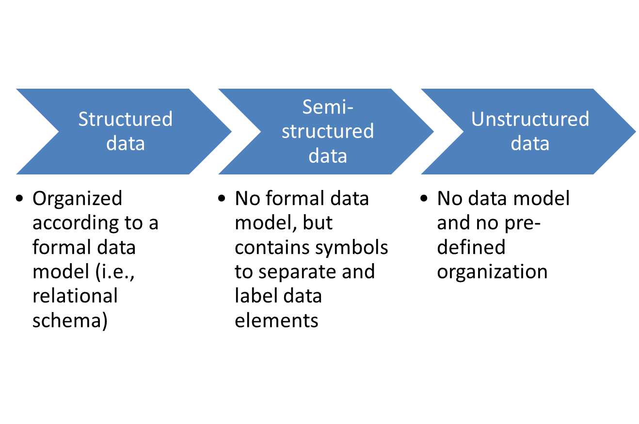
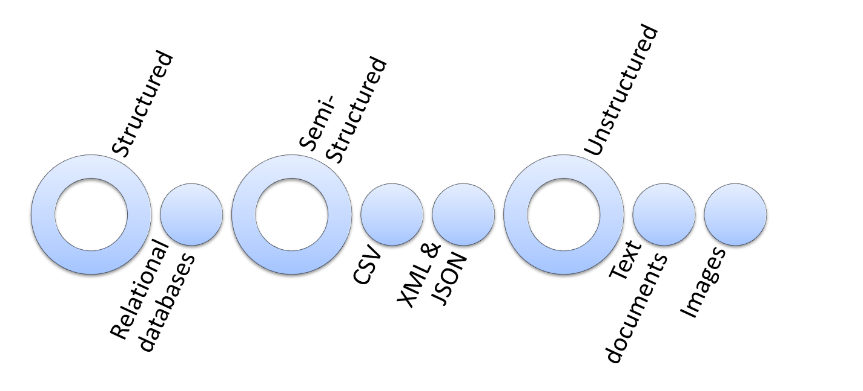
Semi-Structured Data

Slide 17
Semi-Structured Data
CSV
Comma-separated Values
Each value is separated by a comma
The first row is often the field names.
Uses text for values between tags for labels
<opening tag>data</closing tag>
<height>172</height>
XML
Extensible Markup Language
Uses key-value pairs
key: value
“name”: “C-3PO”
JSON
JavaScript Object Notation

Slide 18
Semi-Structured Data
Relational database table
XML file
JSON file
first | last | year | GPA
Bob | Smith | Sophomore | 3.4
Judy | Jones | Senior | 3.9
Barbara | Watkins | Junior | 3.2
<root>
<Person>
<first>Bob</first>
<last>Smith</last>
<year>Sophomore</year>
<GPA>3.4</GPA>
</Person>
<Person>
<first>Judy</first>
<last>Jones</last>
<year>Senior</year>
<GPA>3.9</GPA>
</Person>
<Person>
<first>Barbara</first>
<last>Watkins</last>
<year>Junior</year>
<GPA>3.2</GPA>
</Person>
</root>
[
{
"first": "Bob",
"last": "Smith",
"year": "Sophomore",
"GPA": 3.4
},
{
"first": "Judy",
"last": "Jones",
"year": "Senior",
"GPA": 3.9
},
{
"first": "Barbara",
"last": "Watkins",
"year": "Junior",
"GPA": 3.2
}
]
CSV file
first,last,year,GPA
Bob,Smith,Sophomore,3.4
Judy,Jones,Senior,3.9
Barbara,Watkins,Junior,3.2

Slide 19
RDBMS vs. NoSQL
RDBMS | NoSQL
Pre-defined schema | Flexible schema
Data is distributed across multiple tables | Data is typically nested in a few collection
Based on relations | (Very few) relations
Not good for hierarchical work | Best fit for hierarchical work

Slide 20
MySQL vs MongoDB Query
MySQL | MongoDB
WHERE | $match
GROUP BY | $group
ORDER BY | $sort
LIMIT | $limit
SELECT expressions FROM.. | $project
JOIN | $lookup
n/a | $size, $all, dot notation
SELECT purchaseMethod, sum(price) as totalprice
FROM salesDB.sales
WHERE couponUsed = FALSE
GROUP BY purchaseMethod
ORDER BY sum(price) ASC
LIMIT 2;
db.sales.aggregate(
[ { $match: { couponUsed: FALSE }},
{ $group: { _id: "$purchaseMethod",
totalprice: { $sum: "$price" }}},
{ $sort: { totalprice: 1 }},
{ $limit: 2 }
])

Slide 21
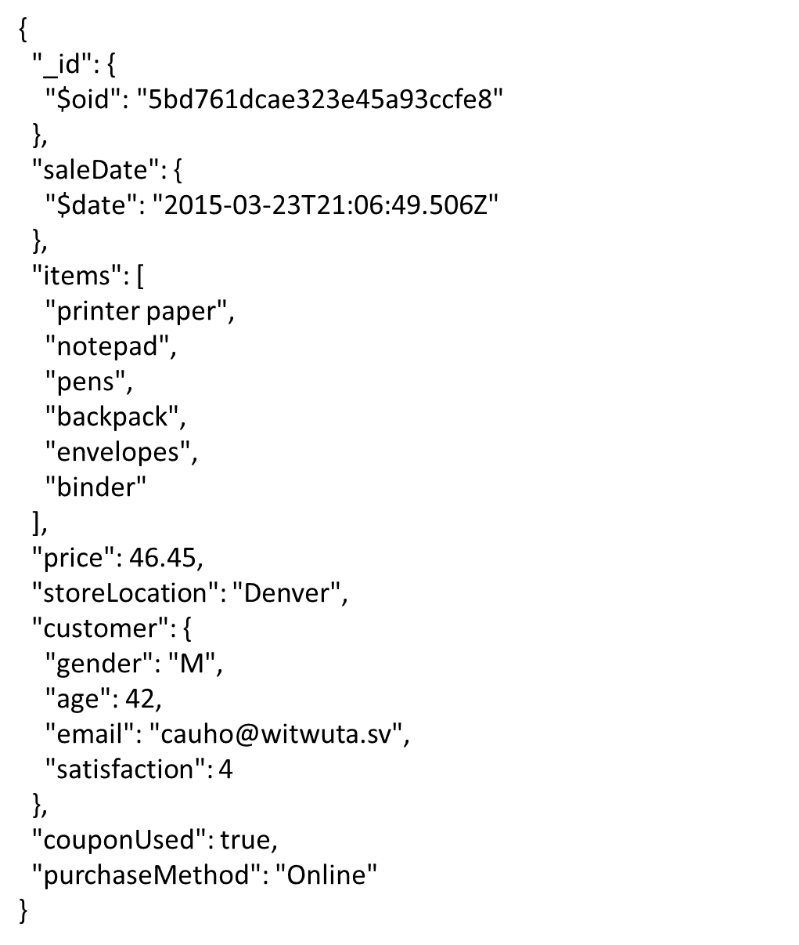
MongoDB
salesdb.sales
NoSQL code
Describe what the code will return.
Present id, price and store location of sales where price is greater than 180.
$match: _____________________
$project: {_id: 1, price: 1, storeLocation: 1}

Slide 22
MongoDB
salesdb.sales
NoSQL code
$match: { $and: [{ price: { $gt: 180} } ,
{ storeLocation: "Seattle"}]}
$ project: {_id: 1, price: 1, storeLocation: 1}
What is the problem with the code? Write a correct code.
$match: { $and: [{ price: { $gt: 180} } ,
{ storeLocation: "Seattle"}]}
$ project: {_id: 1, price: 1, storeLocation: 1}

Slide 23
ETL
Transform data into an analysis-ready format
Load it into the analytical data store
Extract data from the transactional database
What is it? Why is it important?
Data consistency
Data quality
Explain the purpose of each component (Extract, Transform, Load)

Slide 24
Data Visualization
Data visualization principles.
Tell a story
Graphical integrity
Minimize graphical complexity

Slide 25
Issues with this chart?
Issues:
Tell a Story
Vertical axis isn’t labeled. We don’t know the units
Because there are many states to compare, horizontal lines may be helpful
Graphical Integrity
The 3D chart makes it difficult to compare sizes
The cone-shaped bars make it even harder to compare sizes
Graphical Complexity
The 3D chart requires more ink (Chartjunk)
The number labels are unnecessary

Slide 26
Good Luck!

