Slide 1
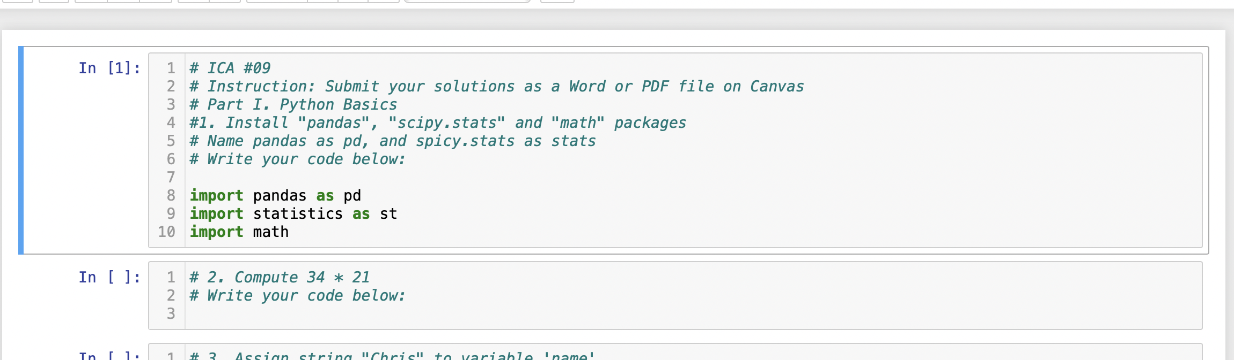
Before you load a csv file onto your Python session, you first need to import pandas.
You have to run the following code at the beginning.
import pandas as pd
If it runs successfully,
You can see a number on the left side.
Nothing will be returned below the box with the query.

Slide 2
To load csv file on Jupyter notebook, there are two ways.
First, make sure you put the csv file and Jupyter Notebook file in the same folder (Windows) or Finder (Mac).
And try this query below: (just add file_name.csv inside the parentheses of pd.read_csv()
If you can see a number on the left and don’t see an error below the box, the csv file has been successfully loaded into the variable salesData
If that’s the case, you don’t have to check the following pages

Slide 3
If you see an error like below, you have to specify the directory of the csv file that you’re trying to load.
See how to do that in the next pages.

Slide 4
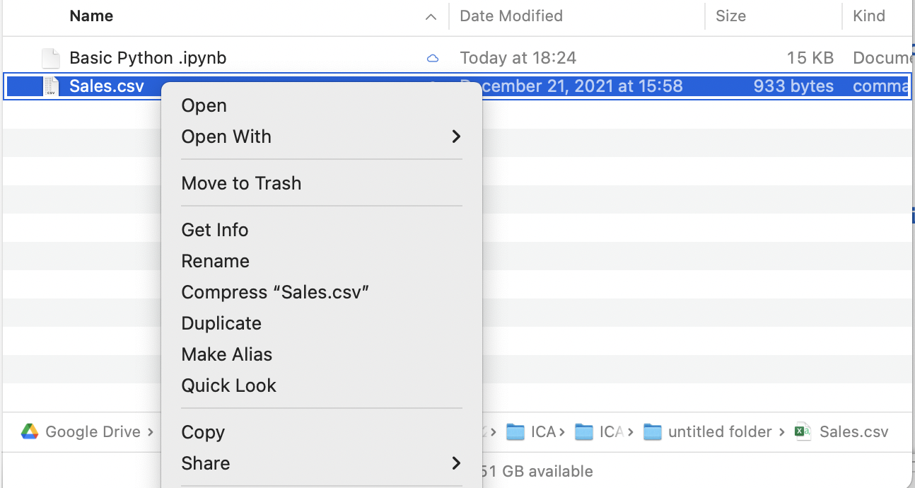
Go to the folder/finder where the csv file is located and click right button on the csv file as below
Mac user: click “Get Info”
Windows user: click “Properties”

Slide 5
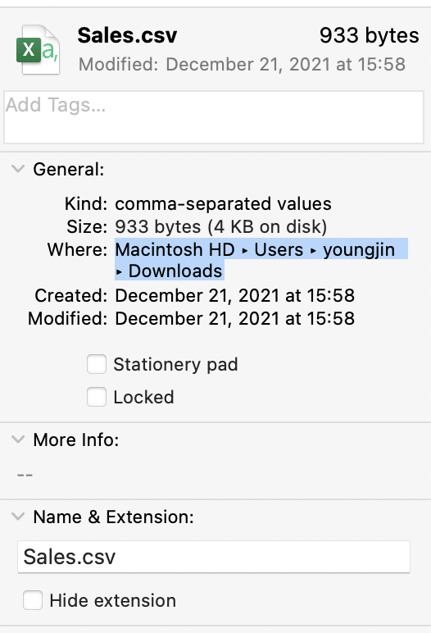
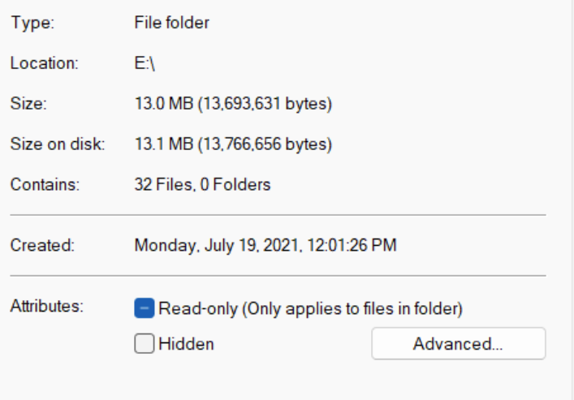
Go to the folder/finder where the csv file is located and click right button on the csv file as below
Mac user: drag and copy under “Where”
Windows user: drag and copy under “Location”
Drag and copy the text in the red box
Left: Mac
Right: Windows

Slide 6
Now you paste the text into the Jupyter notebook. It should be pasted inside parentheses of pd.read_csv()
Here are some notes
Make sure that you convert a backslash \ into slash / in the text you just pasted.
Make sure that you add file_name.csv next to the text you just pasted
Make sure that you wrap the text with the csv file name with single or double quotation marks
Above is the result.
You see (a) the quotation marks, (b) the directory (c) a slash after that, and (d) Sales.csv (file name + file format)
Here, you are specifying the file and its location for Python to read the csv file.
Also note that ‘Users/youngjin/Downloads’ part will be different in your query unless your laptop has the same name as me!!

