Slide 1
Review for Exam 3
MIS2502: Data and Analytics
Youngjin Kwon
youngjin.kwon@temple.edu http://community.mis.temple.edu/ykwon

Slide 2
Overview
Date/Time: Friday, Apr 22,
3:0x am – 3:5x am (55 minutes)
Place: Classroom
20-25 questions (multiple choice, short answer, and MySQL)
Closed-book, closed-note
Calculator Policy: You can use a calculator that does not have the ability to communicate with other electronic devices. (You are not allowed to use your smartphone’s calculator.)

Slide 3
Coverage
Check the Exam 3 Study Guide
Data Mining and Data Analytics Techniques (limited to when to use which analysis)
Using Python (limited to t-test)
Decision Tree Analysis
Cluster Analysis
Association Rules
SQL (Join, WHERE, Group By, Order By, Limit, Subselect, etc.)
Not every item on this list may be on the exam, and there may be items on the exam not on this list.

Slide 4
Study Materials
Lecture slides
In-class exercises
Assignments

Slide 5
When to use which analysis? (Decision Trees, Clustering, and Association Rules)
When someone gets an A in this class, what other classes do they get an A in?
What predicts whether a company will go bankrupt?
If someone upgrades to an iPhone, do they also buy a new case?
Which presidential candidate will win the election?
Can we group our website visitors into types based on their online behaviors?
Can we identify different product markets based on customer demographics?
Association Rules
Decision Trees
Association Rules
Decision Trees
Clustering
Clustering
Notes:
Based on each situation which technique should we use
A – association between classes
D – observation(companies)
A – iphone (ante)

Slide 6
Hypothesis Testing
uses p-values to weigh the strength of the evidence
T-test: A small p-value (typically ≤ 0.05) suggests that there is a statistically significant difference in means.
Results of t-test for differences in Runs by League
More about p-values:
http://www.dummies.com/how-to/content/the-meaning-of-the-p-value-from-a-test.html
http://www.dummies.com/how-to/content/statistical-significance-and-pvalues.html
Notes:
Scientific notiation – reduce space

Slide 7
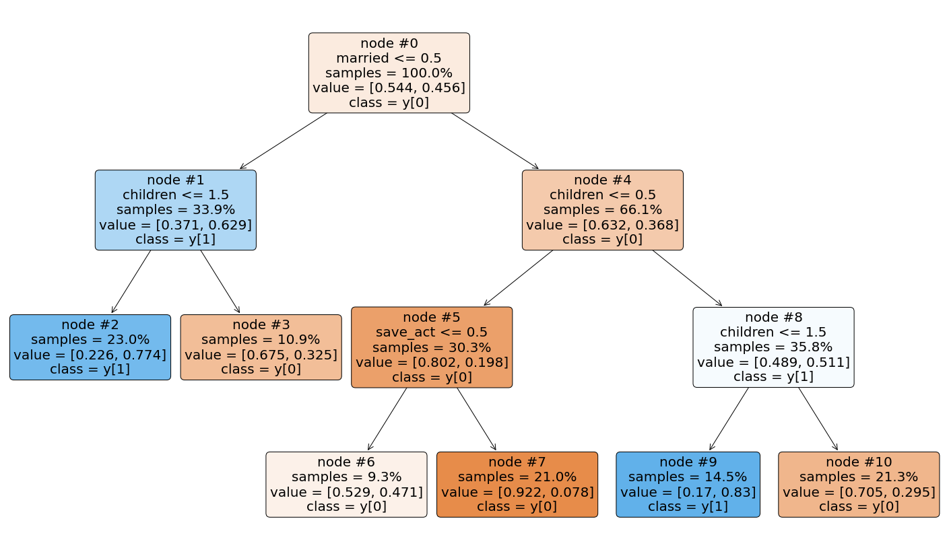
Decision Tree Analysis
Outcome variable: Discrete/Categorical
Interpreting decision tree output
Probability of purchase?
Who are most/least likely to buy?

Slide 8
Decision Tree Analysis
What are the pros and cons with a complex tree?
How would complexity factor affect the tree?
How would minimum split affect the tree?
MINIMUMSPLIT: the minimum number of observations that must exist in a node in order for a split to be attempted
Pros: Better accuracy
Cons: hard to interpret, overfitting
COMPLEXITY FACTOR: the reduction in error needed for an additional split to be allowed
Smaller COMPLEXITYFACTOR →
more complex tree
Smaller MINIMUMSPLIT →
more complex tree

Slide 9
Classification Accuracy
 |  | Predicted outcome:
 |  | 0 | 1
Observed outcome: | 0 | 1001 | 45
 | 1 | 190 | 3764 | Total: 5000
Error rate?
Correct classification rate?
(190+45) /5000= 0.047 (4.7%)
(1-0.047) = 0.953 (95.3%)

Slide 10
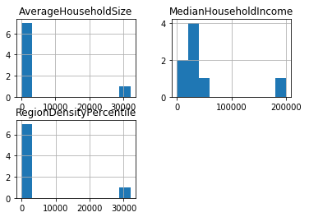
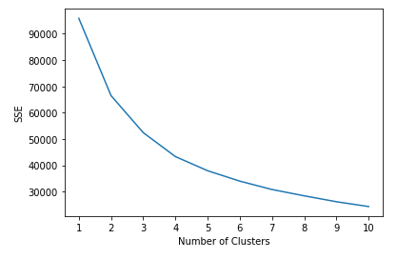
Cluster Analysis
Interpret output from a cluster analysis

Slide 11
Cohesion and Separation
Cohesion
Higher withinss = Lower cohesion (BAD)
High withinss means that elements within cluster are far away from each other
Separation
Higher betweenss = Higher separation(GOOD)
High betweenss means that different clusters are far away from each other
What happens to those statistics as the number of clusters increases?
Higher cohesion (Good)
Lower separation (Bad)

Slide 12
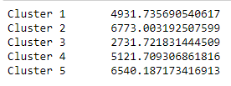
Cohesion and Separation
Interpret withinss (cohesion) and betweensss (separation)
withinss error (cohesion)
total betweensss error
average betweensss error (separation)

Slide 13
Standardized (Normalized) Data
Interpret standardized cluster means for each input variable
For standardized values, “0” is the average value for that variable.
For Cluster 5:
average RegionDensityPercentile >0 ➔ higher than the population average
average MedianHouseholdIncome, and AverageHouseholdSize <0 ➔ lower than the population average

Slide 14

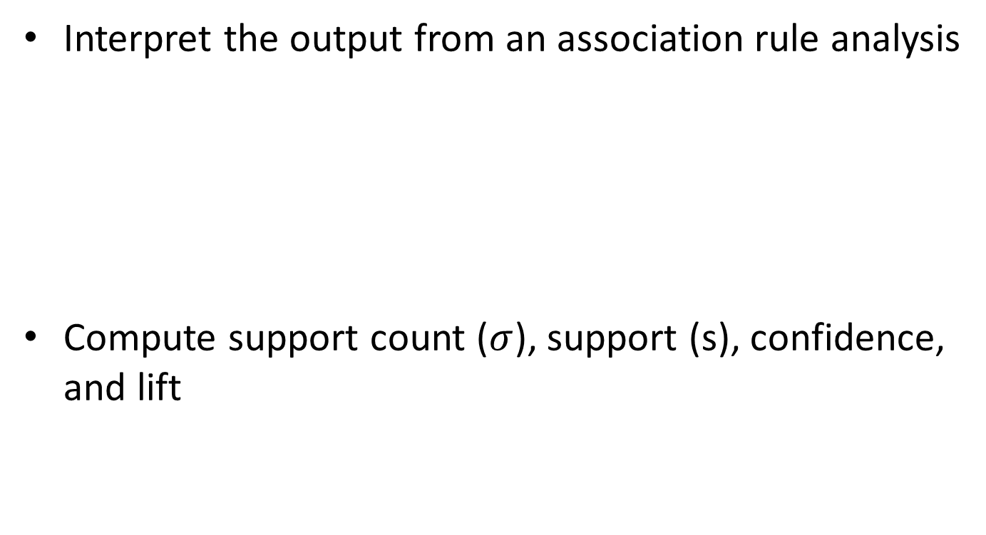
Association Rules
Interpret the output from an association rule analysis
Compute support count ($σ$), support (s), confidence, and lift
$$\text{c}\left(\text{X}\text{→}\text{Y}\right)\text{=}\frac{\text{s}\left(\text{X}\text{→}\text{Y}\right)}{\text{s}\text{(}\text{X}\text{)}}$$
These two formulas will be provided
But you need to know how to compute support

Slide 15
Compute Support, confidence, and lift
Basket Items
1 Coke, Pop-Tarts, Donuts
2 Cheerios, Coke, Donuts, Napkins
3 Waffles, Cheerios, Coke, Napkins
4 Bread, Milk, Coke, Napkins
5 Coffee, Bread, Waffles
6 Coke, Bread, Pop-Tarts
7 Milk, Waffles, Pop-Tarts
8 Coke, Pop-Tarts, Donuts, Napkins
Rule | Support | Confidence | Lift
{Coke} → {Donuts} | 3/8 = 0.375 | 3/6 = 0.50 | $$\frac{0.375}{0.75∗0.375}=1$$
{Coke, Pop-Tarts} →{Donuts} | 2/8 = 0.25 | 2/3 = 0.67 | $$\frac{0.25}{0.375∗0.375}=1.78$$
{Coke, Pop-Tarts} →{Donuts} has both higher lift and confidence
Which rule has the stronger association?
Consider:
a customer with coke in the shopping cart.
a customer with coke and pop-tarts in the shopping cart.
Who do you think is more likely to buy donuts?
The second one, with a higher lift

Slide 16
Compute Support, confidence, and lift
 | Krusty-O’s
Potato Chips |  | No | Yes
 | No | 5000 | 1000
 | Yes | 4000 | 500
 |  |  |  | Total: 10500
What is the lift for the rule {Potato Chips} → {Krusty-O’s}?
Are people who bought Potato Chips more likely than chance to buy Krusty-O’s too?
$$Lift= \frac{\left.s(Potato Chips, KrustyOs\right)}{\left.s\left(Potato Chips\right)∗s(KrustyOs\right)}=\frac{0.048}{0.429∗0.143}=0.782$$
They appear in the same basket less often than what you’d expect by chance (i.e., Lift < 1).

Slide 17
Association Rules
What does Lift > 1 mean? Would you take action on such a rule?
What about Lift < 1?
What about Lift = 1?
The occurrence of X → Y together is more likely than what you would expect by random chance (positive association)
The occurrence of X → Y together is less likely than what you would expect by random chance (negative association)
The occurrence of X → Y together is the same as random chance (no apparent association. X and Y are independent of each other)

Slide 18
Association Rules
Can you have high confidence and low lift?
A numeric demonstration: Suppose we have 10 baskets. X appears in 8 baskets. Y appears in 8 baskets. X and Y co-appear in 6 baskets…
$$σ\left(X\right)=8⟹s\left(X\right)=0.8$$
$$σ\left(Y\right)=8⟹s\left(Y\right)=0.8$$
$$σ\left(X→Y\right)=6⟹s\left(X→Y\right)=0.6$$
$Confidence=$ $\frac{σ\left(X→Y\right)}{σ\left(X\right)}=\frac{6}{8}=0.75$
$$Lift= \frac{s\left(X→Y\right)}{s\left(X\right)∗s(Y)}=\frac{0.6}{0.8∗0.8}=0.9375<1$$
When both X and Y are popular….
You get high confidence
But low lift
When both X and Y are popular, you’d almost expect them to show up in the same baskets by chance !

Slide 19
SQL Query
Given a schema of a database, be able to create a SQL statement to answer a question
Understand how to use
SELECT
FROM
DISTINCT
WHERE (and how to specify conditions)
AND/OR
COUNT, AVG, MIN, MAX, SUM
GROUP BY
ORDER BY (ASC/DESC)
LIMIT
Join Tables

Slide 20
Subselect as One Single Value: Example
Q: Which German customer placed the order(s) with the highest order amount?
Q: Which customer who bought products from seller A placed the order(s) with the highest order amount?
MyDB.Order
MyDB.Customer
OrderID | CustomerID | Seller | Amount
10308 | 2 | A | 100
10309 | 1 | A | 10
10310 | 1 | C | 63
CustomerID | LastName | FirstName | Country
1 | Futterkiste | Alfreds | Germany
2 | Trujillo | Ana | US
3 | Moreno | Antonio | Mexico
SELECT * FROM MyDB.Order
JOIN MyDB.Customer
ON Order.CustomerID=Customer.CustomerID;
Recall the simple join query…
OrderID | CustomerID | Seller | Amount | CustomerID | LastName | FirstName | Country
10308 | 2 | A | 100 | 2 | Trujillo | Ana | US
10309 | 1 | A | 10 | 1 | Futterkiste | Alfreds | Germany
10310 | 1 | C | 63 | 1 | Futterkiste | Alfreds | Germany

Slide 21
Subselect as One Single Value: Example 2
Q: Which German customer placed the order(s) with the highest order amount?
Step 1. We start by writing a subselect query that returns the highest order amount for German customers:
SELECT MAX(Order.Amount)
FROM MyDB.Order JOIN MyDB.Customer
ON Order.CustomerID=Customer.CustomerID
WHERE Customer.Country=‘Germany’;
Amount
63
Step 2. We treat the subselect query as a single value:
SELECT Customer.LastName, Customer.FirstName, Order.Amount
FROM MyDB.Order JOIN MyDB.Customer
ON Order.CustomerID=Customer.CustomerID
WHERE Customer.Country=‘Germany’
AND Amount= (SELECT MAX(Order.Amount)
FROM MyDB.Order JOIN MyDB.Customer
ON Order.CustomerID=Customer.CustomerID
WHERE Customer.Country=‘Germany’);
LastName | FirstName | Amount
Futterkiste | Alfreds | 63

Slide 22
Subselect as One Single Value: Example 2
Q: Which customer who bought products from seller A placed the order(s) with the highest order amount?
Step 1. We start by writing a subselect query that returns the highest order amount from Seller A :
SELECT MAX(Order.Amount)
FROM MyDB.Order
WHERE Customer.Seller=‘A’;
Amount
100
Step 2. We treat the subselect query as a single value:
SELECT Customer.LastName, Customer.FirstName, Order.Amount
FROM MyDB.Order JOIN MyDB.Customer
ON Order.CustomerID=Customer.CustomerID
WHERE Order.Seller=‘A’
AND Amount= (SELECT MAX(Order.Amount)
FROM MyDB.Order
WHERE Customer.Seller=‘A’);
LastName | FirstName | Amount
Trujillo | Ana | 100

Slide 23
Lastly..
Y’all did great this semester!
Good and Bad news
Queries you learned are basic
Even if you are not quick-learners, you can catch up on it quickly
The real process of learning it will be like optional assignments
They are powerful tools for you to avoid laborious work on Excel

Slide 24
Good luck!

