Slide 1
Working with semi-structured data
MIS2502: Data and Analytics
Jeremy Shafer
Jeremy.shafe@temple.edu
http://community.mis.temple.edu/jshafer

Slide 2

Where we are…
Now we’re here…
Data entry
Transactional Database
Data extraction
Analytical Data Store
Data analysis
Stores real-time transactional data in a relational or NoSQL database
Stores historical transactional and summary data

Slide 3
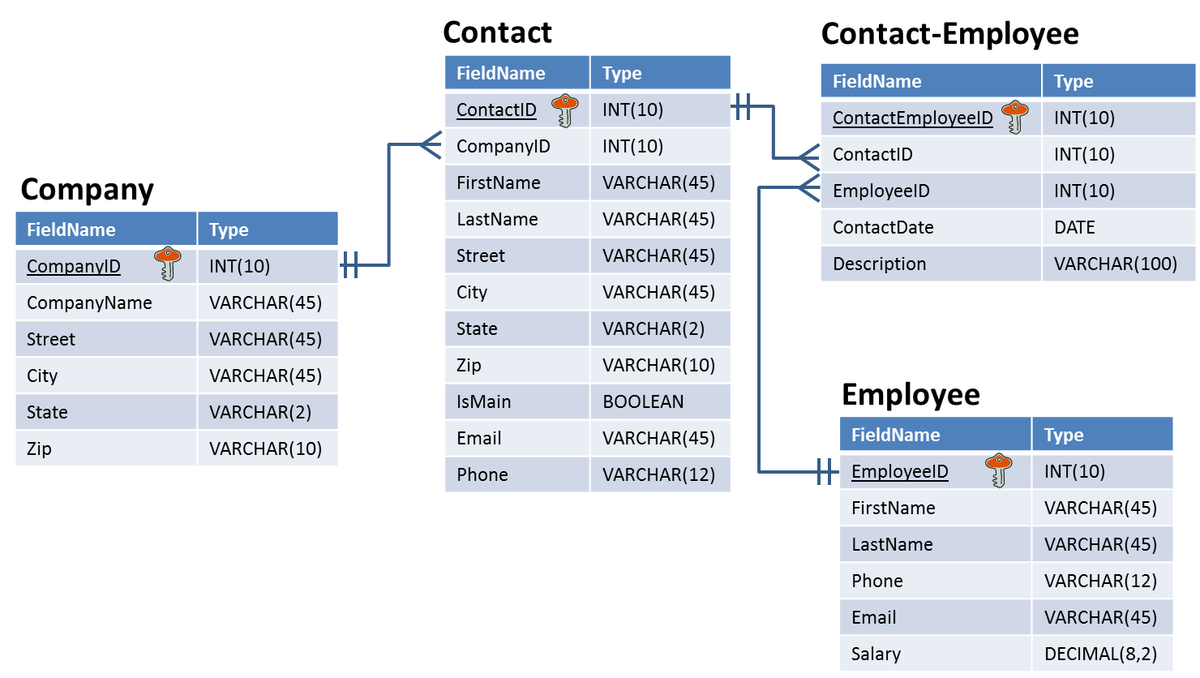
Relational databases are highly structured
Tables have the same number of fields for every record
Each field has a specified data type
Data types have a specified length and precision

Slide 4

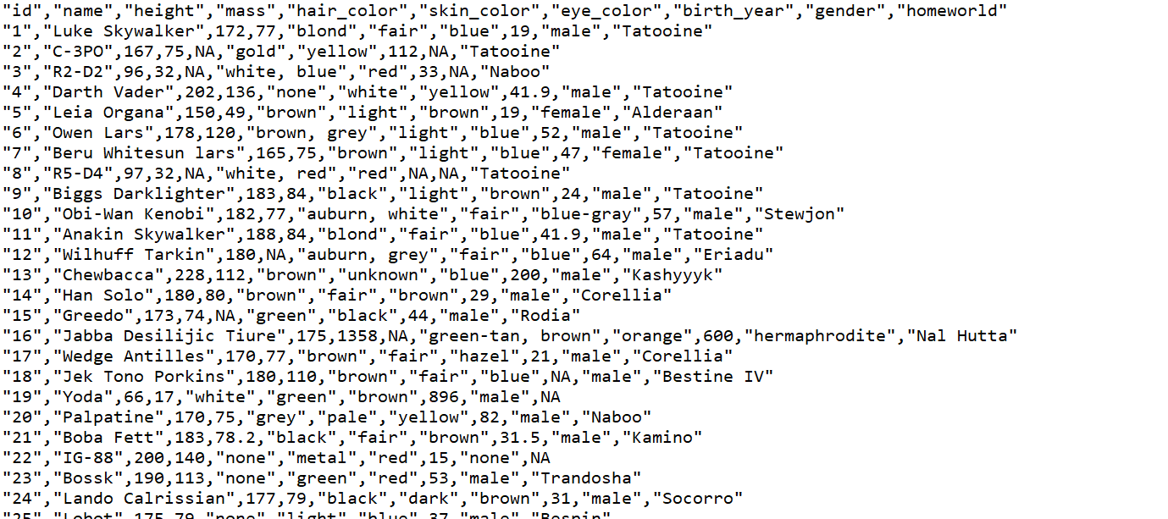
But not all data is stored like that
This is a comma-separated value (CSV) file.
Each value is separated by a comma.
Other than that, it is plain text.
The first row is often the field names.
There are no specified field lengths.
From: Wookieepedia

Slide 5

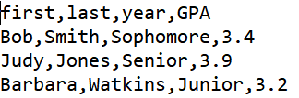
Role of quotation marks
The quotes don’t necessarily imply a data type.
Notice that the ID is in quotes but the height and mass are not.
The quotes just allow commas to be considered part of the value, not a separator.
This is also a valid
CSV file…
From: Wookieepedia

Slide 6
Some definitions
Structured data
Organized according to a formal data model (i.e., relational schema)
Semi-structured data
No formal data model, but contains symbols to separate and label data elements
Unstructured data
No data model and no pre-defined organization

Slide 7
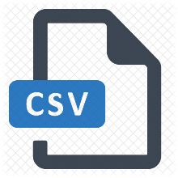






Examples
Structured Data
Semi-Structured Data
Unstructured Data
Relational databases
Text documents
Picture
Video
Would you consider an Excel spreadsheet structured, semi-structured, or unstructured?

Slide 8
Why should we care about semi-structured and unstructured data?
Semi-structured data
Common way to transfer data between software applications
Because plain-text is universal, datasets are often posted using semi-structured formats
Unstructured data
It’s everywhere
Up to 70% to 80% of an organization’s data may be in unstructured forms (Wikipedia)

Slide 9
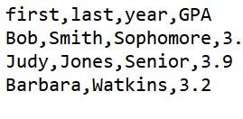
The CSV format is still quite structured
You can’t skip values in a row
You have to be careful when using commas as part of your data
…but there’s no way to create data hierarchies
  Can’t make “first” and “last” part of “name”
This means the year for Watkins is 3.2…
…and she doesn’t have a GPA
4

Slide 10
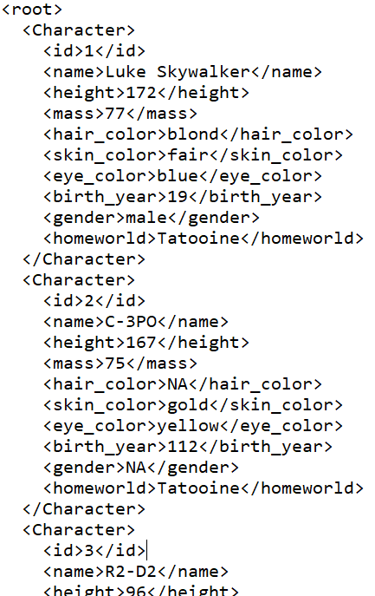
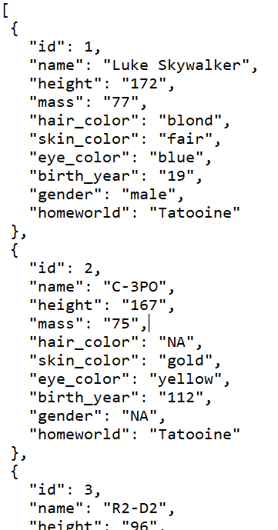
Alternatives to CSV for semi-structured data
XML
Extensible Markup Language
JSON
JavaScript Object Notation

Slide 11
Extensible Markup Language
Plain text file
Uses text for values between tags for labels
<opening tag>data</closing tag>
<height>172</height>
Values can be of any length
Commas and quotes are valid
Fields can be skipped…
Remove <mass>75</mass> from
C-3PO and skin color is still gold
Starts and ends with a tag (often <root> or <document>)

Slide 12
Hierarchies in XML
We know we can break up name into first and last
But we are also nesting it under name
  So first and last are now attributes of name
Easier to find what you’re looking for and organize your data
<Character>
<id>1</id>
<name>
<first>Luke</first> <last>Skywalker</last>
</name>
<height>172</height>
<mass>77</mass>
<hair_color>blond</hair_color>
<skin_color>fair</skin_color>
<eye_color>blue</eye_color>
<birth_year>19</birth_year>
<gender>male</gender>
<homeworld>Tatooine</homeworld>
</Character>
And id, name, height, mass, etc., are all nested under Character

Slide 13
Bottom line for XML
XML is better than CSVs for semi-structured data
  Allow for hierarchies
  More flexible
  Easier to read
But XML takes up a lot more space with all of those tags
  Starwars.csv → 6,251 bytes
  Starwars.xml → 28,521 bytes

Slide 14
JavaScript Object Notation
Plain text file
Organized as objects within braces { }
Uses key-value pairs
  key: value
  “name”: “C-3PO”
  keys are field names; strings in quotes
  values are the data; strings, numbers, Boolean (quotes around strings required)
  a comma separates the key-value pairs
Values can be any length
Fields can be skipped
  Remove “mass”: “75” from
  C-3PO and skin color is still gold
JSON object
JSON object

Slide 15
Object and Array in JSON
Object
Array
Objects are surrounded by curly braces {}.
Objects are written in key/value pairs.
{ Key1: Value1, Key2: Value2, …}
Array is surrounded by square bracket [].
Array can store multiple values.
Values must be separated by comma
[ Value1, Value2, Value3, … ]

Slide 16
Hierarchies in JSON
We can have first and last nested as attributes of name, just like XML
We can list multiple abilities using array
{
"Character": {
"id": "1",
"name": {
"first": "Luke",
"last": "Skywalker"
},
"height": "172",
"mass": "77",
“Abilities": [
“Lightsaber",“Multilingual“
],
"skin_color": "fair",
"eye_color": "blue",
"birth_year": "19",
"gender": "male",
"homeworld": "Tatooine"
}
}
JSON object
What are the differences between arrays and objects?
JSON array

Slide 17
Bottom line for JSON
Best aspects of XML and CSV
More lightweight than XML
  Starwars.csv → 6,251 bytes
  Starwars.xml → 28,521 bytes
  Starwars.json → 21,074 bytes
Supports hierarchies like XML
JSON becoming the standard for transferring data across the web

Slide 18
Same data, four different ways…
Relational database table
XML file
JSON file
first | last | year | GPA
Bob | Smith | Sophomore | 3.4
Judy | Jones | Senior | 3.9
Barbara | Watkins | Junior | 3.2
<root>
<Person>
<first>Bob</first>
<last>Smith</last>
<year>Sophomore</year>
<GPA>3.4</GPA>
</Person>
<Person>
<first>Judy</first>
<last>Jones</last>
<year>Senior</year>
<GPA>3.9</GPA>
</Person>
<Person>
<first>Barbara</first>
<last>Watkins</last>
<year>Junior</year>
<GPA>3.2</GPA>
</Person>
</root>
[
{
"first": "Bob",
"last": "Smith",
"year": "Sophomore",
"GPA": 3.4
},
{
"first": "Judy",
"last": "Jones",
"year": "Senior",
"GPA": 3.9
},
{
"first": "Barbara",
"last": "Watkins",
"year": "Junior",
"GPA": 3.2
}
]
CSV file
first,last,year,GPA
Bob,Smith,Sophomore,3.4
Judy,Jones,Senior,3.9
Barbara,Watkins,Junior,3.2

Slide 19
In Class Activity #5

