Slide 1
Introduction to Advanced Analytics and Python
MIS2502: Data and Analytics
Jeremy Shafer

Slide 2

The Information Architecture of an Organization
Now we’re here…
Data entry
Transactional Database
Data extraction
Analytical Data Store
Data analysis
Stores real-time transactional data in a relational or NoSQL database
Stores historical transactional and summary data

Slide 3
What is Advanced Data Analytics?
The examination of data or content using sophisticated techniques and tools, to discover deeper insights, make predictions, or generate recommendations.
Goals:
Extraction of implicit, previously unknown, and potentially useful information from data
Exploration and analysis of large data sets to discover meaningful patterns
Prediction of future events based on historical data

Slide 4
What advanced data analytics is not…
Sales analysis
How do sales compare in two different stores in the same state?
Profitability analysis
Which product lines are the highest revenue producers this year?
Sales force analysis
Did salesperson X meet this quarter’s target?

Slide 5
Advanced data analytics is about…
Sales analysis
Why do sales differ in two stores in the same state?
Profitability analysis
Which product lines will be the highest revenue producers next year?
Sales force analysis
How much likely will the salesperson X meet next quarter’s target?

Slide 6
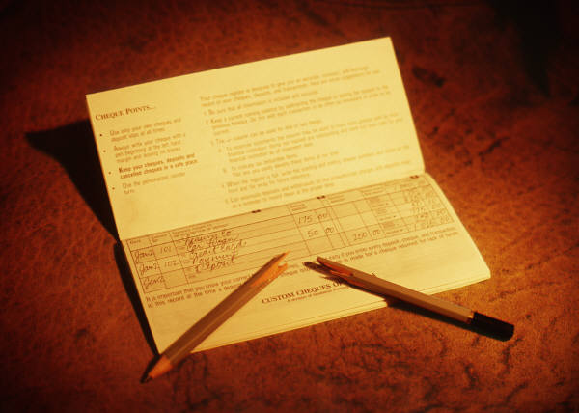
Example: Smarter Customer Retention
Consider a marketing manager for a brokerage
company
Problem: High churn (customers leave)
  Customers get an average reward of $150 to open an account
  40% of customers leave after the 6 months introductory period
  Getting a customer back after they leave is expensive
  Giving incentives to everyone who might leave is expensive

Slide 7
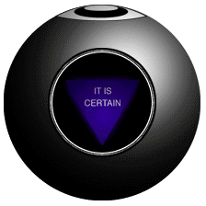
Answer: Not all customers have the same value
One month before the end of the introductory period, predict which customers will leave
Offer those customers something based on their future value
Ignore the ones that are not predicted to churn

Slide 8
Three Analytics Tasks We Will Be Doing in this Class
Decision Trees
Clustering
Association Rule Mining

Slide 9
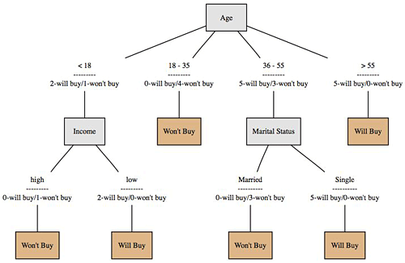
Decision Trees
Used to classify data
according to a
pre-defined outcome
Based on characteristics
of that data
Can be used to predict future outcomes
http://www.mindtoss.com/2010/01/25/five-second-rule-decision-chart/
Uses
Predict whether a customer should receive a loan
Flag a credit card charge as legitimate
Determine whether an investment will pay off

Slide 10
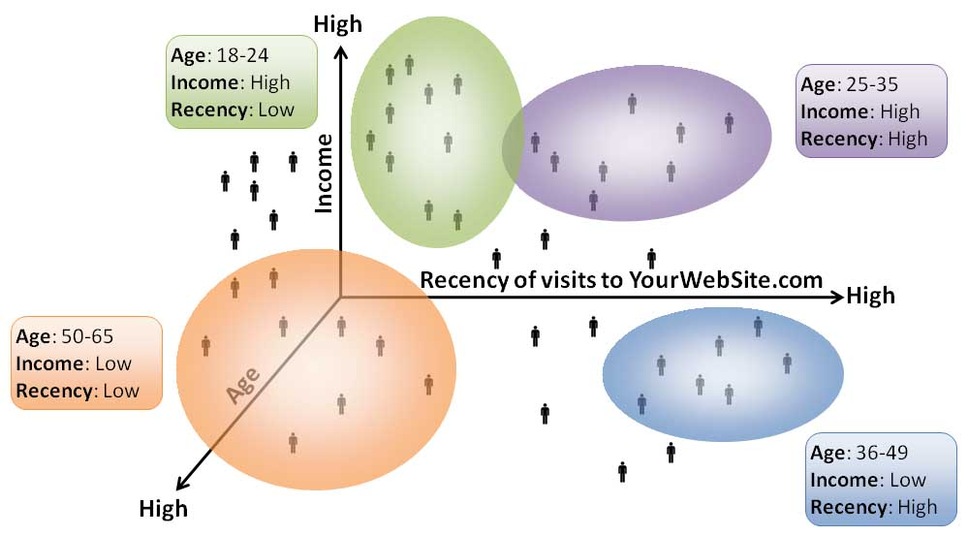
Clustering
Used to determine distinct groups of data
Based on data across multiple dimensions
Uses
Customer segmentation
Identifying patient care groups
Performance of business sectors
http://www.datadrivesmedia.com/two-ways-performance-increases-targeting-precision-and-response-rates/

Slide 11
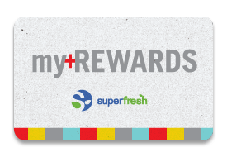
Association Rule Mining
Find out which events predict the occurrence of other events
Often used to see which products are bought together
Uses
What products are bought together?
Amazon’s recommendation engine
Telephone calling patterns

