Slide 1
MIS 2901 Exam 2 Review

Slide 2
Exam Details
25 Multiple Choice Questions
5 from the Readings
10 from the Lectures
10 Mini-Case
Weeks 6, 7, 8 Material- NOT Cumulative
Bring a pencil, pens, highlighters

Slide 3
Exam Material
ERP → Enterprise Resource Planning
Decision Support
Knowledge Management
SDLC→ Systems Development Life Cycle
Digital Innovation

Slide 4
Enterprise Systems (ERP)
Business processes that span multiple functional areas
Some of the largest, most expensive , complicated, highest risk, and greatest reward tech investments an organization can make
Understand them, pros and cons

Slide 5
3.1 Types of Systems in Organizations

Slide 6
3.1.1- Enterprise Resource Planning (ERP)

Slide 7
Value proposition of ERP
Global, real-time view of data
Enables companies to address concerns proactively
Drive improvements
Improve financial compliance and reduce risks
Automate core business operations (Procedure-to-Pay, Lead-to-Cash)
Enhance customer service
Provides one source for billing and relationship tracking

Slide 8
Uses of ERP
Using a single, integrated database, information is always current and accurate.
Business intelligence
E-Commerce
Enterprise asset management

Slide 9
Legacy Systems
Separate systems that really do make each functional area more efficient
BUT
Standalone systems
Organization as a whole not more efficient
Multiple copies of data
Build and support all system interfaces
Different computing platforms
Each system interface designed differently

Slide 10
Challenges of ERP
Adoption
Complex Configuration
Complex implementation
HIGH costs
High risk
Internally focused

Slide 11
SCM, ERP, CRP
SCM
Supply Chain Management
ERP
Enterprise Resource Planning
CRM
Customer Relationship Planning

Slide 12
Tips for Implementing ERP Systems
Upper management support
Clear list of requirements before looking at vendors
Evaluate options before selecting ERP system
Mobile users
Get references from vendors
Think before customizing
Change management
ERP product champion / project manager
Provide time and resources

Slide 13
3.1.2 Decision Support

Slide 14
Decision Making Process
Define the problem
Identify limiting factors
Develop potential alternatives
Analyze the alternatives
Select best alternative
Implement Decision
Control and Evaluation system

Slide 15
Types of Data
Structured
Unstructured
ERD
Organizational databases
ERP
Clearly defined data entities
Relationships
Hierarchies
Emails
Facebook Posts
Tweets
Site Comments

Slide 16
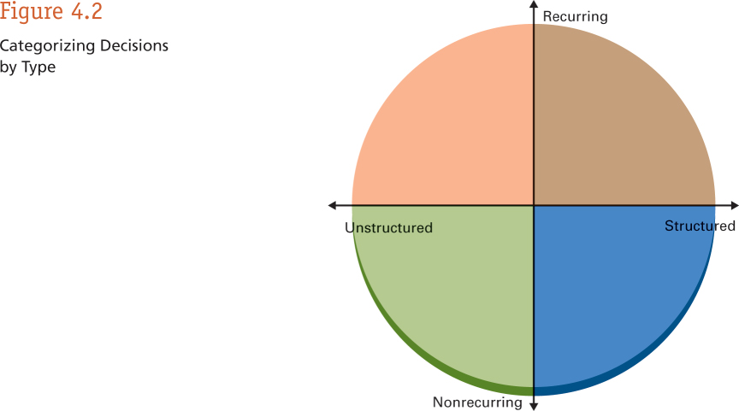
Types of Decisions
Daily & Weekly
regimented tasks
Unstructured
Structured
Reoccurring
Nonrecurring
Analytics can help solve big, complex problems and questions

Slide 17
Data, Information, Knowledge
Data- raw, unstructured numbers, meaningless
Information- meaningful data → statistics, TuID, titles
Knowledge
Gaining insight
Making actionable decisions

Slide 18
Data Analytics
Making sense of large data
Unlocking patterns
Using data visualization
Enables better decision making

Slide 19
OLtP
OLAP
Online Transaction Processing
class of information systems
facilitate and manage transaction-oriented applications
for data entry and retrieval
a computer-based technique
analyzing data to look for insights
cube refers to a multi-dimensional dataset
Aggregated, historical data stored in multidimensional schemas

Slide 20
3.1.3 – Knowledge Management, R&D, social Business

Slide 21
Knowledge Management
Multi-disciplinary approach to achieve organization’s objectives
Capturing knowledge
Using organizational knowledge efficiently
Developing knowledge
Sharing knowledge

Slide 22
Explicit Knowledge
Knowledge that can be readily articulated, codified, accessed and verbalized
Easily transmitted to others
Encyclopedias
Textbooks
Manuals, documents, procedures, how-to videos
Works of art
Product design

Slide 23
Tacit Knowledge
Internalized Knowledge that an individual is not consciously aware of
Gained through experiences
Practical and action oriented
Difficult to transfer by writing down or verbalizing
How accomplish tasks
Facial recognition

Slide 24
Systems Management

Slide 25
Systems Development Life Cycle (SDLC)
The process followed by IT organizations when they create systems
Process used for planning, creating, testing, and deploying an information system
Hardware or software systems

Slide 26
Waterfall Methodology
Sequential models
focus on complete and correct planning to guide large projects and risks to successful and predictable results
sequence of stages in which the output of each stage becomes the input for the next.
Phases
Preliminary analysis
Systems Design
Development
Integration and testing
Acceptance, installation, development, training
Maintenance
Evaluation
Disposal

Slide 27
Agile Methodology
Principles
Active user involvement
The team must be empowered to make decisions
Requirements evolve but the timescale is fixed
Capture requirements at a high level
Small, incremental releases
Frequent delivery of products
Testing integrated throughout
collaborative
Iterative approach
Used in software development
focus on limited project scope and improving products by multiple iterations

Slide 28
Compliances with major impact on SDLC
They should be considered all throughout the systems development process
Sarbannes-Oxley
HIPAA
HITECH
FDA
CMS
Safe Harbor Agreement

Slide 29
Digital Business Innovation

Slide 30
The Disruptive Power of the Internet
Marketing products and services
Processing payments
Discovering new prospects
Virtual reality driven business
More CRIME opportunities
Effects:
Increased Competition
Increased Caliber & Quality
Increased Rate of Change
Decreased Margins

Slide 31
2017 Trends In Consumer Electronics
Keep an eye on the following trends and how they impact business models!
Virtual and Augmented Realities
Driverless Cars
Wearable Technology
Artificial Intelligence
The Cloud and Internet of Things (IoT)

Slide 32
Normal Distribution
Normal Distribution
Final grades in MIS2101.
Long Tail Distribution
Better matching consumers to what they are searching for
Amazon Most Popular Books
Most popular movies on Netflix.
Google advertisements

