Slide 1
MIS2901: Honors Digital Systems
1.1 Introduction to MIS
FOX
MIS

Slide 2
Welcome!
Fall 2021
FOX
MIS

Slide 3
“Tell me and I forget. Teach me and I remember. Involve me and I learn.”
- Benjamin Franklin

Slide 4
Managing Expectations
This class is unique!
We will work through challenges together…plan on it!
You will find the class engaging and fun!
You will acquire knowledge and skills that you will use in future classes and your career!!!
FOX
MIS

Slide 5
Course Highlights
Systems Analysis
Process Mapping (Modeling with swim lanes & entity relationship diagrams)
Digital Product Management
Information Systems CRM & ERP, Data Analytics & SCM
Platforms & Digital Business models, including API’s
Cyber security and the Enterprise plus AI
Programming including: JavaScript, HTML & CSS
FOX
MIS

Slide 6
Course Objectives
Explore the systems which organizations use to create their digital products
Explore the platforms which these digital systems are built upon
Explore the API ecosystems by which systems extend their reach and capability.
Discuss cyber security including risks & responses surrounding digital products
Introduction to the creation of software
Learning the basics of programming in JavaScript
FOX
MIS

Slide 7
Graded Components
Component | Percentage
In-Class Activities & Worksheets (approximately 17) * must be present in class to earn credit – no exceptions! | 10%
Learn IT! and Max Lab Assignments ** no late assignments accepted – no exceptions! | 30%
Exam #1 (50 minutes) | 20%
Exam #2 (50 minutes) | 20%
Exam #3 (50 minutes – held during finals week) | 20%
*In-Class activities must be submitted while in class.
**Completed assignments will not be returned in class. Grades will be posted to the gradebook. Please note that two weeks after a grade is posted, the grade will be considered “final.”
FOX
MIS

Slide 8


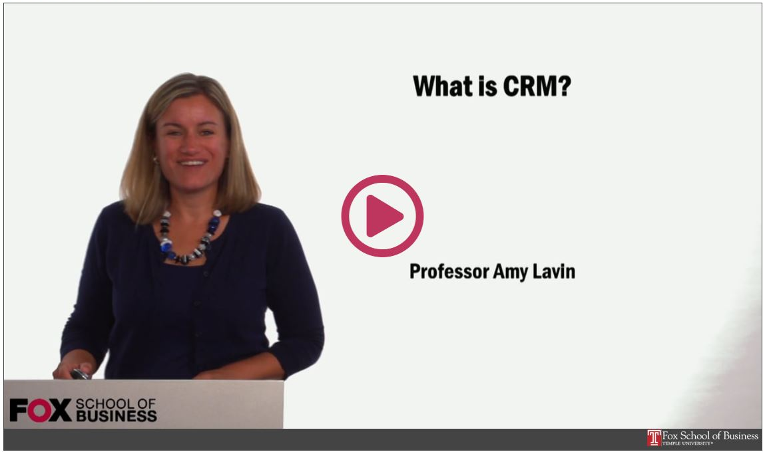
Readings & Videos – Part 1
No required texts the first 2/3’s of the semester!
Engaging collection
Current content
Available for Free!!!
FOX
MIS

Slide 9

Readings & Videos – Part 2
JavaScript
  Create simple JavaScript programs
  Prompt users for input
  Utilize loops
  Process Information
FOX
MIS

Slide 10

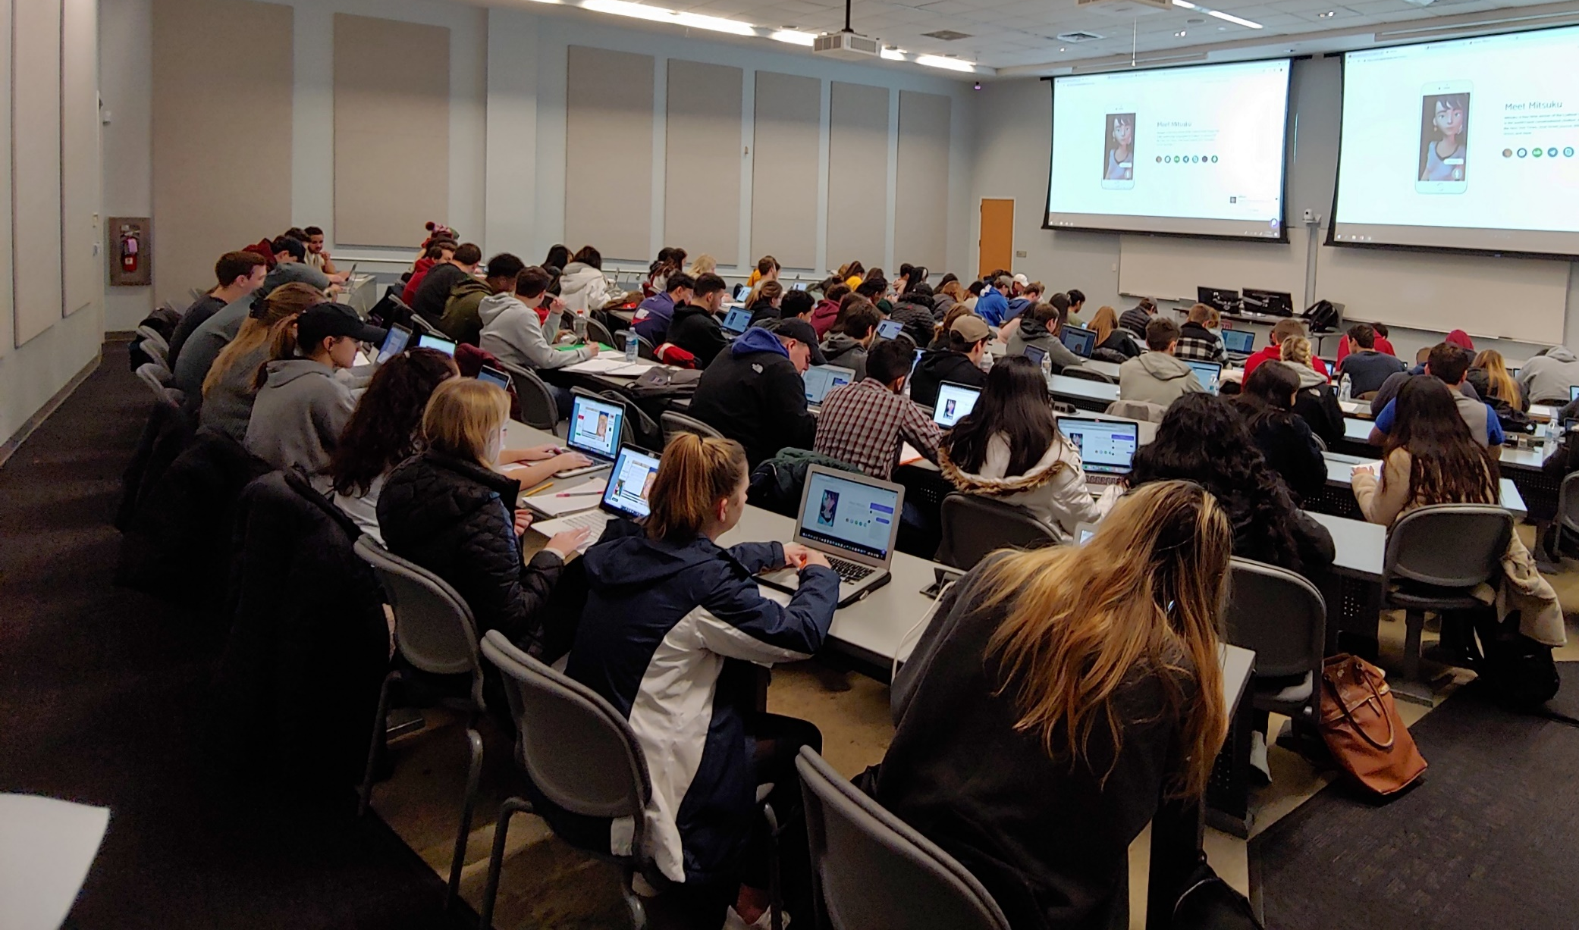
Lecture vs. Activities
Source: https://www.theodysseyonline.com/11-things-college-lecture-hall
3 Hours of zzzzzzzzz’s
1 Hour Discussion
2 Hours of Activity
FOX
MIS

Slide 11
Active Learning Components
TECHNOLOGY
CONTENT
ACTIVITY
FOX
MIS

Slide 12
The Active Learning Funnel
CONTENT
TECHNOLOGY
ACTIVITY
ENHANCED LEARNING ENVIRONMENT
FOX
MIS

Slide 13
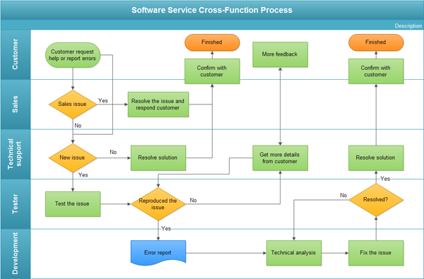
The In-class Activity
Process Diagrams
  Swim lane diagram
Real life scenarios
Knowledge Application
Problem Solve
Synthesize Solutions
FOX
MIS

Slide 14
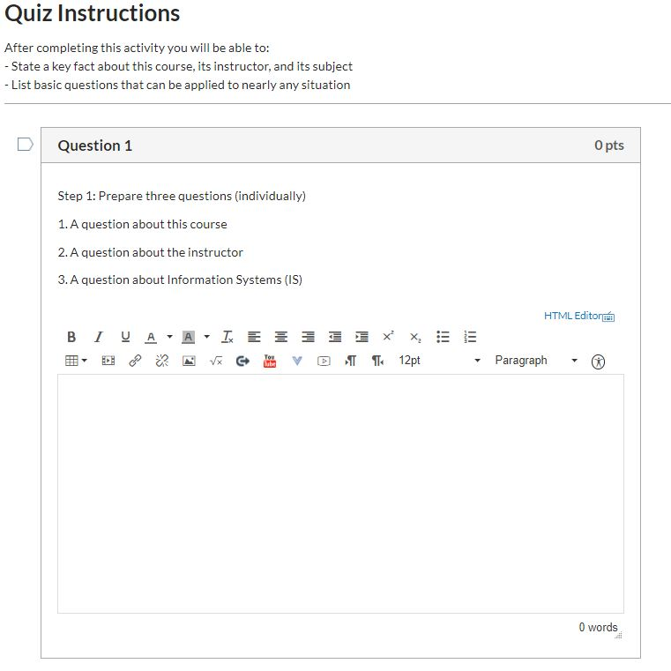
The In-class Activity – Canvas
Reinforce assigned materials
  Readings
  Videos
  Lecture
Exam Preparation
Work in teams
Must be present
You keep your work
FOX
MIS

Slide 15
Not Just Another Intro Class!
Accounting
Business Management
Entrepreneurship & Innovation Management
Financial Planning
International Business Administration
Marketing
Risk, Insurance & Healthcare Management
Supply Chain Management
Actuarial Science
Economics
Finance
Human Resources Management
Legal Studies in Business
Management Information Systems
Real Estate
Statistical Science and Data Analytics
FOX
MIS

Slide 16

FOX
MIS

Slide 17
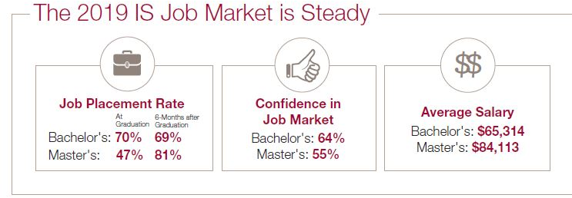
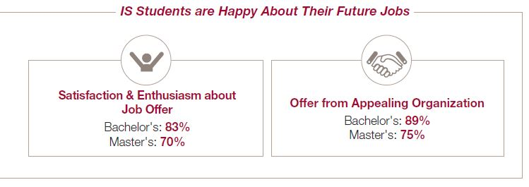
Based on 1420 recent graduates from 43 universities across the U.S.
FOX
MIS

Slide 18
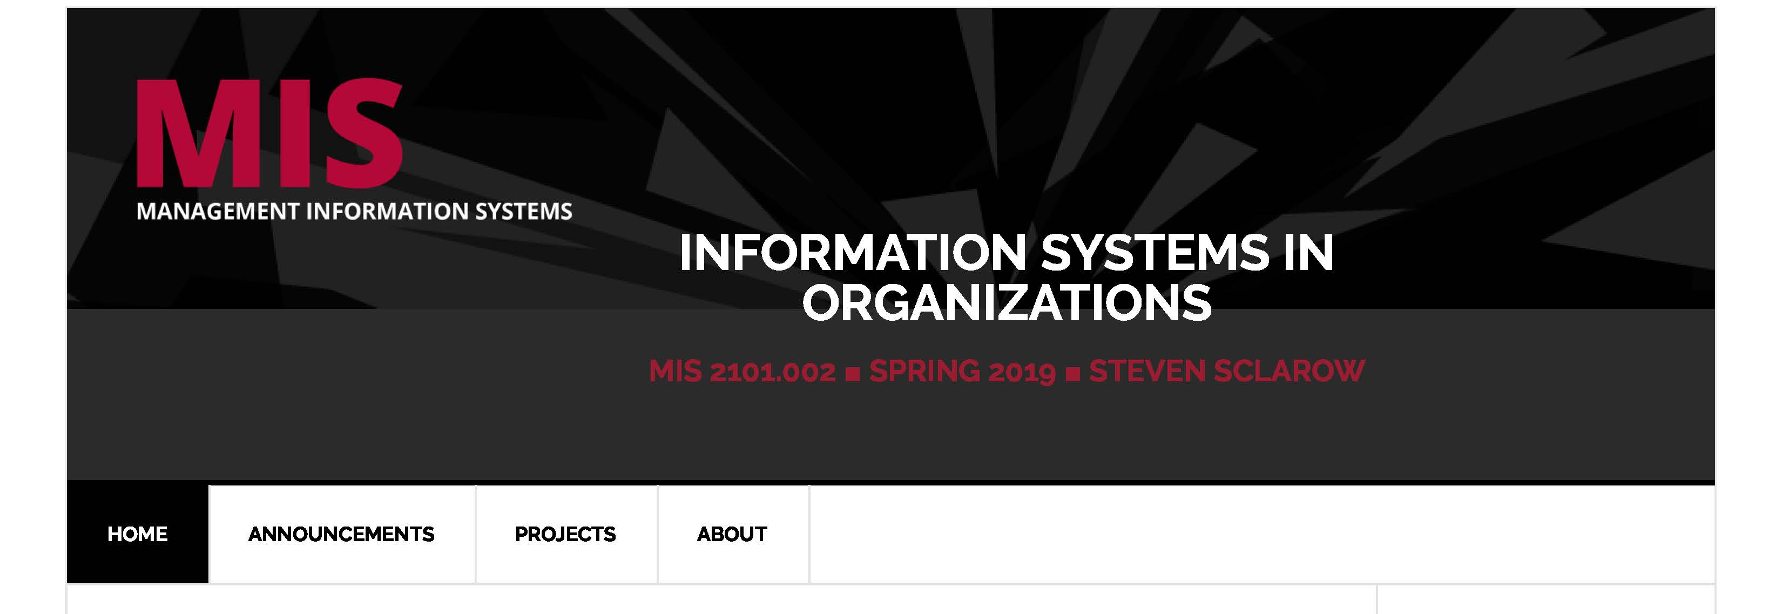
Class Site Review
https://community.mis.temple.edu/
FOX
MIS

Slide 19
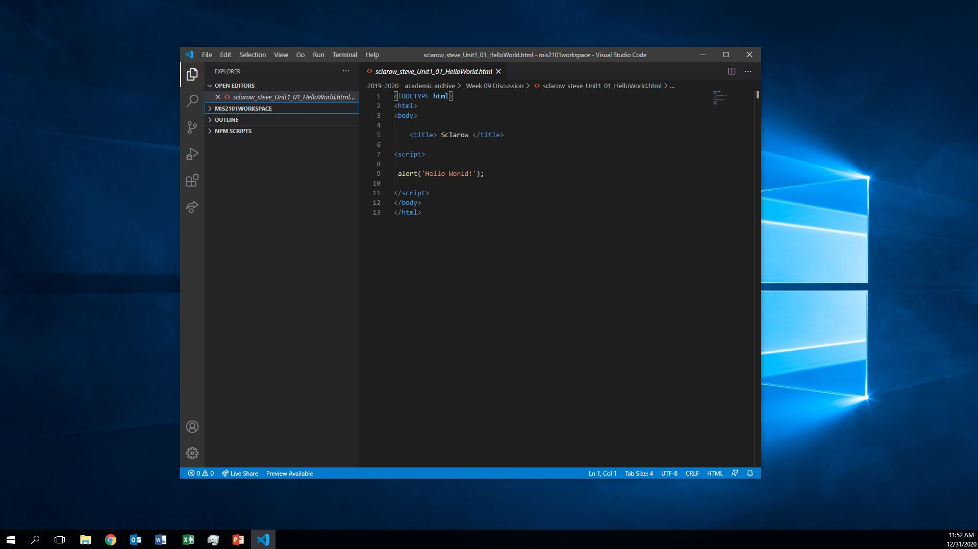
Course Overview Video
Spring 2021
FOX
MIS

Slide 20
ROADMAP
Week 1:
Introduction & Systems Analysis
Course Description
Systems Thinking
Assignments #01 & 02
Week 2:
Digital Product Management & Introduction to Process Mapping
Max Labs 1a & 1b
Systems & Processes
Swim Lane Diagrams
Assignment #03
Week 3:
Data Modeling with Entity Relationship Diagrams
Swim Lane Diagrams
ERD Diagrams
Assignment #04
Week 4:
Digital Systems – Learn IT! #1
ERD Diagrams
Learn IT Kickoff
Assignment #05
Week 5:
Exam #1,
Max Labs & Information
Systems: Part I & II
CRM & ERP
*Exam: check course site
Assignment #06
START
Week 9:
Exam #2 & JavaScript Unit #1
- Part I & II
Hello World, Variables
*Exam: check course site
Week 8:
Cybersecurity & AI – Part I & II
Protection Protocols
Artificial Intelligence
Assignment #08
Week 7:
Platforms & Digital Business Models: Part I & II
Platforms & Digital Models
APIs
Week 6:
Information Systems: Part III & IV
Data Analytics
SCM
Assignment #07
Week 10:
JavaScript Unit #2 Functions
Operator types
Strings
Assignment #9
Week 11:
JavaScript Unit #3 Logical Operators & Conditional Logic
Logical Operators
Conditional Types
Week 12:
JavaScript Unit #4 Loops
Intro to Loops
While and Do
Assignment #10
Week 13:
JavaScript Unit #4 Working with Loops
Writing the code
Week 14:
HTML & CSS Unit
HTML basics
CSS basics
Course Reflection
Assignments #11
FINISH

Slide 21
Digital Systems
1.2 What are Systems?
FOX
MIS

Slide 22
ROADMAP
Week 1:
Introduction & Systems Analysis
Course Description
Systems Thinking
Assignments #01 & 02
Week 2:
Digital Product Management & Introduction to Process Mapping
Max Labs 1a & 1b
Systems & Processes
Swim Lane Diagrams
Assignment #03
Week 3:
Data Modeling with Entity Relationship Diagrams
Swim Lane Diagrams
ERD Diagrams
Assignment #04
Week 4:
Digital Systems – Learn IT! #1
ERD Diagrams
Learn IT Kickoff
Assignment #05
Week 5:
Exam #1,
Max Labs & Information
Systems: Part I & II
CRM & ERP
*Exam: check course site
Assignment #06
START
Week 9:
Exam #2 & JavaScript Unit #1
- Part I & II
Hello World, Variables
*Exam: check course site
Week 8:
Cybersecurity & AI – Part I & II
Protection Protocols
Artificial Intelligence
Assignment #08
Week 7:
Platforms & Digital Business Models: Part I & II
Platforms & Digital Models
APIs
Week 6:
Information Systems: Part III & IV
Data Analytics
SCM
Assignment #07
Week 10:
JavaScript Unit #2 Functions
Operator types
Strings
Assignment #9
Week 11:
JavaScript Unit #3 Logical Operators & Conditional Logic
Logical Operators
Conditional Types
Week 12:
JavaScript Unit #4 Loops
Intro to Loops
While and Do
Assignment #10
Week 13:
JavaScript Unit #4 Working with Loops
Writing the code
Week 14:
HTML & CSS Unit
HTML basics
CSS basics
Course Reflection
Assignments #11
FINISH

Slide 23
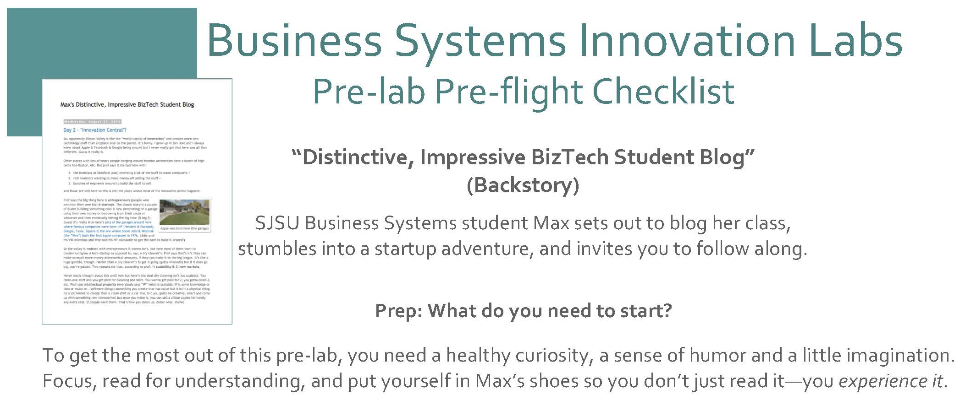
Max Labs
Spring 2021
FOX
MIS

Slide 24
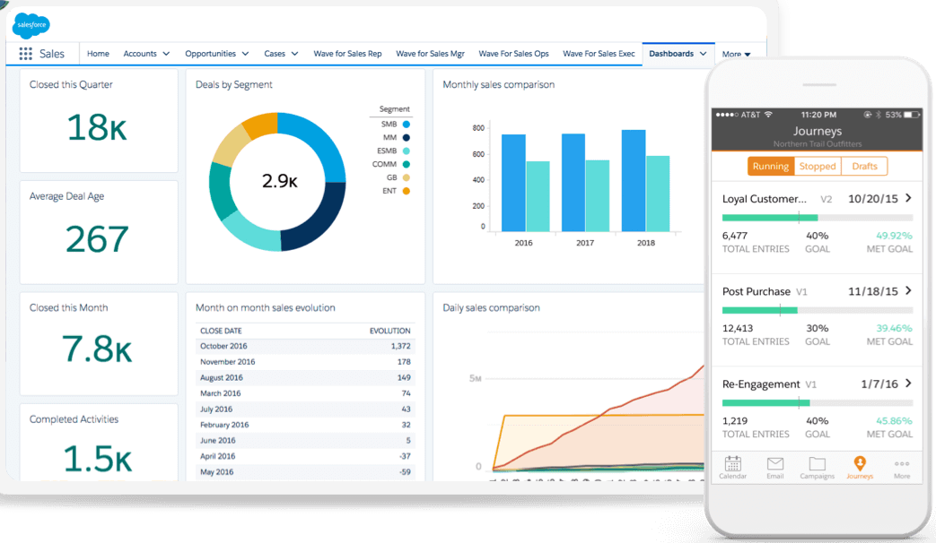

What is MIS?
Using Information Technology to solve business problems.
MIS is not Computer Science
It’s about business where we train people to do what?
Use technology to solve day-to-day business problems
Sources: https://c1.sfdcstatic.com/content/dam/web/en_us/www/images/products/what-is-salesforce/whatis-jumbo-astro-product.png
https://www.kindpng.com/picc/m/568-5683178_real-cash-stack-100-dollar-bill-hd-png.png
FOX
MIS

Slide 25

World View – A collection of “Systems”
Systems = people + process + technology
Manipulation of information = value
Managed by MIS professionals
Systems surround us 24/7
Application Program Interface (API’s)
Source: https://www.aecom.com/ca/management-information-systems-mis/
FOX
MIS

Slide 26
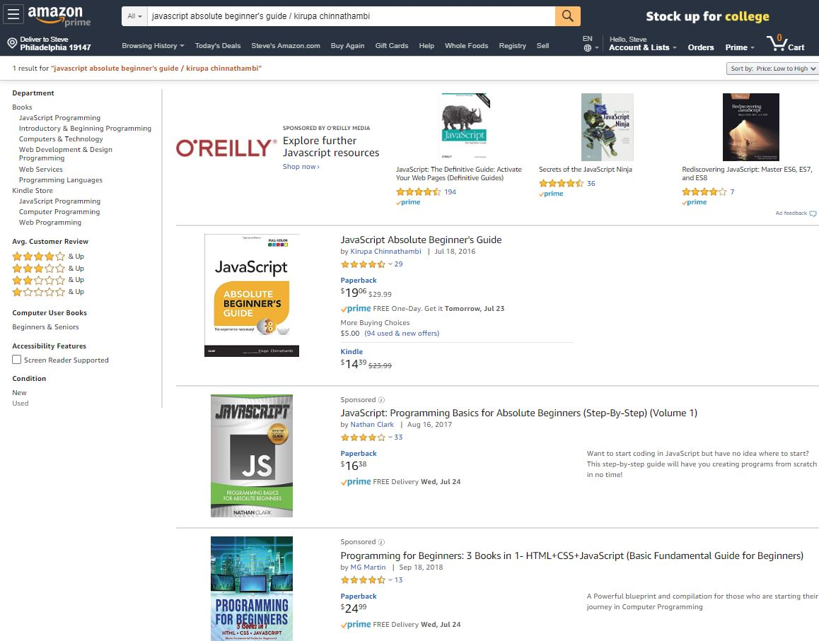
Understanding Systems
Buying textbooks on Amazon
What was part of that system?
Log-in (multiple steps)
Search
Shopping Cart
Purchase (Multiple steps)
What else???
FOX
MIS

Slide 27
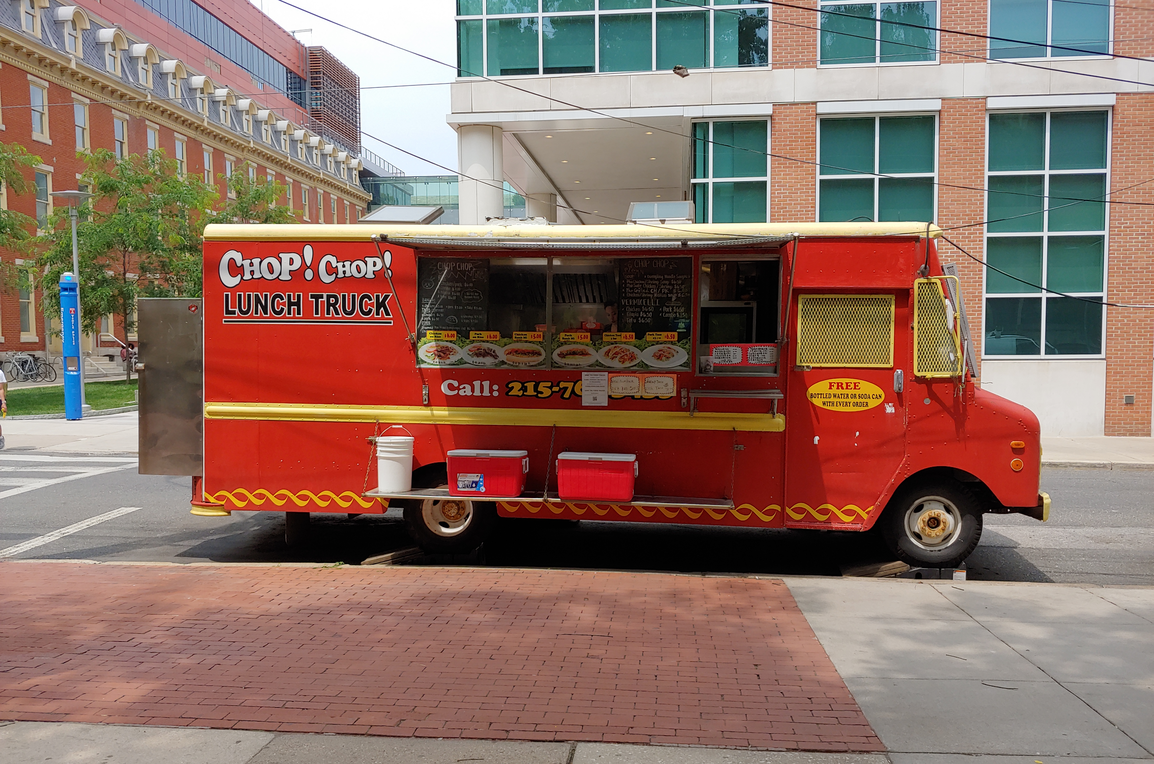
Understanding Systems (cont.)
Buying lunch
What was part of that system?
Take the order
Hand order to cook
Prep to-go bag
Order cooked (multiple steps)
What else???
FOX
MIS

Slide 28

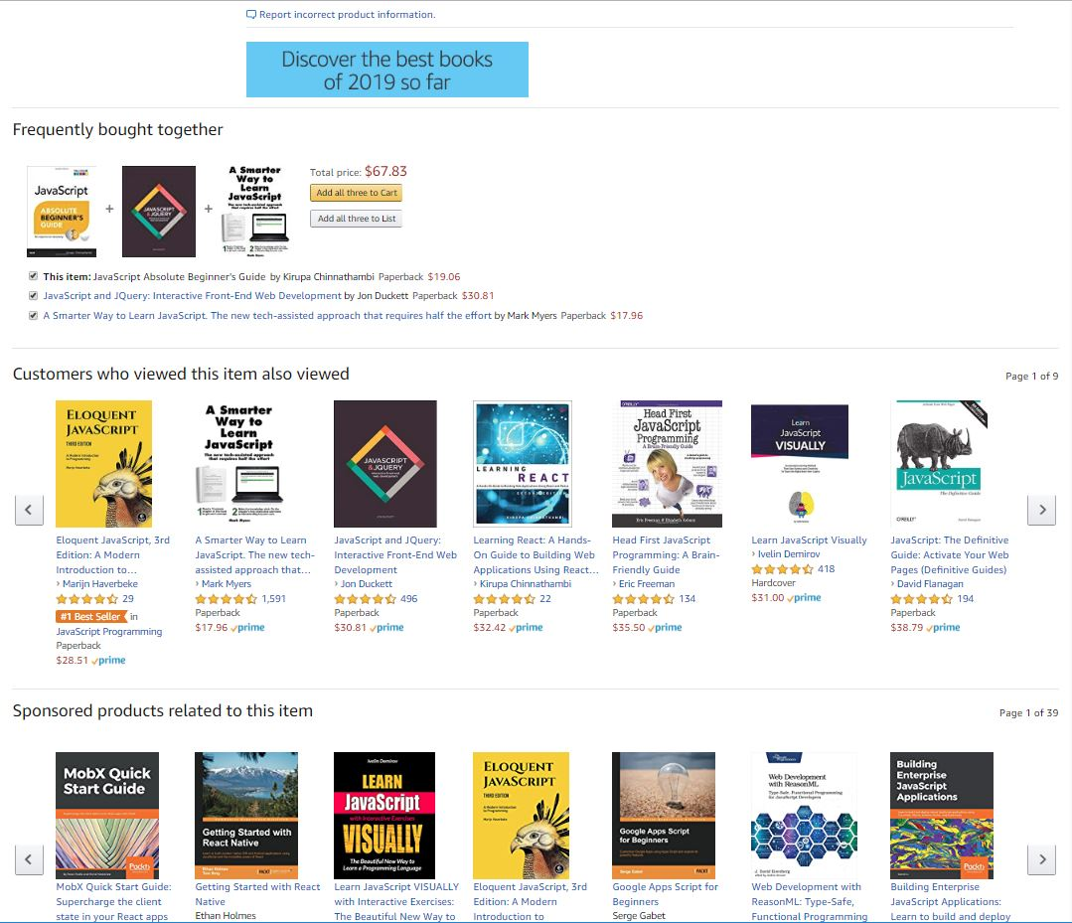
Understanding Systems (cont.)
Describe the Process of Ordering
What keeps info accurate?
  Data
Who is involved?
  Customer ♦ Store ♦ Warehouse Mgr. ♦ Admin ♦ UPS driver…
How much effort?
  None…it’s automated!
  Technology !!!
FOX
MIS

Slide 29
“information system – an integrated set of components for collecting, storing, and processing data and for providing information, knowledge, and digital products.”
- Encyclopedia Britannica
Source: https://www.britannica.com/topic/information-system/Management-support

Slide 30

A collection of technologies
Including:
Hardware
Software
Policies
Education tools
API’s
Etc…
Source: https://www.kisspng.com/png-laptop-computer-hardware-computer-repair-technicia-1180595/preview.html
FOX
MIS

Slide 31
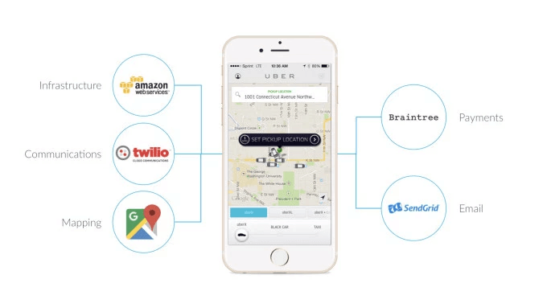
API’s Case Study: UBER
Requesting a ride?
Describe what happens...
  What are these systems?
  How do they work?
Source: https://www.okta.com/security-blog/2019/05/how-uber-takes-advantage-of-the-api-economy/
FOX
MIS

Slide 32

Four Core Steps of Designing UX
Problem Definition
Documenting Business Processes
Process Decomposition
Data Modeling
Source: http://www.petraware.com/consulting/
FOX
MIS

Slide 33
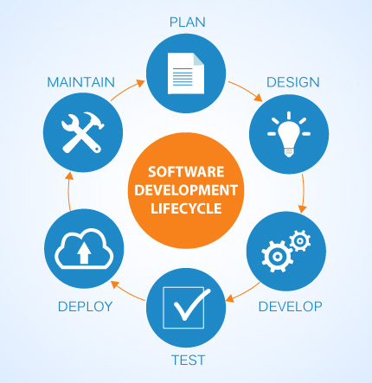
SDLC methodologies
Waterfall
Agile
Lean
Scrum
DevOps
Image: http://www.xanadutec.com/software-as-a-service.html
FOX
MIS

Slide 34
“Once a Product Manager / Technologist understands the business problem, they can architect a solution.”
- Mart Doyle

Slide 35
Process Decomposition
INPUTS: credit card, address, e-mail, phone, shipping preferences, etc.
Purchase Text
OUTPUTS: textbook, packing slip, delivery box
Single entity
Subsystem
Select Text
Check Out
Deliver Text
Shipping address
Payment method
Review Items
Shipping
Change
Add cards
Select card
Reward points
Use method
FOX
MIS

Slide 36
“Systems Architecture is a response to the conceptual and practical difficulties of the description and the design of complex systems.”
- Boris Golden

Slide 37
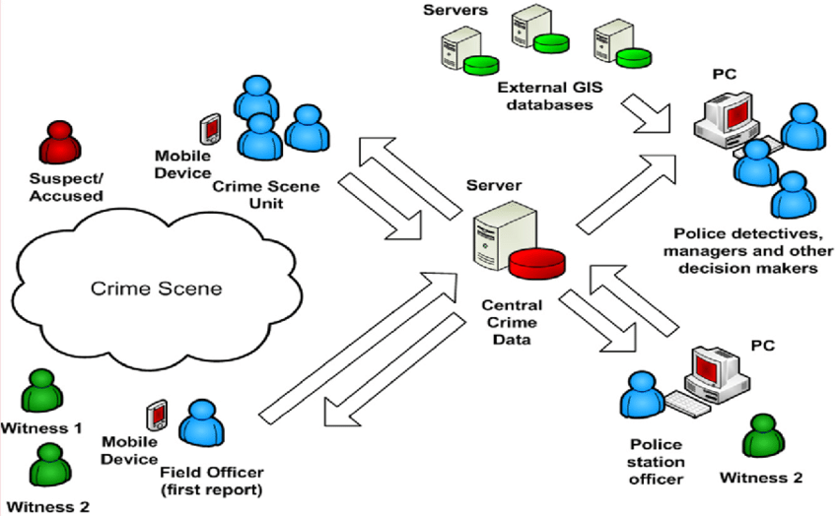
Systems Architecture
Conceptual Diagram
Structural components
Identify/Solve Problems
Existing or New
Communication tool
Source: https://www.researchgate.net/figure/Conceptual-System-Architecture_fig2_327987580
FOX
MIS

Slide 38
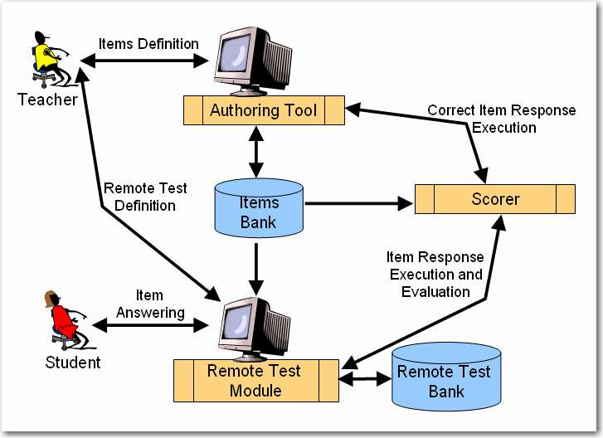
Systems Architecture
Test question defined
  Authoring tool
Remote test created
  Test module
Student responses
  Test module
Execution & Evaluation
Source: http://spmarchitecture.com/systems-architecture/system-architecture-learning-environment-for-automatic-rating-64721-2/
FOX
MIS

Slide 39
More to Come
Prepare with Readings & Videos before our next class!!!

