Slide 1
MIS
Business Computer Applications

Slide 2
Overview
Today running a business involves so many parts and pieces that specialization is required.
This module describes the various applications that are used to assist managers in all aspects of running a business, including transaction processing, decision support systems, executive information systems, marketing management, human resources, enterprise resource planning, supply chain management, and customer relationship management.
Notes:
We've all heard of a business's CEO (Chief Executive Officer) but many C-level titles are given to high-ranking officials to mark their duties, responsibilities, and areas of expertise.
A few of the many C-level titles include: CFO (Chief Financial Officer), CIO (Chief Information Officer), CMO (Chief Marketing Officer), CTO (Chief Technology Officer), and CEO (Chief Engineering Officer).

Slide 3
How Businesses Use Specific Applications
Management information systems technology has revolutionized the manner in which small businesses process payments, conduct billing and keep records.
Technology that was once the sole province of large corporations is now in the hands of small coffee shop owners.
The single biggest impact of this technology has been in business applications that allow credit and debit payments to be processed virtually instantly.
In addition to allowing small retailers to quickly process credit and debit card payment, business applications make it possible to accept mobile payment methods such as Apple Pay and Google Wallet using contactless, near field communications (NFC) technology.
for many consumers, cash has become virtually obsolete.
Notes:
For decades, for a customer to pay by credit card, the card was run through an imprinter. The imprinter made two carbon-copies of the raised numbers and letters on the face of the credit card. The teller would have the patron sign the carbons to authenticate the purchase, keep one copy for the shop, and give the other to the customer. These imprinters, often called “knuckle-busters,” were used in every store that accepted credit cards until the mid-1980s when personal computers and computer networks made point-of-sale (POS) terminals economically feasible. Some retailers still have imprinters for use in the case of power outages, but few people ever see them today, and even fewer under the age of 40 have ever seen them in use.

Slide 4
How Businesses Use Specific Applications (cont.)
The advantages provided by a POS terminal over an imprinter are relatively obvious.
carbon-copies are fragile and over time the imprint becomes hard to read so important data can be easily lost
additionally, the data on the copy needed to be manually transferred to a database, creating opportunities for entry errors
Internet-enabled POS terminals and ATMs (automated teller machines) effectively eliminated the need for financial instruments such as traveler’s checks.
Today, Internet connectivity allows vendors to accept credit cards virtually anywhere in the world, since the viability of the card-holder’s account can be ensured in seconds.
Notes:
Many credit-card users spent a lot of time carefully checking their monthly statements against their carbon-copies to verify transactions. The manual entry method had no means of electronic verification. Whenever a merchant had a question about the legitimacy of a customer's credit card, the merchant needed to call the credit card company directly, with typically long hold times, or consult large books of lost or stolen credit-cards, provided monthly by each credit-card company. This made the transaction itself time-consuming. As a result, relatively few small businesses, such as restaurants, accepted credit cards. The advent of inexpensive Internet-connected POS terminals allowed for credit card readers, first stripe-scanners, and, later, chip-readers, which made credit cards instantly verifiable and easily incorporated into data analysis tools. POS terminals are now ubiquitous.
Traveler’s checks were once a necessity for international or interstate trips. In the past most retailers refused to accept out-of-state checks due to the extended processing time and the inability to verify the check’s soundness. This meant that travelers had to purchase travelers checks, at a premium, that would be accepted by most hotels, restaurants, and local banks, with a counter-signature to verify the check’s validity. If traveler’s checks were lost or stolen, the issuer would replace the checks at a local office of the issuer (typically an American Express office), or upon returning home. In addition to having to pay for the traveler’s checks, travelers would also often have to pay a processing fee when used at a hotel, restaurant, or bank, as well as any currency exchange fees. While traveler’s checks provided a degree of financial security from theft, this security came at a price.
With magnetic ink character recognition (MICR) technology, out-of-state checks can be processed nearly as quickly as credit cards, so many merchants are willing to accept these, particularly when issued by large national banks. As a result, very few retailers accept traveler’s checks and today they are about as relevant as an 8-track cassette player.

Slide 5
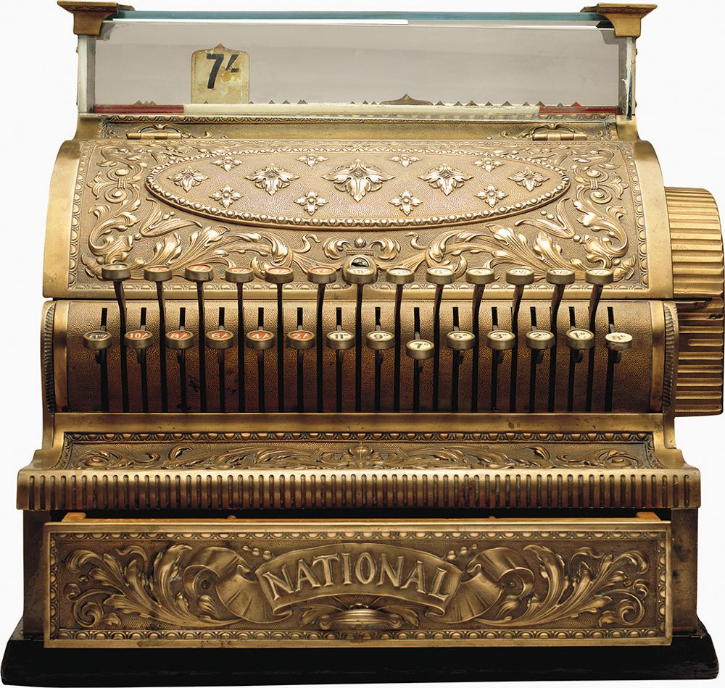
Transaction Processing Systems
Transaction processing systems help to make the sales process itself more efficient.
consider how the transition from a barter system to a money system of exchange increased the efficiency of trade
In a barter system, it is essential to find someone who not only has a product that you desire, but who also wants or needs the product that you are willing to exchange at the time you are willing to exchange it.
Instead of bartering goods and services, money allows wealth to be stored and allows individuals to trade with intermediaries who may not want the items you have to trade.
Just as cash and other financial instruments allowed retailers to move away from an inefficient system of bartering, transaction processing systems allow methods of exchanging money for goods and services to operate more efficiently.

Slide 6
Cash Registers
For nearly a century, the cash register remained the primary means of transacting payments.
The cash register, invented in the 1880s by James Ritty, a bar owner in Dayton, Ohio, allowed retailers to move throughout the shop without worrying about someone robbing the till. He called his invention “Ritty’s Incorruptible Cashier.”
The cash register included a bell that would ring each time the cash drawer was opened, alerting the shop owner.
The term “ringing up a sale” was derived from this alert.
to use this system, the shopkeeper entered the starting amount in the register and then each subsequent sale or return was entered into the register
at the end of the work-shift, the shopkeeper would verify that the amount of cash in the till matched the total shown by the register itself, deterring theft by cashiers
Notes:
Ritty sold his cash register company to investors who renamed it the National Cash Register (NCR) Corporation. By 2019, NCR was valued at $9 billion.

Slide 7
Cash Registers (cont.)
The POS terminal effectively eliminated the traditional cash register.
in addition to displaying the total amount of cash in the till, the POS terminal provides inventory information, allowing the merchant to become aware of shortages almost instantly
This inventory data also could also be used to compare sold inventory data as recorded by the POS to actually shelf data, helping to increase awareness of shoplifting.
Notes:
The POS terminal provides an interface for debit and credit cards, smartphone payments, check processing, and a host of other tools, depending on the needs of the retailer. For example, grocery store POS terminals typically include scales for weighing produce, QR code and barcode scanners, cameras, and thermal printers.

Slide 8
Merchant Service Aggregators
Large businesses with significant numbers of credit card sales typically work through a merchant service provider (or merchant account provider) to process credit card payments.
The merchant service provider has a relationship with an acquiring bank that is authorized to process the payments.
To support small businesses, merchant service aggregators (or merchant account aggregators) allow small businesses to share merchant accounts.
merchant service aggregators typically charge slightly higher fees and have lower annual processing limits than merchant account providers, because of the increased risk of fraud or default
Notes:
The merchant service providers, also known as independent sales organizations, sell or lease the hardware and software necessary to process credit card payments. The acquiring bank issues the business a line-of-credit, allowing the business to use their customers' credit card payments while the payment is being processed. The acquiring bank assumes the risk of the lost funds if the business closes and fails to provide the products that were purchased with credit cards.
Additionally, fund reversals, such as when an item purchased with a credit card is returned, or if a customer disputes the validity of a credit card charge, result in lost processing fees and interest on the part of the acquiring bank. For these reasons, acquiring banks and merchant service providers (ISOs) are reluctant to establish accounts with smaller, riskier businesses.
Despite these costs, most small business owners believe that the increased sales that accompany the ability to accept credit cards make the expense well worth it. Typically, once a business has a sufficient number of credit card sales, it transitions from an aggregator to a merchant service provider.

Slide 9
Review: Barter, Cash Registers, Merchant Service Aggregators
What are some of the drawbacks of using an imprinter for a credit card transaction?
many possible answers -- the imprinter relied on carbon copies of a transaction and could be lost and faded over time. It was difficult to verify a card
What are the biggest problems with the barter system?
a person with something to trade had to find someone else who wanted that product at that time and had something in return that the trader wanted at that exact time as well
What is a merchant service provider and what is a merchant service aggregator?
the merchant service provider has a relationship with an acquiring bank that is authorized to process the payments
.
Notes:
Because the risk is high, merchant service providers are not anxious to deal with small businesses. Merchant service aggregators allow small businesses to share merchant accounts and may charge a higher rate

Slide 10
PayPal
To support a payment transfer system PayPal incorporated a highly profitable money market and lending businesses.
In 2002, PayPal went public and was purchased by eBay for $1.5 billion. PayPal Holdings Inc. is now one of the world’s largest merchant service aggregators, with assets exceeding $50 billion.
Through PayPal, account holders can send or receive payments, convert currency, and accept debit and credit card payments.
In 2012, PayPal launched PayPal Here, a chip, swipe, and contactless credit card reader hardware and software application for accepting payments through a smartphone..

Slide 11
Stripe
Initially, Stripe sold the software interface so that websites and apps, such as Lyft could integrate credit card payment processing.
Stripe expanded into the point-of-sale (POS) market. In 2019, the Stripe Terminal POS hit the U.S. market, offering merchant aggregator services to brick and mortar businesses.
While this software competes in the same environment as PayPal, the PayPal founders, Elon Musk and Peter Thiel, supported the Collison brothers and both invested heavily into Stripe.

Slide 12
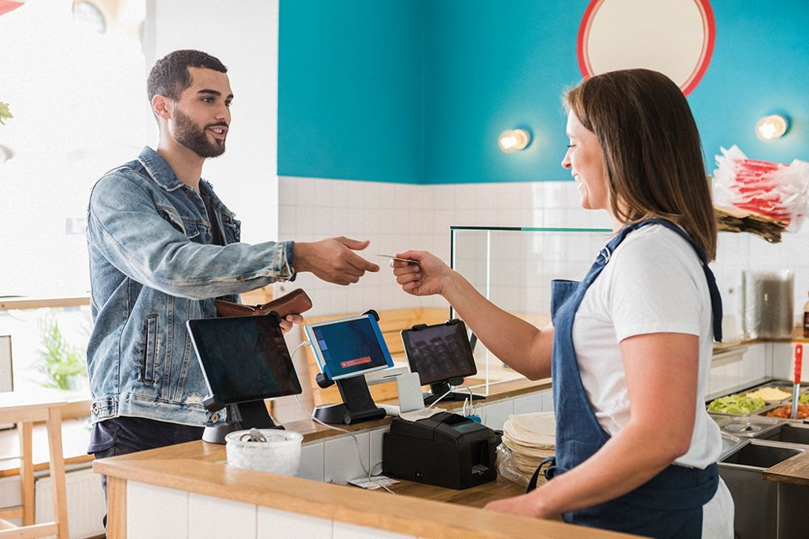
Square
Square began as a card reader and iPhone app and soon joined with Apple to create the Square Stand.
The Square Stand combines an iPad, a cash drawer, a thermal printer, and a chip/swipe/contactless reader, to form an inexpensive point of sale terminal.
Merchants using Square card readers and Square Stands can receive financing through Square Capital.
In 2009, Jack Dorsey, co-founder and CEO of Twitter, saw a need for a credit card payment system that operated through iPhones, providing aggregator services for small business owners.

Slide 13
Square (cont.)
Square Payroll offers payroll services such as tax withholding, payroll payments, and tax filing for Square merchants.
While PayPal is a popular aggregator for online businesses, Square is widely used by brick and mortar businesses in the U.S. and has assets approaching $6 billion.

Slide 14
QuickBooks
QuickBooks is by far the dominant financial services software for small businesses in the United States.
Following the success of Intuit’s Quicken financial management software for individuals, Intuit founders Scott Cook and Tom Prouix developed QuickBooks for small business owners.
In 2003, Intuit purchased Innovative Merchant Solutions, creating QuickBooks Payments to offer credit card processing and merchant aggregator services. I
In 2006, QuickBooks, along with PayCycle, added payroll services to its software and in 2009 purchased PayCycle outright.
Currently, QuickBooks, QuickBooks Online, and QuickBooks for Desktops account for at least 60% of the small business accounting software market.

Slide 15
Review: PayPal, Stripe, Square, and QuickBooks
What services are provided by PayPal?
through PayPal, account holders can send or receive payments, convert currency, and accept debit and credit card payments
Who originally developed Square?
Jack Dorsey, co-founder and CEO of Twitter, in 2009
Which system accounts for at least 60% of the small business accounting software market?
QuickBooks including QuickBooks Online and QuickBooks for Desktops

Slide 16
Decision Support Systems
Decision support system (DSS) software, also known as business intelligence (BI) software, gained credibility with airlines and air traffic control systems in the mid-1980s and 1990s.
DSSs provide decision makers with the information necessary to solve problems in complex and rapidly changing environments.
This allows individuals to focus attention on areas that have the most immediate importance or over which they can have the most influence.
DSS only became capable to accomplish these tasks through the use of computers, and, as hardware improves, so too did the capability of DSS.
Today, nearly all businesses use some sort of DSS.

Slide 17
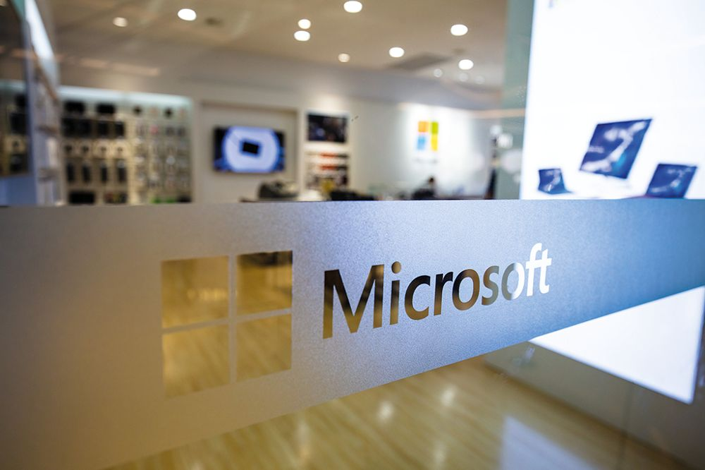
The Three Components of a Decision Support System
A decision support system (DSS), or a business intelligence system (BI), varies depending on the software developer and the needs of the customer, but every DSS requires three basic components.
These include the requisite data, a decision-making model, and a user interface.
The data used by a DSS may be a database of information or, more commonly, a data warehouse of information.

Slide 18
The Three Components of a Decision Support System (cont.)
methodology is called the model of the DSS and is comprised of the complex software that actually makes the determinations or recommendations
the user interface of a DSS may not seem as important as the data itself or the decision-making model, but it is arguably the most important component of a DSS because the interface determines which decisions are actually implemented
For businesses, most DSSs provide a client dashboard that can be modified to meet the unique needs of each user.
A dashboard is the user-facing portion of the DSS that can be adjusted depending on which decisions the manager needs to make
a marketing manager’s DSS dashboard might provide sales and advertising information, while an HR manager’s DSS dashboard might include personnel and training information

Slide 19
Major Providers of Decision Support Systems
Microsoft offers several versions, including its popular Microsoft Power BI.
Microsoft BI Professional version comes with a monthly subscription fee, is user friendly and can be a good choice for businesses that use Office 365.
SAP’s BusinessObjects platform is arguably more powerful than Microsoft Power BI but is less intuitive.
Tableau is more intuitive than BusinessObjects, though not quite as user-friendly as Power BI.
Intuit’s QuickBooks does not provide a decision support system, but a large number of companies provide business analytics software (apps) that integrate with QuickBooks.

Slide 20
The Impact of AI on Decision Support Systems
The model of a decision support system (DSS), or business intelligence (BI) system, typically adapts its processes based on the degree of accuracy of each prior decision.
In this respect most DSSs can be considered to have a type of artificial intelligence.

Slide 21
Review: Decision Support Systems
What, basically, do decision support systems do?
DSSs provide decision makers with the information necessary to solve problems in complex and rapidly changing environments, allowing managers to focus attention on areas that have the most immediate importance or over which they can have the most influence
What are the three basic components of a decision support system?
the data, a decision-making model, and a user interface
Why is the user interface of a DSS so important?
it determines which decisions are actually implemented

Slide 22
Executive Information System Software
An executive information system (EIS), sometimes referred to as an executive support system (ESS), is a version of decision support system (DSS), or business intelligence (BI) software designed to expressly meet the needs of senior corporate executives of larger companies or corporations.
as with all DSS (or BI) software, EIS applications obtain data from sources internal to the firm, as well as external sources and use the data to assist executives to gain a broader view of the competitive landscape

Slide 23
Elements of Executive Information System Software
The key element of any executive information system (EIS) is a highly intuitive user interface, often referred to as the dashboard.
this interface provides the executive with the ability to quickly scan the organization and note any discrepancies from anticipated norms
typically the software presents goals based on prior outcomes, and then displays the organization's track toward these goals
an EIS interface allows the executive to drill down into areas of concern.

Slide 24
Elements of Executive Information System Software (cont.)
An EIS should be oriented to meet the specific needs of the executive and will vary based upon the executive’s department or area of responsibility.
Traditionally, EIS software has been designed to focus on operations, finance, marketing, and human resources management.
Another element of an EIS is the ability to communicate throughout the executive’s department or area of responsibility.
The final element of any EIS is the software infrastructure supporting the system.
while many firms have moved this software to the Cloud using a SaaS type platform, some organizations prefer to keep the software in-house using the firm’s servers and network

Slide 25
Major Categories of Executive Information System Software
Executive information systems (EIS) software is usually tailored to meet the needs of the specific organization and the executive’s role in the firm.
Generally, these needs fall into five major categories: operations management, financial management, marketing, human resources management (HRM), and supply chain management (SCM).

Slide 26
Executive Operations Management Software
Operations management systems software and manufacturing operations management (MOM) systems applications for EIS focus on the processes involved in producing goods and services for sales.
in the case of a manufacturing firm this would entail the processes involved in transitioning raw materials or intermediate products into sale-ready goods
the EIS software provides the executive with an overview of the entire manufacturing processes and equips the executive with the ability to drill down into each specific step in the process

Slide 27
Major Providers of Operation Management EIS Services
Operations management systems software and manufacturing operations management (MOM) systems software provide senior executives with visibility into all aspects of processes performance within a corporation.
Major providers of this software include enterprise resource planning software manufacturers such as SAP (with its business process management or BPM software) and Oracle (with its NetSuite software).
Other vendors include experienced manufacturing corporations such as General Electric Digital, with its Predix Platform, and ABB’s Ability software.

Slide 28
Executive Financial Management Software
Financial management systems software enables executives to quickly scan the internal and external environments for changes that might impact the firm’s finances.
financial management software provides the tools necessary to adequately hedge against significant market fluctuations.
financial management software allows managers to analyze all aspects of an organization’s finances, including budgets, revenue, expenses, asset management, credit, debt, investments, as well as tax and accounting information.

Slide 29
Major Providers of Financial Management EIS Services
Financial management systems software enables executives to quickly scan the internal and external environments for changes that might impact the firm’s finances.
As major enterprise resource management (ERP) system providers, both Oracle and SAP offer financial management systems software for executives, primarily focused on major corporate or governmental institution customers.

Slide 30
Executive Marketing Management Software
Executive marketing information systems assist senior managers by providing visibility over the numerous processes related to marketing management.
some of the processes include gathering marketing data, storing the data, analyzing, and distributing sales and marketing information to appropriate users
Information such as marketing research and environmental scanning, customer feedback, industry trends, and the advertising campaigns of competitors are often included in marketing information system data.
this information can be used to construct marketing models, assist senior managers with cost-benefit analyses, and gain better insight into an advertising campaign’s return on investment for a business

Slide 31
Review: Executive Information System Software
Who are executive information systems designed for?
they are designed to expressly meet the needs of senior corporate executives of larger companies or corporations
What is the purpose of a dashboard?
this is the interface that provides the executive with the ability to quickly scan the organization and note any discrepancies from anticipated norms
it normally presents goals based on prior outcomes, and displays the organization's track toward these goals
the dashboard allows the executive to drill down into areas of concern
What are the major categories of executive information system software?
these fall into five major categories: operations management, financial management, marketing, human resources management (HRM), and supply chain management (SCM)

Slide 32
Executive Human Resources Management Systems Software
Executive human resources management (HRM) systems provide executives with visibility over all areas of human resource management including personnel requirements forecasting, recruiting, selection, hiring, evaluation, training, retention (re-assignment, promotion, and grievance management), scheduling, and compensation (payroll and benefits administration).

Slide 33
Major Providers of Human Resource Management Systems
Major providers such as SAP and Oracle provide comprehensive management information systems including human resources management (HRM) systems software typically for large organizations.
Salesforce, though primarily known for its customer relationship management (CRM) systems, also offers HRM software for its users
Workday Inc., based in Pleasanton, CA, offers a Cloud-based HRM system for both large and small corporations

Slide 34
Enterprise Resource Planning System Software
Enterprise resource planning (ERP) integrates the management of nearly all aspects of an organization.
typically, ERP incorporates a suite of business applications in a unified system
business applications supported and coordinated in an ERP include finance and accounting systems, human resource systems, production systems, logistics (supply chain management, and inventory) systems, customer resource management systems, sales and marketing systems, and many others that depend on the type of organization
Increasingly, ERP forms and reports are available on mobile devices, making the information far more accessible.

Slide 35
Elements of Enterprise Resource Planning System Software
(ERP) software centralizes the key business applications of a corporation, it contains all the software required to manage every corporation’s departments, including finances and accounting, human resources (HR), operations and manufacturing, supply chain (SCM) and inventory management systems, as well as customer relationship management (CRM) software.

Slide 36
Elements of Enterprise Resource Planning System Software (cont.)
To accomplish its tasks, an ERP system requires a robust data analytics system that retrieves data from all applicable internal and external data warehouses.
it also uses advanced modelling software to provide the required decision support system, executive information system (EIS) or business intelligence (BI) system, and all the coordinating aspects that are valuable to an organization
finally, an ERP must have a user interface comprehensive enough to meet the needs of all departmental managers while being intuitive enough to satisfy senior executives
this user interface, or dashboard, is arguably the most critical part of any ERP since any value coming from the significant investment is only realized through the information available through this dashboard

Slide 37
Major Manufacturers
Because of the development of Cloud-based ERP systems by firms such as Microsoft, SAP, and Oracle, ERP systems are now available for smaller businesses that may not have the capital to invest in large in-house IT systems and the requisite IT specialists.
cloud-based ERP systems are easily scalable to easily meet the needs of relatively small companies
Other major competitors in the ERP systems market include Epicor, based in Austin, TX, and the Sage Group, based in Newcastle-upon-Tyne, in the U.K.

Slide 38
Review: HRS and ERP Software
What are at least three areas covered by human resources management systems?
here are 9: personnel requirements forecasting, recruiting, selection, hiring, evaluation, training, retention (re-assignment, promotion, and grievance management), scheduling, and compensation (payroll and benefits administration)
What is an ERP and what does it do?
enterprise resource planning (ERP) incorporates a suite of business applications in a unified system including finance and accounting systems, human resource systems, production systems, logistics (supply chain management, and inventory) systems, customer resource management systems, sales and marketing systems, and others, depending on the type of organization
What is the benefit of a Cloud-based ERP system?
are easily scalable to easily meet the needs of relatively small companies.

Slide 39
Supply Chain Management System Software
(Supply chain management (SCM) systems provide the software needed to ensure the efficient flow of goods and services from the initial extraction of raw materials all the way to customer distribution and receipt of payment.
Essentially, SCM assists managers in anticipating issues, such as increased demand or production slowdowns, so they can quickly institute accommodations.

Slide 40
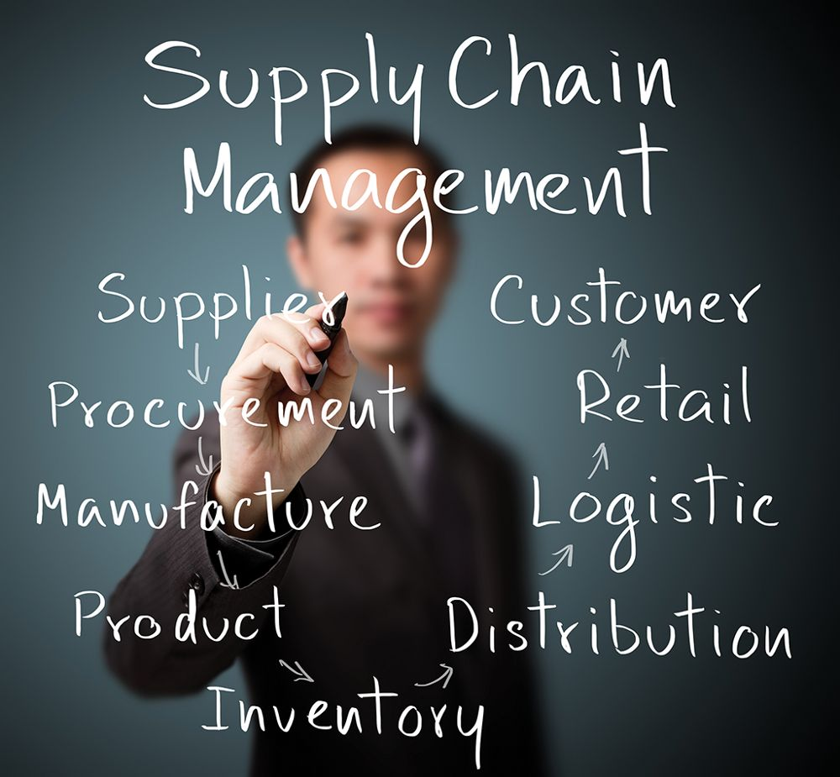
The Elements of Supply Chain Management Software
The components of a supply chain management (SCM) system depend on the product provided.
Complex organizations, such as major retail outlets or automobile manufacturing and distribution, require comprehensive SCM systems with a significant number of elements, whereas a doughnut shop may not require an SCM system for anything other than its local suppliers.
Every SCM system requires a basic set of components which include supplier relationship management, order fulfillment management, and customer relationship management.

Slide 41
The Elements of Supply Chain Management Software (cont.)
The supplier relationship management element may include the product development, manufacturing, purchasing, and inventory processes.
The order fulfillment or procurement management element might encompass the logistics and warehousing elements.
The customer relationship management element may include payment and demand management, customer service management, and returns management.
The goal of management of each of these elements is to create the most efficient supply chain possible.

Slide 42
The Functions of Supply Chain Management Software
The primary function of any supply chain management (SCM) system is to provide managers with increased visibility of the entire supply chain so that the manager can improve the efficiency of the entire system.
Providing visibility means that the user interface of any SCM remains a critical component.
Typically, a user interface comes in the form of a dashboard that calls attention to deviations from an established norm.
A sophisticated SCM can also reduce the impact of the Bullwhip effect.
the Bullwhip effect, also known as the Forrester Effect (named for Professor Jay Forrester of MIT’s Sloan School of Management), occurs when small variations in consumer demand create amplified demand variations in the supply chain

Slide 43
The Functions of Supply Chain Management Software (cont.)
For example, if consumers unexpectedly stock up on toilet paper, as occurred at the start of the COVID-19 pandemic, this can cause retailers to increase their orders of pallets of toilet paper, resulting in distributers increasing orders for truckloads and for manufacturers to increase orders of raw materials (wood pulp).
In this example each step in the process increases until the entire SCM system breaks down.
Notes:
An efficient SCM system anticipates this amplifying effect and adjusts accordingly, allowing each successive step in the chain to flex slightly rather than react abruptly.

Slide 44
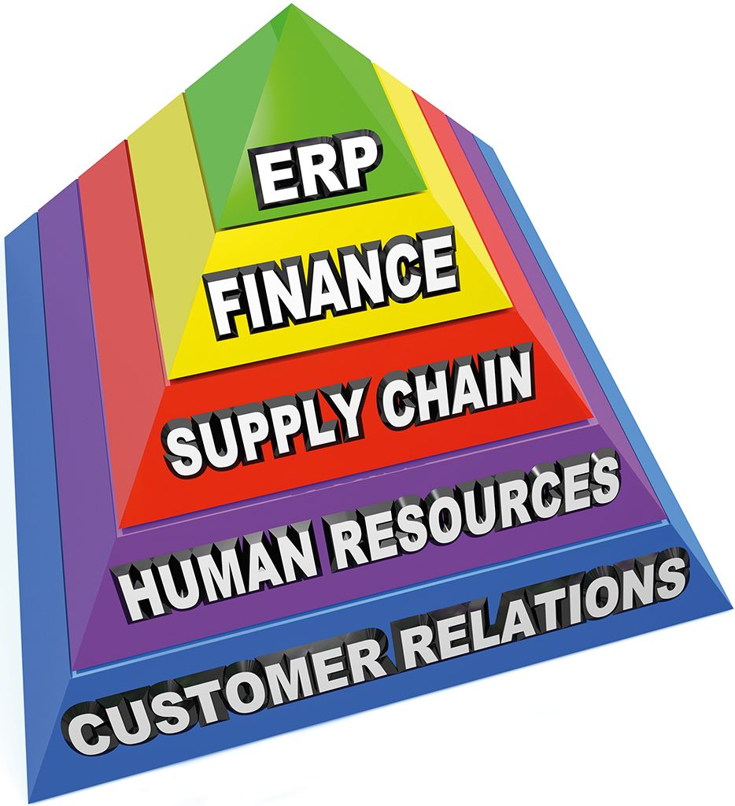
Supply Chain Management Software Feeds Enterprise Resource Planning Software
Many corporations integrate supply chain management (SCM) software into an enterprise resource planning (ERP) suite of software.
There are advantages to this comprehensive approach.
efficiencies are created by ensuring that nearly all aspects of the firm’s operations coordinate with each other
in such a comprehensive approach, hiring and training processes can be coordinated with procurement decisions and timing
Notes:
For example, a major hotel with its associated restaurant may anticipate a large variation in the number of customers based on the outcome of a particular sporting event. To meet this change in demand the managers must bring in more employees, food and beverage products, and sundries such as toiletries or reduce or maintain existing quantities. Hiring additional employees necessitates increased advertising, interviewing, on-boarding, and training, along with increased pay and accounting expenses.

Slide 45
Supply Chain Management Software Feeds Enterprise Resource Planning Software (cont.)
Using an ERP provides the entire management team with visibility on the status of each of these variables and highlights discrepancies or areas that need direct attention.
if a hotel that typically maintains enough liquor inventory for 100 customers suddenly hosts 500 thirsty enthusiastic sports fans, it needs coordinated supply chain management, human resources management, and customer relationship management systems to anticipate these requirements if it is to maximize profits
Coordinating these systems is the primary role of an enterprise resource planning system.

Slide 46
Major Providers of Supply Chain Management Systems
The critical nature of supply chain management (SCM) systems to any corporation has resulted in a large number of software providers. SAP (Systems, Applications, and Products in Data Processing), as one of the world's largest business software companies, is also one of largest suppliers of SCM.
SAP, based in Walldorf, Germany, offers a stand-alone SCM application that can be hosted on a corporation’s servers, but more often the SCM system is integrated with SAP’s enterprise resource planning (ERP) system and often is Cloud-based

Slide 47
Major Providers of Supply Chain Management Systems (cont.)
Oracle, based in Redwood City, CA, also sells SCM systems as part of its Oracle Fusion Applications (OFA) suite of business applications.
like SAP, it offers this as a part of a larger ERP, on the Cloud and as an on-premise, user-hosted system
both Oracle and SAP offer SCM as both stand-alone systems or as a major element of an ERP system
Blue Yonder, based in Scottsdale, AZ, is another a major manufacturer of SCM.
while not as large a software provider as Oracle or SAP, Blue Yonder, previously JDA, specializes in SCM
it has built a reputation for being one of the best SCM providers in the industry
Notes:
Along with these top three (by revenue) SCM software providers, there are over 100 other firms providing SCM systems.

Slide 48
Review: Supply Chain Management Software
What is supply chain management software?
supply chain management (SCM) system software helps managers ensure the efficient flow of goods and services from the initial extraction of raw materials to customer distribution and receipt of payment by anticipating issues, such as increased demand or production slowdowns, to institute accommodations quickly
What is are the basic components of SCM?
supplier relationship management, order fulfillment management, and customer relationship management
What is the Bullwhip effect?
this occurs when small variations in consumer demand create amplified demand variations in the supply chain

Slide 49
Customer Relationship Management Software
A customer relationship management (CRM) system seeks to manage a firm’s interactions with customers using analytics and data analysis to identify the most valuable customers and target future customers.
By tracking consumer behavior, it strives to focus on the customer experience in order to attract and retain customers, with the ultimate goal of increasing sales, market share, and profit.
A CRM system helps managers to maintain the business’s focus on the individual customer by developing a lasting relationship that promotes long-term buying. CRM is also used to encourage strong relationships with suppliers and other colleagues.
Notes:
In many retail industries, CRM software is the most complex and expensive segment of a business management system. It typically integrates social media, customer support call center interactions, sales and returns, and often joins with supply-chain management. It normally begins by collecting customer information such as email, telephone, and social media data, and then combines this with information regarding the customer’s buying habits so that the management team can better anticipate customer desires.

Slide 50
The Functions of Customer Relationship Management Software
Most customer relationship management (CRM) software helps to organize three main functions: marketing, sales, and customer service.
Marketing incorporates the acquisition of potential marketing leads, segmenting the market, and targeting promotions, such as advertisements, to create a lasting relationship with customers.
Sales involves pricing, managing marketing lead contacts, and organizing sales activities.
Customer service encompasses responding to customers’ questions, managing returns, and managing customer contacts to improve customer relationships.

Slide 51
Major Providers of Customer Relationship Management Systems
Because customer relationship management (CRM) systems comprise such a major portion of most businesses’ overall management system, CRM systems are often incorporated with other systems, such as inventory management systems, to streamline the entire enterprise.
Salesforce remains one of the largest suppliers of CRM software solutions
accordingly, Salesforce software integrates with Oracle, QuickBooks, SAP, and other business management software
Businesses such as HubSpot CRM, Zoho CRM, and Freshsales CRM focus primarily on meeting the customer relationship management requirements of smaller businesses that might not have a need for a full enterprise resource planning system
Notes:
Most firms offer their own CRM software. For example, SAP includes embedded CRM modules in its enterprise resource planning software, as do Oracle (Commerce solutions), Adobe (Marketing Cloud), and Microsoft (Dynamics CRM).

Slide 52
End of Main Content

