Slide 1
MIS
Computer Networks and the Internet

Slide 2
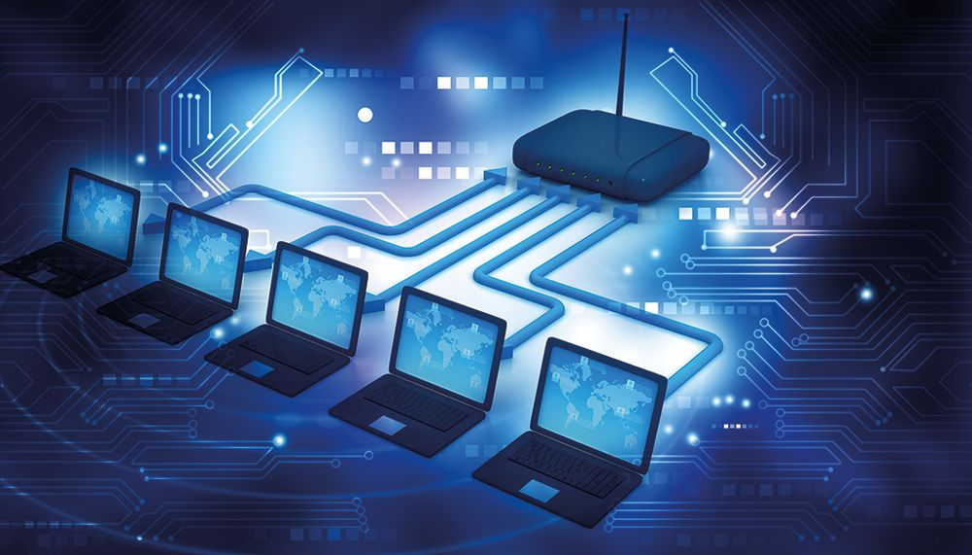
Computer Networks and the Internet
A network is a group of two or more devices/computers connected together to allow for the exchange of information and for the sharing of resources.
many computer networks are linked together and supported by the Internet
Computer networks support many different software applications and services including allowing access to the World Wide Web, digital video and audio, storage, application servers, and email.
Notes:
Networks range in size from small home networks to the Internet, which is the world’s largest network.
The Internet allows for the communication and exchange of many types of data and information.

Slide 3
Overview of Computer Networks and the Internet

Slide 4
Computer Networks
A network is a group of two or more devices/computers connected together to allow for the exchange of information and for the sharing of resources such as printers.
Network Size
Networks range in size from small home networks to the Internet which is the world’s largest network.
Benefits of Networks
Networks provide many benefits including allowing users to share resources and the ability to access other networks and the Internet

Slide 5
Computer Networks (cont.)
The four basic types of networks include:
Personal Area Network (PAN) typically involve laptops, tablets, and smartphones.
Local Area Network (LAN) connect a variety of devices at a single site such as an office or retail store.
Wide Area Network connect a variety of devices between two or more geographic locations.
Internets connect LANs, WANs, and other internets together, think of an internet as a network of networks and is the world’s largest network.
Notes:
PAN, When you share your smartphone’s Internet connection to other devices (such as your tablet) you are creating a PAN.
WAN,
For example, connecting point-of-sale devices in retail stores in two different geographic locations.
Internets, Private internets used solely within an organization and for use by people within the organization are referred to as an intranet.

Slide 6
Local Area Networks (LAN) and Wide Area Networks (WAN)
There are specific elements that make up LANs and WANs
Local Area Network (LAN)
used to connect devices within a limited geographic range, usually no more than a half mile, and all devices are housed at a location controlled by the organization responsible for the LAN
typically comprised of equipment owned by an organization
devices in a LAN can be connected via a variety of wired and wireless means including Ethernet cables, Bluetooth, and Wi-Fi
the Institute for electrical and Electronics Engineers (IEEE) creates and published protocols (rules and guidelines) and other standards that support LANs. The group of standards created for LANs are called IEEE 802

Slide 7
Local Area Networks (LAN) and Wide Area Networks (WAN) (cont.)
There are specific elements that make up LANs and WANs
Wide Area Network (WAN)
connects a variety of devices between two or more geographic locations
facilitate communications and the sharing of information between devices across cities, countries and the globe
used by large organizations to facilitate data and information exchange across multiple locations
WANs typically rely on leased line data circuits provided by Teleco carriers
provided by WAN vendors such as Cisco Systems and VMware

Slide 8
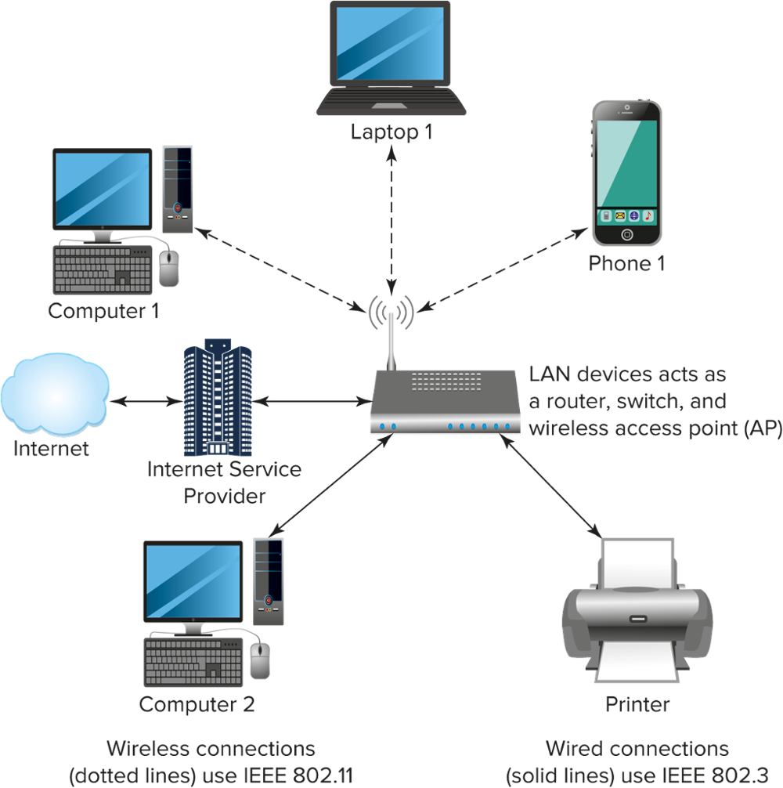
Local Area Networks (LAN) and Wide Area Networks (WAN) (cont. 2)
Notes:
LAN diagram with multiple digital devices, showing the router, switch, and wireless access point.

Slide 9
How to Connect a Local Area Network (LAN) to the Internet?
Connections to the Internet are provided by an Internet service provider (ISP).
An ISP provides three important functions:
Provide an Internet Protocol (IP) address
Provide access or a gateway to the resources on the Internet
Your ISP pays for access to the Internet (ISPs charge a fee to their customers to access the Internet)

Slide 10
How to Connect a Local Area Network (LAN) to the Internet? (cont.)
Connecting to the Internet
to connect to the Internet, a device must first connect to a network that is connected to the Internet
wired LANs connect via fiber optic cable or Ethernet cables, digital subscriber lines (DSL), and cable via coaxial
wireless access includes access points that transform wired LANs to wireless LANs

Slide 11
How the Internet Works-Example
How Packets Move Through the Internet
Sending a package | UPS Procedure | Sending a message vis the Internet
Package (pkg) assembly | Package is readied for shipping | Assemble the data packet
Putting name pkg | Business or person’s name is identified | Correct domain name is identified (e.g., www.amazon.com)
Find the address | Google search for organization’s or individuals phone number | Look up IP address
Address pkg | Add receiver’s name to pkg | IP address is added to packet
Shipping label | Shipping label (fees) is created and attached to the pkg | Transmission Control Protocol (TCP) ensures delivery of packets
Ship pkg | Ship the pkg via air on ground | Message is sent using a variety of ISPs—messages can “hop” or move from one network to another

Slide 12
Components of an IP Address
An Internet Protocol (IP) address is a number that is assigned to all information technology devices (routers, modems, etc.) that identifies the device and allows the device the ability to communicate with each other on a computer network, including the Internet.
IP Address Key Points
think of an IP address much the same as your home address
in order to receive mail or packages at your home the sending party must have your mailing address (IP address) in your town/city (network)
without a specific IP address, information cannot be received
IP address can be assigned permanently, known as static (email servers, businesses, permanent home address, etc.) or from a pool of available IP addresses that are assigned by your Internet Service Provider (ISP)

Slide 13
Components of an IP Address (cont.)
IP Address Formats
IPv4, has a four-decimal notation such as 182.124.7.9
this allows for approximately 4 billion IPv4 addresses, which is far less than the 7 billion people on earth.
IPv6 is also being adopted. IPv6 uses a format such as 2001:0db8:85a3:0000:0000:8a2e:0370:7334 and can accommodate at least 340 undecillion addresses (that’s a lot of IP addresses!).

Slide 14
Transmission Control Protocol/Internet Protocol (TCP/IP)
Transmission Control Protocol/Internet Protocol (TCP/IP) is a suite of communication protocols (standards/rules/guidelines) used to connect devices to the Internet.
TCP/IP Four Layers
Layer | Definition
Network Access | Handles the physical parts of sending and receiving data.
Internet | Controls the movement of packets through the network.
Transport | Divides data into segments and acknowledges the packets have been received.
Application | Include email and messaging applications that require network communication and are to used by people.
Notes:
TCP/IP can also be used as a private network communications protocol for private networks including intranets and extranets.
TCP/IP specifies how data and information are exchanged over the Internet by identifying how it should be broken into packets, addressed, transmitted, routed, and received at the destination where it was intended.

Slide 15
Sending Information on the Internet
Computers and other digital devices connect and communicate on the Internet using the Transmission Control Protocol/Internet Protocol (TCP/IP).
TCP/IP is a system of rules listed step-by-step that each computer connected to the Internet uses to communicate with each other.
in order to connect to the Internet and other computers on a network, each device must have a network interface card (NIC) installed
a network cable (or wireless technologies) must have access to a modem or router to access the Internet
Notes:
TCP/IP Rules
What each computer must do to transmit data and when and how to transmit the data.
Stipulate how to receive the data (in the same manner described above).

Slide 16
Services to Users
Digital devices that connect to the Internet have access to a number of different resources that increase communication and efficiency.
Resources Provided by the Internet
Resource | Support Functions
World Wide Web | Displaying, formatting, and retrieval of data
Instant Messaging and Chat | Conversations based on the Internet
File Transfer Protocol (FTP) | Sending a digital file through a communication channel from one computer to another
Email | File sharing and message exchange
Electronic Funds Transfer | Digitized bank transactions
Notes:
File sharing is the public or private sharing of computer files, data, or network access with various levels of security.

Slide 17
The World Wide Web and Geographic Information Systems

Slide 18
The World Wide Web (WWW)
The World Wide Web, commonly referred to as WWW or the Web, is an interconnected system of webpages accessible through the Internet.
The WWW consists of various components including:
Hypertext Transfer Protocol (HTTP) – Is a protocol for the transmission of hypermedia documents (such as HTML)
Uniform Resource Locators (URL) - URLs are one type of Uniform Resource Identifier (URL).
Hypertext Markup Language (HTML) – Commonly used format for publishing web documents and content.
Notes:
The Web and the Internet are not synonymous.
The Web is one of many applications supported by the Internet.
HTTP was designed for communication between web browsers and web servers.
HTTP governs the transfer of data between a client and server computer.
URL is a generic term for all types of names and addresses that refer to objects and content on the Web.
A URL is the address of a document or other content/resources found on the Web.
URL example, if you want to visit Google you type the URL www.google.com
With HTML you can create hyperlinks to link or connect various resources on the web.

Slide 19
Web 2.0
Web 2.0 refers to the second-generation Internet which is based on interactivity and dynamic content.
Key Features of Web 2.0
Web 2.0 Feature | Definitions
Interactivity | Content that is dynamic and responsive to user input.
Folksonomy | Users collectively determine the classification of information.
User Participation | Two-way information flow between sites and site users via evaluation, reviews, and online commenting.
Software as a Service (SaaS) | Web 2.0 sites developed application programming interface (APIs) which serve as an interface between different parts of a computer software program to allow automated usage.
Notes:
Web 2.0 allows people to collaborate and share information online. Key features of Web 2.0 Include interactivity, folksonomy, user participation, and Software as a Service (SaaS).
Interactivity-a user can click on an image to find more information.
Folksonomy-tagging of websites, images, videos, and links.
User Participation-using Yelp to review your favorite restaurant.
Software as a Service (Saas)-mashup sites.

Slide 20
Geographic Information Systems (GIS) (cont.)
Proximity Location | With a location specified, the GIS finds targets within the defined area.
Route Information | When a user has determined their destination, GIS can assist in providing directions.
Alerts | GIS can be used to notify users of congestion/accidents on the road or if a store is having a sale.
Density Maps | GIS can map population densities based on a standardized unit of measure (kilometers).
Quantity Maps | GIS can provide information related to how many businesses are present in a certain geographic area.
Uses of GIS

Slide 21
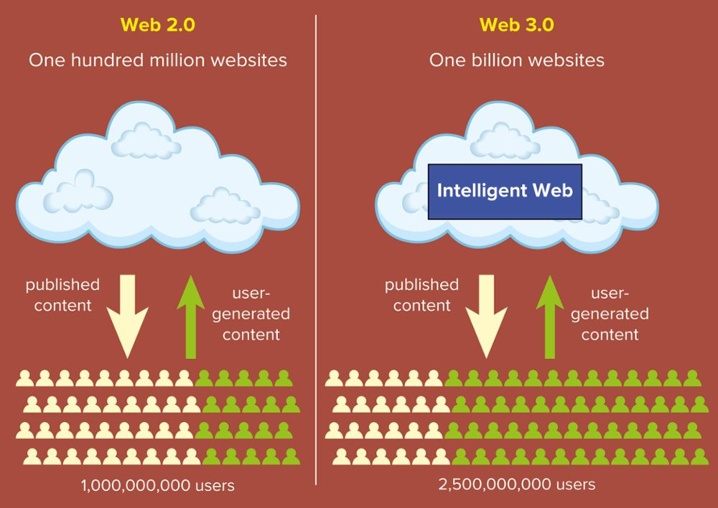
Web 3.0
Web 3.0 is the next evolution in the development of the World Wide Web.
Internet of Things (IoT)
The IoT refers to a pervasive Web that controls many of the processes we go through in our everyday lives.
Uses of IoT
IoT allows billions of devices to be connected to the Internet.
IoT is used in driverless vehicles, smart cities with countless sensors to monitor and control the environment, and in many home devices including lightbulbs, heating/cooling systems, and security.
Notes:
Includes many features and tools that allow individuals to make better use of the billions of web pages on the Internet, the wide array of smartphone applications, and to make the best use of the Internet of Things (IoT).
Supports more widespread use of cloud computing and Software as a Service in business environments.

Slide 22
The Future of the Web…

Slide 23
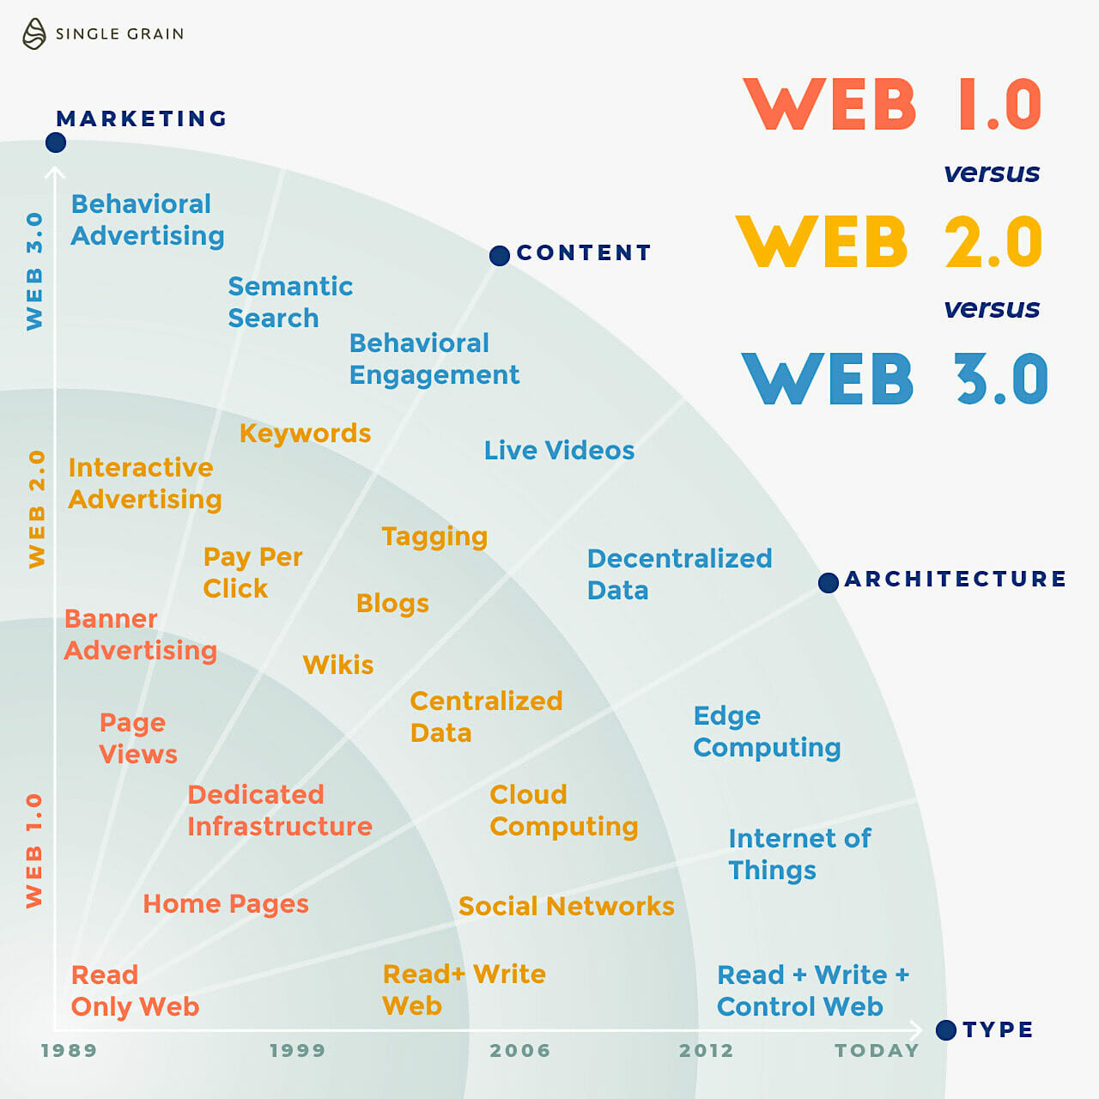
The Future of the Web…

Slide 24
Geographic Information Systems
Geographic Information Systems (GIS) are built on a foundation provided by the Global Positioning System (GPS).
GPS is a navigation system that uses at least 24 satellites to help people find their way across the globe.
allows for the analysis of spatial data (including geospatial data and geographic information) which is used for more informed decision making
geospatial data is data about items, events, or phenomena that have a physical location somewhere on the surface of the earth
spatial data identifies the geographic features found on Earth
Notes:
GIS permits organizations and users the ability to store, view, and analyze geographic and geographic data in the form of multidimensional charts and maps.
Geospatial locations may be temporarily static (the location of a highway, people living in poverty in a certain location), or dynamic (vehicle traffic, the spread of virus such as COVID-19).
Transportation based organizations use GISs combined with databases and GPS technology to facilitate the transportation of goods from one location to another.

Slide 25
How are Geographic Information Systems (GIS) Used in Business?
Geographic Information Systems (GIS) are focused on the capture, analysis, use, and management of spatial location information.
GIS is rooted in the science of geography and seeks to integrate many types of data to create visualizations using maps and 3D scenes.
Enhancements to GIS software and practices have allowed businesses to get real-time access to a wide variety of geospatial data.

Slide 26
How Are Geographic Information Systems Used in Business (cont.)?
Applications of GIS
applications of GIS include uses by telecommunications providers to map out cell tower placement and the retail sector that uses GIS information to place certain products based on regional demand preferences
organizations can use GIS combined with data analytics to better determine customer needs and wants
by combining the use of telecommunications and data analytics, organizations can enable better customer segmentation which allows for highly-targeted marketing campaigns.

Slide 27
Cellular Networks and Mobile Communication

Slide 28
The Process of Cellular Phone Communication
Cellular communication via a phone may seem like a complex process, but essentially a cell phone is a two-way radio consisting of a radio transmitter and receiver.
When you place a call on a cell phone, your phone converts your voice into an electrical signal that is transmitted via radio waves to the nearest cell tower.
Once the call is received by the nearest tower it is relayed to a system/network of cell towers where it is then converted and received by the phone you were calling.
When the person on the other phone accepts the call and begins to speak, the person’s voice is converted to an electrical signal that is sent back through the network until it is received and converted by the caller’s phone.

Slide 29
The Process of Cellular Phone Communication (cont.)

Slide 30
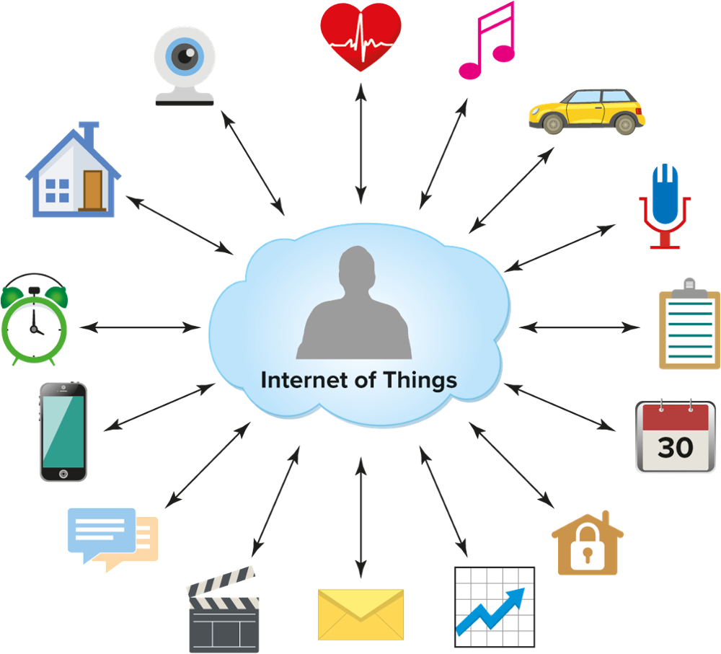
Internet of Things (IoT)
The Internet of Things (IoT) in the broadest sense refers to everything connected to the Internet.
IoT is increasingly being used to define objects connected to the Internet that talk to each other including sensors, wearable technology, and smartphones.
it is estimated there will soon be over 30 billion IoT devices across the globe and that over $3 trillion dollars were spent last year on endpoints and services
Notes:
IoT allows billions of devices to be connected to the Internet.
IoT combines connected devices with automated systems that gather data, analyze the data, and convert the data into useable information.
For IoT to work you must have networks, devices, and data. The proliferation of networks and inexpensive sensors has made it possible to connect almost any device to the IoT.

Slide 31
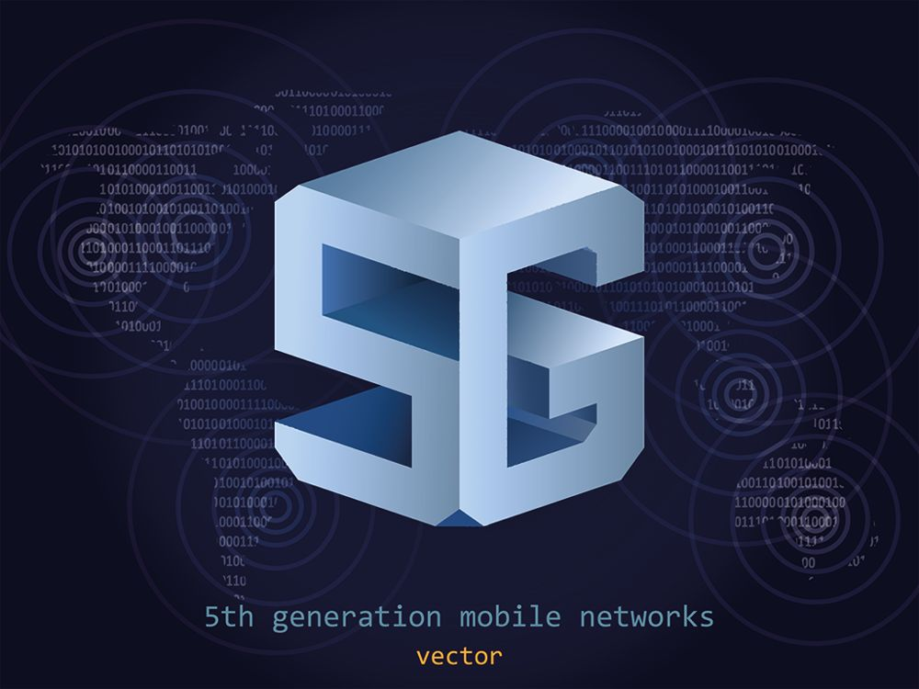
How Will 5G Connectivity Support IoT?
5G connectivity will unlock IoT capabilities that were not available using 4G networks.
IoT Activities Supported by 5G include:
Connected Cities - 5G networks can handle the large amount of data generated by a connected city
Transportation - Autonomous vehicles cannot operate efficiently on existing 4G networks
Connected Devices - 5G connectivity will greatly improve what businesses and individuals can do with connected devices
Notes:
5G connectivity will allow for faster connection speeds, greater data capacity, and lower latency.
Connected Cities-This data helps first responders, city planners, and utility companies more efficiently manage the daily operations in some cities.
Transportation-5G networks may eventually allow for autonomous vehicles to safely interact with each other and their environment.
Connected Devices-This will enable the support of more simultaneous Internet connections and even more connected devices.

Slide 32
5G Connectivity
5G networks are the next generation of mobile connectivity and will provide faster data transfer speeds and enhanced connection reliability.
Benefits of 5G
Faster connection/data transfer speeds | Networks will support 500mbps to 10Gbps of download speed.
Greater Capacity | Allows for more high-demand devices to connect over single network.
Lower Latency | Also known as lag time, latency is the amount of time that passes when a device is asked to perform a task to when it completed the task..
Notes:
It is the fifth-generation wireless technology for digital cellular networks that began wide deployment in 2019.
Currently, US-based cell phone carriers including Verizon, AT&T, T-Mobile, and Sprint are testing and offering 5G service. In order to connect and optimally use a 5G network, you’ll need to have a phone that is 5G enabled.
Faster connection/data transfer speeds-Speeds vary by location and carrier. At the top end, that’s over 100 times the speed of 4G.
Greater Capacity-This mean more people can transmit data at the same time.
Lower Latency-On 4G networks latency speeds are between 40-50 milliseconds. It is estimated 5G can reduce this by 75 percent.

Slide 33
The Cloud and Cloud-Based Applications

Slide 34
The Importance of Cloud Computing in Today’s Business Environment
Cloud computing has provided alternative solutions for running critical software and applications and has become increasingly important in the business environment.
it is estimated that 70 percent of global businesses and 93 percent of small businesses backup some portion of their data using a cloud provider
in the United States, over 96 percent of all organizations use the cloud in one form or another

Slide 35
Why Do Organizations Prefer the Cloud?
Cloud computing offers many benefits to businesses including flexibility, cost savings, collaboration, and disaster recovery.
Benefits of Cloud Computing
Cost Savings | Reduced the expenditures on IT infrastructure and hard disk space.
Collaboration | Enables organizations to communicate and share data/information more efficiently. Collaboration is facilitated because multiple users can share and work on files at the same time.
Disaster Recovery | Makes data backup and recovery easier because critical data is stored offsite and in multiple locations.
Flexibility | Allows for the access of data, files, and programs when you are off-site or at home via web-enabled devices.

Slide 36
Cloud Computing
Cloud computing is a computing model where processing, storage, software, applications, and a variety of services are provided over a network, mainly access via the Internet.
Cloud computing removes the need to have data, files, and software stored directly on a device.
Cloud services include Apple iCloud, Google Drive, and Microsoft 365
Google and Amazon Web Services offer cloud computing centers that can assist organizations with data storage and management, applications management, and increased computing power which can be maintained remotely/outside of the organization
SAP and Oracle offer software applications that are delivered via the Internet and accessible to employees in various locations
Notes:
These “clouds” of resources are accessed by individuals on devices connected to the Internet on as-needed basis.

Slide 37
Cloud Computing (cont.)

Slide 38
Cloud Computing – NIST Recommendations
Benefits of Cloud Computing
On-demand self-service | A consumer can unilaterally provision computing capabilities.
Broad network access | Capabilities are available over the network and accessed through standard mechanisms that promote use by heterogeneous thin or thick client platforms (e.g., mobile phones, tablets, laptops, and workstations).
Resource pooling | The provider’s computing resources are pooled to serve multiple consumers using a multi-tenant model, with different physical and virtual resources dynamically assigned and reassigned according to consumer demand.
Rapid elasticity | Capabilities can be elastically provisioned and released to scale rapidly outward and inward commensurate with demand.
Measured service | Cloud systems automatically control and optimize resource use by leveraging a metering capability at some level of abstraction appropriate to the type of service.

Slide 39
Limitations of the Cloud
While cloud computing has many advantages, there are some disadvantages of using Cloud computing.
Disadvantages of Cloud Computing
Downtime | Downtime can occur because of maintenance, system/mechanical failure, natural disasters, and outside intrusions/attacks.
Security | Security measures often align with security and governmental standards. However, storing data and files using cloud services always has a certain level of risk.
Limited Control | Cloud infrastructure is owned, managed, controlled, and monitored by the Cloud service provider meaning the customer often has little control over Cloud processes and procedures.
Vendor Agreements | A vendor agreement is a signed contract with the Cloud service provider for their services.
Notes:
According to a study found on Statista.com, the average hourly cost of Cloud-based server downtime is $400,000 dollars that is largely composed of lost sales revenue and productivity.

Slide 40
Cloud Deployment Models
A Cloud deployment model is a configuration of specific Cloud environment frameworks.
This framework includes variables such as storage capacity, accessibility, computing requirements, and network requirements.
There are four cloud deployment models as identified by the National Institute of Standards and Technology.
Private Cloud
Infrastructure is provisioned for exclusive use by a single organization comprising multiple consumers, e.g., business units)
Notes:
Private Cloud-It may be owned, managed, and operated by the organization, a third party, or some combination of them, and may exist on or off premises

Slide 41
Cloud Deployment Models (cont.)
Community Cloud
infrastructure for exclusive use by a specific community of consumers from organizations that have shared concerns (e.g., mission, security requirements, policy, and compliance considerations)
Public Cloud
infrastructure is provisioned for open use by the general public. It may be owned, managed, and operated by a business, academic, or government organization, or some combination of them
Hybrid Cloud
infrastructure is a composition of two or more distinct Cloud infrastructures (private, community, or public) that remain unique entities
Notes:
Community Cloud-It may be owned, managed, and operated by one or more of the organizations in the community, a third party, or some combination of them, and it may exist on or off premises. Access to community Clouds is often restricted to members of the community.
Public Cloud-It exists on the premises of the Cloud provider. Public Clouds are often used for file sharing and email.
Hybrid Cloud-clouds are bound together by standardized or proprietary technology that enables data and application portability (e.g., cloud bursting for load balancing between clouds).

Slide 42
Services Provided by Cloud Service Vendors
There are a number of Cloud service vendors that provide a variety of Cloud services.
Cloud Service Vendors
Cloud Service Provider | Services Offered
Amazon Web Services (AWS) | AWS offers a broad set of global Cloud-based products
Google Cloud | Google offers a suite of modular Cloud computing services including data storage, data analytics, computing, and machine learning
Kamatera Performance Cloud | Kamatera offers a range of flexible Cloud infrastructure services including Cloud servers, Cloud block storage, private Cloud network, Cloud firewall, and fully managed Cloud.
Salesforce | Salesforce Cloud computing offers Cloud solutions for Customer Relationship Management (CRM).
Notes:
AWS-a broad set of global Cloud-based products includes compute, storage, databases, analytics, networking, mobile, developer tools, management tools, IoT, security , and enterprise applications. These services help organizations move faster, lower IT costs, and scale.
Google Cloud-offers serverless computing, IaaS, and PaaS (these concepts are covered in a later chapter)
Salesforce-solutions include all the applications required by businesses like CRM, Enterprise Resources Planning (ERP), customer service, sales, mobile applications, and marketing

Slide 43
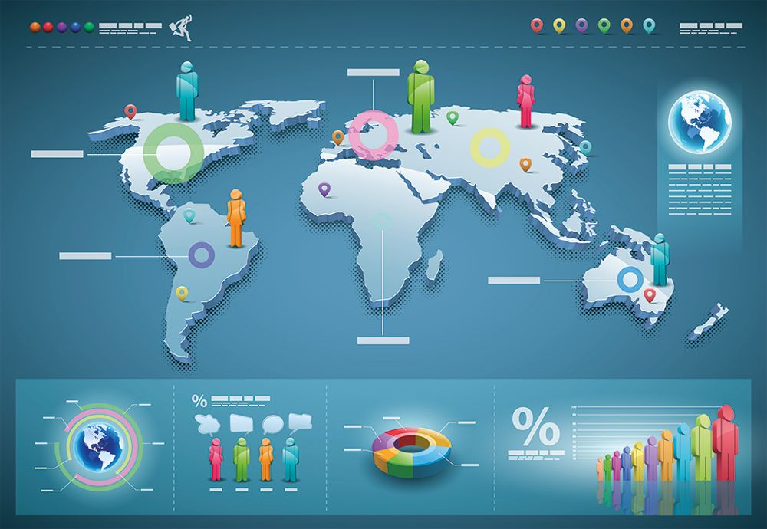
Content Delivery Network (CDN)
Content delivery network (CDN) refers to geographically distributed network server groups that work together to deliver web pages and other web content to users.
CDNs provide more efficient delivery of Internet and Web content because the closer the CDN server is to the user geographically, the faster the content will be delivered.
this helps to create less load time for users and protects against surges in web traffic that can slow content delivery

Slide 44
Content Delivery Network (CDN) (cont.)
CDN Process
The basic process for how a CDN work is fairly straightforward.
to minimize the distance between visitors to a website and a website server, a CDN stores a cached (a storage location where active data is placed to make it easier to access) version of content in multiple geographic locations (also called points of presence or PoPs)
PoPs include various caching servers that assist in delivering content to website visitors within its operational proximity
Notes:
For example, when someone in Rio de Janeiro wants to access a website that is hosted in the United States, it can be executed more quickly through a PoP located in Brazil.

Slide 45
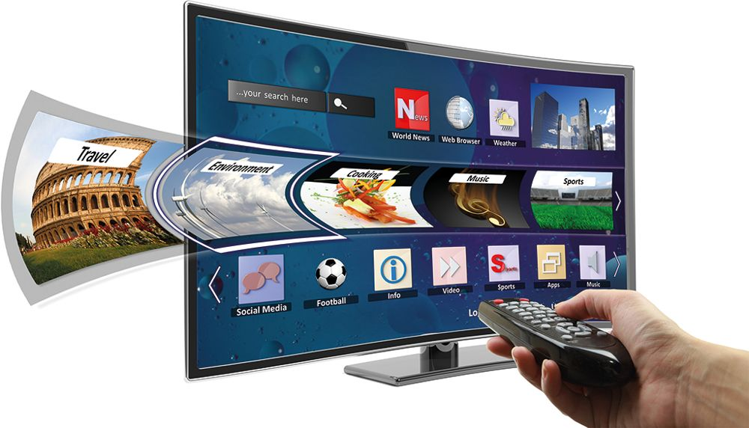
Web Services
Web services are a set of software technologies that are able to exchange information with each other using standardized web communication protocols and languages.
Notes:
Web services allow for the exchange of information between two systems and are not tied to any one operating system or programming language.

Slide 46
Web Services (cont.)
Uses of Web Services
Used create apps that link different systems of different organizations and to build open-standard based web applications
One of the technologies on which web services are based is XML. XML stands for Extensible Markup Language, and is a set of recommendations from the World Wide Web Consortium (W3C).
XML is a markup language that is self-defining and is designed to be both human and machine-readable
Notes:
XML is similar to Hypertext Markup Language (HTML), although HTML is limited to describing how data should be displayed in webpages

Slide 47
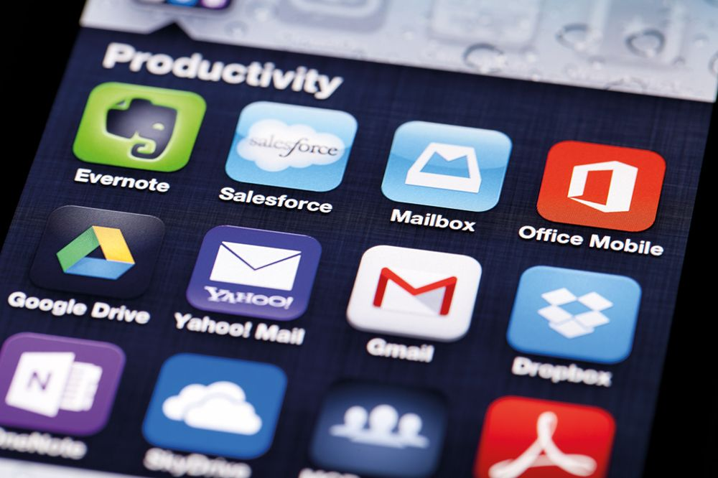
Software as a Service (SaaS)
Software as a Services (SaaS) is a Cloud-based service offered by vendors and hosted on a vendor’s Cloud that allows users to access a software application using a web browser and Internet connection.
With SaaS you simply access Microsoft Office applications using a web browser and an Internet connection.
Google apps is another example of SaaS.
Notes:
An example of SaaS is Microsoft 365. Before Microsoft Office 365, you would purchase and download the software directly to a device.

Slide 48
Software as a Service (Saas) (cont.)
Advantages and Disadvantages of SaaS
advantages of SaaS are the frequent updates that occur to the applications and lower upfront costs to use the applications
the main disadvantage is the requirement of an Internet connection to access the application

Slide 49
Platform as a Service (PaaS)
Platform as a Service (PaaS) is a Cloud-based computing model where Cloud service providers offer hardware and software tools need for application/software development via the Internet.
PaaS Vendors
host the hardware and software needed for development on their own infrastructure, removing the need for developers to install on their own devices
provide a number of services including mobile software development kits (SDKs)
Notes:
PaaS vendors also provide point-and-click app building, multi-language program development, and built-in social and mobile capabilities.

Slide 50
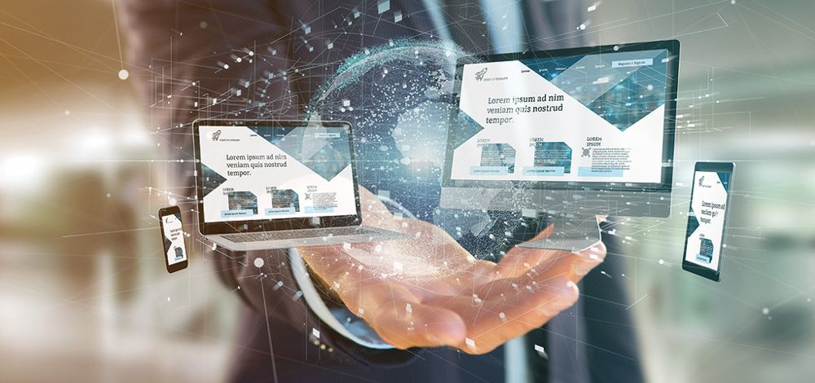
Infrastructure as a Service (IaaS)
Infrastructure as a Service (IaaS) is an instant computing infrastructure composed of processing, data storage, and a variety of other computing resources provided by a Cloud vendor to assist in running an organization’s information systems.
IaaS Service Providers
cloud computing service providers, such as Microsoft Azure, work with organizations on the management of information systems infrastructure allowing them to focus on software purchase, installation, and configuring
Notes:
IaaS helps organizations avoid the cost of acquiring and managing their own physical servers and datacenter architecture.

Slide 51
Serverless Computing
Serverless computing occurs when a Cloud service provider offers backend-end services (infrastructure and infrastructure management) on an as-used basis.
Serverless Computing Providers -Amazon Web Services
Amazon Web Services (AWS) offers a variety of fully managed serverless services including AWS Lamda which is responsible for computing
Amazon Simple Storage Service (S3) that is responsible for object storage, and Amazon DynamoDb that is a NoSQLdatabase service
Notes:
Serverless Computing allows developers the opportunity to build applications (write and deploy code) more efficiently because they do not have to worry about infrastructure management.
Although physical servers are still used by the Cloud service provider, we still refer to it as serverless computing because this infrastructure is not owned, controlled, or maintained by the organization

Slide 52
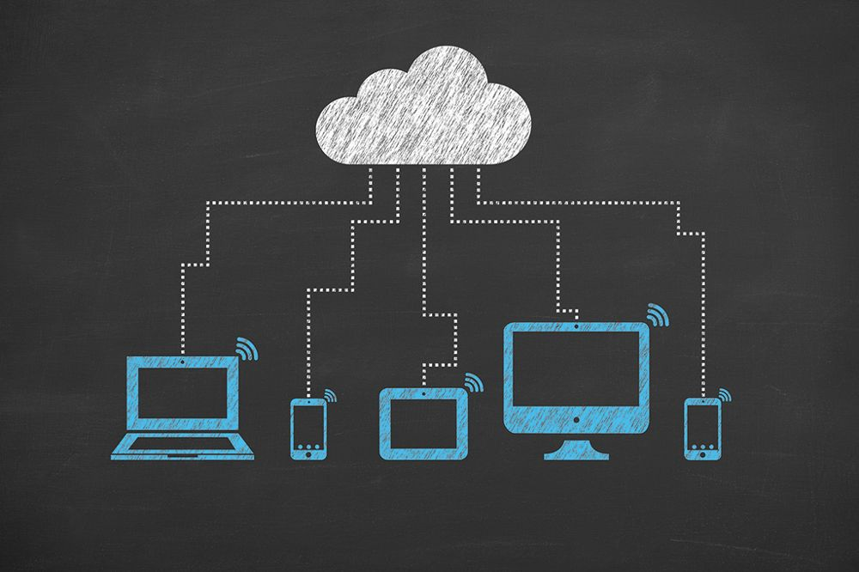
Cloud Services Security
Cloud services security, also referred to as Cloud security, includes policies, procedures, controls, and hardware that work together to ensure Cloud-based systems are secure.
The implementation plan of Cloud security processes is often a joint responsibility of the organization and Cloud services provider.
Notes:
Cloud services security policies vary by Cloud provider, so it is important to research policies before signing a service level agreement (SLA).
Once an agreement for service has been reached, an implementation plan is usually created.
Cloud service providers can configure security plans to the exact specification of the organization.

Slide 53
Cloud Services Security (cont.)
Important Questions to Ask About Cloud Security
What type of disaster plans are in place?
Are you in compliance with local, state, federal security standards and regulations?
Do you go through external security audits?
Do you have any specific security certifications?
How are data from different corporations kept separate?
What encryption mechanisms are in place?

Slide 54
Cloud Services Security (cont. 2)
Measures for Cloud Service Security
Data protection
Regulatory compliance,
Customer privacy protection
Authentication rules for users and devices.
Cloud service providers can configure security plans to the exact specification of the organization.

Slide 55
Collaboration Software
Collaboration software is designed to enhance the productivity of teams, groups, and organizations.
Collaboration software allows for the creation of a dedicated workspace where users can add data and workflows.
Many of today’s collaboration software programs are cloud-based, removing the need for users to have specific software download on a device.
Notes:
The dedicated workspace is viewable and editable (based on assigned privileges) by users regardless of their physical location.
Any changes, edits, additions made to the data, or workspace are made in real-time ensuring that all who have access are receiving the most current and up-to-date information.

Slide 56
How Is Collaboration Software Used in Today’s Business Environment?
Collaboration software is increasingly used in a variety of business settings.
Advantages and Benefits Of Using Collaboration Software
Benefits | Details
Better Communication | People from across the organization, regardless of their physical location, can share content in real-time including documents, spreadsheets, videos, and messages.
Project Management Capabilities | Collaboration software allows project leads the ability to create the plan and schedule and share this with all members of the team.
Improved Engagement | Bitcoin Cash is a forked cryptocurrency from Bitcoin. A fork is when a cryptocurrency is split into two different cryptocurrencies.
Streamlined Workflow | Scheduling activities can easily be added and updated in the software.

Slide 57
Popular Collaboration Software Programs
The best collaboration software program to choose depends on the needs and wants of the organization.
Popular Collaboration Software Programs
Software | Details
Smartsheet | Smartsheet focuses on the collaborative aspects of project management. It is a web application that is used via the web and an Internet connection.
Slack | Slack is composed of channels where teams and members of the organization can communicate. Slack allows for thousands of apps to be connected to each workspace which assists in creating efficient communication.
Trello | This creates a visual representation of what’s being worked on, who’s doing the work, and where something is in a process.
Notes:
Before choosing a collaboration software program it is important to investigate the options and functionality each program offers, cost, and ease of use.

Slide 58
End of Main Content

