Slide 1
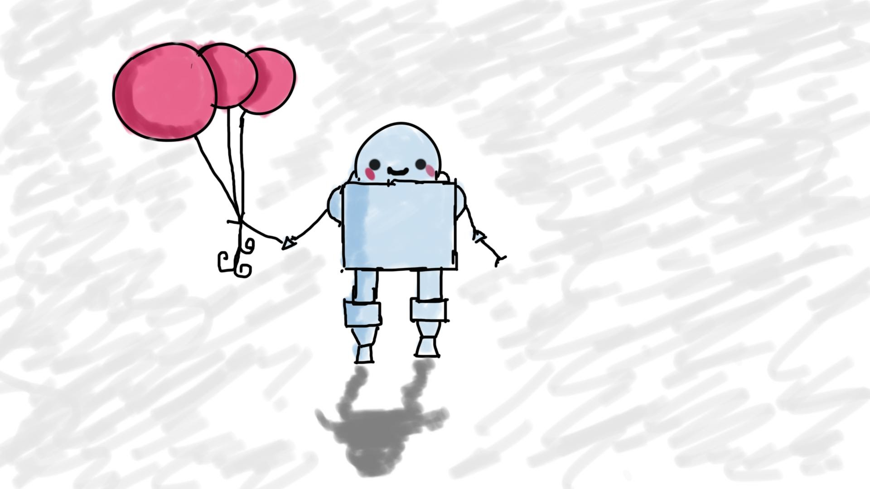
Course Intro
MIS3502: Web Service Programming
Jeremy Shafer
jeremy@temple.edu
https://community.mis.templ.edu/jshafer
Unless otherwise indicated, all decorative images are by Unknown Author and licensed under CC BY-NC

Slide 2
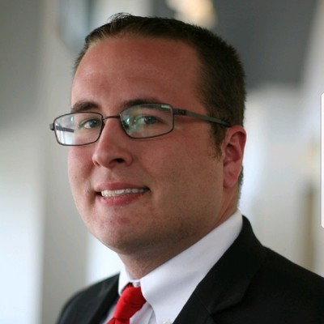
Let’s talk about Darin ..

Slide 3

Let’s talk about this course …

Slide 4
Now let’s look at the syllabus.
https://community.mis.temple.edu
Don’t let me forget the PRO point requirement!

Slide 5
Food for thought…
“In recent decades as the economy has shifted and large companies promising lifelong employment have given way to freelance jobs and migratory careers. Understanding motivation has become increasingly important. In 1980 more than 90% of the American workforce reported to a boss. Today more than 1/3 of working Americans are freelancers, contractors or in otherwise transitory positions.”
“The workers who have succeeded in this new economy are those who know how to decide for themselves how to spend their time and allocate their energy. They understand how to set goals prioritize tasks and make choices about which projects to pursue. People who know how to self-motivate (according to studies) earn more money than their peers, report higher levels of happiness, and say they are more satisfied with their families, jobs, and lives.”
-- Charles Duhigg (2016)

