Slide 1
Web Services, asynchronous requests, and Axios (oh, my!)
MIS3502: Web Service Programming
Jeremy Shafer
jeremy@temple.edu
https://community.mis.temple.edu/jshafer
Unless otherwise indicated, all decorative images are by Unknown Author and licensed under CC BY-NC

Slide 2
Get ready!
Start up
Start up VS Code
Sign in
Sign into AWS Console
Download
Download demo_stooges.zip and unzip it to be worked on locally

Slide 3
Agenda
Understanding asynchronous vs. synchronous code
Using Axios to leverage resources

Slide 4
Let’s start with some fun…
These are the three stooges: Larry, Moe, and Curly.

Slide 5
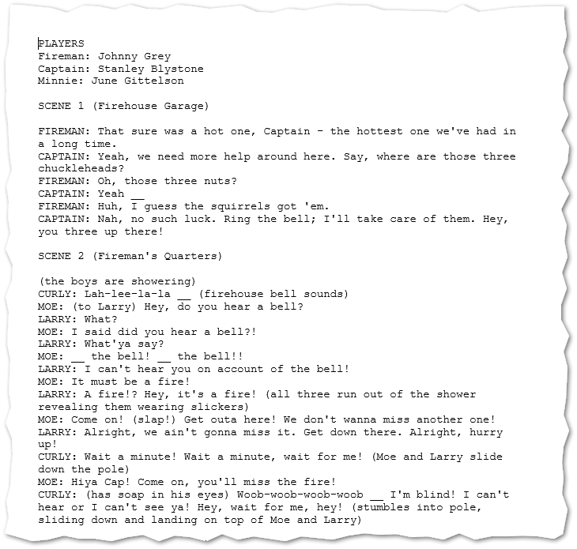
This is a script…

Slide 6
Ok… good to know… how is this relevant?
These ideas can help us think about:
What does it mean for communication to be asynchronous?
Why JavaScript is called a "non-blocking" language?
An experiment with an API that doesn't always respond in a timely fashion.
Why do all that nasty thinking?
Understand JavaScript a bit better
Understand Web Development a bit better
Prepare you to work with multiple APIs (like, in the class project)

Slide 7
What does it mean for communication to be asynchronous?
VS
Talk, wait, talk... Super polite. (Synchronous)
Everyone talks at once. No one waits for anyone. (Asynchronous)

Slide 8
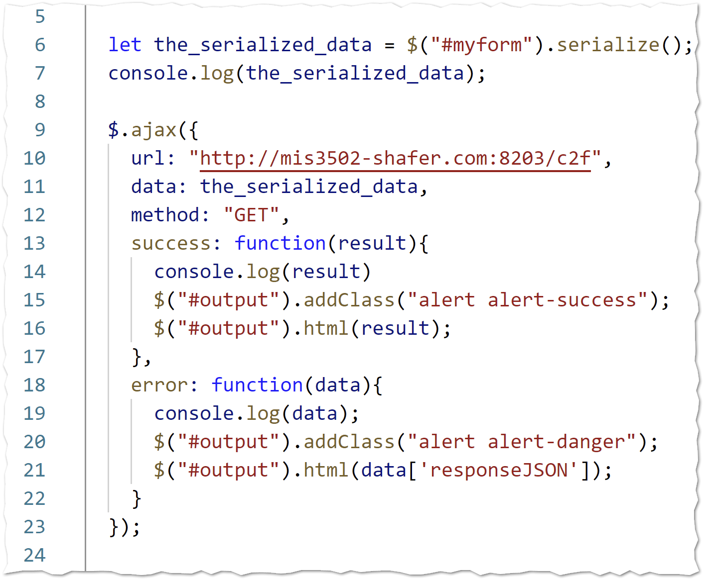
Non-blocking
That's why we need callback functions!
Why is JavaScript called a "non-blocking" language?
VS
When we call a resource that is outside the script, the script will not wait. The script will not be "blocked".

Slide 9
Why this matters…
Often, this behavior is exactly what we want. The www is full of resources, and it is not realistic to think that everything will run like clockwork!
But .. Sometimes… we need to put multiple asynchronous tasks in sequence.

Slide 10
So… what can we do?
With today's demo file, I will illustrate three different approaches to getting multiple, asynchronous calls, to work in a desired sequence.
Basically, we'll be forcing JavaScript to do something that is contrary to its nature! By nature, JavaScript is non-blocking when it processes calls to external resources.
But sometimes I want that blocking behavior. Sometimes I want to wait. How can I get blocking behavior when I want it?
The three different approaches are:
Chain the functions together using their callback functions. (Perhaps the easiest.)
Store intermediate results in the DOM. Trigger on DOM changes. (A bit harder, but more flexible.)
Use async / await from ES 2017. (The most modern approach.)
Remember, there's more than one way to skin an alligator!

Slide 11
What we have seen so far…
(Database)
(Your Lambda code)
(Client-side code)
(We used jQuery to make Ajax requests)
(Third-party API)

Slide 12
The final frontier…
jQuery does not run here!
(Database)
(Your Lambda code)
(We can use Axios to make Ajax requests)
(Third-party API)
(Client-side code)
(We used jQuery to make Ajax requests)
Sometimes we do this to manage credentials. (Because I don’t want my API key on the client.)
Sometimes I do this to comply with CORS restrictions
(Third-party API)

Slide 13
What is CORS again?
CORS is short for Cross Origin Resource Sharing.
CORS is an industry accepted convention for communicating how the owners of a Web Service API want it to be used.
If you are using a third-party API, you can’t change the CORS policy of the API. You are not the owner! You must figure out a way to comply with the policy.
Most CORS errors students encounter are the result of typos and/or AWS configuration mistakes.
But sometimes… you have a legitimate CORS restriction. Axios on the server-side can help you do that.

Slide 14
Examples of Axios code
axios.get(url).then((response)=>{});
– OR –
let response = await axios.get(url);
These are just examples… there is a lot more detail here: https://axios-http.com/
There’s also:
axios.post()
axios.put()
axios.patch()
axios.delete()
Can you believe it? ☺
But wait, this is different from $.ajax … I don’t like it.
Yep. But when you use new npm package, you don’t get to choose syntax that is “comfortable”.
FYI – I don’t think memorizing the axios syntax is important for you.
But it is important that you when to use axios, and that you be able to read and apply the documentation.
The variable response will be a JSON object. Typically, you want the data attribute of that object. As in: response["data"]

Slide 15
Let’s do an experiment with https://forismatic.com/en/api/
Sample: http://api.forismatic.com/api/1.0/json?method=getQuote&lang=en&format=text

Slide 16
Summary
Secret Tips
Here
Here are some things students should be able to answer with confidence.
What does it mean that JavaScript is a "non-blocking" language?
Identify situations where JavaScript code will behave synchronously, and when it will behave asynchronously.
Describe three different approaches to force asynchronous responses to be executed in sequence.
Callback functions used in succession
Listening for a change event on an HTML tag (and how we did it!)
The async/await mechanism from ES 2017 (and how we did it!)
Verbalize why asynchronous code is inherently faster that synchronous code.
Explain what Axios is, and why it is needed.

