Slide 1
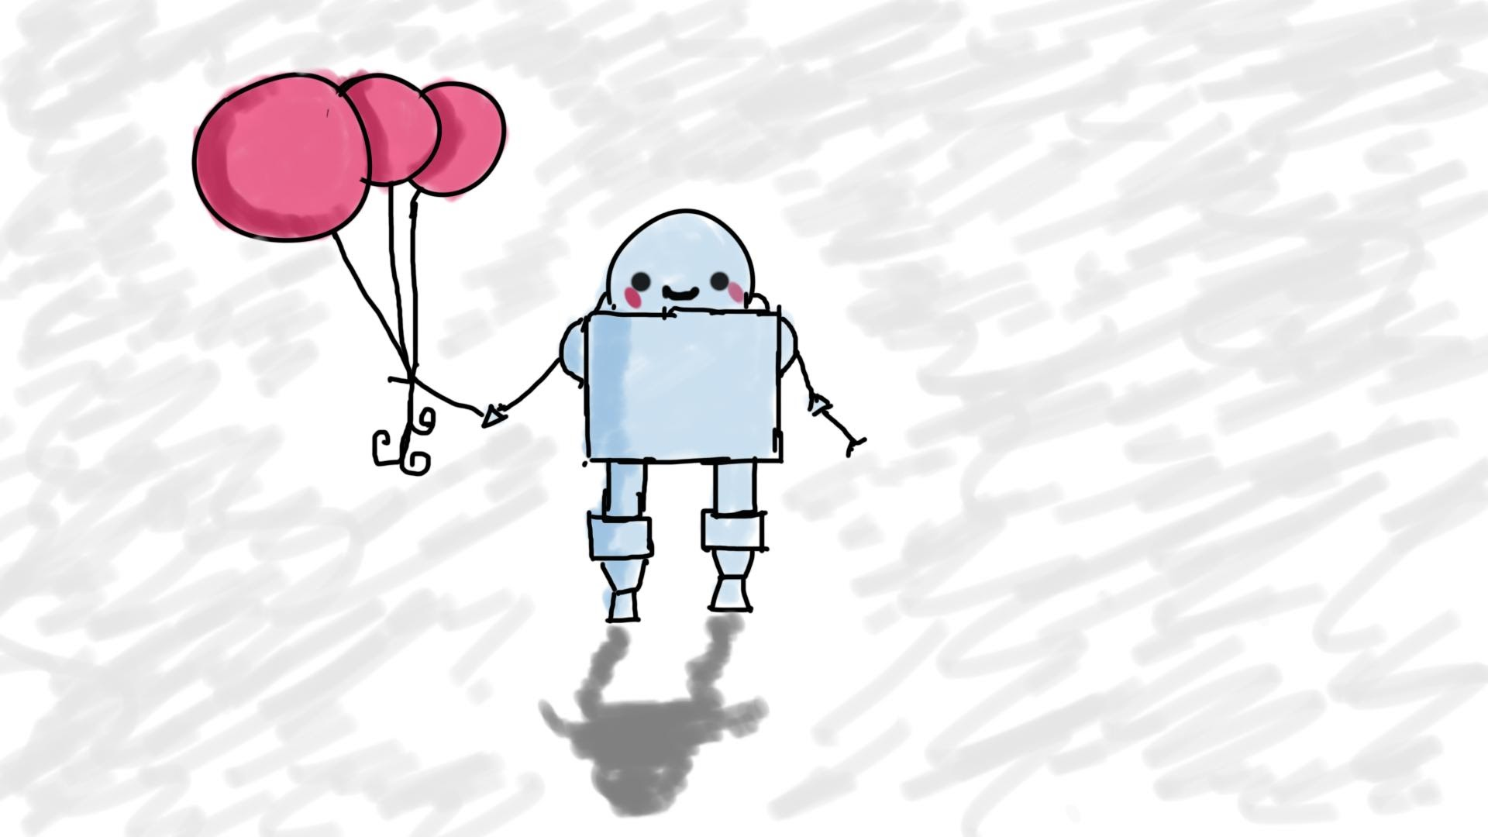
What’s an API again?
MIS3502: Web Service Programming
Jeremy Shafer
jeremy@temple.edu
https://community.mis.temple.edu/jshafer
Unless otherwise indicated, all decorative images are by Unknown Author and licensed under CC BY-NC

Slide 2
Agenda
Terminology
Protocol
Object
Architectural Style
Software Library
Framework
Kinds of APIs
HTML5 APIs
Web Services
Libraries
Third-Party APIs

Slide 3
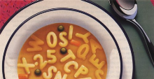
Terminology Soup

Slide 4
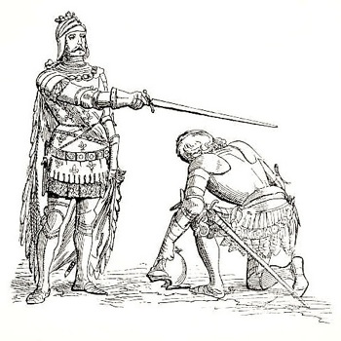
Protocol
"The official procedure or system of rules governing affairs of state or diplomatic occasions."
"A set of rules governing the exchange or transmission of data between devices."
HTTP (and also TCP/IP)
( Definitions from Oxford Languages )

Slide 5
Object
"A material thing that can be seen and touched."
"A data construct that provides a description of something that may be used by a computer."
document.ready()
res.body
connection.execute()
request["httpMethod"]
result["insertId"]
result.insertId
Attributes, events and methods.
How can you easily spot the difference?
( Definitions from Oxford Languages )

Slide 6
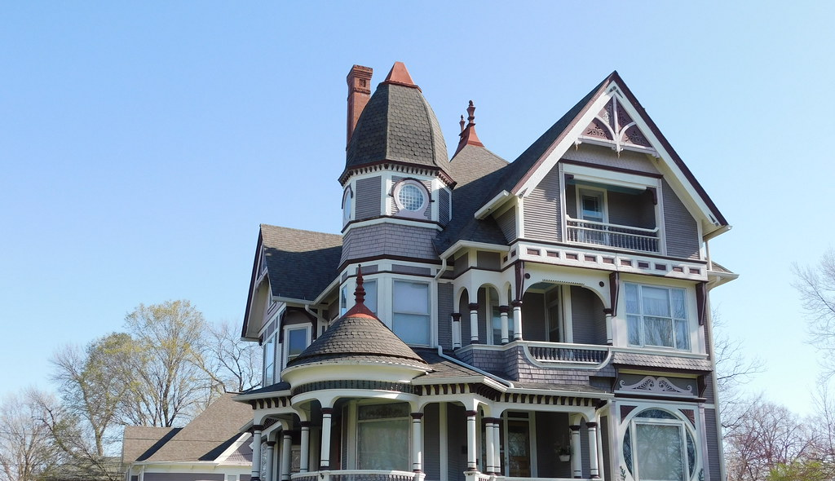
Architectural Style
"A specific method of construction, characterized by the features that make it notable".
In our class we have used a software architectural style known as…
REST
https://en.wikipedia.org/wiki/Software_architecture

Slide 7
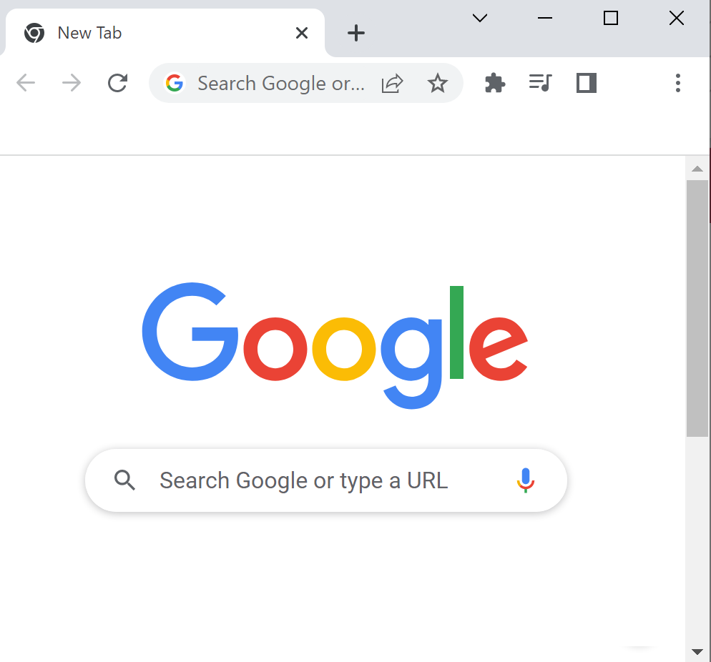
What’s a library?
Browsers interpret HTML, CSS, and JavaScript. Developers could create web pages and web applications from scratch, each and every time. (Or, at least, the talented ones could.) But that would not be a good use of their time.
So, developers put together collections of pre-written, generic, reusable code.
Those collections are called "libraries".
Sometimes libraries just make it easier to write code, and sometimes a library provides an API to a resource by creating one or more objects.
What's our favorite library?
jQuery

Slide 8
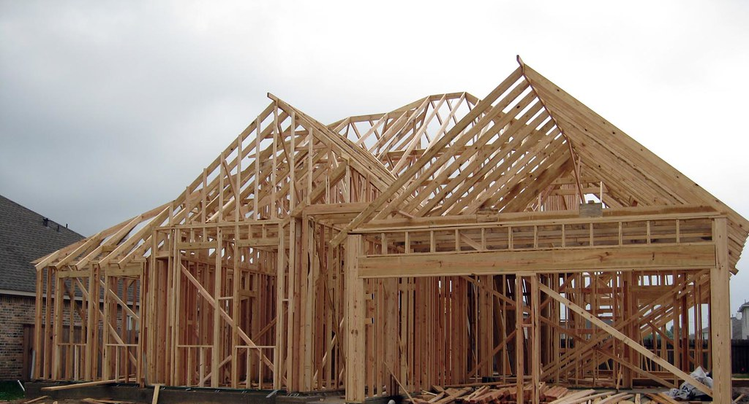
What’s a Framework?
Frameworks also include lots of generic, pre-written, reusable code. But a framework is *more* than a library. Frameworks not only contain pre-written code they prescribe a certain way to use it. Also, frameworks often contain libraries.
Frameworks vary wildly in sophistication. Some are very simple, and others are quite complex. What's our favorite framework?
Bootstrap
This Photo by Unknown Author is licensed under CC BY-NC-ND

Slide 9
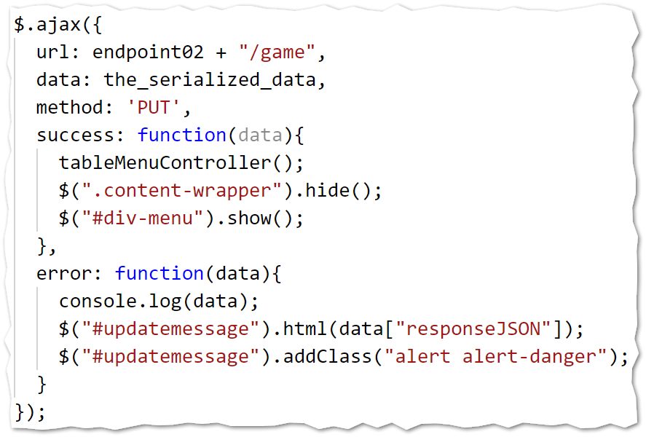
Kinds of APIs
Computer
HTTP
For a web service
Any API you didn't write, and that's not built into the browser, is a 3rd Party API
A library that gives us a resource
HTML5
HTML5
Third Party

Slide 10
Challenge
Review the code we have written so far this semester.
Review the templates I have given you.
Review the “Proof of Concept” code: https://misdemo.temple.edu/classexamples/scan_poc
Identify object properties, methods and events. Be sure that you understand the difference.
Look for places where we have used APIs. These include the web services we have created, and the third-party API that we have used. ( A good example is the Project 2 Proof-Of-Concept code I gave you!)
Finally, recall the criteria for sophistication (“Shafer’s Eight”) that we established as part of Project 4. How many criteria will our Project 2 and Project 3 solutions meet when it is done?

Slide 11
Summary
Here are some terms that students should be completely familiar with:
Protocol
Object
Architectural style
Library
Framework
Kinds of APIs
HTML5 APIs (Built-In to the browser)
Web Service (Accessed over HTTP)
Library (creates an object to extend the browser)
Third Party APIs (Any API you didn't write and not part of the browser!)

