Slide 1
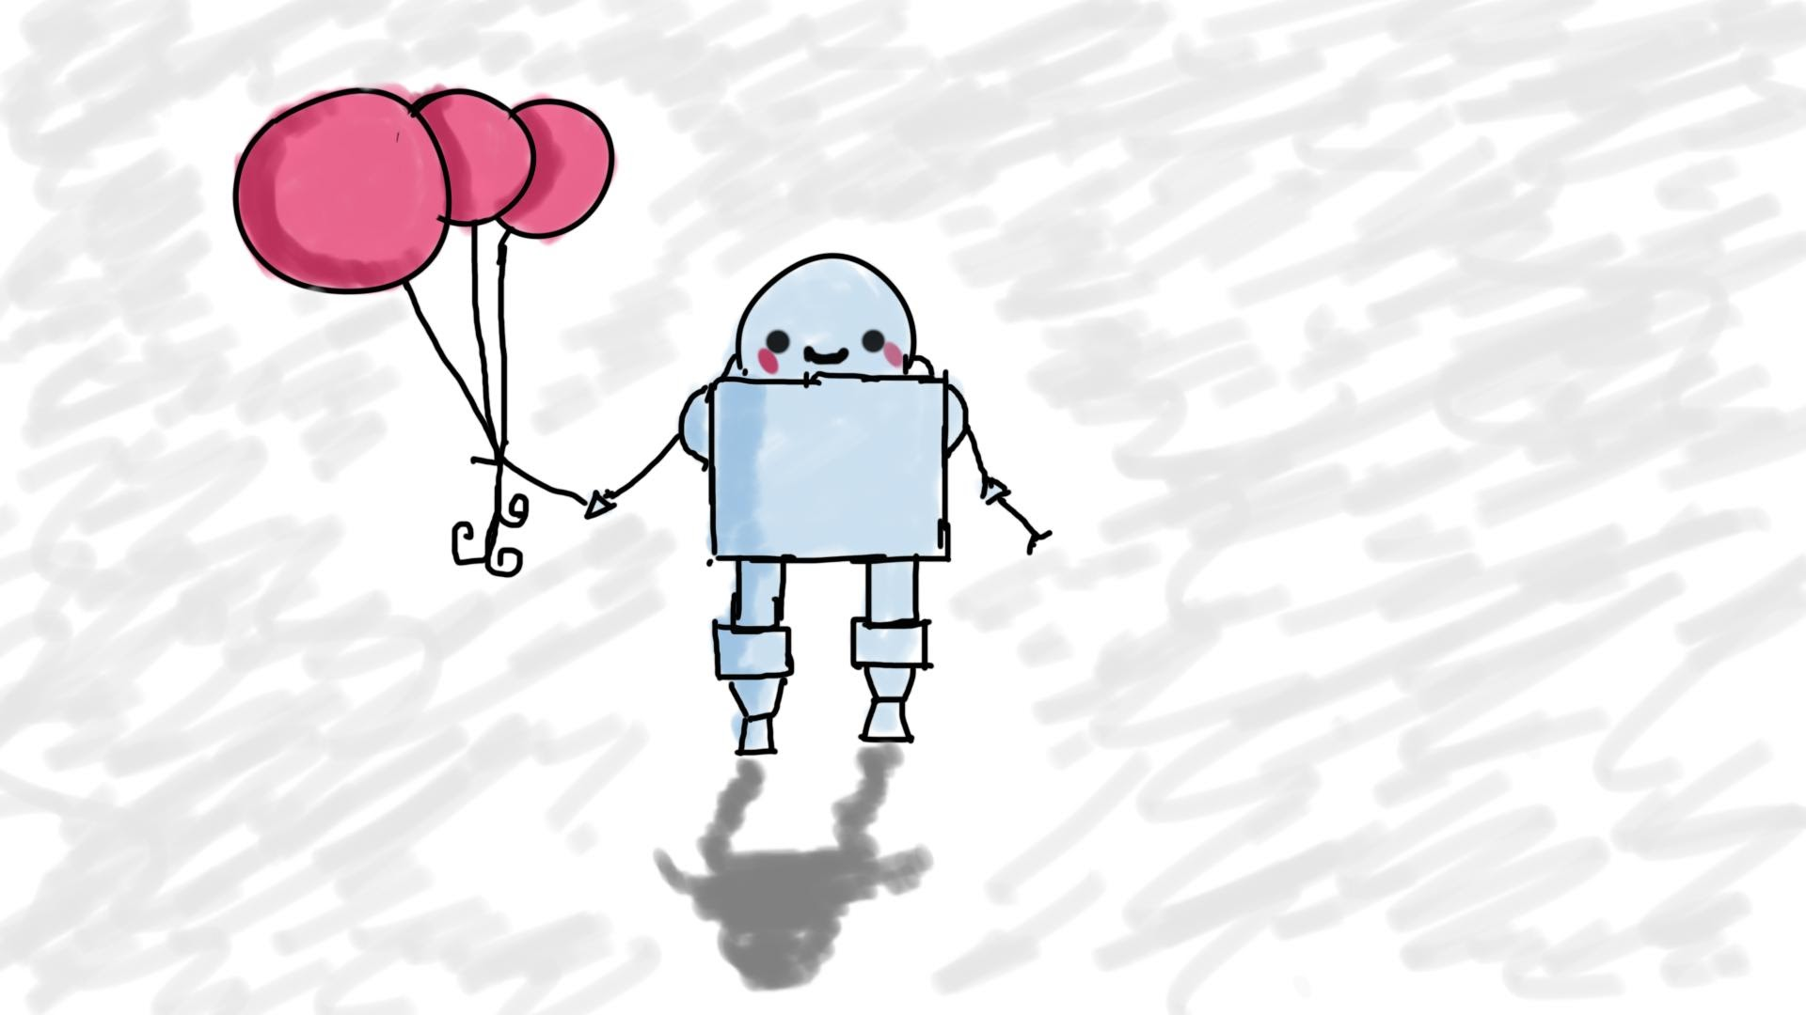
Course Intro
MIS3502: Web Service Programming
Jeremy Shafer
jeremy@temple.edu
https://community.mis.templ.edu/jshafer
Unless otherwise indicated, all decorative images are by Unknown Author and licensed under CC BY-NC

Slide 2
Are we sick of Artificial Intelligence yet?
Show of hands … Too much AI talk last semester? Not enough?
What do you mean by that?
"Students are growing increasingly weary of the constant AI hype, as the initial excitement around AI's potential has begun to fade, leading to a sense of disillusionment."
(This sentence written by AI ☹)
Yao, Richard. “The AI Hype Cycle: Are We on the Precipice of Disillusionment?” IPG Media Lab, 22 Mar. 2024, Medium, https://medium.com/ipg-media-lab/the-ai-hype-cycle-are-we-on-the-precipice-of-disillusionment-139ab28cee77

Slide 3
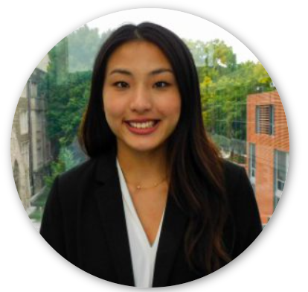
Let’s talk about Ying …

Slide 4
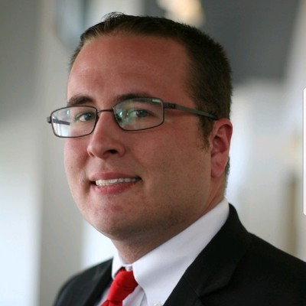
Let’s talk about Darin ...

Slide 5
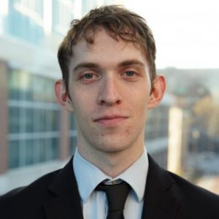
Let’s talk about Scott Lafferty …

Slide 6
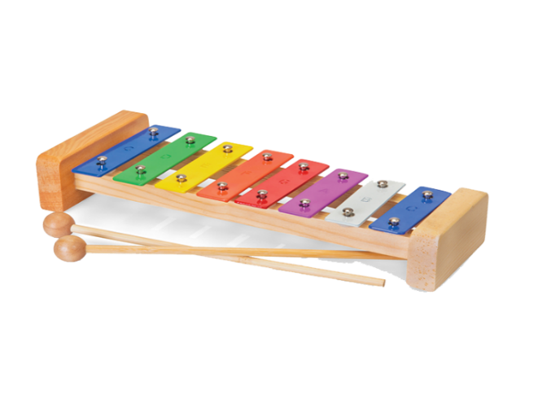
Let’s talk about this course …
Three “meta skills” that I want every student to have:
Write good prompts / as good questions
Follow a chain of thought
Reflect and validate (“how do I know if this is right?”)

Slide 7


This course has changed …
GitHub Co-Pilot can do a lot of coding for you!
Where some intellectual burdens are lifted, new ones can be introduced.
Specifically:
  UI/UX
  Security
  Accessibility

Slide 8
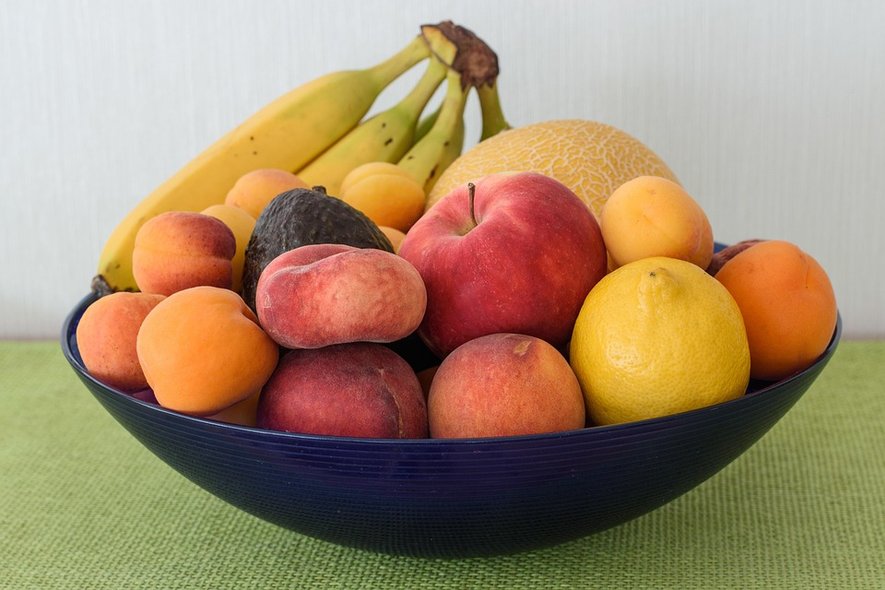
Why CoPilot? Why AWS?
(What am I looking for my software choices for this class?)
Cost: Free or free-to-try technologies
Brand: Software titles with established name recognition
Ease-of-Use: Minimal learning curve
I am deliberately trying to:
minimize complexity
make fruitful learning possible

Slide 9
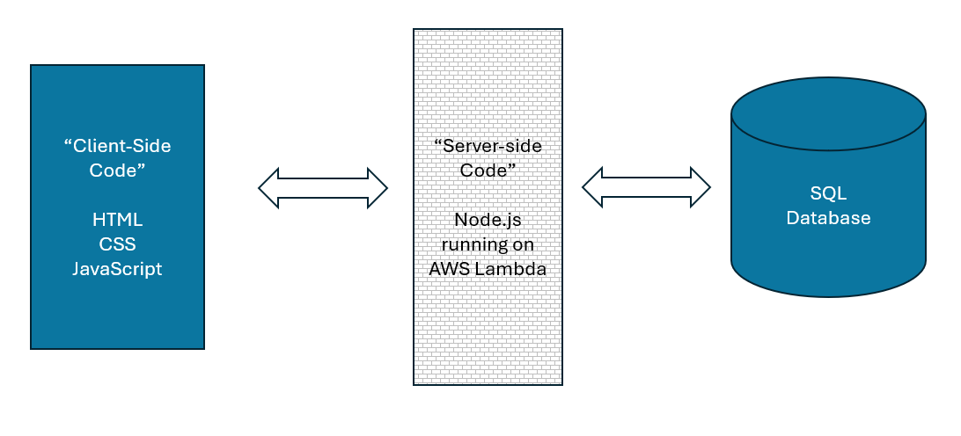
This course has stayed the same …
To build a web application, you need to “cook” with many “ingredients”. You need client-side code, web service code, and (usually) a database.

Slide 10

Now let’s look at the syllabus.
https://community.mis.temple.edu

Slide 11
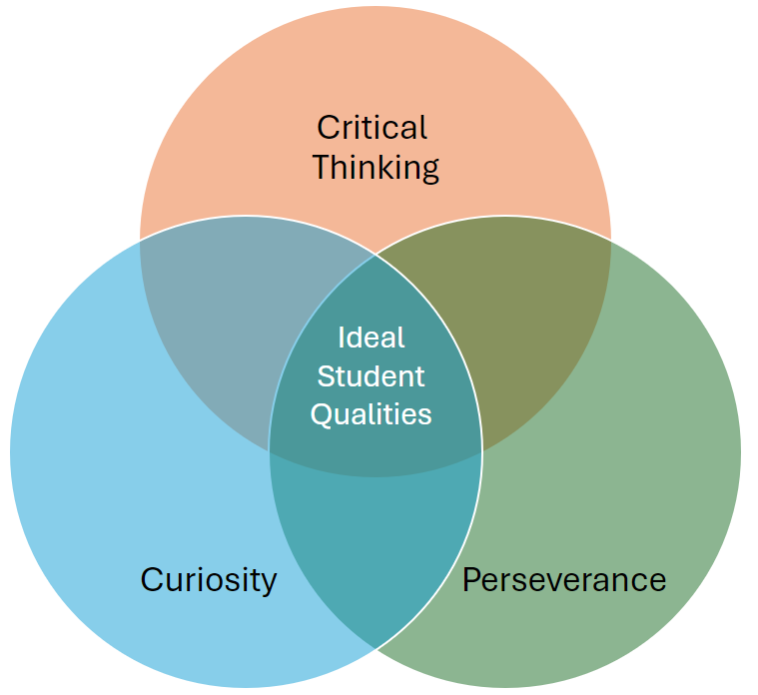
MIS Department Instructional Practices
Ask good questions in class
Independently experiment to discover answers
Choose project work that is meaningful to you.
Break large tasks down into smaller tasks
Don’t be satisfied with “magical” solutions
When your code doesn’t work, step back, think, and try again.
Come to class prepared.
Take notes.
Submit your work on time.
Notes:
This is for your slide deck at the start of each lecture. You may, of course,

Slide 12

Food for thought…
“The workers who have succeeded in this new economy are those who know how to decide for themselves how to spend their time and allocate their energy. They understand how to set goals prioritize tasks and make choices about which projects to pursue. People who know how to self-motivate (according to studies) earn more money than their peers, report higher levels of happiness, and say they are more satisfied with their families, jobs, and lives.”
-- Charles Duhigg (2016)

Slide 13
The progression of an educated person
Course work
Skills
Gainful Employment

