Slide 1
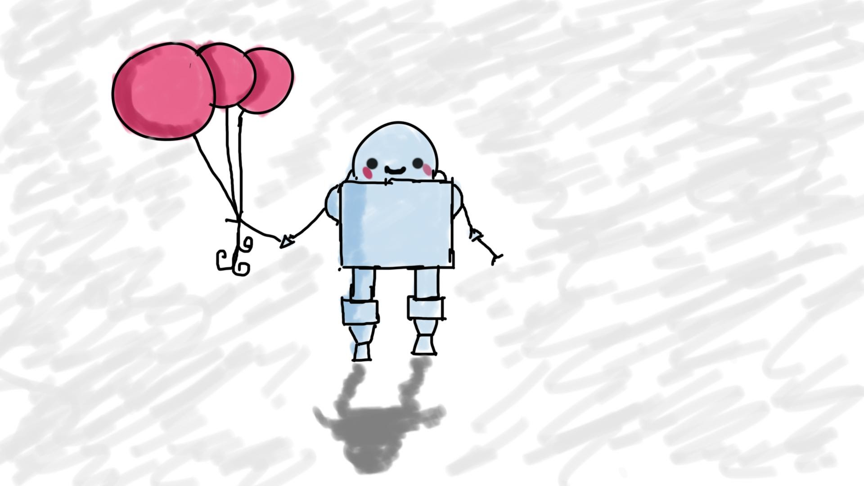
JavaScript and jQuery (old stuff)
MIS3502: Web Service Programming
Jeremy Shafer
jeremy@temple.edu
https://community.mis.temple.edu/jshafer
Unless otherwise indicated, all decorative images are by Unknown Author and licensed under CC BY-NC

Slide 2
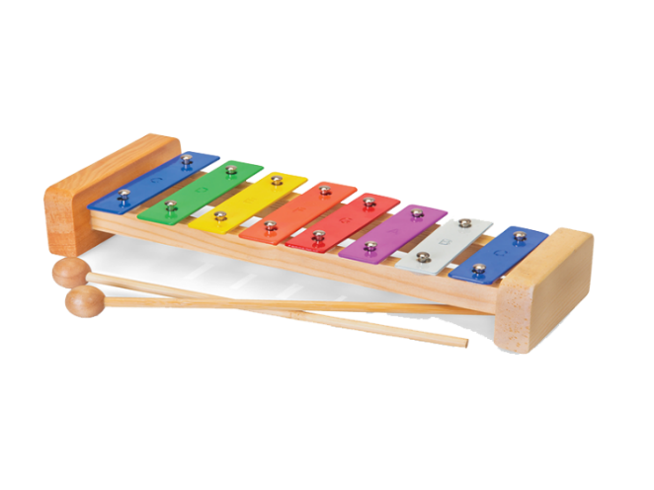

Our strategy
There will be some follow up, “hands on” things for you to do in VS Code

Slide 3

JavaScript
“use strict”;
Declare variables with let
Declare functions
Write a “for” loop
Write a “if” statement

Slide 4
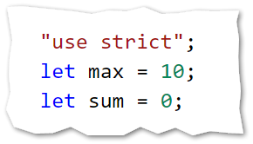
Declaring variables with “let”
Specifying the “use strict” directive is widely regarded to be a best practice.

Slide 5
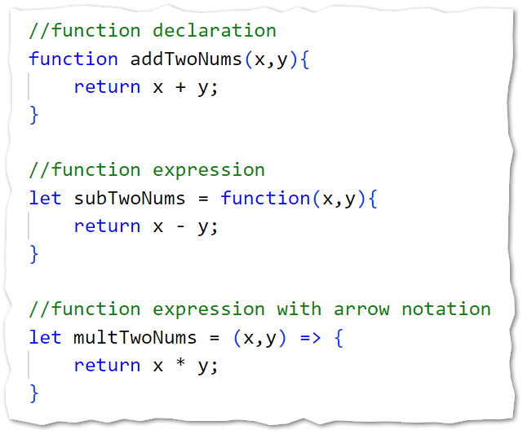
Declaring functions
Note how the syntax for function declaration differs from the syntax of function expression
Function expressions and specifically arrow notation is used more commonly that the older function declaration.

Slide 6
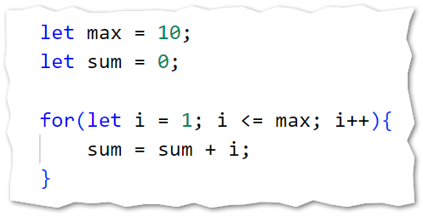
“for” loops

Slide 7
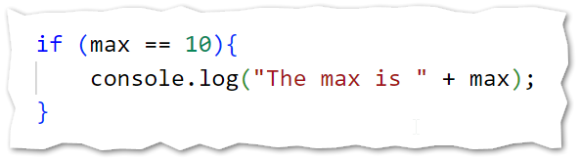
Writing an “if” statement
Note the use of concatenation too!

Slide 8
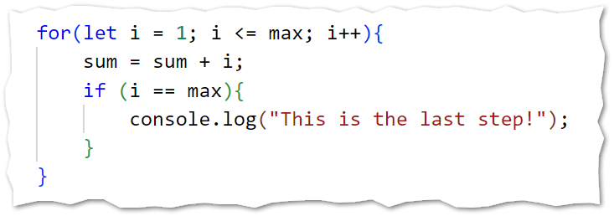
Putting these pieces together…

Slide 9
jQuery Methods & Events you need to know
Methods
show
hide
html
val
append
addClass
removeClass
Events
click
How to use jQuery methods:
$('#message').html("Perseverance Conquers");
How to use jQuery events:
$('#theButton').click( () => {
//code goes here
});
Reference
https://www.w3schools.com/jquery/

Slide 10
Some HTML tags
Which tags are "self closing"?
Which tags can have inner html?
<h1>Hello World</h1>
<p></p>
<br>
<div></div>
<img>
<input>
<a></a>
References
W3Schools
https://www.w3schools.com/html/
HTML Essential Training with Jen Simmons
https://linkedinlearning.temple.edu

Slide 11
HTML tags with common attributes
<h1>Hello World</h1>
<p>It was the best of times.</p>
<br>
<div id="message">Success!</div>
<img src="/home.png">
<input id="theButton" type="button" value="Click me!">
<a href="https://www.temple.edu">Click me</a>

Slide 12
Expectations
Question: Write the jQuery command that will put the content "Go Owls!" into a div with the id of message.
Correct Answer:
$("#message").html("Go Owls!");
Incorrect Answers:
("#message").html("Go Owls!");
$("#message").val("Go Owls!");
$("message").html("Go Owls!");

Slide 13
Quiz Advisory!
When I ask you a jQuery question, I will not always indicate the exact jQuery method (or event) I want you to use.
Good Question: Write the jQuery command that will put the content "Go Owls!" into a div with the id of message.
Bad Question: Using the html method of jQuery, put the content "Go Owls!" into a div with the id of message.
Good Question: Write the jQuery command that will retrieve the user provided data from the input tag with the id of comment and assign it to an existing variable x.
Bad Question: Use the val method of jQuery to put the value of an input tag into a variable x. The input tag has an id of comment.

Slide 14
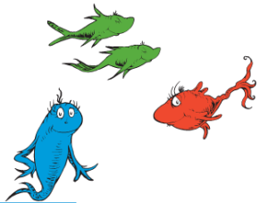
Let's get to work!
As we work… be sure to make note of:
The use of function expressions with arrow notation.
Our use of Bootstrap classes. These are CSS classes that have already been created for you! (We will use Bootstrap version 4)
Bootstrap Reference (BS4)
https://www.w3schools.com/bootstrap4/

