Slide 1
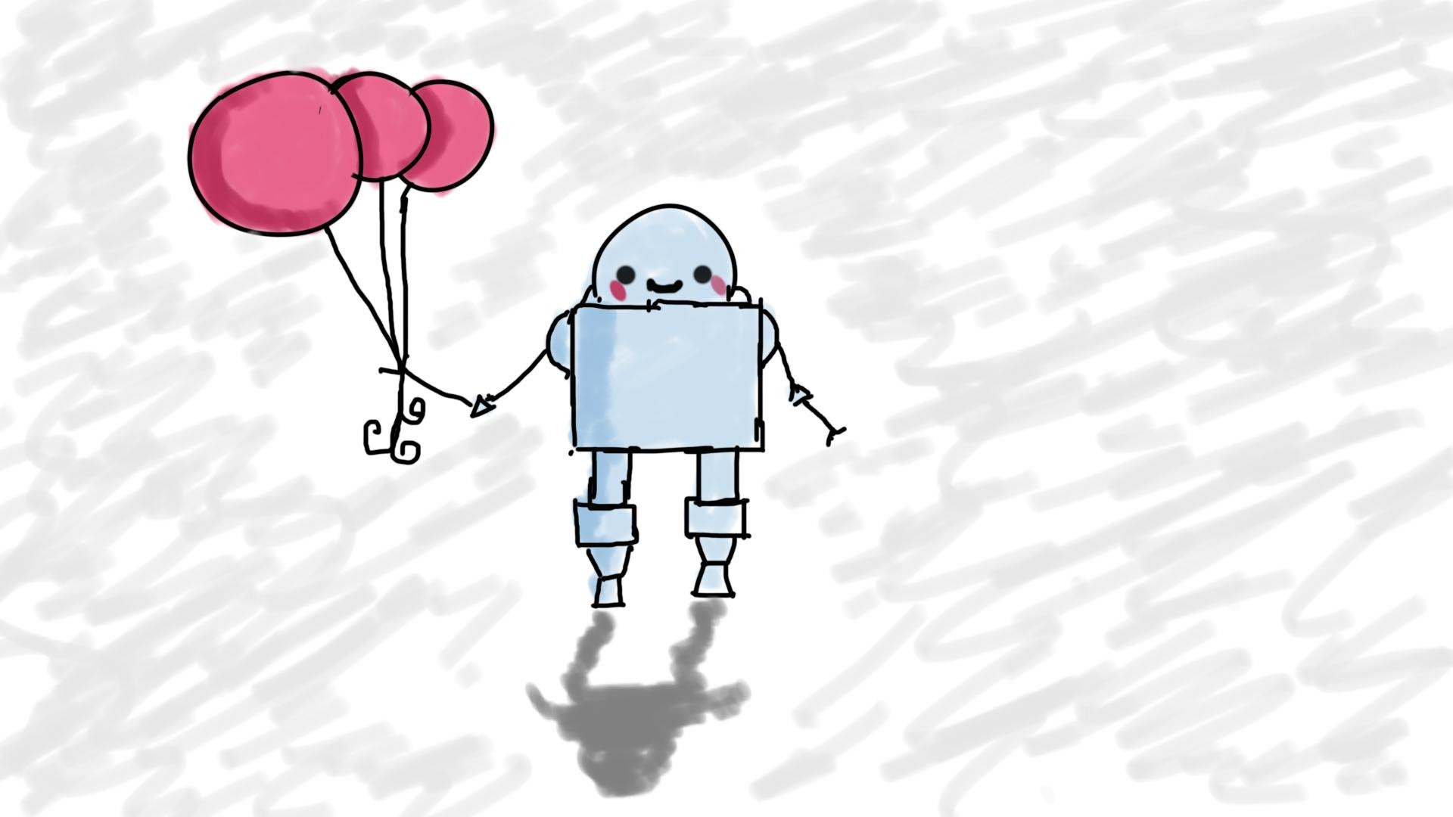
Course Intro
MIS3502: Web Service Programming
Jeremy Shafer
jeremy@temple.edu
https://community.mis.templ.edu/jshafer
Unless otherwise indicated, all decorative images are by Unknown Author and licensed under CC BY-NC

Slide 2
Let’s talk about education …

Slide 3
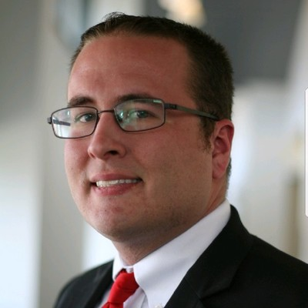
Let’s talk about Darin ..

Slide 4
Let’s talk about this course …

Slide 5
Now let’s look at the syllabus.
https://community.mis.temple.edu
Don’t let me forget the PRO point requirement!

